Slide 1
NAACCR V26 Edits Metafile
MLTG v26 vendor meeting
9/22/2025
Jim Hofferkamp, ODS, NAACCR Edits Metafile Administrator

Slide 2
V26 Implementation
Round 1 testing is complete
Round 2 testing is pending completion of Cancer PathCHART tables
Round 2 is tentatively planned to begin in on 9/22/25 and be completed by 10/3/25
Expected release date is 10/7/25
https://www.naaccr.org/standard-data-edits/

Slide 3
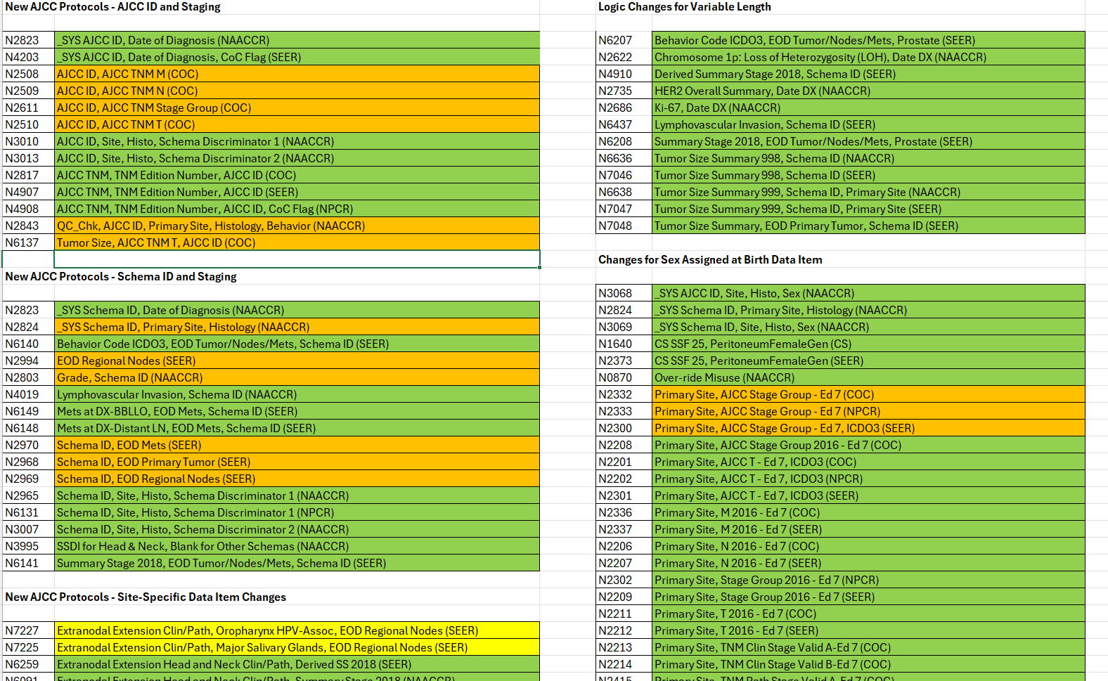
V26 Changes
V26 Changes Spreadsheet will be posted along with Edits Metafile

Slide 4
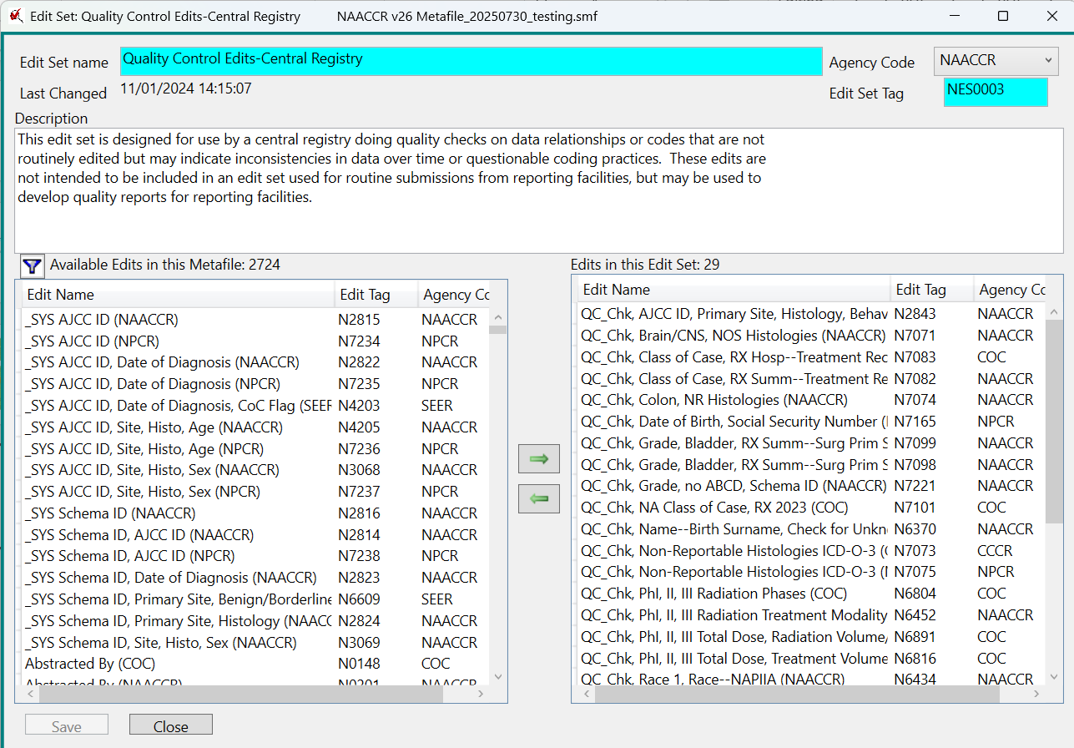
QC Edits
All QC edits begin with QC_
QC edits should only be used in a quality control aspect.
QC edits should not be included standard edit sets used when abstracting.

Slide 5
Pediatric Edits Metafile
The most current version of the pediatric metafile is
Pediatric_Metafile_20250701_Vendor25
Currently available upon request
We will not post a v26 version of the metafile.
Changes to the standard v26 do not impact the pediatric metafile
If it becomes necessary to release a new metafile, we will notify vendors involved with the pediatric initiative

Slide 6

jhofferkamp@naaccr.org
Questions?

Slide 7
Thank You!

