Slide 1
NorthCon 260 Update
09/22/2025

Slide 2

NorthCon:
General Information
Tool for converting files in one NAACCR Version to the next NAACCR version
  Utility Programs | NPCR | CDC
Converts files of cancer registry records; API also included in the install which can be used to perform conversion in other applications
Meets conversion specifications described in the NAACCR 2026 Implementation Guidelines and Recommendations
https://www.naaccr.org/implementation-guidelines/

Slide 3
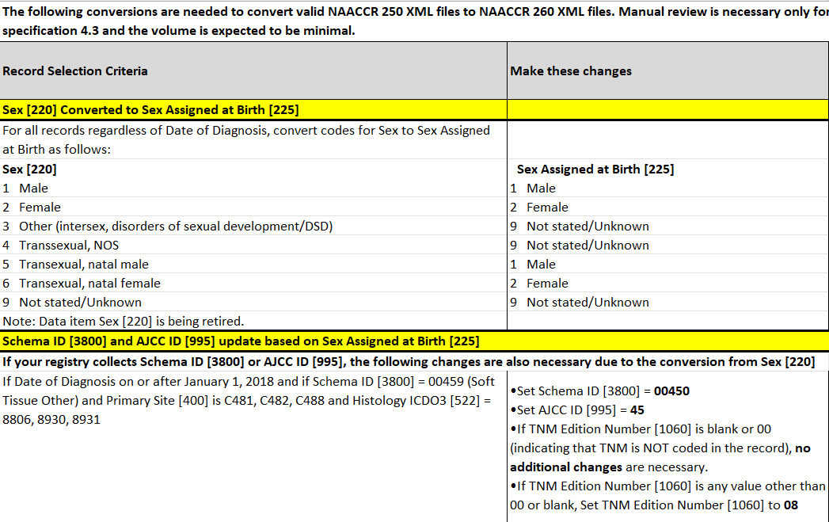
V26 Conversion Specifications
Notes:
For v26, there are very few conversion specifications.

Slide 4
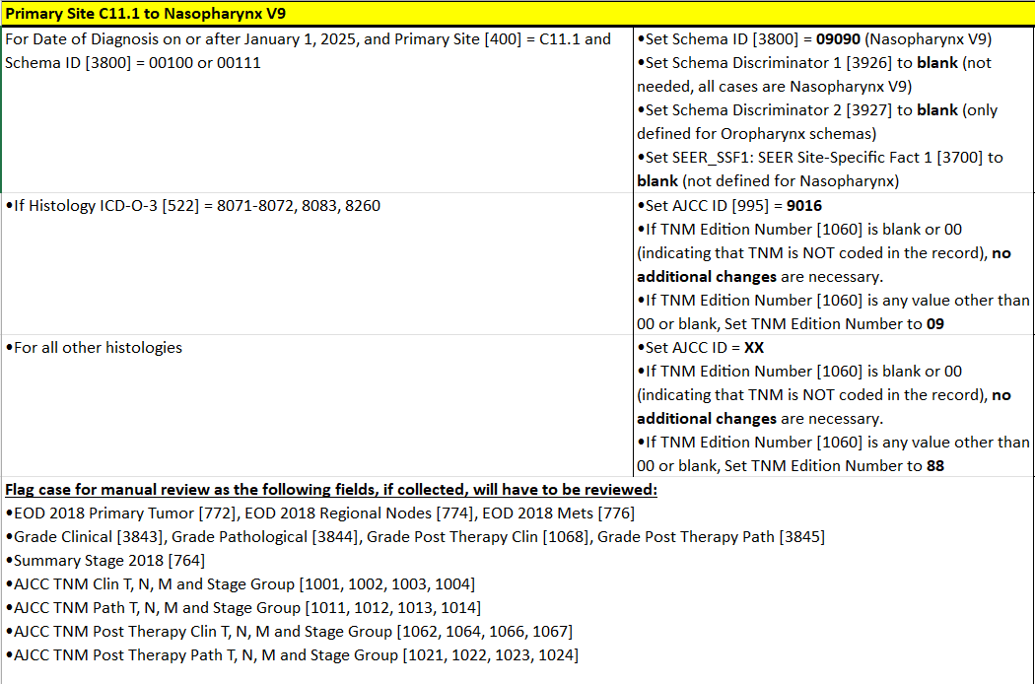
V26 Conversion Specifications
Notes:
manual review will be necessary for one of the conversions

Slide 5
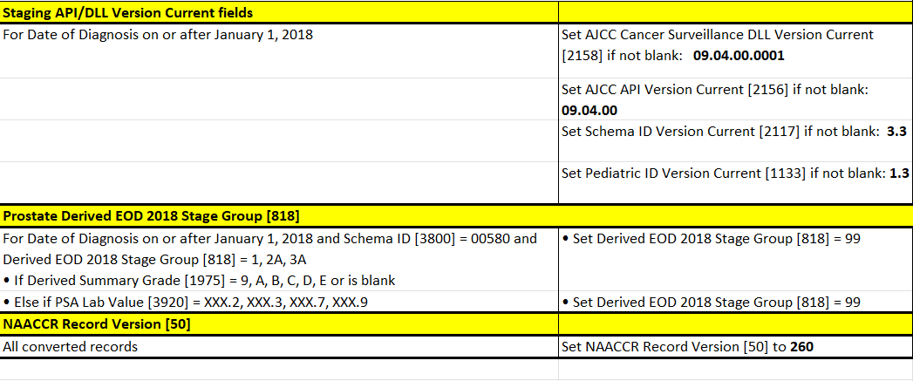
V26 Conversion Specifications

Slide 6
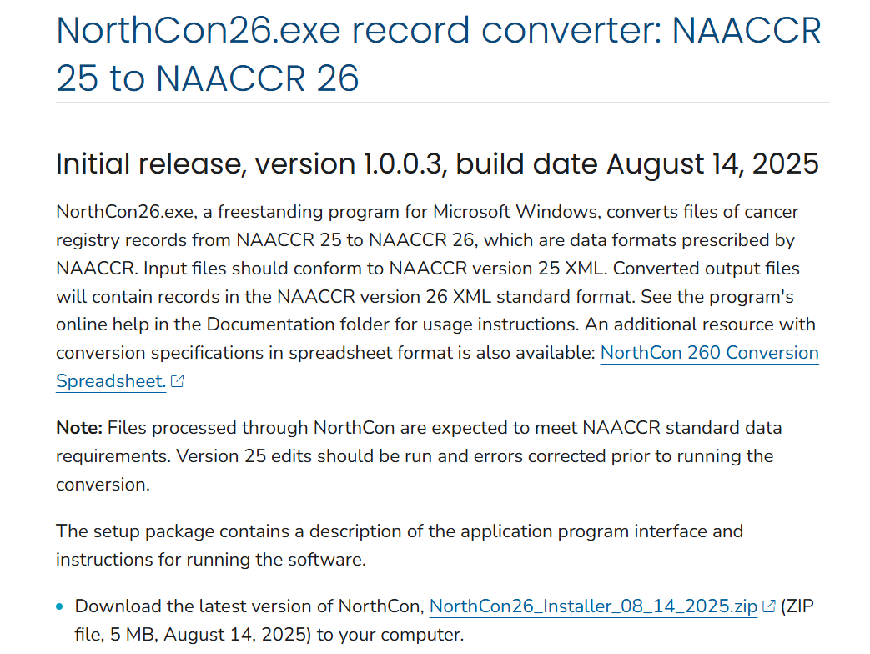
Utility Programs | NPCR | CDC

Slide 7
  Please contact cancerinformatics@cdc.gov for all support needs.

