Slide 1
Cancer PathCHART
Release Updates
MLTG Vendor Meeting
Alison L. Van Dyke, MD, PhD, MPA, FCAP
Notes:
Today I’m going to take you on the journey of achieving more timely reporting of cancer surveillance data, how registries are trying to meet that demand through automated data collection using NLP algorithms, and how CAP and cancer surveillance community have partnered to ensure data quality.

Slide 2
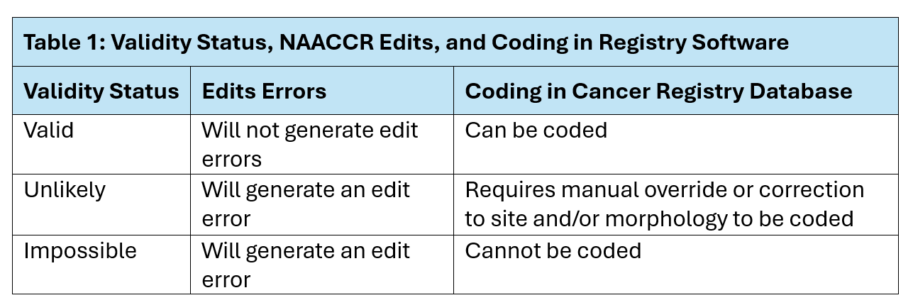
CPC Site-Morphology Combination Validity Status
Unlikely site-morphology combinations not included in the standards file

Slide 3
Need for CPC Updates & Additional Review
Needed improvements identified through questions submitted using real world cases (AASR & SINQ)
In Depth Review
Pediatric WHO vs. existing standards from organ system review
Germ cell tumor standards across an organ system
Conflicting standards for NOS and overlapping sites
Standards conflicting with other edits for site-type

Slide 4
Need for CPC Updates & Additional Review
Solved conflicts with CPC & other site-morphology edits
N0446 Primary Site, Morphology-Imposs ICDO3 (SEER IF38)
N4911 Histologic Type ICDO3, Primary Site, Date of Diagnosis (NAACCR)
N2021 Primary Site, Heme Morph, DateDX, NoOverride (SEER)
N2022 Primary Site, Heme Morph, DateDX, Override (SEER)

Slide 5
Updated Standards in Next Week
Standards will be released in one file
V2024A
V2025A
V2026 (New: head/neck)
Unlikely combinations included if valid or impossible for other years
Column | Description | Example/note
FullKey | Concatenated site, histology, & behavior codes | C01180703 for Morphology 8070/3 at C1.1
C_Site | ICD-O-3 topography code | C56.9 for Ovary
Hist | ICD-O-3.2 histology code | 8070 for Squamous cell carcinoma, NOS
Behavior | ICD-O-3.2 behavior code | 3 for invasive
CPC2024A | 1=Valid 2=Unlikely 3=Impossible 9=Not yet reviewed (use 2023 standard) | Applies to 2024 CY cases
CPC2025A |  | Applies to 2025 CY cases
CPC 2026 |  | Applies to 2026 CY cases

Slide 6
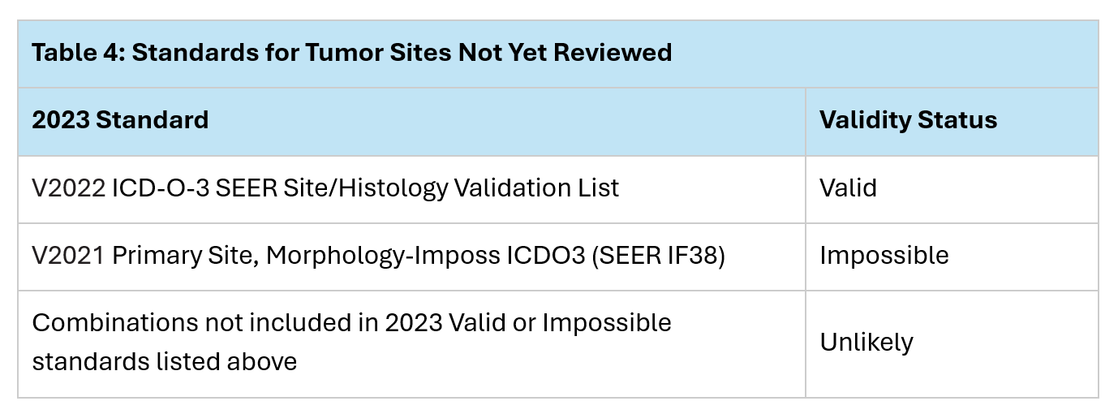
2023 Standards
Organ Systems Not Yet Reviewed – planned 2027
Endocrine (including intracranial glands), Skin, & Eye/Orbit

Slide 7
ICD-O-4
When released CPC review processes will be starting point
Vetting ICD-O-3.2 / ICD-O-4 crosswalk
Reviewing standards
Creating search tool

Slide 8


For More Information
Visit the Cancer PathCHART website & CPC*Search tool
https://seer.cancer.gov/cancerpathchart/
https://seer.cancer.gov/cancerpathchart/search
Alison Van Dyke
alison.vandyke@nih.gov
cancerpathchart@mail.nih.gov
Notes:
Informational webpages and contact information for the Cancer PathCHART team and web links for CPC*Search are shown. One of the next steps are to conduct joint review of ICD-O-4 terms and codes and of the Solid Tumor Rules by pathologists, clinicians, and registrars.

Slide 9
When Data Quality Marries AI:
Automation in Cancer Data
Thank You

