Slide 1
AJCC Cancer Surveillance DLL V26 2026
Daniel Oluwadare
Sr. Programmer Analyst
Notes:
.

Slide 2
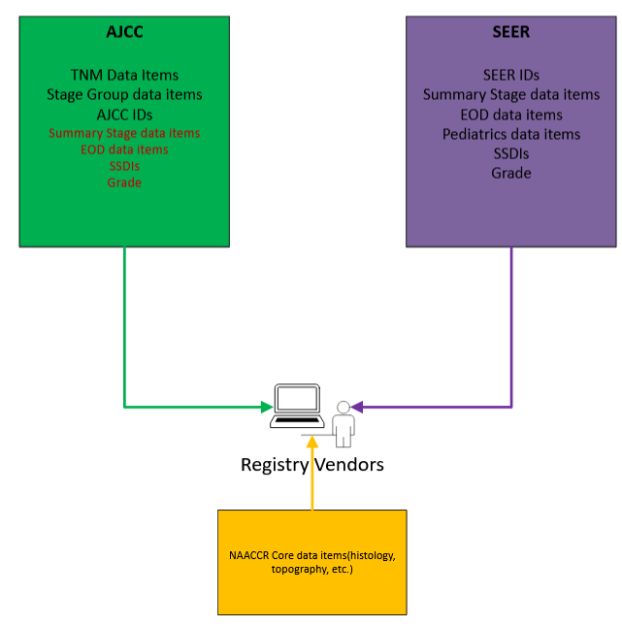
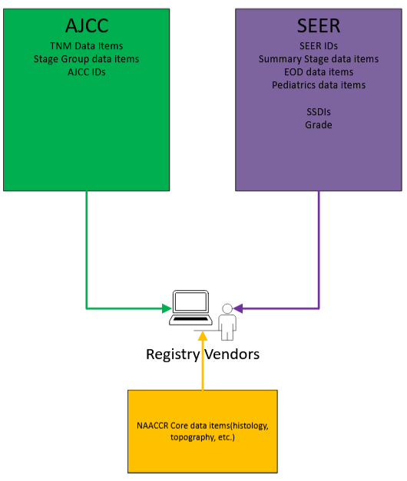
Notes:
AJCC Cancer Surveillance DLL currently supports TNM and non-TNM DATA( including Summary stage data items, eod data items, ssdis, and grade)
For our upcoming release, we will only be providing TNM data items, Stage group data items, and AJCC IDs

Slide 3
What is excluded from the V26 DLL
EOD data items
Summary Stage 2018
Grade
SSDI

Slide 4
What is included in the V26 DLL
AJCC ID
TNM
Stage Group
Notes:
our DLL does contain both 8th ed and Version 9, and that the software picks which is the one to use – if there is no version 9 for the disease site, 8th edition is used

Slide 5
Functional Changes
Notes:
So, what will the new AJCC Cancer surveillance DLL look like to developers

Slide 6
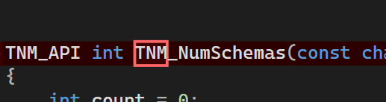
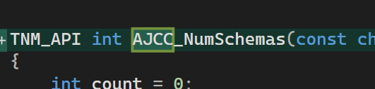
Function Names
All functions will be renamed to reflect AJCC TNM
Functions or logic that are non-AJCC will result in an error
SQLite error codes have been added

Slide 7
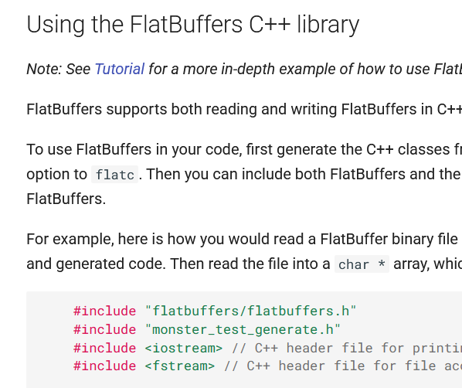
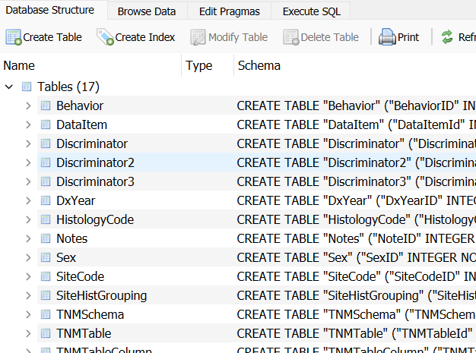
Data Storage – Hybrid Approach
Notes:
Initially planned to replace 2-dimensional data storage with sqlite
One important use-case – schema discriminators
Complications in querying single data point – speed is very poor – test harness takes 42 seconds to load
Flatbuffers storage was chosen because of its speed(similar to the 2-dimensional array structure) and it is easy to debug. It generates storage from sql database

Slide 8
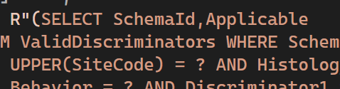
Data Storage – SQLite?

Slide 9
Data Storage – Flatbuffer?
Binary serialization format by Google
Fast to read
Efficient for storing structured table data from
Schema enforcement keeps SQL-derived data consistent
Good fit for embedding inside DLLs or distributing with apps
https://flatbuffers.dev/languages/cpp/
Notes:
Flatbuffers storage was chosen because of its speed(similar to the 2-dimensional array structure) and it is easy to debug.
Long term goal is still to have sqlite as the main data storage and work is in progress for future release – vendors will be notified

Slide 10
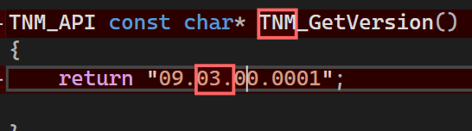
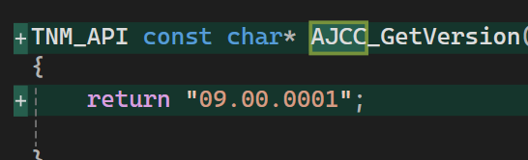
Versioning – AJCC 09.00.0001
09: Major version (big release, e.g., AJCC 9th Edition)
00 : Minor version (smaller updates, still 9th Edition)
0001: Build/revision (first build of 9.0)

Slide 11
Other Changes
File name: TNM9 09.XX.XX.XXXX.dll AJCC 09.XX.XXXX.dll
Test Harness: .NET 4.8 .NET 6
Optional JSON implementation: Return JSON for each disease
Update to release documentation

Slide 12
Dates
Test release date – Sep. 30
Test feedback – Oct. 1 – Oct. 30
Release date – Dec. 19

Slide 13
Feedback
Email: doluwadare@facs.org
https://www.facs.org/quality-programs/cancer-programs/american-joint-committee-on-cancer/cancer-staging-systems/ajcc-cancer-surveillance-dll/
S

