Slide 1
AJCC Cancer Surveillance DLL V26 Beta
Daniel Oluwadare
Notes:
This presentation is a high level but still contains the necessary technical components for discsussion

Slide 2
Mission Statement
The goal is to provide AJCC staging data elements to registry vendors for integration into hospital registry software. This aims to enable registrars to accurately report AJCC staging information to the National Cancer Database (NCDB) and other state registries, thereby contributing to the development of future versions of AJCC staging systems. The method of implementation is yet to be discussed.
Notes:
The goal is to provide AJCC staging data to registry vendors so they can integrate it into hospital software, allowing registrars to accurately report cancer staging information to the National Cancer Database and other registries, which will help develop future AJCC staging systems.

Slide 3
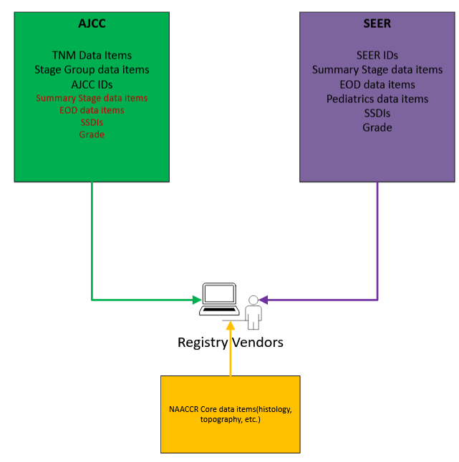
CURRENT STATE OF AJCC CANCER SURVEILLANCE DLL
The AJCC Cancer Surveillance DLL contains SEER components, leading to data redundancy for vendors. Additionally, the introduction of new disease sites makes maintenance increasingly complex and costly for the AJCC team, potentially impacting release timelines and increasing the risk of bugs.
Notes:
The AJCC Cancer Surveillance DLL has redundant data due to SEER components, making maintenance complex and costly, especially with new disease sites being added, which can delay releases and increase the risk of errors.

Slide 4
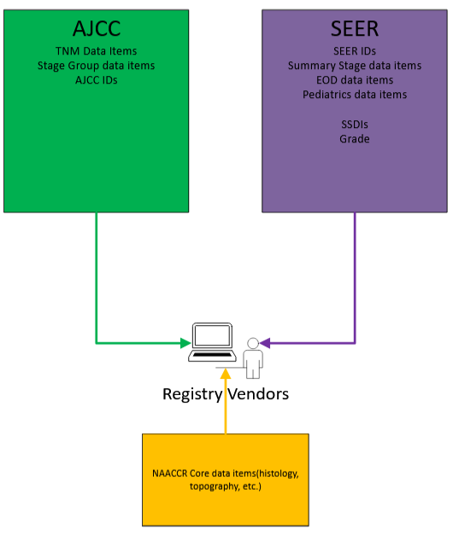
SOLUTION
To resolve this issue, AJCC will provide only AJCC-specific data, including TNM data items, stage group data items, and AJCC IDs. Vendors can obtain Summary Stage data items, EOD data items, SSDIs, and Grade from the SEER API, giving them the flexibility to determine how they implement data from both sources.
Notes:
To resolve the issue, AJCC will only provide its own specific data, and vendors will need to obtain the additional data from SEER.

Slide 5
TECHNICAL APPROACH:C++,C# DLL and SQLITE DATABASE
Customers will have access to C++ and C# DLL
SQLite being local ensures offline availability, which can be useful for standalone applications.
Local databases are fast for read and write operations, as they avoid network overhead.
SQLite databases are self-contained, easy to distribute, and work across platforms without setup.
Notes:
The current system stores its data inside C++ code in the form of 4 lookup 2-dimensional arrays(one for each version and algorithm).
The new DLL will consist of current framework(c++ and C#) with SQLite- a new way to store data.

Slide 6
BENEFITS OF APPROACH
Notes:
A simplified approach is being taken to improve the integration of AJCC staging data into registry vendor software, aiming to enhance quality, reduce errors, and minimize conflicts by transitioning to a microservice structure.

Slide 7
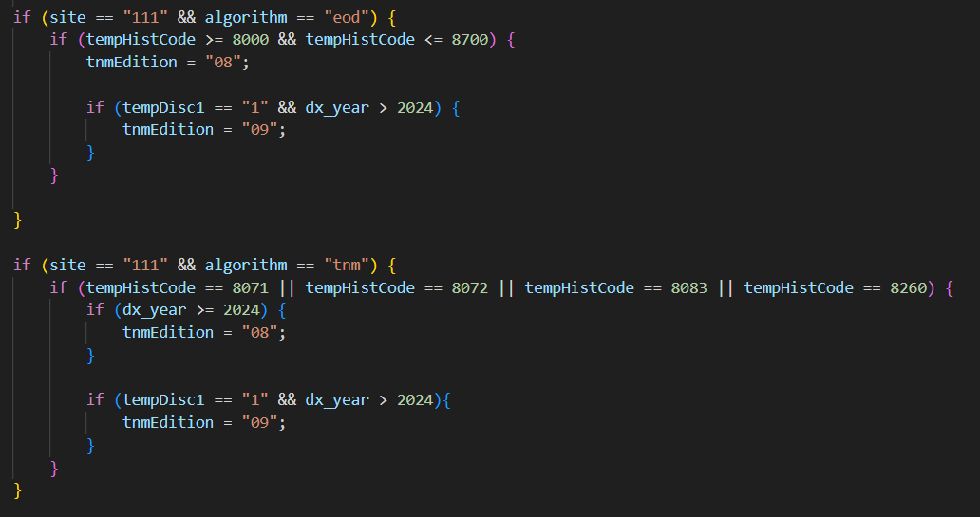
BENEFITS OF APPROACH: REDUCTION OF HARD-CODING
Notes:
Reduction of hard-coding which also means reduction of potential bugs

Slide 8
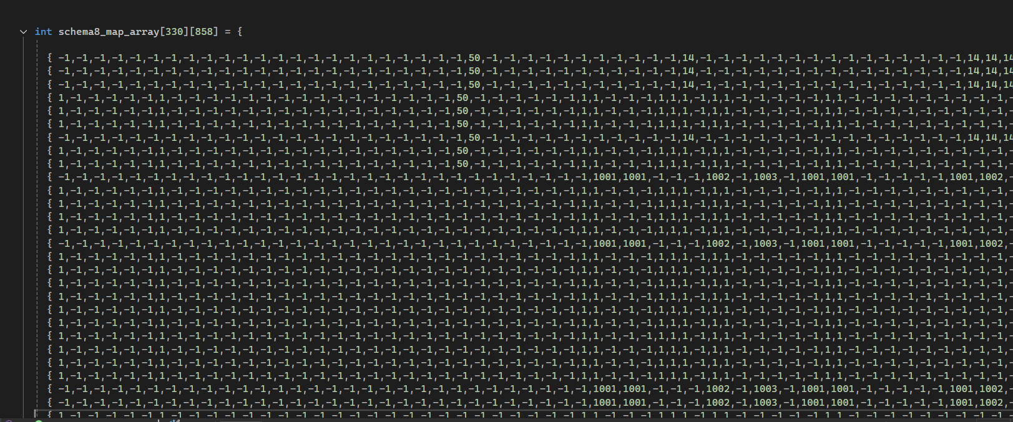
BENEFITS OF APPROACH: EASIER DEBUGGING
Current data storage format
Notes:
Through increased visibility, accelerate the identification and resolution of system errors.
Debugging is made easier through creation of unit tests and utilizing queries to find problems

Slide 9
BENEFITS OF APPROACH: TABULAR DATA
Notes:
Elevate quality of integration for registry vendors
Users can easily manipulate and customize their data to fit their needs through SQLite queries

Slide 10
BENEFITS OF APPROACH: STREAMLINED UPDATES WITH SQLITE DATABASE DOWNLOAD
Download from cloud
Faster updates
Streamlined Process
Notes:
Instead of downloading the entire codebase with each update, users will now only need to download a lightweight SQLite database file.
Which makes for easier integration and faster updates

Slide 11
WHAT IS EXCLUDED FROM THE DLL V26
EOD data items
Summary Stage 2018
Grade
SSDI

Slide 12
WHAT IS INCLUDED IN THE NEW DLL V26
AJCC ID
TNM
Stage Group

Slide 13
NOTABLE CHANGES
Some functions will be excluded
GetSEERVersion
SQLLITE Database
New Data storage that replaces current data matrix storage system
New error codes such as:
DEPRECATE_ERR – lets users know that function is no longer in use
SQLLITE_QUERY_NO_RESULTS_FOUND – lets users know that the query performed has failed
Notes:
Function structures and parameters will remain the same. However, functions that involve non-TNM data will not return new data

Slide 14
Next Steps
Meeting with Vendors
Construct a timeline for testing and implementation

Slide 15
Questions

