Slide 1
Glioma incidence and survival variation by county-level socioeconomic measures
Jill S. Barnholtz-Sloan, PhD
Sally S Morley Designated Professor in Brain Tumor Research
Associate Director for Bioinformatics and Translational Informatics
Case Western Reserve University School of Medicine

Slide 2
Disclosures
None

Slide 3
Outline
Introduction
Methods
Incidence by SES
Survival by SES
Conclusions

Slide 4
Introduction
SES is associated with risk of multiple cancers
This may be due to correlation with case ascertainment or actual causal risk factors
Higher rates of glioma in areas with higher SES (RR 1.1-1.2), but without stratification by race or urbanicity

Slide 5
Methods
Incidence data from CBTRUS 2011-2015
Survival data from SEER 2000-2015
Urbanicity defined by Rural Urban Continuum Codes (RUCCs), which classify counties by population size and proximity to a metropolitan area
RUCC codes 1-3 (urban) vs. 4-9 (rural)

Slide 6
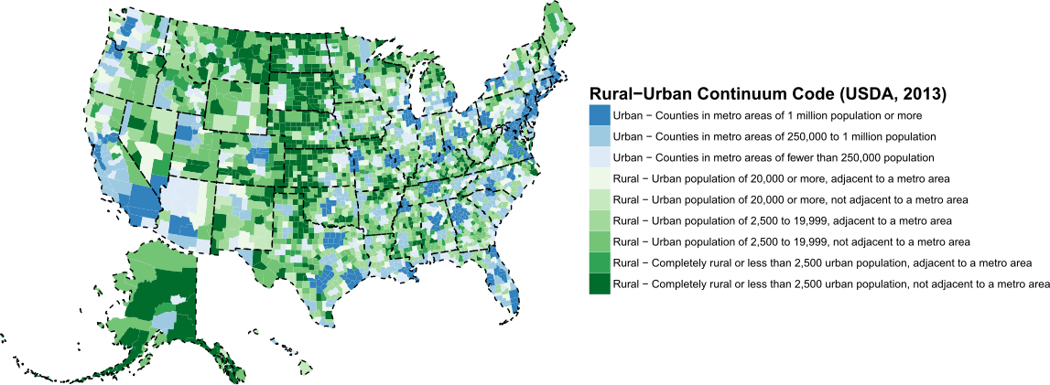
Figure 1. USDA 2013 urban rural continuum codes used for analysis.
Urban
Rural

Slide 7
Methods
SES metric generated from 2010 American Community Survey
Normalized six variables and summed:
% residents ≥25 years old with <HS degree
% residents with ≥bachelor’s degree
% families with income <poverty level
Median household income
% aged ≥16 who are unemployed
% of persons who work in management, business, science, and arts occupations
SES metric dichotomized and in quintiles for analysis

Slide 8
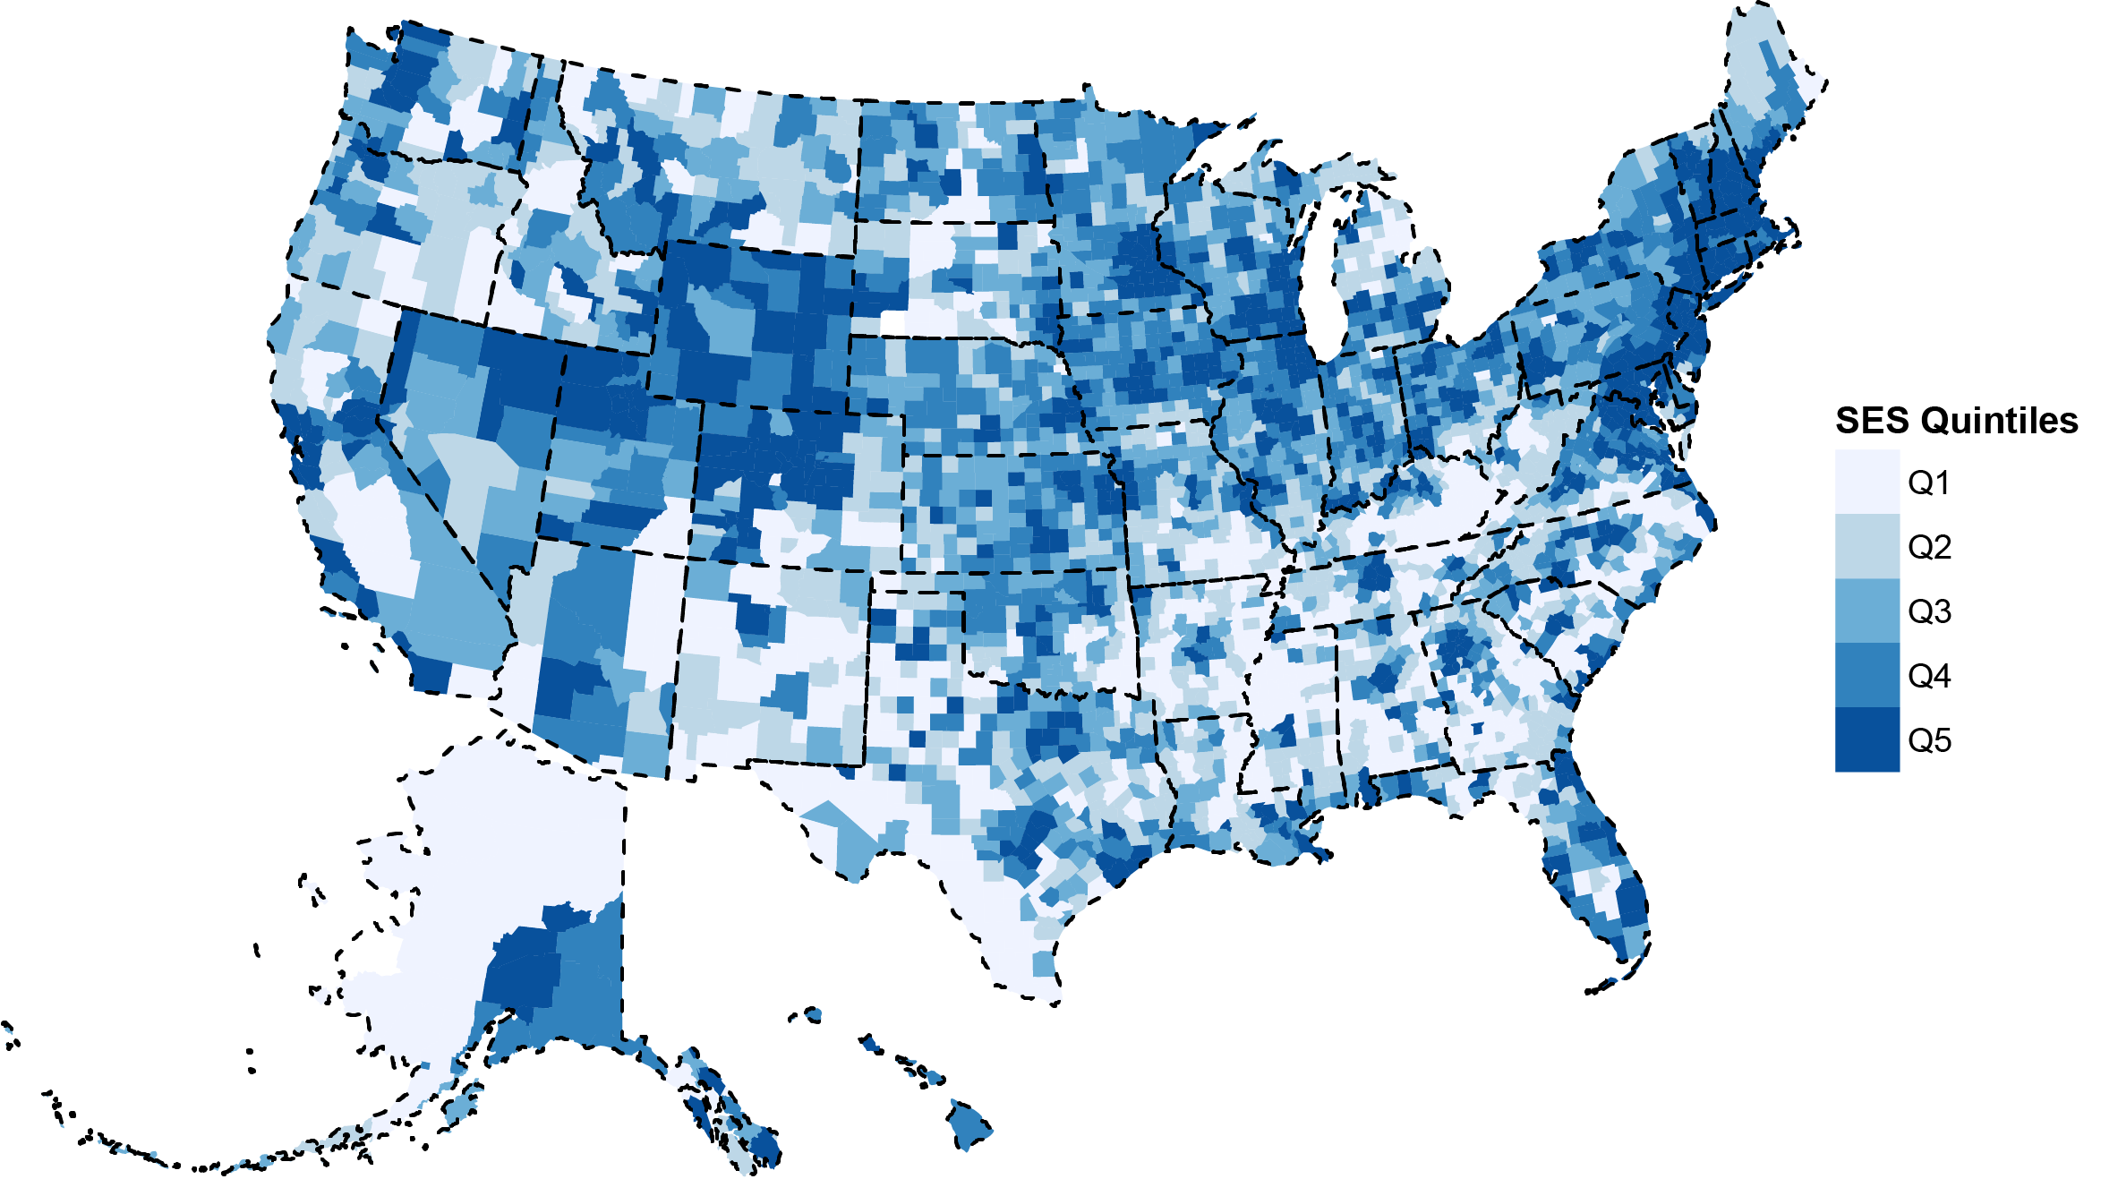
Figure 2. SES quintiles used for analysis, based on data from the American Community Survey 2006-2010.

Slide 9
Methods
Calculated average annual age-adjusted incidence rates (AAAIR) by SES, with stratification by urbanicity and race, by glioma subtypes
Also computed hazard ratios for death after glioma diagnosis by the same factors, using Cox models

Slide 10
Glioma Incidence by SES

Slide 11
Incidence by SES
Rates of glioma were highest in counties with higher SES (IRR 1.18, 95%CI: 1.15-1.22, p<0.001)
Upon stratification by race, these differences were most prominent for White non-Hispanic and White Hispanic individuals
Upon stratification by urbanicity, differences were more pronounced in urban rather than rural areas

Slide 12
Figure 3. Incidence of glioma of various subtypes by SES quintile, p-value indicates p-trend

Slide 13
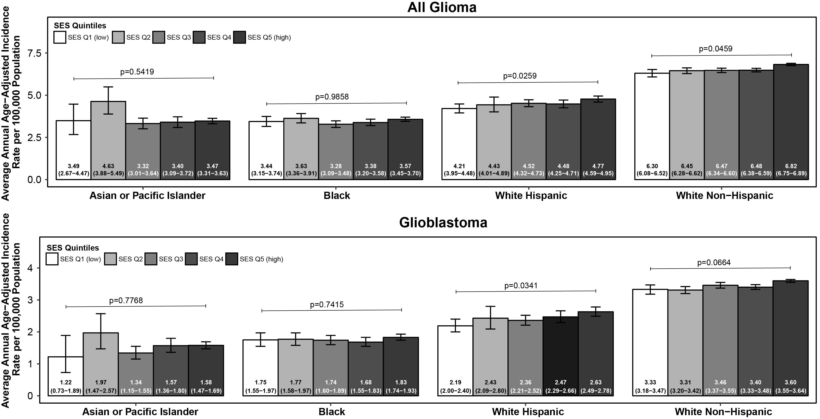
Figure 4. Incidence of glioma and glioblastoma by SES quintile, stratified by race, p-value indicates p-trend

Slide 14
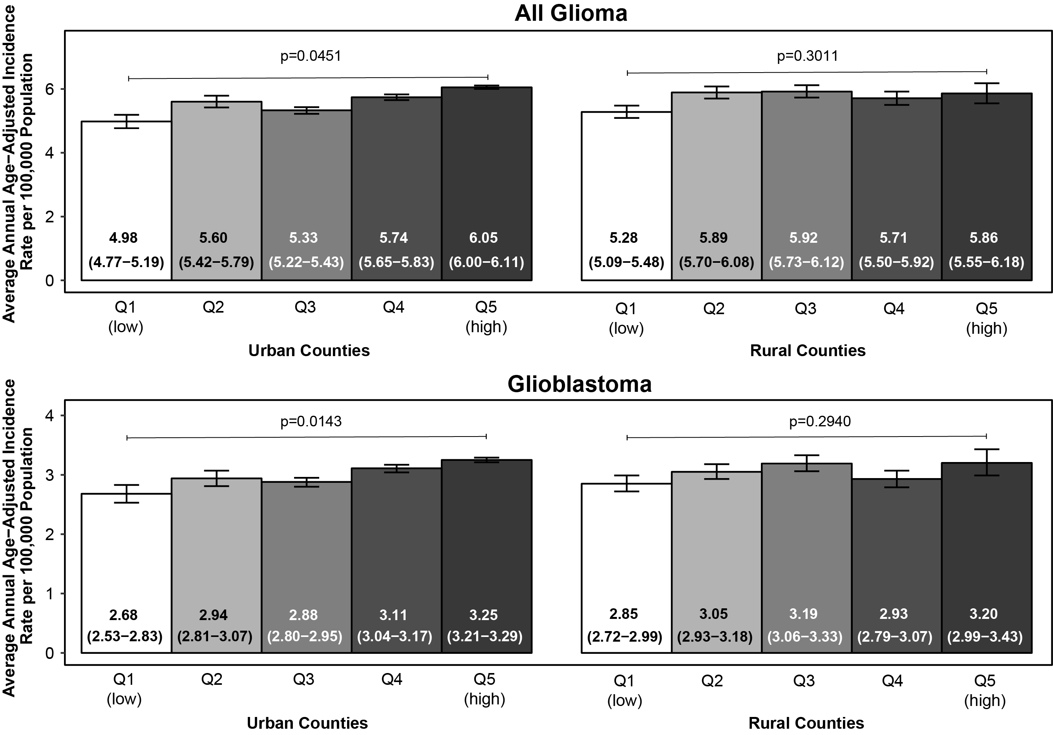
Figure 5. Incidence by SES quintile, stratified by urban/rural status, p-value indicates p-trend

Slide 15
Glioma Survival by SES

Slide 16
Survival by SES
Survival after GBM diagnosis was higher for residents of high SES versus low SES counties after adjustment for age and EOR (HR=0.82, 95%CI: 0.76-0.87 comparing SES Q1 vs. Q5, p<0.001)
This was true for non-GBM gliomas and among GBM patients who received radiation/chemotherapy
This suggests that SES is associated with survival beyond access to adequate surgical treatment (EOR) and medical treatment (chemo/radiation)

Slide 17
Figure 6. Survival after diagnosis for glioma of various subtypes, by SES, SEER18 2000-2015

Slide 18
Survival by SES
Survival after GBM diagnosis was significantly higher among White Hispanic and Asian or Pacific Islander individuals compared to White non-Hispanic individuals, after adjustment for age, SES, and EOR
Notably, among all patients with GBM, Black individuals did not have improved survival compared to White non-Hispanic individuals

Slide 19
Survival by SES
After restriction to those who received radiation and chemotherapy, Black individuals did have improved survival compared to White individuals
This suggests that access to these treatments may be worse among Black individuals, independently of SES, and that this adversely affects survival after GBM diagnosis
Upon mutual adjustment, urbanicity was not a significant predictor of survival after glioblastoma diagnosis (p=0.12), while SES (p<0.001) and race (p=0.03) were

Slide 20
Conclusions
Incidence of glioma was higher in US counties of high SES compared to counties of low SES
These differences were most pronounced among White non-Hispanic individuals and, to a lesser extent, White Hispanic individuals, in urban areas
Differences in incidence were largely driven by race and SES rather than urbanicity, based on mutual adjustment
Better survival was observed in high SES counties, even when adjusting for extent of resection, and when restricting to those who received chemo/radiation for GBM
Differences in survival were also driven by both SES and race, rather than urbanicity, based on mutual adjustment

Slide 21
Acknowledgments and Funding
Thank you to coauthors: David Cote, Quinn Ostrom, Haley Gittleman, Rose Duncan, Travis CreveCoeur, Carol Kruchko, Timothy Smith, Meir Stampfer – This work is in Press at Cancer
CBTRUS Analytic Group: Carol Kruchko, Jill Barnholtz-Sloan, Gabrielle Truitt, Haley Gittleman, Gino Cioffi, Nirav Patil
Funding for CBTRUS was provided by the Centers for Disease Control and Prevention (CDC) under Contract No. 2016-M-9030, the American Brain Tumor Association, National Brain Tumor Society, The Sontag Foundation, Novocure, AbbVie, the Musella Foundation, National Brain Tumor Society, the National Cancer Institute (NCI) under Contract No. HHSN261201800176P, the Uncle Kory Foundation, as well as private and in kind donations.
Contents are solely the responsibility of the authors and do not necessarily reflect the official views of the CDC or of the NCI.
QTO was funded by a Research Training Grant from the Cancer Prevention and Research Institute of Texas (CPRIT; RP160097T)

Slide 22
Questions?

