Slide 1
Patterns of cancer incidence and mortality rates and trends in China
Siwei Zhang
Rongshou Zheng
National Cancer Center
Cancer Hospital, Chinese Academy of Medical Sciences

Slide 2
OVERVIEW
The Burden of Cancer in China
Cancer epidemiology
Cancer trend
Cancer survival

Slide 3
Purpose
To estimate the incidence and mortality of cancer in 2015 and give the patterns of cancer incidence and mortality rates and trends in China

Slide 4
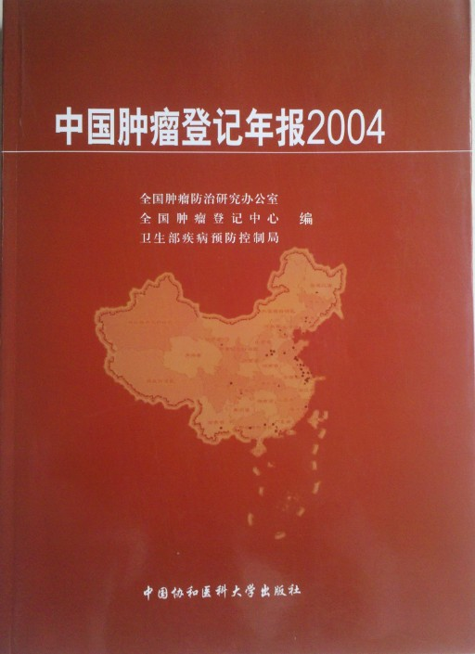
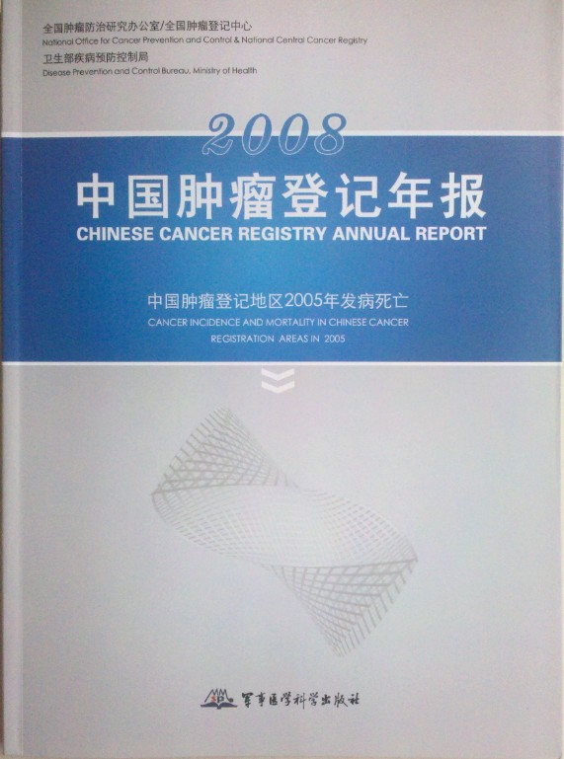
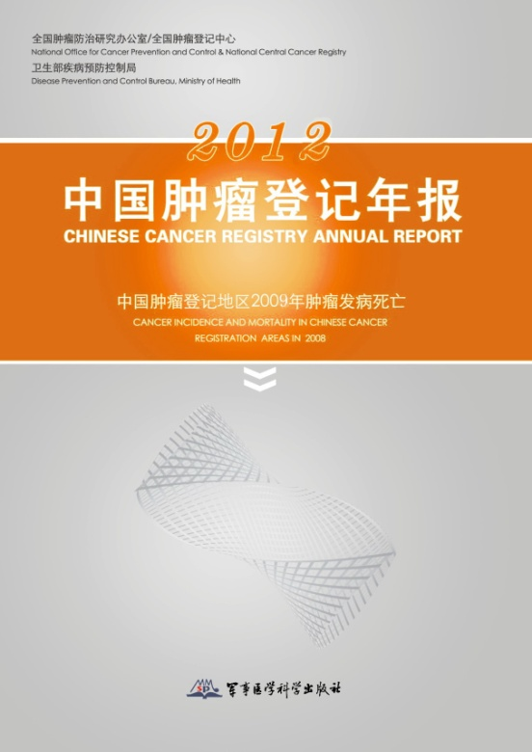
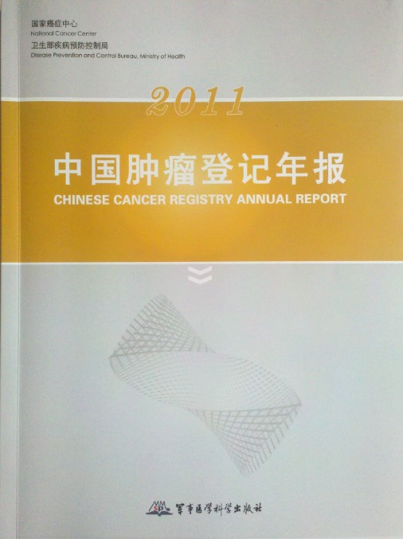
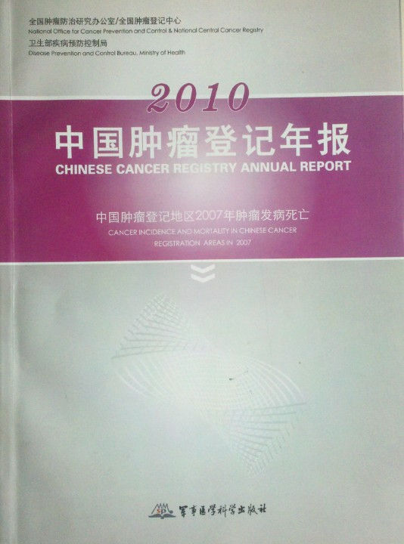
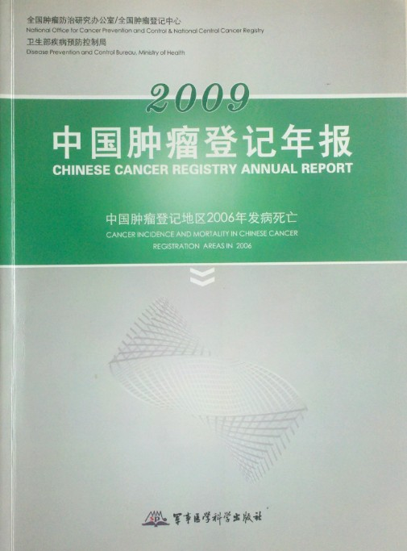
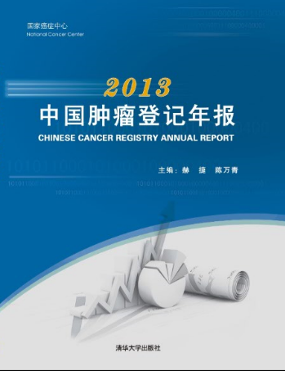
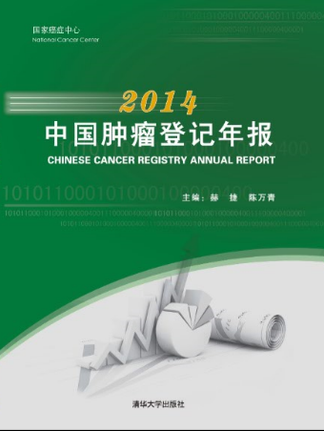
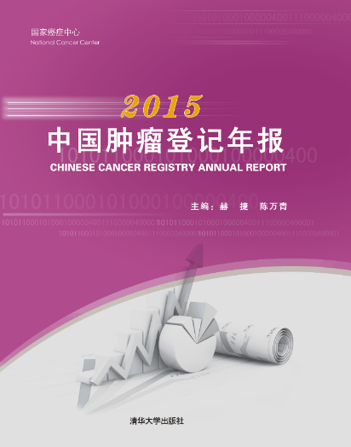
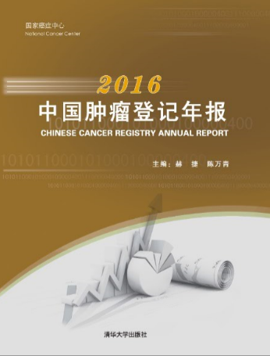
PBCR in China
The first rural PBCR was established in Linxian, Henan province in 1959 in China
The first urban PBCR was established in Shanghai in 1961 in China
Total number of 652 PBCR established in China, covered about 480 million population（about 35% of the national population, until 2018/12/31）
Only 308 PBCRs supported by the national financial with about 38.97 million yuan per year (4.87M € per year), other PBCRs supported by local government
51.1% areas
5.6% population
48.9% areas
94.4% population

Slide 5
Cancer Incidence in China，2015
AREA | Gender | New Case (1000) | Crude rate (1/10⁵) | ASR(cn) (1/10⁵) | ASR (1/10⁵) | Cum rate 0-74(%)
ALL | ALL | 3929.1 | 285.83 | 190.64 | 186.39 | 21.44
 | MALE | 2151.0 | 305.47 | 207.99 | 206.49 | 24.36
 | FEMALE | 1778.2 | 265.21 | 175.47 | 168.45 | 18.60
URBAN | ALL | 2351.7 | 304.96 | 196.09 | 191.38 | 21.81
 | MALE | 1258.7 | 319.82 | 209.14 | 207.44 | 24.26
 | FEMALE | 1093.1 | 289.47 | 185.42 | 177.64 | 19.50
RURAL | ALL | 1577.4 | 261.40 | 182.70 | 179.17 | 20.88
 | MALE | 892.3 | 287.30 | 206.04 | 204.79 | 24.46
 | FEMALE | 685.1 | 233.92 | 161.27 | 155.48 | 17.33

Slide 6
Top 10 cancer incidence in China，2015
Notes:
The top 10 cancer incidence in China, with the lung cancer was the first leading cancer in male, follow with stomach,liver, colorectal and esophagus The top five cancer in male accounted about 70%, the breast cancer was the first leading cances in female, followed with lung ,colorectal, thyroid and stomach cancer. The top five cancer in female accounted about 56%,

Slide 7
Cancer Incidence in urban and rural areas of China，2015
Notes:
The top 10 cancer incidence in urban areas and rural areas of China, with the lung cancer was the first leading cancer both in urban areas. follow with colorectal , stomach,liver, and breast cancer , The top five cancer in male accounted about 57%,
the breast cancer was the first leading cances in female, followed with lung ,colorectal, thyroid and stomach cancer. The top five cancer in female accounted about 56%,

Slide 8
Top 10 cancer incidence in China, 2015
Urban
Area
Rural
Area
Notes:
This slides shows the top 10 proportion of cancer incidence in urban areas and rural areas. Detailed data showed before.

Slide 9
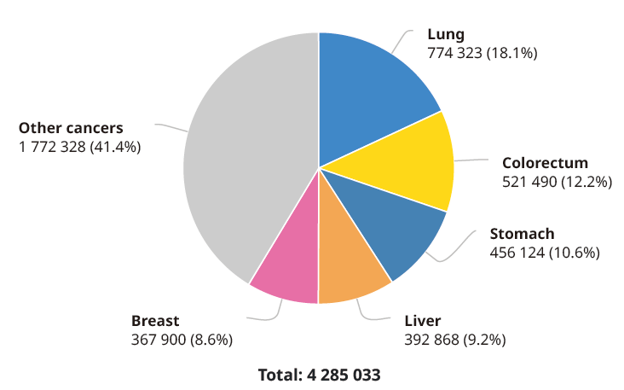
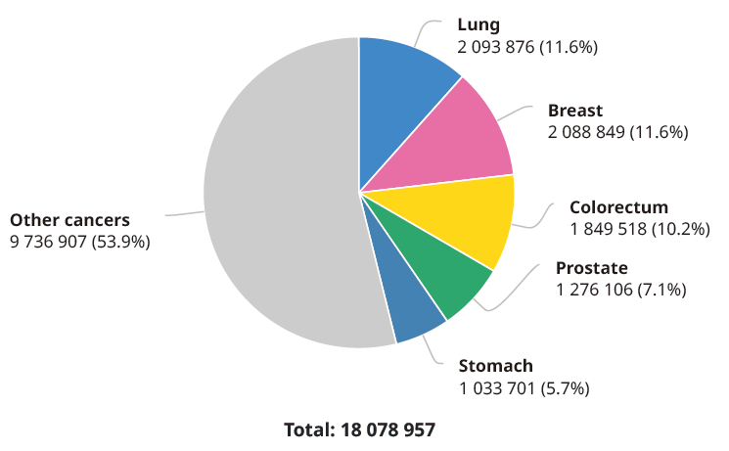
Cancer incidence between China and the world
China
World
China
World
数据来源： Globocan 2018

Slide 10
Cancer Mortality in China , 2015
AREA | Gender | Case (10,00) | Crude rate (1/10⁵) | ASR(cn) (1/10⁵) | ASR (1/10⁵) | Cum rate 0-74(%)
ALL | ALL | 2337.6 | 170.05 | 106.72 | 105.84 | 11.94
 | MALE | 1479.4 | 210.10 | 139.13 | 138.57 | 15.79
 | FEMALE | 858.2 | 128.00 | 75.92 | 74.81 | 8.13
URBAN | ALL | 1331.1 | 172.61 | 103.65 | 102.97 | 11.40
 | MALE | 835.4 | 212.28 | 134.08 | 133.83 | 15.03
 | FEMALE | 495.7 | 131.26 | 74.78 | 73.72 | 7.83
RURAL | ALL | 1006.5 | 166.79 | 110.76 | 109.57 | 12.65
 | MALE | 644.0 | 207.35 | 145.72 | 144.68 | 16.79
 | FEMALE | 362.5 | 123.78 | 77.43 | 76.24 | 8.52

Slide 11
Top 10 Cancer mortality in China, 2015
Notes:
The top 10 cancer mortality in China, with the lung cancer was the first leading cancer in male , follow with liver, stomach, esophagus and colorectal
The top five cancer mortality in male accounted about 76%,
the lung cancer was also the first leading cause of cancer death in female, followed with lung ,stomach, liver,colorectal, and breast cancer . The top five cancer in female accounted about 61%,

Slide 12
Cancer mortality in urban and rural areas
Notes:
The top 10 cancer incidence in urban areas and rural areas of China, with the lung cancer was the first leading cancer both in urban areas. follow with colorectal , stomach,liver, and breast cancer , The top five cancer in male accounted about 57%,
the breast cancer was the first leading cances in female, followed with lung ,colorectal, thyroid and stomach cancer. The top five cancer in female accounted about 56%,

Slide 13
Top 10 cancer mortality in China , 2015
Urban
Area
Rural
Area
Notes:
This slides shows the top 10 proportion of cancer mortality in urban areas and rural areas. Detailes showed before.

Slide 14
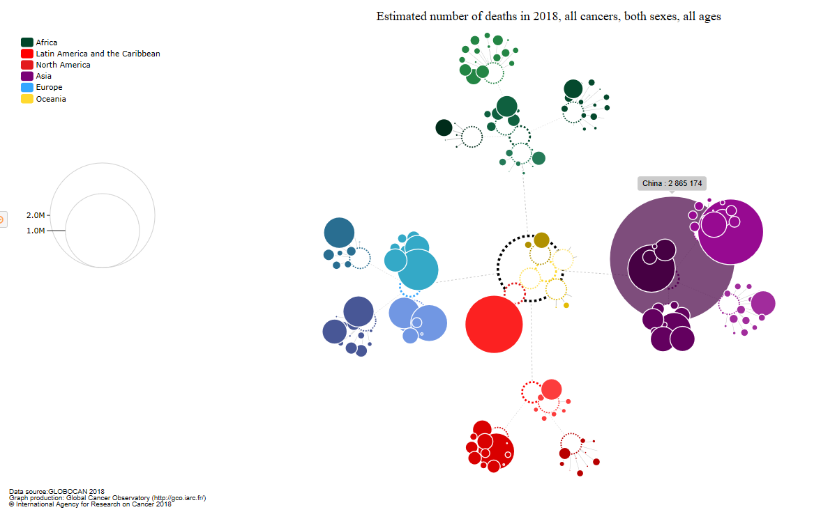
Cancer mortality between China and the world
China，286.5万，30.2%
China
World
数据来源： Globocan 2018

Slide 15
Lifetime risk of developing cancer
SITES | Both sexes |  |  | Male |  |  | Female
 | Current Probability（%） | 1 in X |  | Current Probability（%） | 1 in X |  | Current Probability（%） | 1 in X
Oesophagus | 2.00 | 49.95 |  | 2.60 | 38.4 |  | 1.33 | 75.5
Stomach | 3.18 | 31.40 |  | 4.13 | 24.2 |  | 2.11 | 47.4
Colorectum | 3.01 | 33.19 |  | 3.24 | 30.9 |  | 2.75 | 36.3
Liver | 2.60 | 38.47 |  | 3.45 | 29.0 |  | 1.66 | 60.2
Pancreas | 0.79 | 126.06 |  | 0.81 | 123.4 |  | 0.77 | 129.1
Lung | 6.33 | 15.79 |  | 7.80 | 12.8 |  | 4.66 | 21.5
Breast | 3.48 | 28.72 |  |  |  |  | 3.48 | 28.7
Cervix | 1.23 | 81.53 |  |  |  |  | 1.23 | 81.5
Uterus | 0.81 | 124.07 |  |  |  |  | 0.81 | 124.1
Ovary | 0.66 | 152.52 |  |  |  |  | 0.66 | 152.5
Prostate | 1.33 | 75.21 |  | 1.33 | 75.2
Kidney | 0.53 | 190.10 |  | 0.61 | 164.7 |  | 0.44 | 229.5
Bladder | 0.68 | 147.23 |  | 0.98 | 101.7 |  | 0.33 | 301.4
Brain,CNS | 0.70 | 143.21 |  | 0.61 | 163.1 |  | 0.79 | 126.1
Thyroid | 0.98 | 102.16 |  | 0.47 | 212.3 |  | 1.53 | 65.5
Lymphoma | 0.64 | 157.47 |  | 0.70 | 142.7 |  | 0.56 | 178.7
Leukaemia | 0.60 | 167.81 |  | 0.64 | 155.2 |  | 0.54 | 185.0
All sites | 28.57 | 3.50 |  | 30.54 | 3.3 |  | 26.20 | 3.8

Slide 16
BASED ON GLOBOCAN2018
 | INCIDENCE |  |  |  |  |  | MORTALITY
 | CASES | % | CR |  | ASR |  | DEATHS | % | CR |  | ASR
ICD10 |  |  | CR | RANK | ASR | RANK |  |  | CR | RANK | ASR | RANK
ALL | 4285033 | 23.7 | 301.1 | 56 | 201.7 | 68 | 2865174 | 30.0 | 201.3 | 44 | 130.1 | 12
C11 | 60558 | 46.9 | 4.3 | 7 | 3.0 | 13 | 31413 | 43.0 | 2.2 | 11 | 1.5 | 20
C15 | 307359 | 53.7 | 21.6 | 1 | 13.9 | 5 | 283433 | 55.7 | 19.9 | 1 | 12.7 | 5
C16 | 456124 | 44.1 | 32.1 | 3 | 20.7 | 4 | 390182 | 49.9 | 27.4 | 2 | 17.5 | 3
C18-21 | 521490 | 28.2 | 36.6 | 53 | 23.7 | 54 | 247563 | 28.1 | 17.4 | 54 | 10.9 | 39
C22 | 392868 | 46.7 | 27.6 | 5 | 18.3 | 9 | 368960 | 47.2 | 25.9 | 4 | 17.1 | 9
C23-24 | 54131 | 24.7 | 3.8 | 39 | 2.4 | 30 | 46753 | 28.3 | 3.3 | 23 | 2.1 | 21
C25 | 116291 | 25.3 | 8.2 | 59 | 5.2 | 65 | 110390 | 25.5 | 7.8 | 60 | 4.9 | 61
C33-34 | 774323 | 37.0 | 54.4 | 35 | 35.1 | 16 | 690567 | 39.2 | 48.5 | 27 | 30.9 | 11
C50 | 367900 | 17.6 | 53.3 | 82 | 36.1 | 120 | 97972 | 15.6 | 14.2 | 98 | 8.8 | 163
C53 | 106430 | 18.7 | 15.4 | 89 | 10.7 | 119 | 47739 | 15.3 | 6.9 | 111 | 4.4 | 123
C54 | 73253 | 19.2 | 10.6 | 71 | 7.1 | 87 | 13329 | 14.8 | 1.9 | 89 | 1.2 | 148
C56 | 52971 | 17.9 | 7.7 | 78 | 5.3 | 116 | 30886 | 16.7 | 4.5 | 84 | 2.9 | 142
C61 | 99322 | 7.8 | 13.6 | 115 | 9.1 | 158 | 51895 | 14.5 | 7.1 | 121 | 4.7 | 153
C64-65 | 70407 | 17.5 | 4.9 | 65 | 3.4 | 74 | 43486 | 24.8 | 3.1 | 54 | 1.9 | 58
C67 | 82270 | 15.0 | 5.8 | 69 | 3.7 | 84 | 38208 | 19.1 | 2.7 | 67 | 1.6 | 98
C70-72 | 76494 | 25.8 | 5.4 | 59 | 4.1 | 64 | 63860 | 26.5 | 4.5 | 53 | 3.2 | 63
C73 | 194232 | 34.2 | 13.6 | 22 | 10.1 | 20 | 8603 | 20.9 | 0.6 | 75 | 0.4 | 91
C82-86，C96 | 88090 | 17.3 | 6.2 | 73 | 4.3 | 115 | 48129 | 19.4 | 3.4 | 72 | 2.3 | 115
C88+C90 | 20066 | 12.5 | 1.4 | 87 | 0.9 | 122 | 14655 | 13.8 | 1.0 | 86 | 0.7 | 131
C91-95 | 82607 | 18.9 | 5.8 | 74 | 5.1 | 89 | 65531 | 21.2 | 4.6 | 69 | 3.5 | 65

Slide 17
OVERVIEW
The Burden of Cancer in China
Cancer epidemiology
Cancer trend
Cancer survival

Slide 18
National Retrospective Death Survey
The composition of all malignant tumors in death
Comparison of three National Retrospective Death Survey
Data source:
three National Retrospective Death Survey(1973-75,1990-92,2004-05)
Cancer registry(2014-15)
Notes:
Comparison of three National Retrospective Death Survey,
the Age-standardized Cancer mortality was increased from 1970s to 1990s, but with a little decrease from 1990s to the third National Retrospective Death Survey in 2004-2005. but during the past 40 years, the composition of all malignant tumors in death was increased from 10.53% in 1970s to 22.32% in 2004-2005,this means that about 1 in five people died caused by cancer.

Slide 19
Trend for cancer mortality
Comparison of three National Retrospective Death Survey
Crude rate
Age-standardized(1982 China)
Data source:
three National Retrospective Death Survey(1973-75,1990-92,2004-05)
Cancer registry(2014-15)
Notes:
Comparison of three National Retrospective Death Survey,
the Age-standardized Cancer mortality was increased from 1970s to 1990s, but with a little decrease from 1990s to the third National Retrospective Death Survey in 2004-2005. but during the past 40 years, the composition of all malignant tumors in death was increased from 10.53% in 1970s to 22.32% in 2004-2005,this means that about 1 in five people died caused by cancer.

Slide 20
Cancer Patterns in China
Lung cancer, colorectal cancer increased rapidly
Digestive cancers still stayed at a high level
Rank | 1973-75 | 1990-92 | 2004-05 | 2014-15
1 | Stomach | Stomach | Lung | Lung
2 | Esophagus | Liver | Liver | Liver
3 | Liver | Lung | Stomach | Stomach
4 | Cervix | Esophagus | Esophagus | Esophagus
5 | Lung | Colorectum | Colorectum | Colorectum
Notes:
Lung cancer, colorectal cancer increased rapidly, meanwile, digestive tract cancers still stayed at a high level, this lead the cancer prevention and control facing with new challenge, and showed the coexistence of cancer patterns between developed and developing countries.

Slide 21
Trend for cancer mortality
Crude rate
Age-standardized (1982 China)
Data source:
three National Retrospective Death Survey(1973-75,1990-92,2004-05)
Cancer registry(2014-15)

Slide 22
Trends for cancer Incidence in China
Male crude rate
Female crude rate
（* Segi’s population）

Slide 23
Trends in Incidence for Selected Cancers：Male
Cancer Site | Crude rate |  |  | ASR | China |  | ASR | World
 | AAPC | 95%CI |  | AAPC | 95%CI |  | AAPC | 95%CI
Oesophagus | -0.5 | -1.3~0.4 |  | -3.5* | -3.9~-3.1 |  | -3.4* | -3.8~-3.0
Stomach | 0.4 | -0.2~1.0 |  | -3.0* | -3.7~-2.3 |  | -2.9* | -3.6~-2.2
Colorectum | 5.9* | 5.3~6.5 |  | 2.4* | 2.0~2.8 |  | 2.5* | 2.1~2.9
Liver | 0.6 | 0.0~1.2 |  | -2.2* | -2.8~-1.6 |  | -2.1* | -2.7~-1.5
Pancreas | 4.8* | 4.3~5.2 |  | 1.0* | 0.7~1.3 |  | 1.0* | 0.7~1.3
Lung | 3.5* | 3.2~3.7 |  | -0.2 | -0.4~0.0 |  | -0.1 | -0.4~0.1
Prostate | 11.9* | 10.5~13.3 |  | 7.4* | 6.8~8.1 |  | 7.5* | 6.8~8.2
Bladder | 4.8* | 2.9~6.6 |  | 1.0* | 0.2~1.7 |  | 1.0* | 0.3~1.7
Brain,CNS | 3.5* | 2.9~4.2 |  | 1.6* | 0.9~2.2 |  | 1.5* | 0.8~2.2
Lymphoma | 4.8* | 3.4~6.2 |  | 2.0* | 0.7~3.2 |  | 1.9* | 0.6~3.1
Allsites | 3.4* | 3.1~3.6 |  | 0.1 | -0.1~0.3 |  | 0.1 | -0.1~0.3
Trends in Incidence Rates from 2000 to 2014

Slide 24
Trends in Incidence for Selected Cancers:Female
Cancer Site | Crude rate |  |  | ASR | China |  | ASR | World
 | AAPC | 95%CI |  | AAPC | 95%CI |  | AAPC | 95%CI
Oesophagus | -3.0* | -4.0~-1.9 |  | -5.7* | -6.3~-5.2 |  | -5.7* | -6.2~-5.2
Stomach | -0.1 | -0.5~0.4 |  | -2.7* | -3.0~-2.4 |  | -2.7* | -3.0~-2.5
Colorectum | 4.3* | 3.7~4.9 |  | 1.4* | 1.0~1.8 |  | 1.4* | 1.0~1.8
Liver | 0.7* | 0.3~1.1 |  | -2.5* | -3.1~-1.9 |  | -2.5* | -3.1~-1.8
Pancreas | 5.1* | 4.6~5.5 |  | 1.5* | 0.9~2.0 |  | 1.5* | 0.9~2.1
Lung | 4.5* | 4.1~5.0 |  | 1.4* | 1.0~1.9 |  | 1.4* | 1.0~1.9
Breast | 5.1* | 4.2~6.0 |  | 3.2* | 2.5~4.0 |  | 3.4* | 2.6~4.2
Cervix | 10.5* | 8.5~12.5 |  | 9.2* | 7.3~11.2 |  | 9.5* | 7.5~11.4
Ovary | 3.7* | 2.9~4.4 |  | 1.7* | 1.0~2.3 |  | 1.7* | 1.0~2.4
Thyroid | 18.9* | 16.7~21.1 |  | 18.1* | 15.9~20.4 |  | 17.8* | 15.6~20.1
All sites | 4.6* | 4.3~4.8 |  | 2.4* | 2.2~2.7 |  | 2.3* | 2.0~2.5
Trends in Incidence Rates from 2000 to 2014

Slide 25
Trends for cancer Incidence in China
Male crude rate
Female crude rate
Male ASR
Female ASR
（* Segi’s world standards population）
Notes:
调整后，肺癌发病率稳定，胃癌、肝癌、食管癌呈现明显下降趋势，但是男性前列腺癌呈现上升趋势；女性甲状腺，子宫颈、乳腺癌上升明显，

Slide 26
Trends in Mortality Rates for Selected Cancers：Male
Cancer Site | Crude rate |  |  | ASR | China |  | ASR | World
 | AAPC | 95%CI |  | AAPC | 95%CI |  | AAPC | 95%CI
Oesophagus | -0.5 | -1.2~0.2 |  | -3.9* | -4.7~-3.2 |  | -3.9* | -4.7~-3.1
Stomach | 0.3 | -0.2~0.9 |  | -3.5* | -4.0~-2.9 |  | -3.4* | -4.0~-2.8
Colorectum | 5.6* | 5.0~6.2 |  | 1.2* | 0.7~1.8 |  | 1.3* | 0.8~1.9
Liver | 0.5* | 0.0~0.9 |  | -2.7* | -3.2~-2.1 |  | -2.6* | -3.1~-2.0
Pancreas | 5.0* | 4.6~5.4 |  | 1.1* | 0.6~1.5 |  | 1.1* | 0.6~1.5
Lung | 2.9* | 2.4~3.5 |  | -0.7* | -1.0~-0.3 |  | -0.6* | -1.0~-0.2
Prostate | 11.0* | 10.1~11.9 |  | 4.8* | 4.1~5.6 |  | 4.9* | 4.2~5.7
Bladder | 4.7* | 4.1~5.3 |  | -0.7* | -1.3~-0.2 |  | -0.6* | -1.1~0.0
Brain,CNS | 2.5* | 1.8~3.2 |  | 0.0 | -0.8~0.7 |  | 0.2 | -0.6~1.0
Leukaemia | 3.9* | 3.2~4.6 |  | 0.6 | -0.7~1.8 |  | 0.6 | -0.7~2.0
Allsites | 2.2* | 1.8~2.7 |  | -1.2* | -1.6~-0.9 |  | -1.2* | -1.5~-0.8
Trends in Mortality Rates from 2000 to 2014

Slide 27
Trends in Mortality Rates for Selected Cancers：Female
Cancer Site | Crude rate |  |  | ASR | China |  | ASR | World
 | AAPC | 95%CI |  | AAPC | 95%CI |  | AAPC | 95%CI
Oesophagus | -2.9* | -3.8~-2.0 |  | -6.2* | -6.7~-5.7 |  | -6.3* | -6.7~-5.8
Stomach | -0.9* | -1.5~-0.4 |  | -4.1* | -5.2~-2.9 |  | -4.1* | -5.1~-3.1
Colorectum | 3.8* | 2.6~5.0 |  | 0.2 | -0.2~0.6 |  | 0.2 | -0.2~0.6
Liver | 0.1 | -0.5~0.8 |  | -3.1* | -3.8~-2.4 |  | -3.1* | -3.8~-2.4
Pancreas | 5.1* | 4.5~5.6 |  | 1.4* | 0.7~2.0 |  | 1.4* | 0.7~2.1
Lung | 3.1* | 2.8~3.5 |  | -0.5* | -0.8~-0.1 |  | -0.5* | -0.9~-0.1
Breast | 4.1* | 3.6~4.7 |  | 0.9* | 0.5~1.2 |  | 1.0* | 0.7~1.3
Cervix | 7.4* | 6.8~8.0 |  | 5.4* | 4.8~6.1 |  | 5.6* | 4.9~6.2
Ovary | 8.1* | 5.4~10.8 |  | 5.0* | 2.3~7.8 |  | 5.1* | 2.3~8.0
Allsites | 2.2* | 1.7~2.7 |  | -1.0* | -1.2~-0.7 |  | -0.9* | -1.2~-0.7
Trends in Mortality Rates from 2000 to 2014

Slide 28
OVERVIEW
The Burden of Cancer in China
Cancer epidemiology
Cancer trend
Cancer survival

Slide 29
Cancer survival in China
Trends in age-standardized 5-year survival in 17 registries of China, 2003-2015
Survival is an indicator of the role of the process of diagnosis and care

Slide 30
Compare with SEER data（5-year survival）
Cancer | China |  | SEER
 | 2009-2011 | 2012 | 1975 | 1980 | 1985 | 1990 | 1995 | 2000 | 2005 | 2009
Breast | 79.5% | 82.0% | 75.2% | 74.9% | 78.4% | 84.6% | 86.8% | 90.2% | 90.5% | 91.3%
Thyroid | 77.2% | 84.2% | 92.3% | 92.8% | 92.6% | 95.5% | 95.8% | 96.3% | 97.3% | 98.7%
Prostate | 59.2% | 66.4% | 66.0% | 70.2% | 75.0% | 88.5% | 95.7% | 98.8% | 99.1% | 99.3%
Colorectum | 52.7% | 56.9% | 48.6% | 51.2% | 58.1% | 60.8% | 59.7% | 64.8% | 66.2% | 66.4%
Stomach | 31.8% | 35.1% | 14.3% | 15.7% | 17.6% | 20.0% | 21.9% | 22.9% | 25.8% | 31.4%
Esophagus | 25.6% | 30.3% | 4.0% | 5.6% | 8.6% | 10.0% | 11.6% | 18.9% | 18.9% | 20.6%
Leukaemia | 19.2% | 37.3% | 33.1% | 37.4% | 41.3% | 45.1% | 48.1% | 49.8% | 60.8% | 62.9%
Brain | 21.1% | 26.7% | 22.8% | 22.8% | 24.7% | 28.5% | 33.3% | 34.8% | 34.8% | 36.1%
Lung | 16.8% | 19.7% | 11.4% | 12.5% | 13.1% | 13.3% | 14.5% | 15.7% | 17.4% | 19.6%
Pancreas | 7.4% | 7.2% | 3.0% | 3.3% | 3.2% | 3.7% | 3.6% | 5.1% | 6.2% | 8.5%
Liver | 9.8% | 12.1% | 3.0% | 3.2% | 7.0% | 5.3% | 5.7% | 11.7% | 16.8% | 16.8%
Both | 35.8% | 40.5% | 48.7% | 49.1% | 52.5% | 57.7% | 61.6% | 66.0% | 67.7% | 69.3%
DATA：https://seer.cancer.gov/statfacts/html/all.html
Notes:
和美国的生存相比，总体而言中国的癌症生存率相对较低，但分癌症的生存率差异还好，之所以Both相差一倍多，主要原因还是因为中美两国的癌谱构成不同，中国以Lung、Stomach癌、Liver等癌症高发，而这些癌症的生存率都相对较低，美国则Breast、 Prostate 癌、 Thyroid 癌等生存预后效果较好的癌症高发

Slide 31
Summary
The burden of Cancer in China increased during the past decades
Coexistence of cancer patterns between developed and developing countries
Disparities of cancer burden in China

Slide 32
Thanks for your attention !
zhangsw@cicams.ac.cn
Zhengrongshou@cicams.ac.cn

