Slide 1
Cancer Risk Among Florida Firefighters (1981-2014): Evidence from the Florida Firefighter Cancer Registry
David J. Lee
Tulay Koru-Sengul, Monique N. Hernandez, Jill. A. Mackinnon, Laura A. McClure, Alberto J. Caban-Martinez, Erin N. Kobetz
This work was supported by State of Florida appropriation #2382A

Slide 2
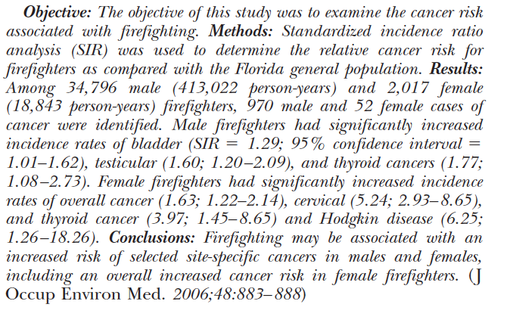
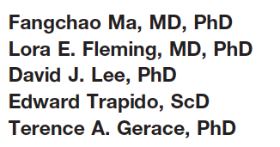
Objective of this study was to update a previous firefighter linkage initiated 15 years ago

Slide 3
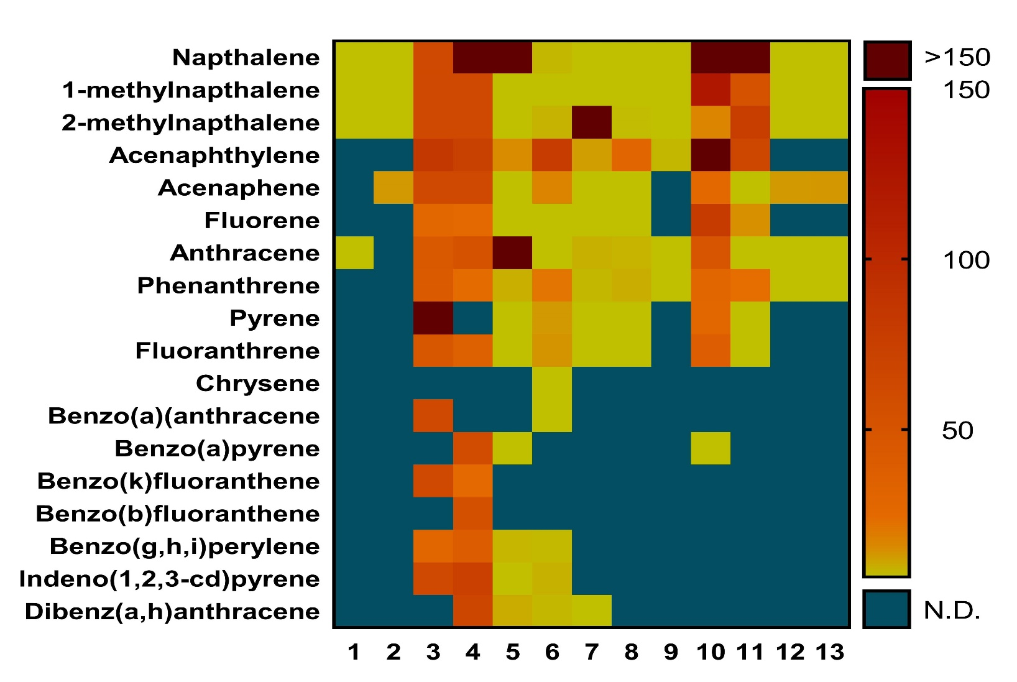
Firefighters are exposed to numerous carcinogens via dermal, respiratory and ingestion routes
OSHA guidelines Permissible exposure limit (PEL)
PAHs 35.4 ppb
PAHs in water 0.2 ppb (EPA)

Slide 4
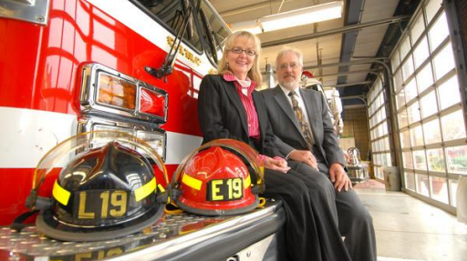
The first comprehensive review of firefighter risk was published in 2006 by LeMasters and colleagues
Cancers “probably elevated” in firefighters include:
Multiple myeloma
Non-Hodgkin’s lymphoma
Prostate cancer
Testicular cancer
J Occupat Environ Med 2006; 48: 1189-1202
Notes:
Based on analysis of 32 studies; undertook a meta-analysis and a synthesis of results across study types to identify probable (4) and possible candidate cancers (7).

Slide 5
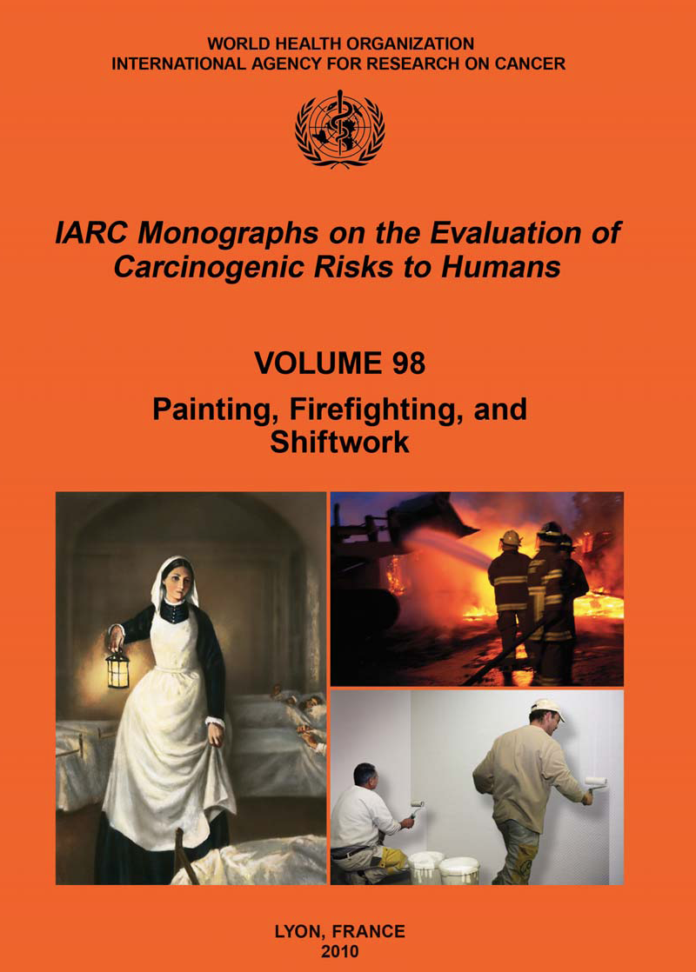
The second comprehensive review of firefighter risk was undertaken by IARC and released in 2010
Large variations in exposure across different types of fires and different groups of firefighters. RR’s consistently increased for:
testicular
prostate
non-Hodgkin’s lymphoma
https://monographs.iarc.fr/iarc-monographs-on-the-evaluation-of-carcinogenic-risks-to-humans-23/
Notes:
Based on analysis of 32 studies; undertook a meta-analysis and a synthesis of results across study types to identify probable (4) and possible candidate cancers (7).

Slide 6
The firefighter-associated cancer list expanded in 2019
Cancer Site | LeMasters et al Meta-Analysis 2006 | IARC Report 2010 | Jalilian et al Meta-Analysis 2019
Prostate | Probable | ✅ | Incidence
Testicular | Probable | ✅ | Incidence
Non-Hodgkin’s Lymphoma | Probable | ✅ | Mortality
Multiple Myeloma | Probable
Rectum | Possible |  | Incidence + Mortality
Colon | Possible |  | Incidence
Melanoma | Possible |  | Incidence
Thyroid |  |  | Incidence
Bladder |  |  | Incidence
Pleura |  |  | Incidence
Int J Cancer. 2019 Feb 8. doi: 10.1002/ijc.32199. [Epub ahead of print]
Notes:
Jalilian incidence data pulled from 29 studies representing over 30,000 mostly male firefighters; for mortality 26 studies with a maximum of 30,057 firefighters

Slide 7
Healthy worker influence on cancer studies has been underestimated
Cancer Site | SIR | 95% CI
All sites | 0.91 | 0.89-0.93
Prostate | 0.93 | 0.88-0.98
Thyroid | 0.78 | 0.60-1.00
Leukemia | 0.80 | 0.68-0.92
Major tobacco-associated cancers
Lung | 0.81 | 0.76-0.87
Larynx | 0.74 | 0.59-0.92
Esophagus | 0.60 | 0.46-0.78
Lip, oral cavity, pharynx | 0.81 | 0.72-0.92
Am J Epidemiol 2012;
177: 1218-24
Notes:
Created a randomly selected cohort of Norwegian workers hired between 1981 and 2003 (n =366,114)
The cohort was linked to the Cancer Registry of Norway, including all new cancer cases (n = 11,271) reported up to 2003.
Calculated standardized incidence ratios for this worker cohort using the entire Norwegian population as the comparison

Slide 8
Applied a case-control analytic approach previously utilized in the analysis of California registry data
Am J Indust Med 2007; 50: 339-344
Am J Indust Med 2015; 58: 715-729
Notes:
These were registry-based case–control studies in with other cancer cases are selected as controls. Selection of control cancers can be based on those for which you do not anticipate common risk factor exposures or you can treat all other other cancers other that the cancer of interest as controls.
By definition registry-based case–control studies must restrict their analyses to records with information on work history. This is needed to identify your exposure variable: firefighters vs. all other employed or previously employed.
One potential advantage to this approach is that it may help to partially mitigate the healthy worker effect since you are comparing firefighters to those who are either currently employed or was previously in the workforce.
Initial attempt was to select neutral cancers identified in the Jallian meta-analysis for the male analysis: pharynx, stomach, liver, and pancreas

Slide 9
Occupational information in the cancer registry record is not missing at random
PLoS ONE 14(4): e0215867. https:// doi.org/10.1371/journal.pone.0215867

Slide 10
Firefighter occupation is more likely to be correctly classified if male, <65 yrs & more recently diagnosed
PLoS ONE 14(4): e0215867. https:// doi.org/10.1371/journal.pone.0215867

Slide 11
Firefighter occupation is more likely to be correctly classified if male, <65 yrs & more recently diagnosed
PLoS ONE 14(4): e0215867. https:// doi.org/10.1371/journal.pone.0215867
Notes:
Restricting to records with work history may lead to bias so we took the female approach.

Slide 12
Newly available fastLink software was used to undertake a probabilistic record linkage
Computationally faster
Reproducible
Provides estimates of linkage quality (‘confusion tables’)
Sensitivity=98.9%
Specificity=100%
http://imai.princeton.edu/research/files/linkage.pdf

Slide 13
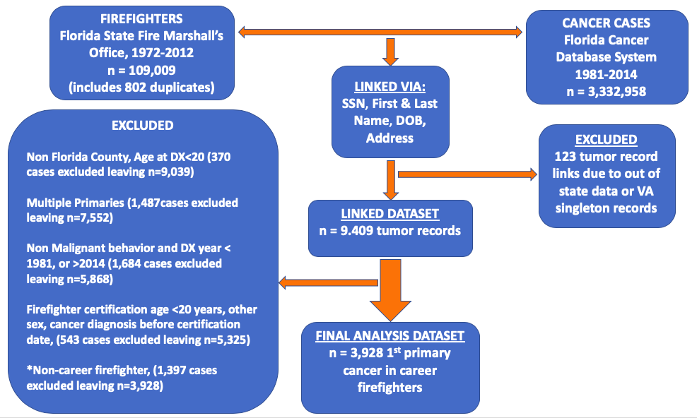
Linkage led to more than a tripling of the number of career firefighter cases available for analysis
N=3760
Male
cases
N=168
Female
cases

Slide 14
Calculated gender-specific age & calendar year adjusted odds ratios and 95% confidence intervals
Overall
<50 versus 50 and older (males only)
Late-stage versus early stage (males only)

Slide 15
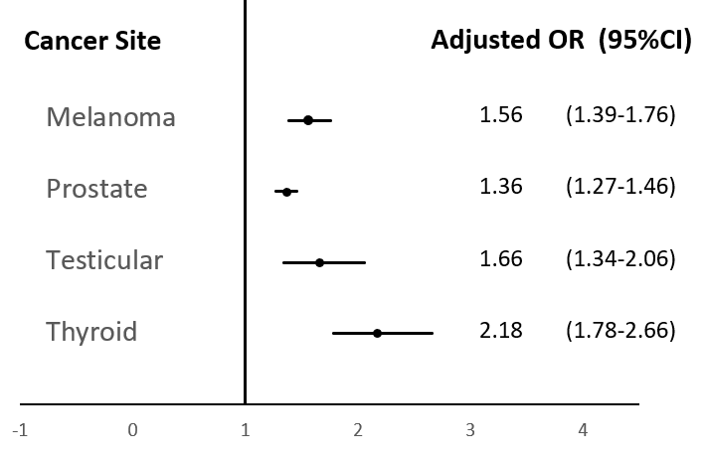
Overall Male: Elevated Sites

Slide 16
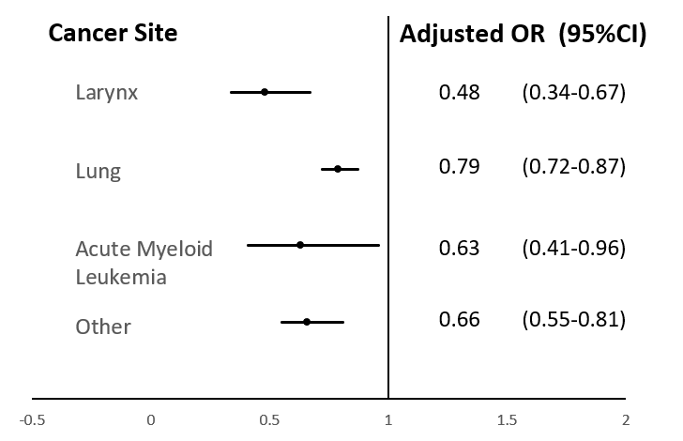
Overall Male: Reduced Risk Sites

Slide 17
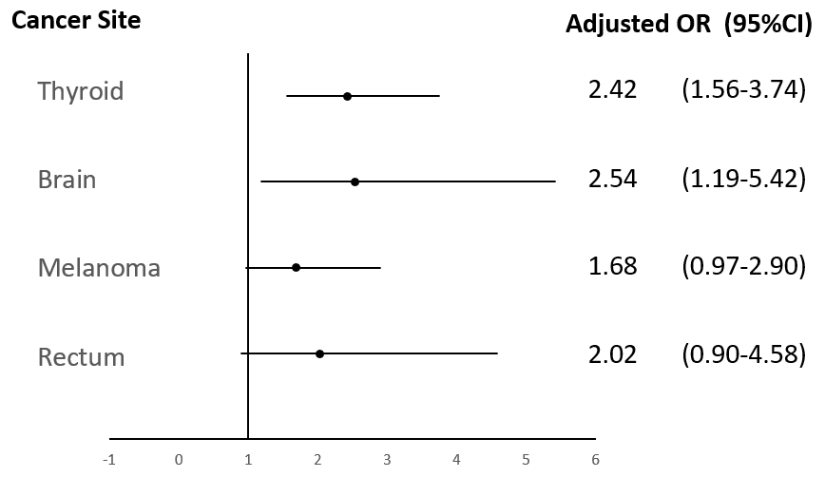
Overall Female: Elevated Sites

Slide 18
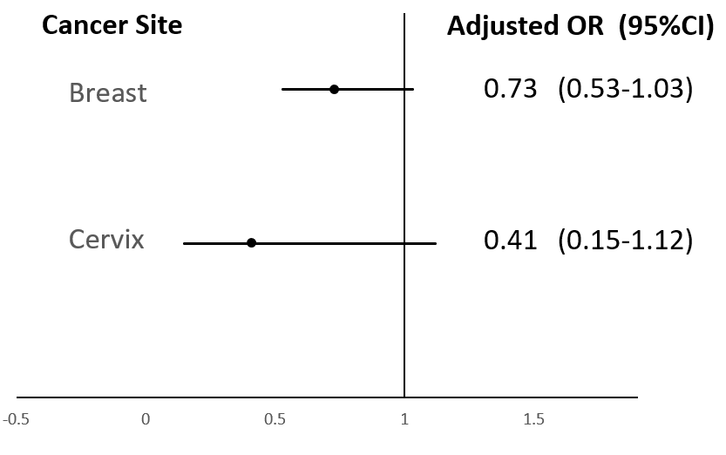
Overall Female: Reduced Risk Sites

Slide 19
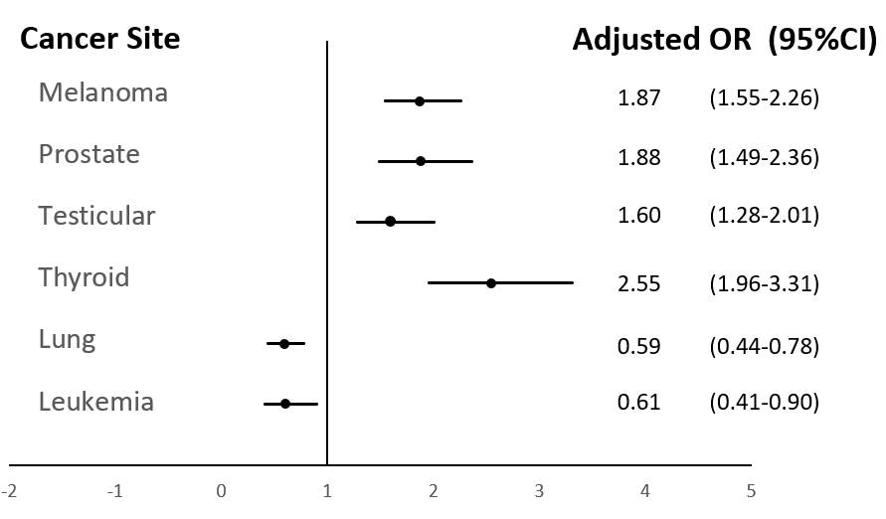
Males: <50 years

Slide 20
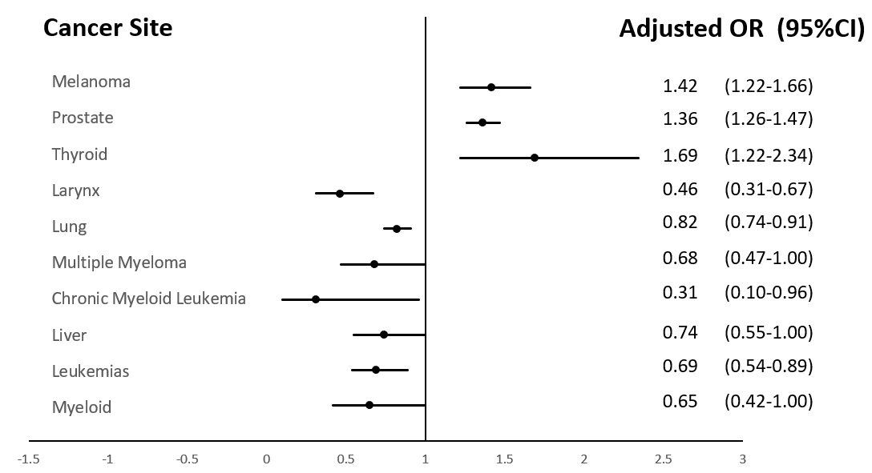
Males: =>50

Slide 21
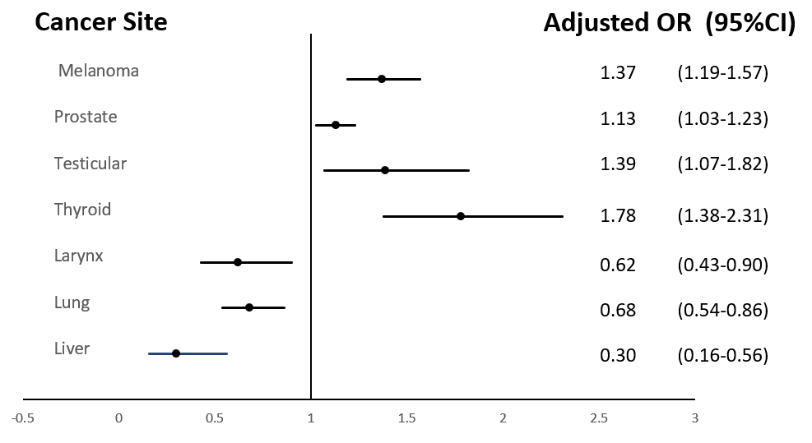
Males: Early Stage

Slide 22
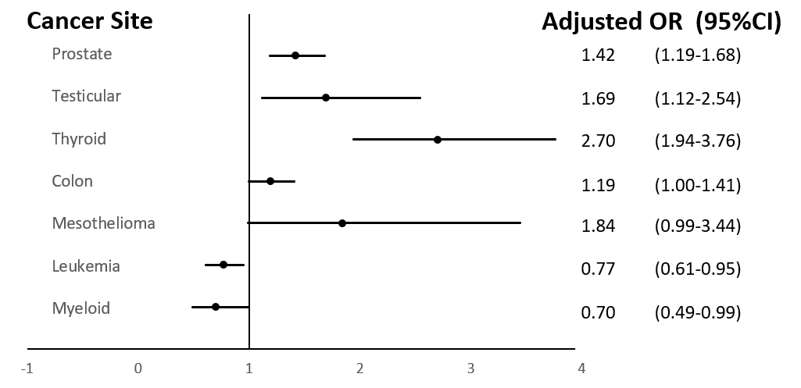
Males: Late Stage

Slide 23
Florida associations often stronger then those identified in the Jalilian meta-analysis
Cancer Site | Jalilian et al Meta-Analysis 2019 | Florida 1981-2014
Prostate | 1.15 [1.05-1.27] | 1.36 [1.27-1.46]
Testicular | 1.34 [1.08-1.68] | 1.66 [1.34-2.07]
Thyroid | 1.22 [1.01-1.48] | M 2.18 [1.78-2.66]; F: 2.42 [1.56-3.74]
Melanoma | 1.21 [1.02-1.45] | M: 1.56 [1.39-1.76]; F: 1.68 [0.97-2.90]
Rectum | 1.09 [1.00-1.20] | M: 0.97 [0.80-1.17] F: 2.02 [0.90-4.58]
Colon | 1.14 [1.06-1.21] | Male Late Stage: 1.19 [1.00-1.41]
Bladder | 1.12 [1.04-1.21]
Pleura | 1.60 [1.09-2.34] | Male late stage: 1.84 [0.99-3.44]
Brain | 1.07 [0.87-1.33] | Females: 2.54 [1.19-5.42]

Slide 24
Next steps
Cancer mortality analyses are underway
Will study the smaller number of volunteer firefighters
Will also study multiple primaries in career firefighters
Also interested in examining the influence of tobacco policy on lower tobacco-associated cancer risk in Florida firefighters

Slide 25
Thank you

