Slide 1
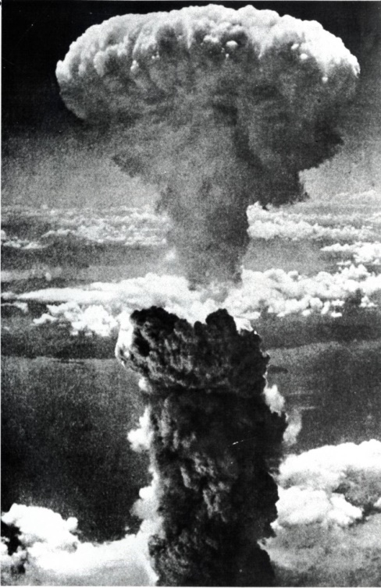

Radiation Risk of colorectal cancer among atomic bomb survivors: 1958-2009
*Hiromi Sugiyama¹, Munechika Misumi¹, Alina Brenner¹
Eric J Grant¹, Ritsu Sakata¹, Dale Preston², Atsuko Sadakane¹, Mai Utada¹, Kiyohiko Mabuchi³,Kotaro Ozasa¹
¹Radiation Effects Research Foundation, ²Hirosoft International Corporation,
³U.S. National Cancer Institute
NAACCR / IACR Combined Annual Conference June 9-13, 2019 Vancouver
Notes:
Thank you, Dr Greek. Good morning everyone. Today, I’m very happy to be able to talk to you.
I am Hiromi Sugiyama of Radiation Effect Research Foundation (RERF). I am studying radiation epidemiology among atomic bomb survivors and those who were exposed in utero. Also I am responsible for managing the operation of Hiroshima Cancer Registry which has a contract with our research foundation.
I’d like to talk about the radiation risk of colorectal cancer among atomic bomb survivors.
In August 1945, two atomic bombs were dropped in Hiroshima and Nagasaki, Japan. Radiation Effects Research Foundation (RERF) has followed up the atomic bomb survivors to evaluate radiation risk for health outcomes over almost 70 years.

Slide 2
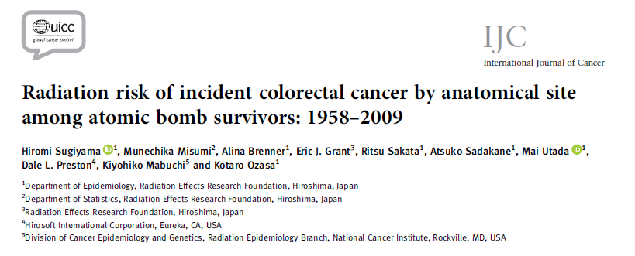
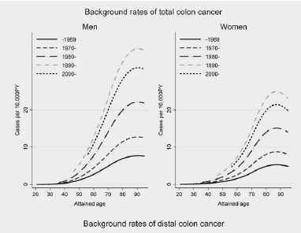
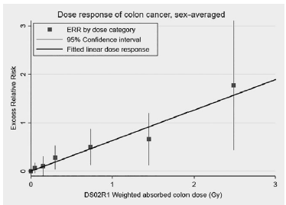
Int J Cancer. 2019 Mar 15. doi: 10.1002/ijc.32275. [Epub ahead of print]
Notes:
First of all, I am pleased to inform you that our paper of this study was published last March in the International Journal of Cancer.
OK, let’s move on to my talk,

Slide 3
Background:
Risk factors of colorectal cancer
  Ionizing radiation: A-bomb survivors, nuclear
  workers, and patients who have received radiotherapy
  Lifestyle: smoking, diet consumption (alcohol, fat, and meat, etc)
  Anthropometric factors:
  obesity, body mass index (BMI)
  Other: race, certain disease
Notes:
Several risk factors of colorectal cancer have been reported.
Radiation effects on colon cancer were reported among A-bomb survivors, nuclear workers, and patients who have received radiotherapy.
Among the atomic bomb survivors, RERF has reported evidence of radiation risk of colon cancer, but not for rectal cancer in previous studies.
By many epidemiological studies, lifestyle factors like smoking status, alcohol, fat and meat intake, obesity, BMI, race and certain diseases have been reported as risk factors of colorectal cancer. However, RERF has not adjusted for these factors to estimate radiation risk of colorectal cancer in the past.

Slide 4

Colorectal cancer: Anatomical site
Proximal colon
Diet (fat, red meat)
Type2 diabetes
Obesity
Hereditary disease
Microsatellite instability (MSI-high)
Distal colon & rectum
- Smoking
- Diet (red meat)
- Chromosomal
instability- high
Proximal colon
Distal colon
Rectum
Notes:
Also these risk factors have been reported to have different effects by anatomical site, such as for proximal colon and distal colon separately, as shown in this slide.
(For proximal colon cancer, high intake of fat and red meat, Type 2 diabetes, obesity, and hereditary disease are risk factors. Microsatellite instability-high colon cancer occurs in proximal colon more frequently than distal colon.
Conversely, lifestyle factors such as smoking and red meat intake are related to distal colon cancer more strongly than proximal colon cancer. Chromosomal instability–high are thought to be related to the development of polyp type cancer more frequently in distal colon than in proximal colon.)

Slide 5
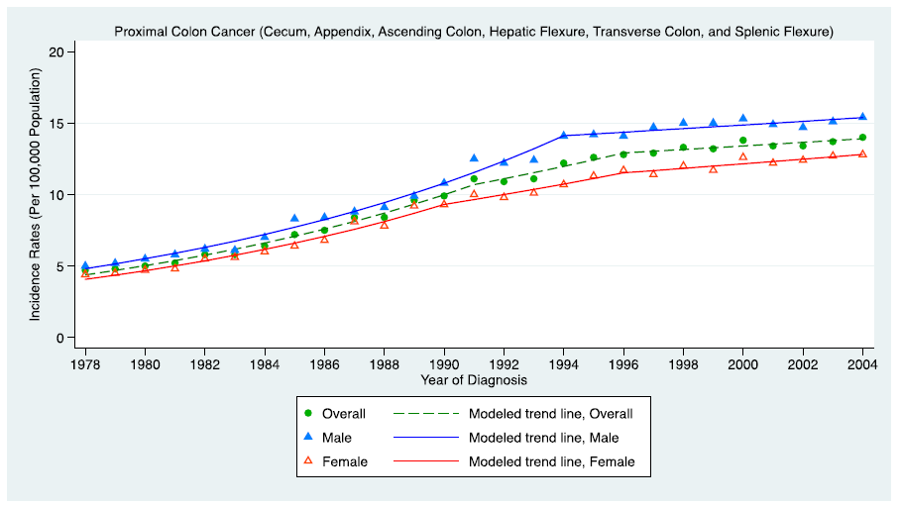
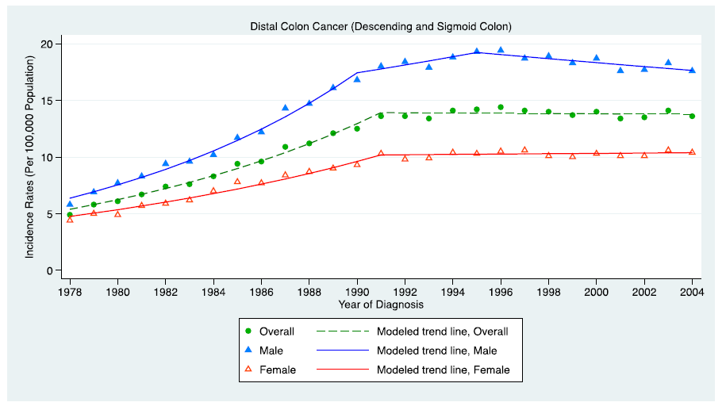
Trend of colon cancer incidence by site in Japan
Proximal colon
Colonoscopy
Increasing fat
& alcohol intake
Distal colon
Screening
Polypectomy
H Nakagawa, H Ito, and S Hosono, at al. Eur J Cancer Prev. 2017;26(4):269-276
Notes:
Here, these figures show the time trend of incidence rates for proximal colon and distal colon cancer based on the Japanese cancer registries data. The incidence rates for both proximal and distal colon cancer increased from 1978 until 1990s, when the increasing trend for proximal colon stopped, while the rates for distal colon cancer started to decrease. (*) Increasing fat and alcohol intake are thought to contribute to the increasing trend. (*) Colorectal cancer screening started in 1992, and (*) colonoscopy and polypectomy techniques have been used widely since around 1990.

Slide 6
Aim
To evaluate radiation risk for colorectal cancer by anatomical site with adjustment for lifestyle factors and body mass index (BMI) among atomic bomb survivors
Notes:
(*) The aim of this study was to evaluate radiation risk of colorectal cancer by anatomical site with adjustment for lifestyle factors and BMI among atomic bomb survivors.
In the next few slides, I’ll introduce our cohort and methods of this study

Slide 7
Subjects : Life Span Study（LSS）
  LSS : 120,123 subjects selected by 1950 National Census
  →Subjects: N=105,444, Alive and cancer free as of 1958
Number of the subjects by age at exposure
Number of the alive subjects by age (2009)
Men
Women
Men
Women
37.6％ were alive.
Notes:
RERF has followed up 120,123 Life Span Study cohort members comprising atomic bomb survivors and controls. Essentially, they were selected based on the 1950 National Census.
(*) Eligible subjects for this analysis were 105,444 members, who were alive and cancer free as of 1958 when the Hiroshima and Nagasaki Cancer registries were initiated.
(*) This population pyramid shows the number of subjects by age at exposure group.
The proportion of subjects who were exposed at younger ages was large. On the other hand, the proportion of men aged 20-39 years old at the time of bombing was small, because many young men went to war.
(*) As of 2009, 37.6% of subjects were still alive.

Slide 8
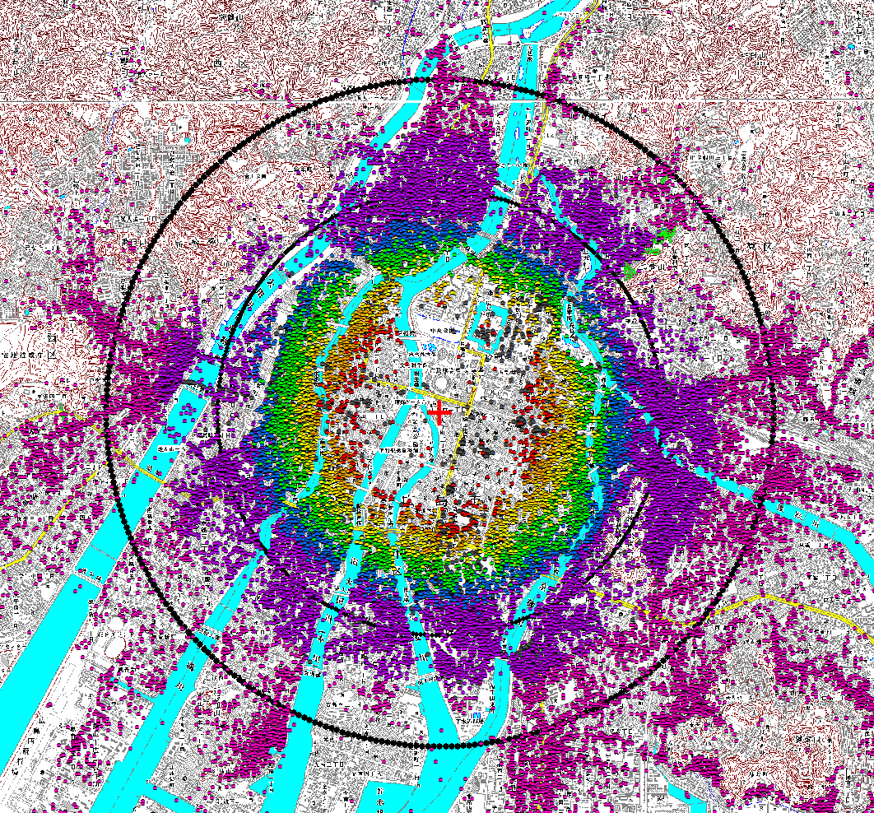
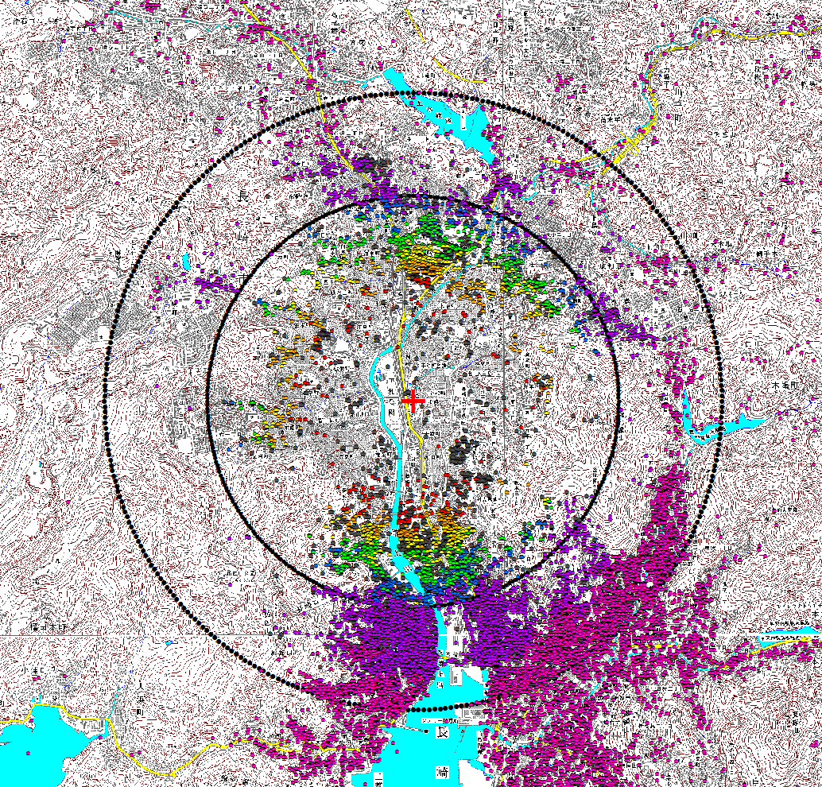
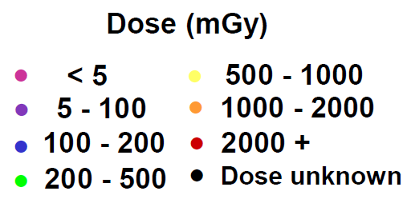
Radiation estimates: DS02R1
Hiroshima survivors location
Nagasaki survivors location
Figure 24. Revised survivor locations in Hiroshima. Map: Digital Map 25000, Geographical Survey Institute of Japan, 2002. Circles of black dots at 2 and 3 km from hypocenter.
Figure 25. Revised survivor locations in Nagasaki. Map: Digital Map 25000,
Geographical Survey Institute of Japan, 2002.
Circles of black dots at 2 and 3 km from hypocenter.
Cullings, et al. Health Physics, 2016,
  Weighted absorbed colon or bladder dose
  Those who were not estimated radiation dose were excluded.
Notes:
RERF has estimated the radiation dose for each subject using Dosimetry System 2002 revision 1, or DS02R1, which takes into account their exact location and shielding history. These figures show each survivor’s location at the time of the atomic bombings in Hiroshima and Nagasaki, with red crosses showing the hypocenters.
For this analysis, we used weighted absorbed colon dose and bladder dose. Those with unknown radiation dose were excluded from the analysis.

Slide 9
Follow-up, outcomes, and Lifestyle
  Follow-up: 1958-2009
  Outcomes: First primary colorectal cancer.
              Proximal colon
              Distal colon
              Rectum
              Mucosal cancers were excluded.
              Ascertained from Hiroshima and Nagasaki Cancer Registries.
  Lifestyle: Mail surveys and interviews (1963-1991)
Notes:
The follow-up period was from 1958 to 2009. Outcomes of interest were first primary colorectal cancers by anatomical subsite. Cases were ascertained from Hiroshima and Nagasaki Cancer Registries. Lifestyle data were obtained from periodic mail surveys and interviews.

Slide 10
Statistical analysis
Poisson regression :
Excess Relative Risk (ERR)
λ＝λ₀(c, s, cy, a, nic, sk, uksk, alc, ukal, bmi, m)[1+ρ(d)ε(s, a, e, cy)]
ρ(.): dose-response function
ε(.): effect modification
  c: city, s: sex, cy: calendar year, a: sex-specific attained age trend, age at exposure, nic: indicator of residents who were in the neither city of Hiroshima nor Nagasaki at the time of bombing, sk: smoking (pack-years at age 70, time dependent variable), uksk: unknown smoking status, alc: alcohol (drink/day), ukal: unknown alcohol information, bmi: BMI (unknown, <18.5, 18.5-25, 25+), m: frequency of meat consumption (unknown, no or less than once a week, 2-4 days a week, almost everyday)
Radiation Relative Risk
λ₀: Background rate
Radiation ERR
Notes:
We used Poisson regression to estimate the expected incidence rate and excess relative risk (ERR). λ is the expected incidence rate, λ0 describes the background rate, which is the incidence rate for those with no radiation exposure. The background rate was modeled with adjustment for city, sex, calendar year, whether the subjects were in the city or not at the time of bombing, smoking intensity, amount of alcohol intake, BMI, and frequency of meat consumption.
Here, this part shows the relative risk and this part shows the radiation-associated ERR which means “relative risk minus 1”.
We modeled the radiation ERR using a radiation dose-response function and effect modifications such as sex, attained age, age at exposure, and calendar year.
Ok, I’d like to move on to the results.

Slide 11
Results:
Number of incident cases and crude rate
 | Subject | Person-years | Colon |  |  |  |  |  | Rectum
DS02R1 dose
 |  |  | Total |  | Proximal |  | Distal
 |  |  | N | Rate | N | Rate | N | Rate | N | Rate
NIC | 25,239 | 761,612 | 475 | 6.2 | 214 | 2.8 | 227 | 3.0 | 239 | 3.1
Distal survivors | 23,165 | 667,754 | 380 | 5.7 | 170 | 2.5 | 180 | 2.7 | 230 | 3.4
<0.005 | 12,813 | 364,820 | 235 | 6.4 | 114 | 3.1 | 101 | 2.8 | 126 | 3.5
-0.1 | 27,511 | 807,891 | 467 | 5.8 | 213 | 2.6 | 215 | 2.7 | 285 | 3.5
-0.2 | 5,594 | 164,117 | 112 | 6.8 | 61 | 3.7 | 43 | 2.6 | 49 | 3.0
-0.5 | 5,926 | 169,182 | 115 | 6.8 | 54 | 3.2 | 51 | 3.0 | 58 | 3.4
-1 | 3,136 | 88,997 | 71 | 8.0 | 43 | 4.8 | 25 | 2.8 | 38 | 4.3
-2 | 1,565 | 42,240 | 41 | 9.7 | 19 | 4.5 | 19 | 4.5 | 17 | 4.0
2+ | 495 | 12,956 | 18 | 13.9 | 6 | 4.6 | 10 | 7.7 | 4 | 3.1
Total | 105,444 | 3,079,570 | 1,914 | 6.2 | 894 | 2.9 | 871 | 2.8 | 1,046 | 3.4
?
DS02R1 Radiation dose category by absorbed colon dose for colon and bladder dose for rectum. Rate: /10,000 person-years
Notes:
The number of subjects, person years and cases by radiation dose category are shown in this table. We observed 1,914 total colon cancer cases and 1,046 rectal cancer cases.
Proximal and distal colon cancers were almost half and half among colon cancer cases.
The crude rates by dose category for total colon, proximal colon, and distal colon cancer all show (*) increasing trends with radiation dose, whereas (*) the crude rate for rectal cancer seems to be stable.

Slide 12
Background rates of proximal colon cancer
1990-
2000-
1980-
H Nakagawa, at al. Eur J Cancer Prev. 2017;26(4):269-276
1970-
-1969
Notes:
These figures show the background rate for proximal colon cancer.
The x-axis indicates attained age, with men on the left and women on the right.
(*) The background rate for proximal colon cancer increased, (*) then the increasing trend stopped, (*) which is consistent with the time trend of the incidence rate in Japan.

Slide 13
Background rates of distal colon cancer
1990-
2000-
H Nakagawa, at al. Eur J Cancer Prev. 2017;26(4):269-276
1980-
1970-
-1969
Notes:
(*) The background rate for distal colon cancer increased until 1990s, then the increasing trend stopped, then started to decrease, as we saw (*) in the population-based result.

Slide 14
Background rates of rectal colon cancer
1990-
2000-
1980-
1970-
-1969
Notes:
(*) Rectal cancers showed a similar trend to distal colon cancer.
Alright, In the next slide, I’ll show which factors were associated with background rates of colorectal cancer in the LSS.

Slide 15
Colorectal cancer and lifestyle & BMI
 |  | Colon |  |  | Rectum
 |  | Total colon | Proximal | Distal
Lifestyle and BMI |  | Relative Risk (95% CI) | Relative Risk (95% CI) | Relative Risk (95% CI) | Relative Risk (95% CI)
Smoking | Pack-years at age 70 | 1.28 | 1.11 | 1.33 | 1.04
 |  | (1.10; 1.48) | (0.89; 1.39) | (1.08; 1.64) | (0.85; 1.29)
Alcohol | Amount, drink/day | 1.06 | 1.04 | 1.08 | 1.08
 |  | (1.02; 1.10) | (0.98; 1.10) | (1.03; 1.14) | (1.03; 1.14)
BMI | <18.5 | 0.83 | 0.73 | 0.97 | 1.00
(kg/m²) |  | (0.69; 0.99) | (0.55; 0.96) | (0.75; 1.25) | (0.79; 1.26)
 | 18.5-25 | Ref. | Ref. | Ref. | Ref.
 | >=25 | 1.21 | 1.28 | 1.20 | 1.08
 |  | (1.05;1.39) | (1.05; 1.56) | (0.97; 1.48) | (0.83; 1.3)
Meat | None or less than 1 day/week | 1.04 | 0.98 | 1.08 | 0.97
 |  | (0.90;1.19) | (0.80; 1.20) | (0.87; 1.34) | (0.79; 1.20)
 | 2-4 days/week | Ref. | Ref. | Ref. | Ref.
 | Almost everyday | 0.98 | 0.93 | 1.06 | 1.05
 |  | (0.83; 1.16) | (0.73; 1.17) | (0.83; 1.35) | (0.83; 1.32)
Notes:
(The associations of lifestyle factors and BMI with the overall background rate and by anatomical site are shown in this table. )
Smoking, drinking, and BMI were associated with the background rate of colon cancer as a whole. By subsite, BMI was associated with proximal colon cancer.
(while smoking and alcohol were not.)
On the other hand, smoking intensity and amount of drinking both showed associations with distal colon cancer. Only alcohol intake was associated with rectal cancer
(, but smoking and BMI were not.)
Frequency of meat consumption did not show any association with proximal, distal or rectal cancer.

Slide 16
Dose-response of radiation risk (total colon)
ERR/Gy = 0.63
ERR at attained age 70 exposed at age 30, with adjustment for lifestyle factors and BMI
Notes:
We found a significant linear radiation dose response for total colon cancer.
(Y axis indicates ERR and X axis indicates DS02R1 weighted absorbed colon dose.)
The sex averaged ERR/Gy at attained age 70 exposed at age 30 was estimated (*) to be 0.63.

Slide 17
Radiation ERR/Gy estimates by site
-ERR/Gy at age 70 (year 1985) with exposure at age 30, adjustment for lifestyle and BMI-
0.80
Difference of ERRs b/w proximal and distal
= 0.30
95%CI [-0.67, 1.01]
0.63
0.50
0.025
Notes:
(Comparison of radiation ERRs/Gy by sex and subsite are shown here. )
Although several lifestyle factors were associated with background rates of colorectal cancer, the radiation-associated ERRs did not change regardless of adjustment for lifestyle factors and BMI. The ERR estimates shown here were adjusted for lifestyle and BMI.
The blue points show the ERRs for men, red for women, and green for sex-averaged.
The sex-averaged ERR/Gy for total colon cancer was (*) 0.63, for proximal colon was (*) 0.80, and for distal colon was (*) 0.50. The ERR for proximal colon cancer seemed to be higher than that for distal colon cancer, however (*) this difference was not statistically significant. (*) The ERR/Gy for rectal cancer was not elevated.

Slide 18
Radiation ERRs by site of colorectal cancer
(exposed at 30 & attained age at 70 = calendar year 1985,
linear dose-response with adjustment for lifestyle and BMI）
Cancer sites | ERR/Gy (95%CI） | Effect modifiers (95%CI)
 | Sex-averaged | F:M ratio | Age at exposure^{b）} | Attained age (power) | Calendar year^{ｃ）}
Total colon^{e)} | 0.63 | 0.65 | 24% | -3.63
 | (0.34; 0.98) | (0.24; 1.48) | (-16%; 82%) | (-6.17; -1.14)
Proximal colon^{e)} | 0.80 | 0.64 | -6.0% | -2.10
 | (0.32; 1.44) | (0.17; 1.77) | (-44%; 47%) | (-5.27; 2.54)
Distal colon^{f)} | 0.50 | 0.37 | -32% |  | -65%
 | (0.04; 0.97) ^{w} | (0.08; 1.78) ^{w} | (-62%; 14%) |  | (-83%; -35%)
Rectum^{e)} | 0.025 | 3.63 | -81% | 4.1
 | (-0.087; 0.14) ^{w} | (0.28; 47.71) ^{w} | (-98%; 57%) ^{w} | (-6.76; 14.99) ^{w}
a)Confidence intervals (CI) were likelihood bound or Wald type (w). b) Coefficient of age at exposure means the percentage change per decade increase in age at exposure (common to males and females). c) Coefficient of calendar year means the percentage change per decade increase in calendar year (common to males and females). e) ERR/Gy shows at age 70 years old after exposure at age 30 years old. f) ERR/Gy shows in 1985 after exposure at age 30 years old.
Notes:
Sex-averaged ERRs and effect modification by site are shown here. The ERR for total colon cancer decreased with increasing attained age. The ERR for proximal colon cancer was not modified by any factors, whereas the ERR for distal colon cancer was attenuated with increasing calendar year.

Slide 19
Summary 1
2,960 first colorectal cancer cases
Association between
  Proximal colon cancer & high BMI
  Distal colon cancer & smoking and alcohol intake
  Rectal cancer & alcohol intake
Radiation effects on both proximal and distal
colon cancers elevated but not for rectal cancer, even after adjusting for lifestyle factors and BMI.
Notes:
In summary,
We observed 2,960 first colorectal cancer cases among the LSS cohort members.
Proximal colon cancer was associated with high BMI.
Distal colon cancer was associated with smoking and alcohol intake.
Rectal cancer was associated with alcohol intake.
Radiation effects on both proximal and distal colon cancers were elevated, but not for rectal cancer, even after adjusting for lifestyle factors and BMI.

Slide 20
Summary 2
The radiation risk of proximal seemed to be higher than that of distal colon cancer, but they were not significantly different from each other.
The radiation risk of proximal persisted over the period, whereas that of distal colon cancer was attenuated with time.
Notes:
The radiation risk of proximal appeared higher than that of distal colon cancer.
Although we found that associations with lifestyle factors varied by anatomical subsite, the difference of ERRs between proximal and distal was not significant.
The radiation risk of proximal colon cancer persisted, whereas the ERR for distal colon cancer was attenuated with time. In other word, the risk after 1990 was no longer significant.
Further follow-up is necessary to interpret the differences in radiation effects among proximal colon, distal colon, and rectal cancer.

Slide 21
Acknowledgment
All authors appreciate
All LSS members who has contributed to our study
Hiroshima and Nagasaki Cancer Registries
All RERF Staff
The Radiation Effects Research Foundation (RERF), Hiroshima and Nagasaki, Japan is a public interest incorporated foundation funded by the Japanese Ministry of Health, Labour and Welfare (MHLW) and the US Department of Energy (DOE). The research was also funded in part through DOE award DE-HS0000031 to the National Academy of Sciences and contract HHSN261201400009C through the U.S. National Cancer Institute (NCI), with additional support from the Division of Cancer Epidemiology and Genetics in the NCI Intramural Research Program. This publication was supported by RERF Research Protocol 1–75 and 18–61. The views of the authors do not necessarily reflect those of the two governments.
Notes:
All authors appreciate all LSS members who have contributed to our study, and the Hiroshima and Nagasaki Cancer Registries which allow us to use the cancer incidence data. All RERF general staff and their effort on this work are appreciated.

Slide 22
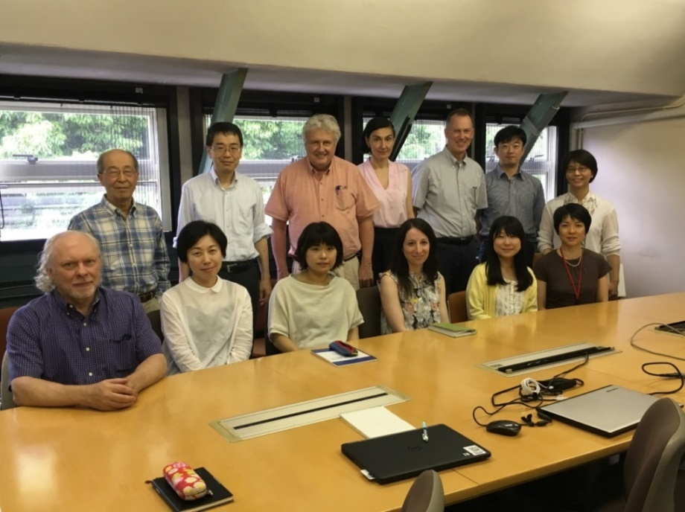
Collaborators
Munechika Misumi (RERF, Statistics)
Alina Brenner, Kotaro Ozasa, Ritsu Sakata,
Atsuko Sadakane, Mai Utada (RERF, Epidemiology)
Eric Grant, associate chief scientist of RERF
Kiyohiko Mabuchi (US National Cancer institute)
Dale Preston
(Hirosoft International)
Thank you for
your attention
Notes:
Here are my collaborators. Thank you for your attention.

