Slide 1
U.S. Cancer Statistics Public Use Database Annual percent change of screening-amenable cancers by state, United States, 2012-2016
Reda Wilson, MPH, CTR
NAACCR Annual Conference
Senior Epidemiologist
11 June 2019
Notes:
I’m presenting today for Mary Elizabeth O’Neil who wasn’t able to attend this year’s conference. For those not familiar with the US Cancer Statistics Public Use Database, I’d like to give you a brief background.

Slide 2
Federally Funded Cancer Registries
NCI’s Surveillance, Epidemiology
and End Results Program
CDC’s National Program of
Cancer Registries
Notes:
Invasive cancer is a reportable disease in the United States. By law, physicians, laboratories, and hospitals are required to report diagnosed cases to their state’s central cancer registry.
Two federal programs provide funding to central cancer registries, the National Cancer Institute’s SEER Program – which was established in 1973 – and CDC’s National Program of Cancer Registries (or NPCR) which was established in 1992 with funding provided two years later.

Slide 3
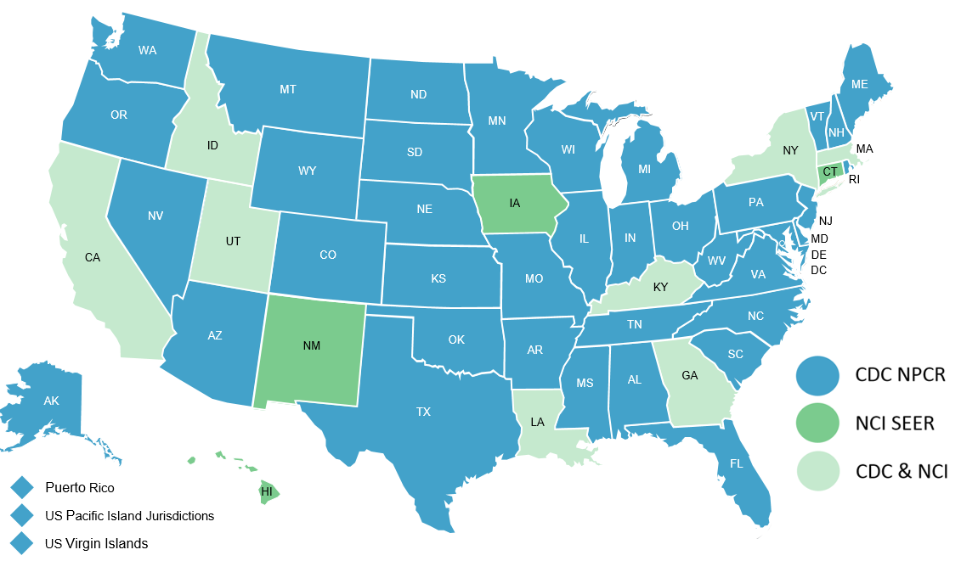
Federally Funded Cancer Registries
Central Cancer Registries Submitting Data to CDC and/or SEER in November 2018
Seattle-Puget Sound
Notes:
Together, data from these 2 programs provide cancer information on 100% of the U.S. population.
This map shows the states and territories that are funded through CDC’s NPCR Program in blue, NCI’s sites are in dark green, and the states who receive funding from both programs are in the lighter green.

Slide 4
Notes:
The combined data from both programs provide the official federal cancer statistics. These data are referred to as “U.S. Cancer Statistics” or USCS.

Slide 5
U.S. Cancer Statistics
Official Federal Cancer Statistics
www.cdc.gov/uscs
Notes:
U.S. Cancer Statistics provides the latest cancer information on the entire U.S. population and are actual US rates rather than rates based on population subsets.
The data is available to researchers in a couple of ways, which are all accessible at the U.S. Cancer Statistics website shown here.

Slide 6
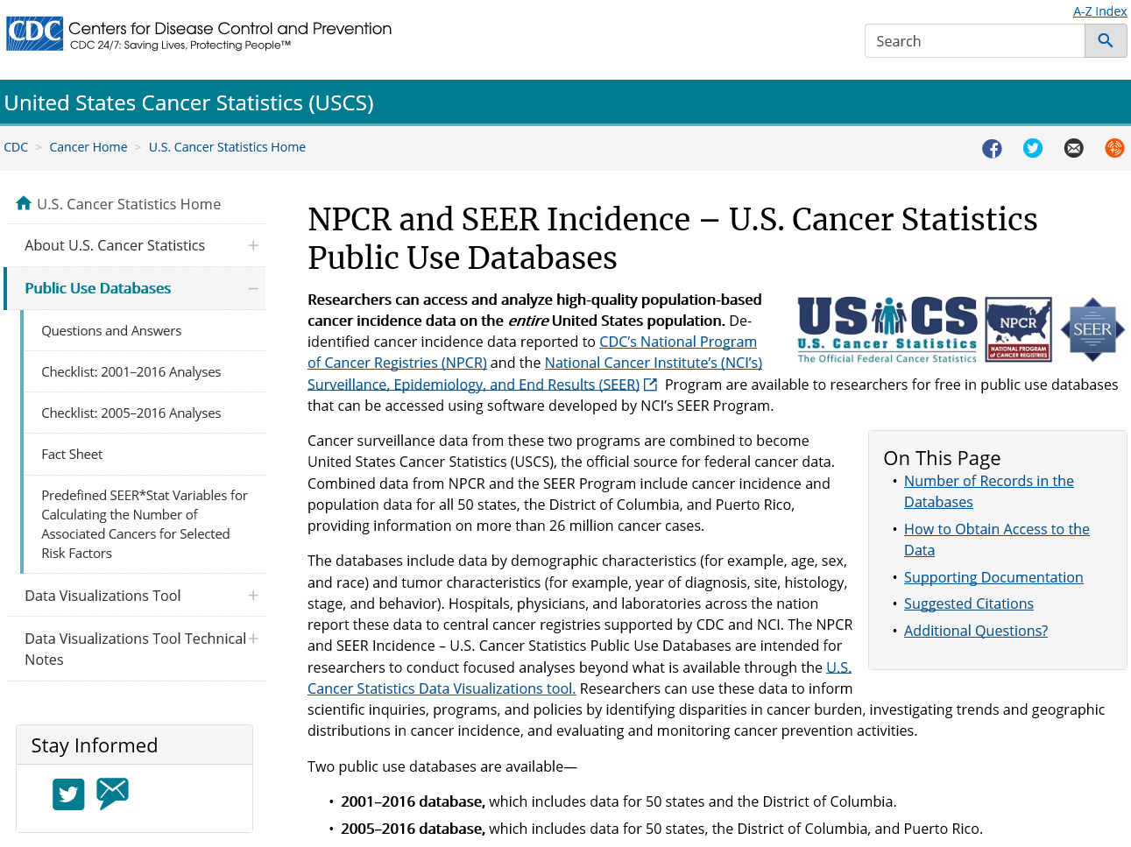
Accessing the data
U.S. Cancer Statistics Public Use Database
www.cdc.gov/cancer/public-use
Notes:
Just last week, we released the latest version of the U.S. Cancer Statistics public use databases, which are available at no cost to researchers.
Instructions on how to access the databases and supporting documentation, including a data dictionary, sample methodology text you can use in your manuscripts, and analysis checklists are at the url shown at the bottom of the slide: cdc.gov/cancer/public-use.

Slide 7
Data Coverage
U.S. Cancer Statistics Public Use Data
November 2018 submission | Number of Cases
2001–2016 database | 26.7 million
2005–2016 database | 20.9 million
Notes:
There are 2 databases, both with data that were submitted to either CDC or NCI in November 2018.
The database with cases diagnosed between 2001 and 2016 includes over 26 million cases from all 50 states and DC.
The 2005-2016 database additionally includes Puerto Rico’s data.

Slide 8
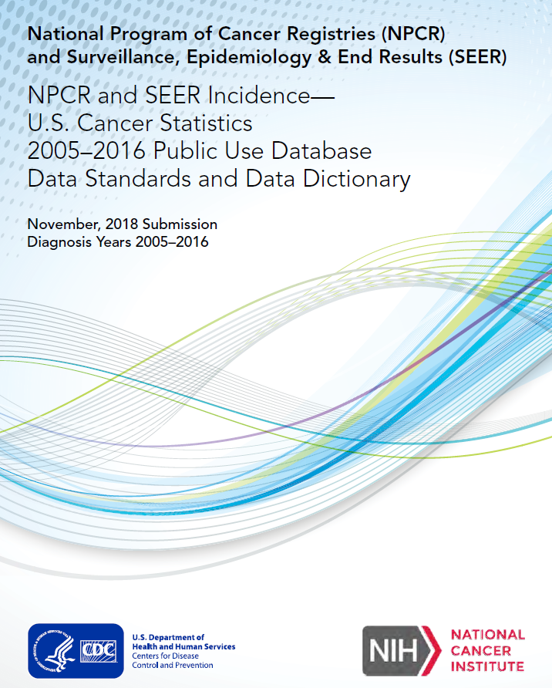
Data Items
U.S. Cancer Statistics Public Use Data
Demographics data
age, sex, race, ethnicity, state
Tumor identification
primary site, histology, grade, behavior, stage
Notes:
The databases provide researchers with de-identified demographic data, including age, sex, and state, and tumor identification data, such as site, histology, and behavior.
With over 26 million cases in the database and 16 years of data available, researchers can conduct scientific inquiries into rare cancers and look at cancer trends.

Slide 9
New variables this year
Surgery & Site Specific Factors
Brain WHO Grade Classification
CS SSF1, CNS excluded, diagnosis years 2011-2016
RX Summ – Surgery Primary Site
female breast
Estrogen Receptor (ER) Assay CS
CS SSF1, female breast, diagnosis years 2004-2016
Progesterone Receptor (PR) Assay
CS SSF2, female breast, diagnosis years 2004-2016
HER2: Summary Result
CS SSF15, female breast, diagnosis years 2010-2016
Notes:
This year, the databases includes 5 new data items limited to the diagnosis years shown here:
- WHO Grade Classification limited to the brain, Other CNS is not included
And 4 variables for female breast cancers:
surgery of primary site
ER, PR and HER2 status

Slide 10
Analysis – Annual percent change of screening-amenable cancers by state, United States, 2012-2016
Notes:
I’ll move to Mary Elizabeth’s analysis.

Slide 11
Screening-amenable cancers
Background
CDC supports the U.S. Preventive Services Task Force’s recommendations for screening
female breast,
cervical,
colorectal,
and lung cancers
Screening can detect asymptomatic cancers
Effective screening can lead to early detection and treatment
Cancer control planners can use trend data to identify needs and monitor progress.
Notes:
CDC supports the U.S. Preventive Services Task Force’s recommendations for screening for female breast, cervical, colorectal, and lung cancers.
Screening can detect cancers when they are asymptomatic. And effective screening can lead to early detection and treatment, thereby potentially reducing cancer-related morbidity and mortality.
Cancer control planners, including comprehensive cancer-control programs, can use screening trend data to identify populations that would benefit from interventions and to monitor the progress of screening programs.

Slide 12
Study objective
Analyze 5-year incidence trends
4 screening amenable cancers
Female breast
Cervical
Colorectal
Lung cancers
By central cancer registry
Using the Public Use Database
Notes:
The objective of this analysis was to analyze 5-year incidence trends of 4 screening amenable cancers – female breast, cervical, colorectal, and lung cancers – by central cancer registry using the Public Use Database.

Slide 13
Methods
Data source: U.S. Cancer Statistics public use database, Nov 2018 submission
Measure: Annual percent change of age-adjusted incidence rates over a 5-year period (2012-2016) by central cancer registry
Increased rate: APC>0 (P<0.05)
Decrease rate: APC<0 (P<0.05)
Otherwise, rates were considered stable
Notes:
The data source for this analysis was the latest U.S. Cancer Statistics public use database, with data submitted to NPCR and SEER in November 2018. We looked at the Annual percent change of age-adjusted incidence rates over a 5-year period by central cancer registry. The geographic coverage was 50 states and District of Columbia. The annual percent change was calculated using weighted least squares regression using the latest version of SEER*Stat [8.3.5]. Rates were considered to increase if APC>0 or to decrease if APC<0. Otherwise, rates were considered stable. APCs were considered statistically significant at p<0.05.

Slide 14
Cervical
Annual percent change of age-adjusted cervical incidence rates over a 5-year period by central cancer registry, United States, 2012-2016
Results
Notes:
For the majority of the states, the 5-year APCs of the age-adjusted incidence rates were stable for cervical cancers. Of the 51 states, 2 had a statistically significant increased APC, 4.3 and 9.9. [Range: 4.3 to 9.9]

Slide 15
Colorectal
Annual percent change of age-adjusted colorectal incidence rates over a 5-year period by central cancer registry, United States, 2012-2016
Results
Notes:
For colorectal cancers, the 5-year APCs of the age adjusted incidence rates were stable for the majority of states. Among 11 states, there was a statistically significant change. 10 states had a decreased APC while 1 had an increased APC of 3.6. [Range: -6.3 to 3.6]

Slide 16
Female breast
Annual percent change of age-adjusted female breast incidence rates over a 5-year period by central cancer registry, United States, 2012-2016
Results
Notes:
For female breast cancer there were 12 states with a statistically significant change. 8 states had an increased APC and 4 had a decreased APC. [Range: -6.4 to 3.6]

Slide 17
Lung
Annual percent change of age-adjusted lung incidence rates over a 5-year period by central cancer registry, United States, 2012-2016
Results
Notes:
All states, but one, had a decreased APC for lung and bronchus cancers over the 5-year period, 24 of which were statistically significant. These ranged from -1.0 to -10.5. The rates were essentially stable in the one state without a decrease in their APC.

Slide 18
Conclusions

Slide 19
Conclusions
Trends in the 4 screening-amenable cancers varied throughout the country.
Differences in incidence rate trends might be explained partially by variations in risk factors and partially by use of screening tests.
Community-based initiatives can reduce exposure to cancer risk factors, promote healthy behaviors, and improve adherence to clinical preventive services.
Population-based surveillance trend data can be used to monitor progress and target action.
Limitations – Stratification and JoinPoint analyses not performed.
www.cdc.gov/cancer/public-use
Notes:
Trends in the 4 screening-amenable cancers varied throughout the country over the 5-year period studied.
Differences in incidence rate trends might be explained partially by variations in risk factors and partially by use of screening tests. Community-based initiatives can reduce exposure to cancer risk factors over the life course, promote healthy behaviors, and improve adherence to appropriate clinical preventive services such as cancer screening. Population-based surveillance trend data – specifically, the U.S. Cancer Statistics public use database available at cdc.gov/cancer/public-use – can be used to monitor progress and target action. Two limitations of this analysis are that we did not stratify by various factors such as race or sex where appropriate and did not do a JoinPoint regression analysis. The stratification can be done using the PUD databases and trend data can be exported for JointPoint analyses.

Slide 20
U.S. Cancer Statistics
Official Federal Cancer Statistics
www.cdc.gov/uscs
Notes:
Again – here’s the URL for the U.S. Cancer Statistics landing page.
In addition to accessing the public use database here, you can find recent publications where CDC and extramural researchers have used the databases for their analyses.

Slide 21
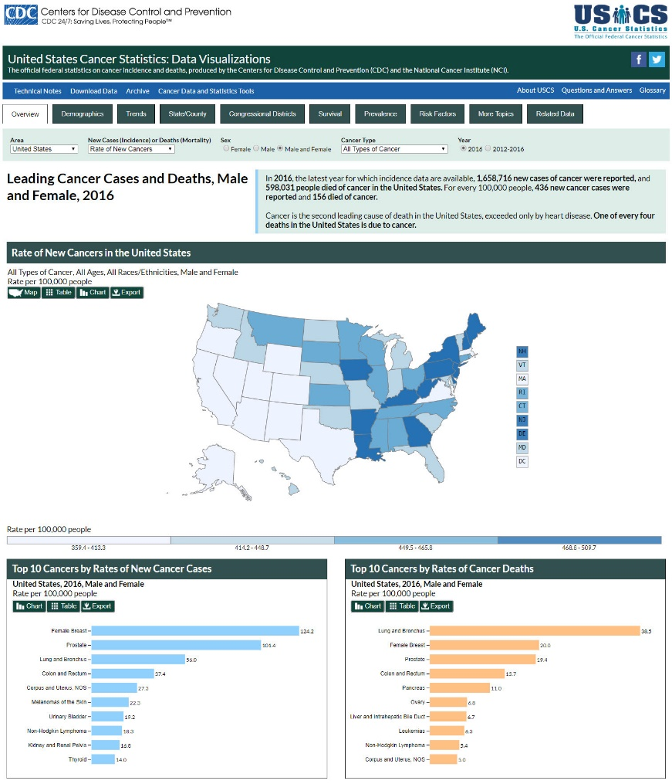
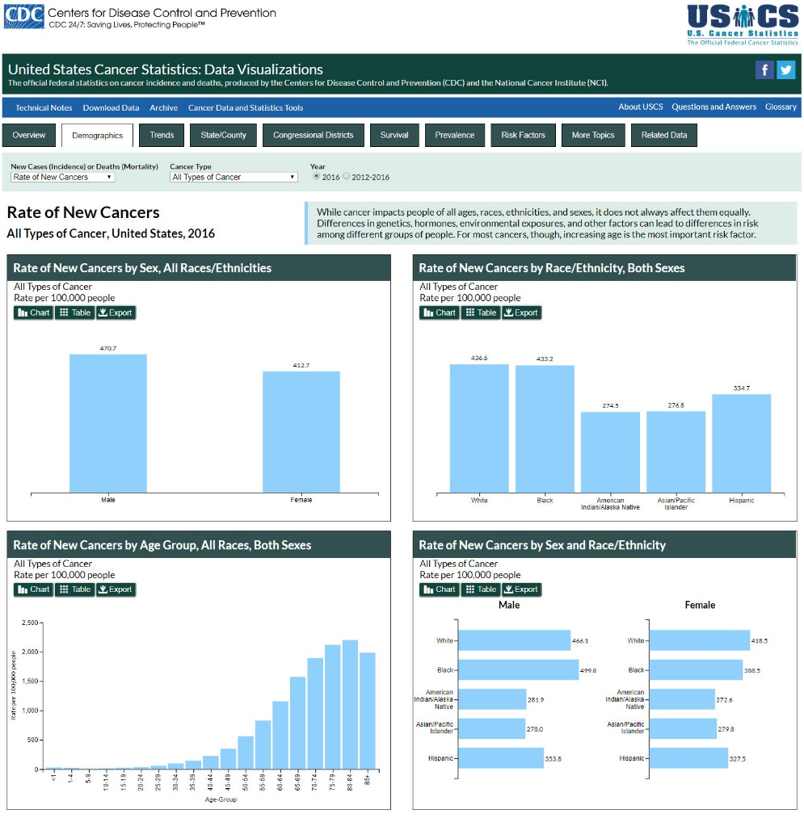
Data Visualizations Tool
U.S. Cancer Statistics
www.cdc.gov/uscs/dataviz
Notes:
And, I’ll leave you with a quick plug for our Data Visualizations tool, which is a quick and easy way to explore and use the latest U.S. Cancer Statistics data.
Last week, we updated the tool with the new November 2018-submission data and also released 2 new modules: the American Indian and Alaska Natives population data for IHS health service areas and incidence data for risk factor-associated cancers. If you’ve not already done so, stop by our booth in the Exhibit Hall and we’ll be glad to demonstrate the public use databases and USCS Data Visualization tool.

Slide 22
Acknowledgments

Slide 23
Authors
Mary Elizabeth O’Neil, MPH
Jane Henley, MSPH
Simple Singh, MD, MPH
Jessica King, MPH
Manxia Wu, MD, MPH
Vicki Benard, PhD
Notes:
I’d like to thank my co-authors, especially Mary Elizabeth who was the lead on this analysis.

