Slide 1
Lung cancer incidence rates in young women versus young men: A systematic analysis in 40 countries
Miranda fidler-benaoudia, Lindsey torre, Freddie bray, Jacques ferlay, ahmedin Jemal
NAACCR/IACR 2019 Conference – June 12, 2019

Slide 2
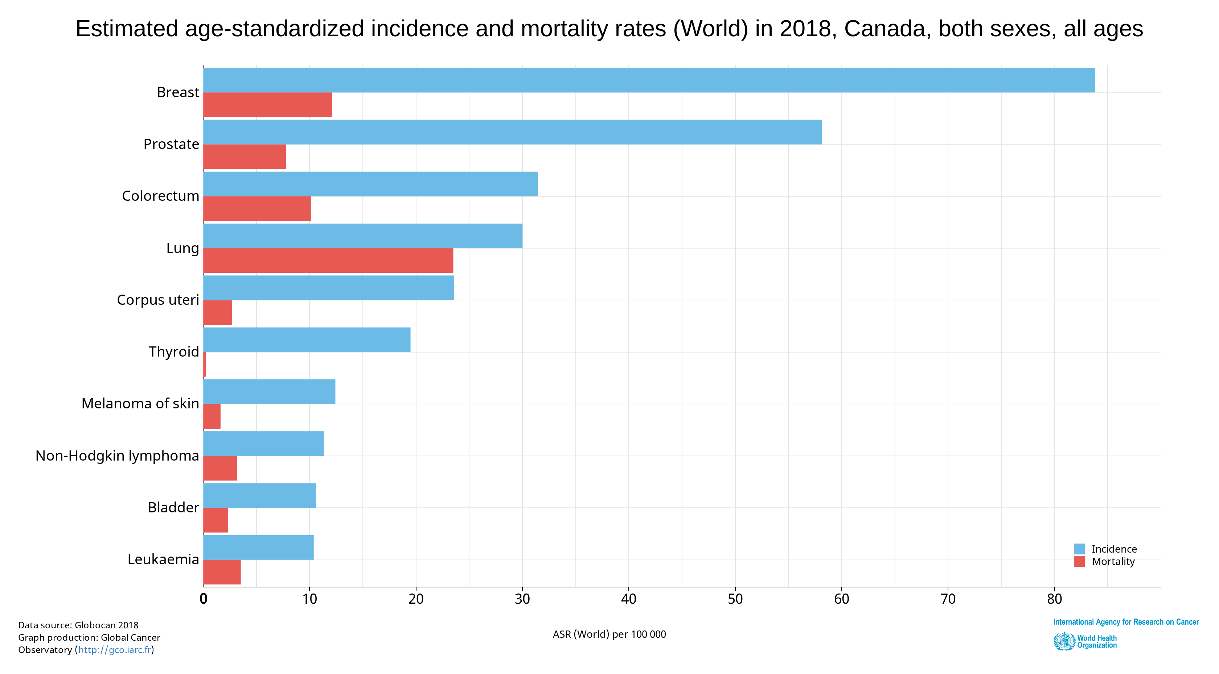
Background
Lung cancer is the fourth most common cancer in Canada, and the main cause of cancer-related mortality
72% of these cancers are caused by smoking
Previous research has found that lung cancer incidence rates appear to be converging between sexes
In the USA, age-specific lung cancer rates were observed to be even higher in young women compared to young men
Source: GLOBOCAN 2018

Slide 3
Background
Lung cancer is the fourth most common cancer in Canada, and the main cause of cancer-related mortality
72% of these cancers are caused by smoking
Previous research has found that lung cancer incidence rates appear to be converging between sexes
In the USA, age-specific lung cancer rates were observed to be even higher in young women compared to young men
74% of cases
18,120 attributable cases
69% of cases
8,488 attributable cases
Source: Poirier et al., Preventive Medicine, 2019
Notes:
About 74% of lung cancer cases in men and 69% of the cases in women are caused by cigarette smoking in Canada.
As such, lung cancer represents the largest number of preventable cancer cases and deaths of any malignancy.

Slide 4
Background
Trends in age-standardized lung cancer incidence rates in the USA
Lung cancer is the fourth most common cancer in Canada, and the main cause of cancer-related mortality
72% of these cancers are caused by smoking
Previous research has found that lung cancer incidence rates appear to be converging between sexes
In the USA, age-specific lung cancer rates were observed to be even higher in young women compared to young men
Females
Source: SEER 9 registries
Notes:
This figure shows trends in age-standardized lung cancer incidence rates, from 1975-2014 in men (blue line) and women (red line).
In the past, lung cancer incidence rates have been notably higher in men than women because of higher consumption of cigarettes in men.
However, the gap in the incidence rates have narrowed during the most recent time period because of increased similarity in cigarette consumption between men and women.

Slide 5
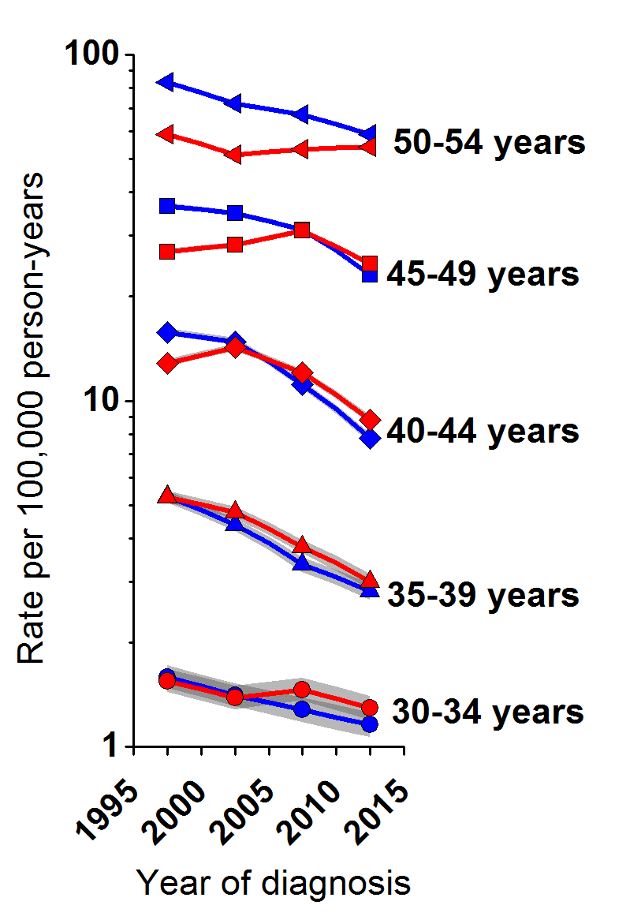
Background
Age- and sex-specific lung cancer incidence rates in the USA
Lung cancer is the fourth most common cancer in Canada, and the main cause of cancer-related mortality
72% of these cancers are caused by smoking
Previous research has found that lung cancer incidence rates appear to be converging between sexes
In the USA, age-specific lung cancer rates were observed to be even higher in young women compared to young men
Source: Jemal et al, NEJM, 2018
Notes:
Among men, incidence rates continued to decrease across the study period in all ages under 55 years.
Among women, rates continued to decrease throughout the study period in age groups under 40 years. Rates in age groups 40-49, however, increased before they cross over and decline, while rates in age 50-54 increased and converged with that in men.

Slide 6
Objectives
Globally, are lung cancer incidence rates among younger, contemporary birth cohorts higher in women than men?
Can the incidence patterns be explained by sex differences in smoking?

Slide 7
Data Sources
Cancer Incidence in 5 Continents (CI5)
Data collected and evaluated by IARC for comparability, completeness, and validity
Only registries deemed to be of high quality are published in the CI5 volume
Lung and bronchus cancer (C34) cases were extracted for 40 countries
5-year age interval (30-34 years, … , 60-64 years)
5-year calendar year (1993-1997, …, 2008-2012)
10 overlapping birth cohorts
Mid-year of diagnosis – Mid-year of age at diagnosis
Sex
Major histologic types
Global Burden of Disease Study 2015
Country-specific daily smoking prevalence data for the period 1980-2015

Slide 8
Statistical Analyses
Sex- and age-specific incidence rates per 100,000 person-years, with corresponding 95% confidence intervals
Period (diagnosis year)
Birth cohort
Sex- and age-specific smoking prevalence, with corresponding 95% confidence intervals
Period (diagnosis year)
Birth cohort
Female-to-male incidence rate ratios (IRRs) with corresponding 95% confidence intervals
Generalized linear Poisson model
Stata – version 14.2

Slide 9
Results
Initial investigations identified three groups:
Countries with a significant crossover from male to female dominance (n=6)
Canada, Denmark, Germany, New Zealand, The Netherlands, and the USA
Countries with a insignificant crossover from male to female dominance (n=23)
Australia, Austria, Brazil, Colombia, Costa Rica, Croatia, Czech Republic, Ecuador, Iceland, India, Ireland, Israel, Italy, Kuwait, Malta, Norway, Korea, Slovenia, Spain, Thailand, Uganda, and the UK
Countries with continued male dominance in lung cancer (n=11)
Belarus, China, Estonia, France, Japan, Latvia, Lithuania, Philippines, Poland, Slovakia, Switzerland

Slide 10
Results
Initial investigations identified three groups:
Countries with a significant crossover from male to female dominance (n=6)
Canada, Denmark, Germany, New Zealand, The Netherlands, and the USA
Countries with a insignificant crossover from male to female dominance (n=23)
Australia, Austria, Brazil, Colombia, Costa Rica, Croatia, Czech Republic, Ecuador, Iceland, India, Ireland, Israel, Italy, Kuwait, Malta, Norway, Korea, Slovenia, Spain, Thailand, Uganda, and the UK
Countries with continued male dominance in lung cancer (n=11)
Belarus, China, Estonia, France, Japan, Latvia, Lithuania, Philippines, Poland, Slovakia, Switzerland

Slide 11
Results – Period effect

Slide 12
Results – Period effect

Slide 13
Results – Period effect

Slide 14
Results – Birth cohort effect

Slide 15
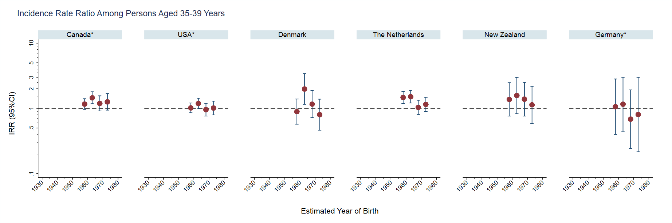
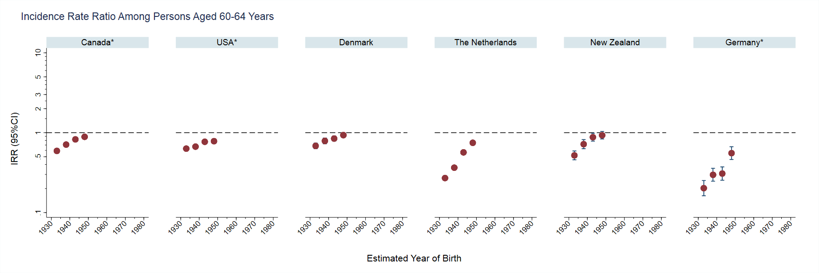
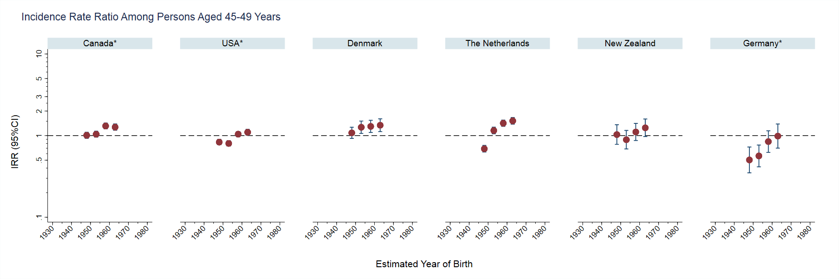
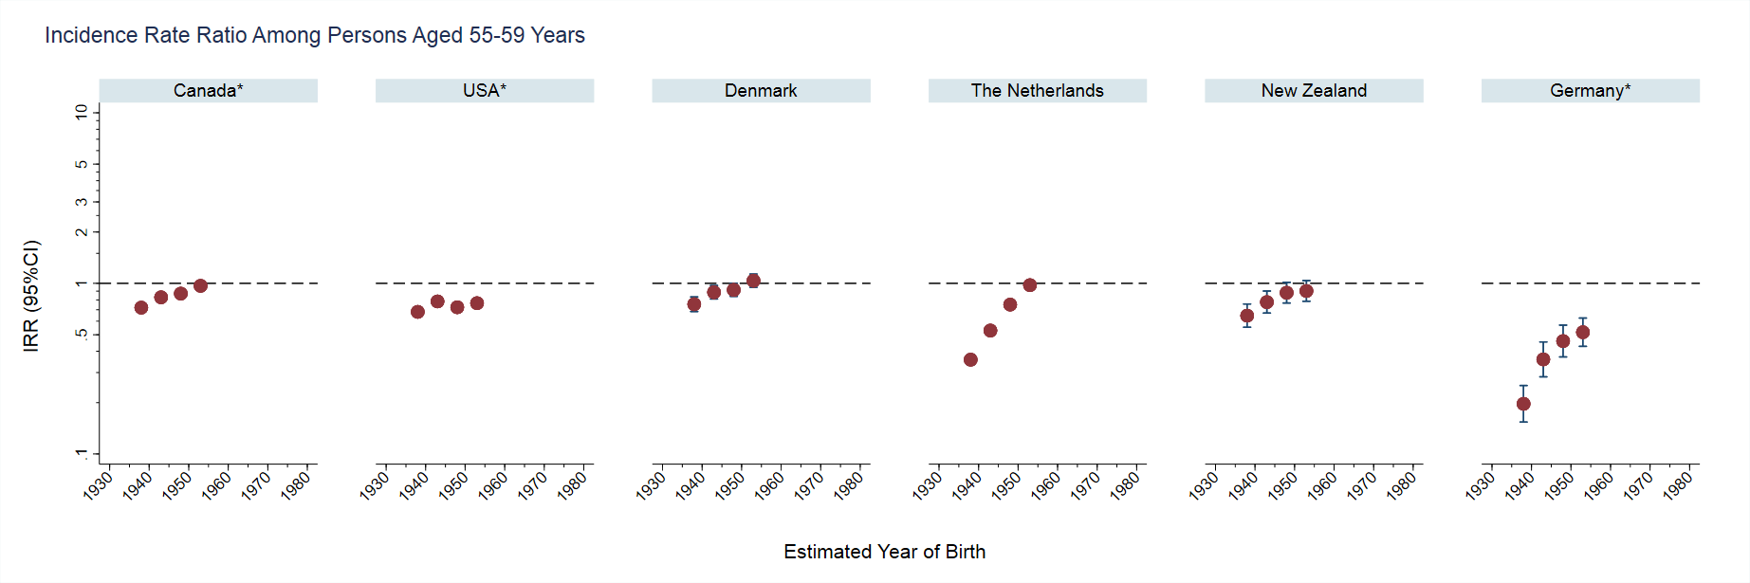
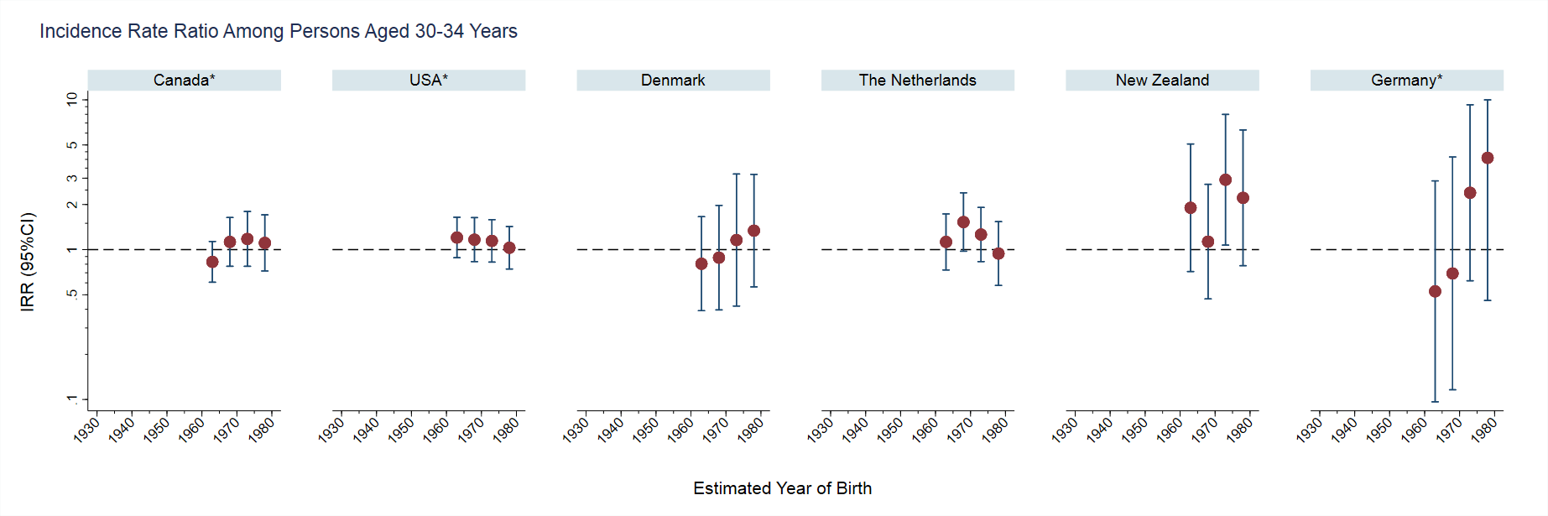
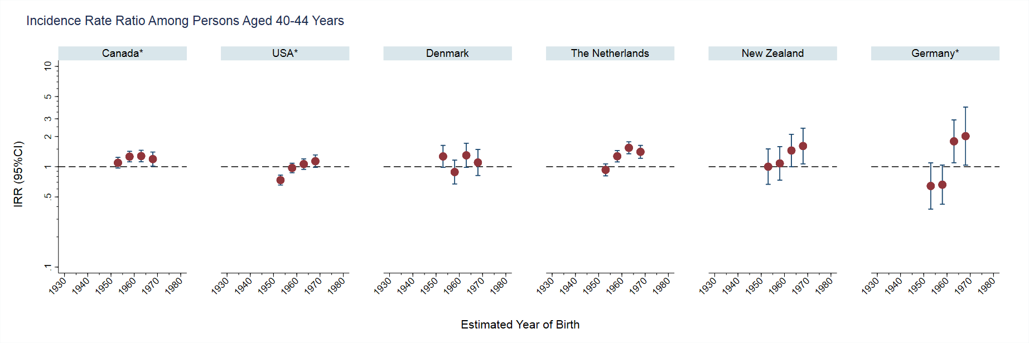
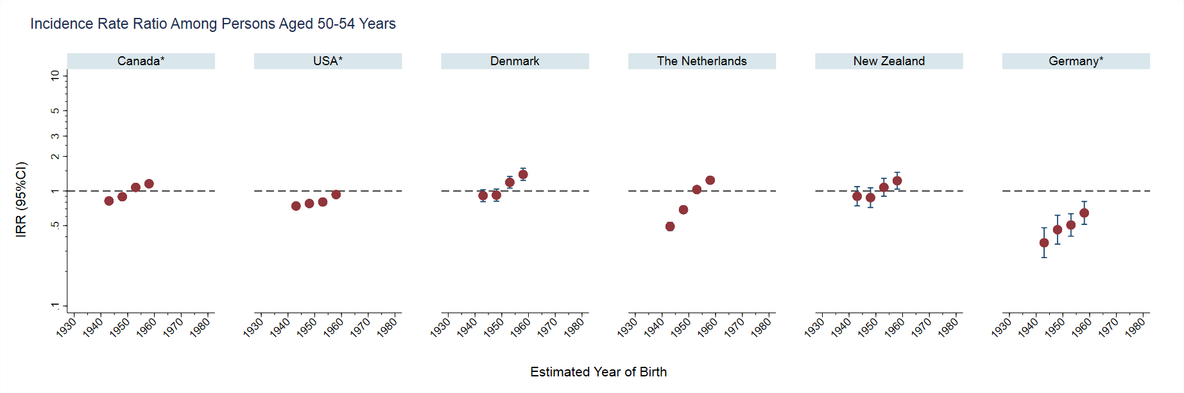
Results – Birth cohort effect

Slide 16
Results – Birth cohort effect

Slide 17
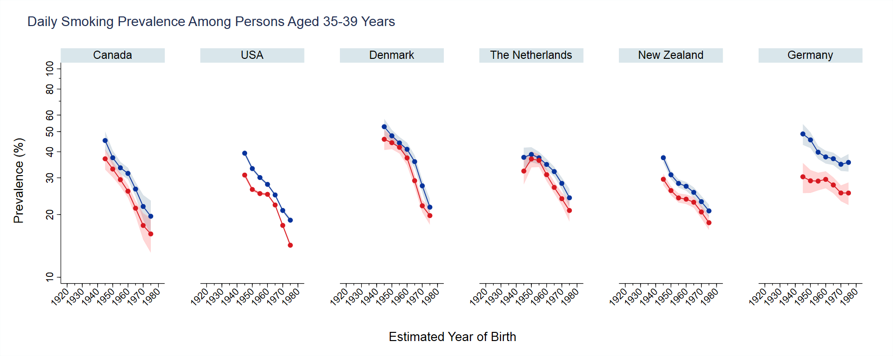
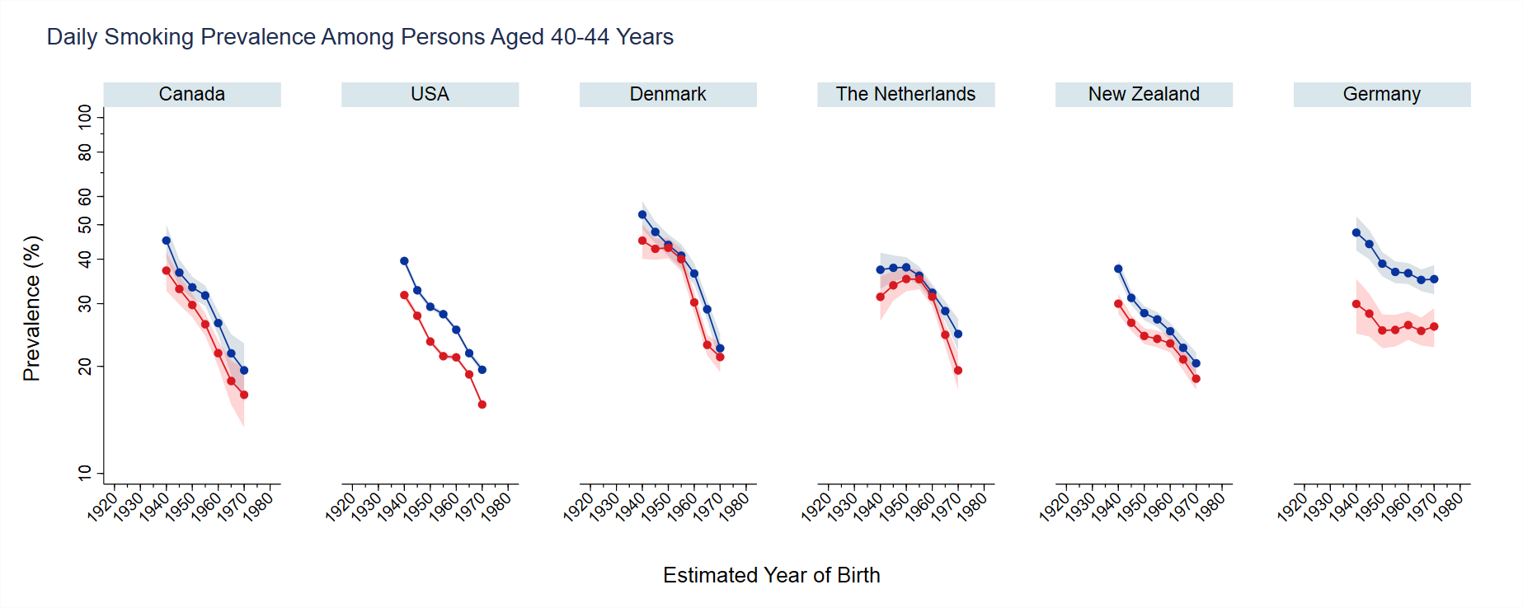
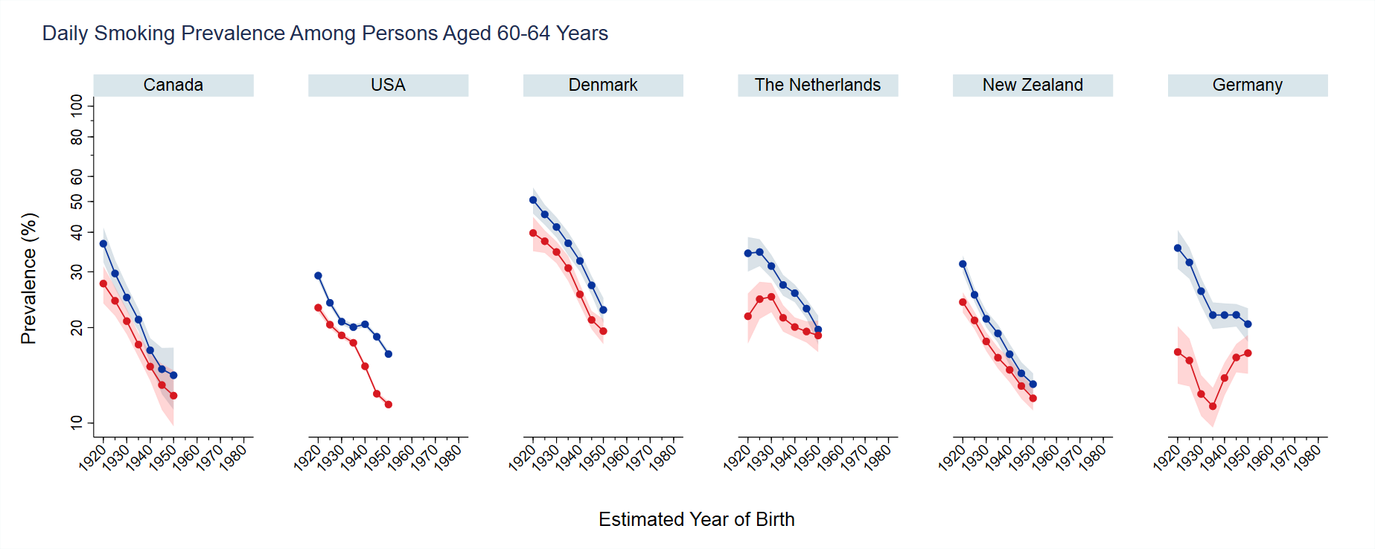
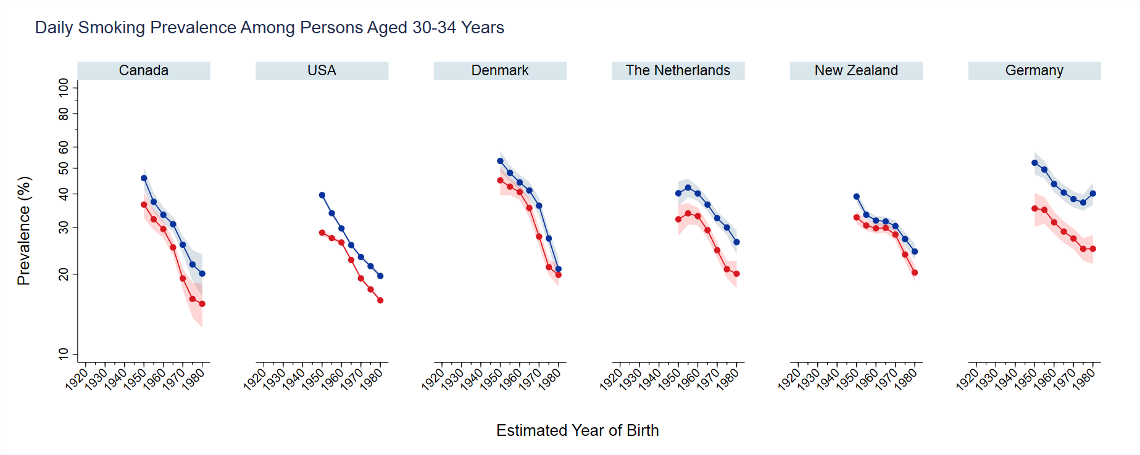
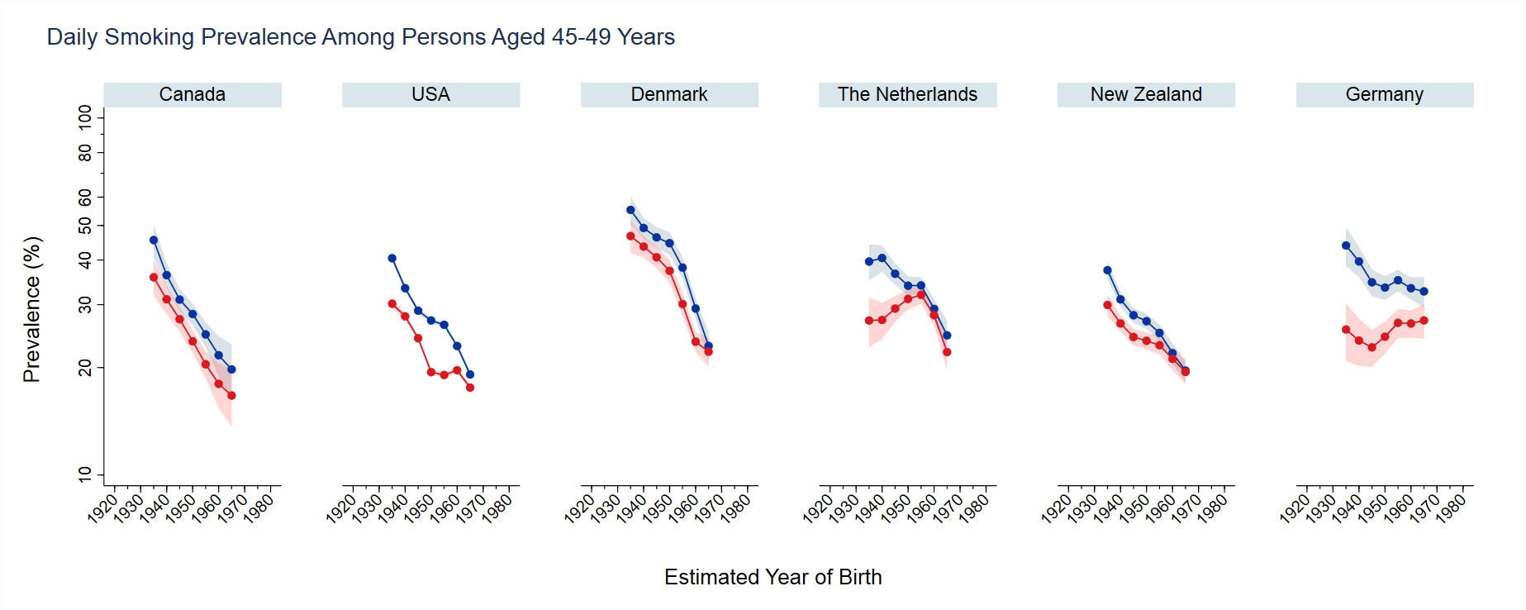
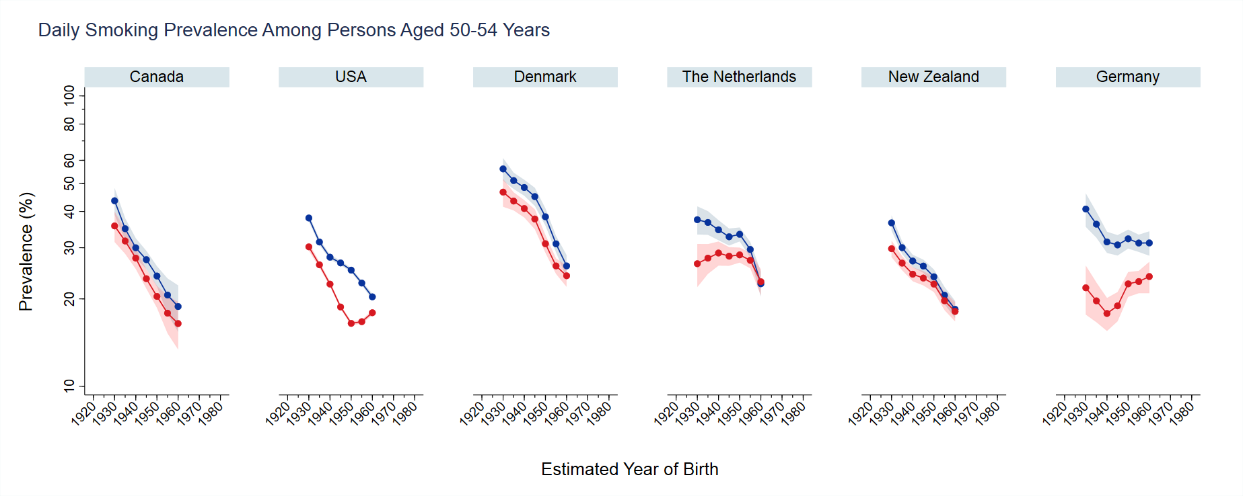
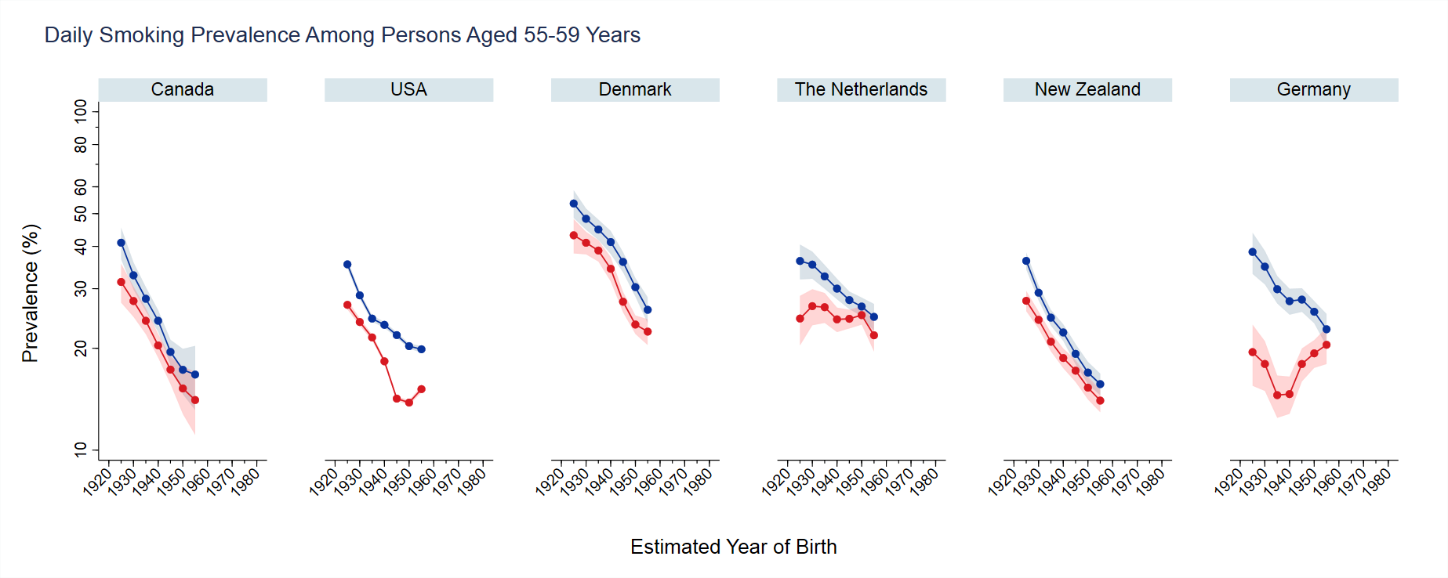
Results – Smoking prevalence

Slide 18
Discussion
The emerging trend of higher lung cancer incidence rates in young women than in young men appears to be widespread, affecting countries with varied geographic locations and income levels
6 countries with significant crossovers
23 countries with insignificant crossovers
The 6 countries demonstrating a significant crossover are among those considered to be more advanced in the tobacco epidemic
Smoking data show that age-specific female smoking prevalence in women approached but not exceeded that of males, suggesting that sex-differences in smoking patterns do not explain the crossover

Slide 19
Discussion – Possible explanations
Susceptibility to tobacco carcinogens
A pooled analysis of 13 studies found that lifelong female non-smokers had higher rates of lung cancer compared to their male counterparts
Changes in occupational exposures
Decrease in occupational exposures more recently, particularly asbestos
Changes in cigarette composition
Women have a greater burden of adenocarcinomas compared to men
Decreases due to smoking cessation may be less in women than men as adenocarcinoma risk does not decrease as substantially
Introduction of filters in 1950s, continued reduction in tar and nicotine level, the addition of tobacco-specific nitrosamine, and ventilation holes in the 1970s
Led to increased puff volume and frequency, and depth of inhalation
Notes:
Quitting smoking >=15 years = 94% decrease in risk for small cell carcinoma and only 70% for adenocarcinoma
Combined with smoking cessation, decreasing occupational exposures assist with the declining lung cancer rates in men
Changes in cigarette composition led to increase puff volume and frequency, and depth of inhalation

Slide 20
Discussion – Unlikely explanations
Lung cancer screening
Our study predates these recommendations
Passive smoke exposure
Not sex specific
Type of cigarettes
Lung cancer risk associated with smoking is not higher for mentholated cigarettes than non-mentholated cigarettes
Tobacco products other than cigarettes
Smokeless tobacco use and cigar use are much lower in women than men

Slide 21
Limitations
Lack of individual-level information on known risk factors for lung cancer
Some countries were assessed using subnational data, and thus our results may not be generalizable to the entire country
Improvements in histologic classification could affect trends, particularly for adenocarcinomas and squamous cell carcinomas
Adoption of these improvements across countries may vary
Would not impact our results for lung cancer overall
Historical data on tobacco use by sex and age group is sparse
Interpretation of the sex differences in lung cancer incidence rates in relation to the tobacco data should be considered with caution

Slide 22
Implications
A higher future burden of overall cancer in women
than men
Intensify anti-tobacco measures in females
Etiologic studies
Notes:
The finding has significant public health implications.
First, it may foreshadow a higher future burden of overall lung cancer in women than men as younger cohorts age,
It underscores, the need for intensified anti-tobacco measures to decrease smoking among young women.
The finding also calls for further etiologic studies to identify reasons for the higher lung cancer rates in young women, including gender differences in susceptibility to deleterious effects of tobacco carcinogens.

Slide 23
Thank you for your attention!
Acknowledgments
Thank you to all cancer registries that contribute data to CI5
Data Availability
Cancer Incidence in Five Continents data is freely available for download at ci5.iarc.fr
Disclaimer
Where authors are identified as personnel of the International Agency for Research on Cancer/World Health Organization, the authors alone are responsible for the views expressed in this presentation and they do not necessarily represent the decisions, policy or views of the International Agency for Research on Cancer/World Health Organization
Contact Details:
Miranda.Fidler-Benaoudia@ahs.ca

