Slide 1
Changing trends in thyroid cancer incidence in Canada: A histologic examination, 1992-2016
Larry F Ellison (presenter), Centre for Population Health Data
and Tracey Bushnik, Health Analysis Division

Slide 2
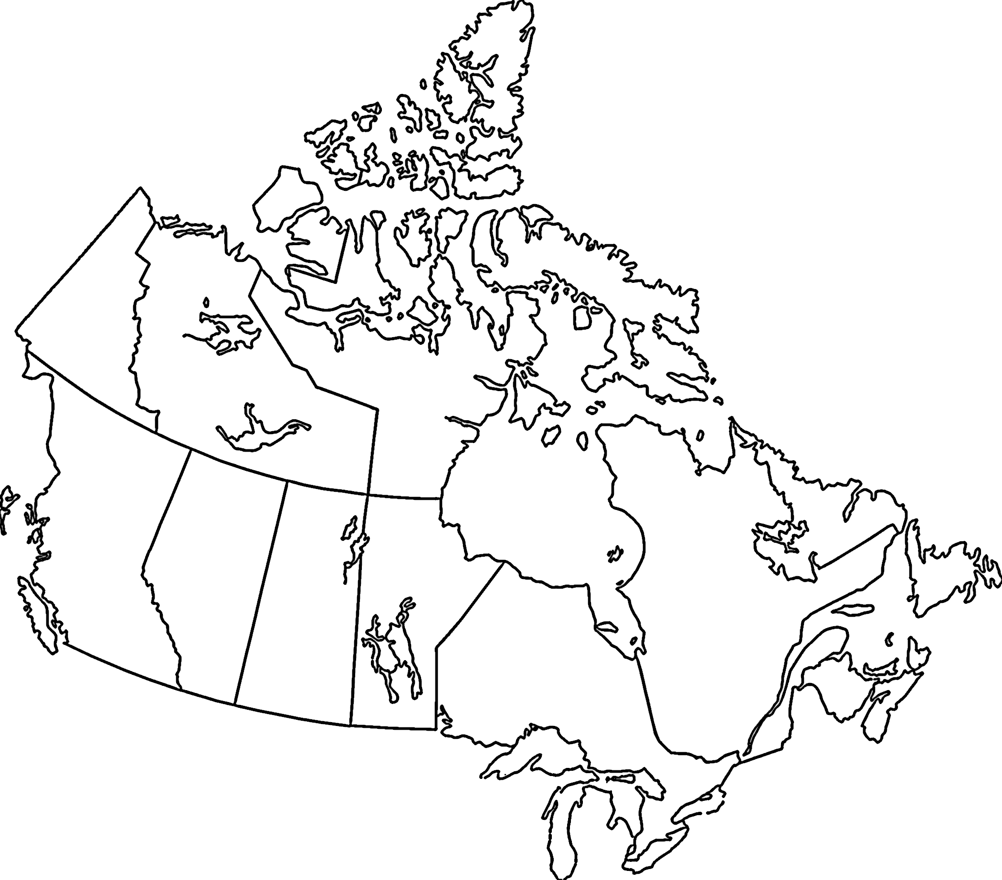
Background
Rapid increases in TC incidence have occurred over the past couple of decades…
Up to 2012, rapid increases in TC incidence have occurred…
In Canada, thyroid cancer (TC) was the fifth most diagnosed cancer among females in 2016…
…and short- and long-term projections indicate this increase will continue
…and the 13th among males

Slide 3
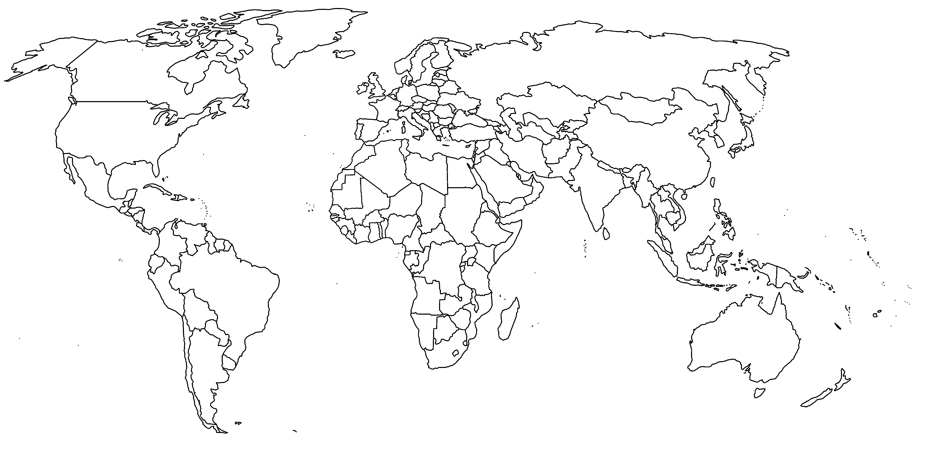
Background
Up to 2012, rapid increases in TC incidence have occurred…
The 5-year survival rate of papillary TC in much of Europe and North America exceeds 95%...
TC incidence has also increased in many parts of the world…
…however the prognosis of the less common histologies is less favourable and incidence and survival patterns vary
…primarily due to increased detection of papillary TC

Slide 4
Background
Back in Canada, an analysis of TC incidence and survival by histologic subtype has been lacking
…moreover, recent data points suggest that the era of rising TC incidence may have come to an end

Slide 5
Objectives
Examine recent (2012-2016) and trends (1992-2016) in sex-specific TC incidence by:
Age
Histology
Province
Examine recent (2012-2016) and trends (1992-2016) in TC mortality by:
Age
Sex
Province
Examine recent (2010-2014) and change (1992-1996) in 5-year TC net survival by:
Age
Sex
Histology
Province

Slide 6
Data
Incidence data are from the 1992-2016 Canadian Cancer Registry (CCR)
The CCR is a dynamic, person-oriented, population-based database comprised of cancer cases diagnosed among Canadian residents
Mortality data are from the 1992-2016 Canadian Vital Statistics – Death database (CVSD)
The CVSD includes demographic and cause of death information for all deaths in Canada
The survival data were created by linking the CCR to the CVSD and mortality information from tax files through December 31, 2014

Slide 7
Methods
Site code 73.9
(excluding 9050-9055; 9590-9992)
ICD-9 code 193 for deaths from 1992 to 1999
Only malignant cases
TC incidence based on ICDO-3
Histologic types:
Papillary (8050, 8260, 8340-8344,
8350, 8450-8460)
Non-papillary
Follicular (8290, 8330-8335)
Medullary (8345, 8510-8513)
Anaplastic (8020-8035)
Other specified
Unspecified (8000-8005, 8010-8015)
ICD-10 code C73 for deaths from 2000 onward
TC mortality

Slide 8
Methods
Age-specific rates
Age-standardized rates (direct method)
TC incidence based on ICDO-3
Annual percent change (APC)
TC mortality
Quebec excluded
Pohar Perme estimator
TC net survival
case-mix

Slide 9
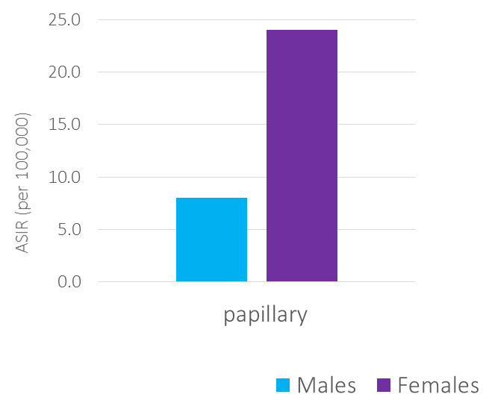
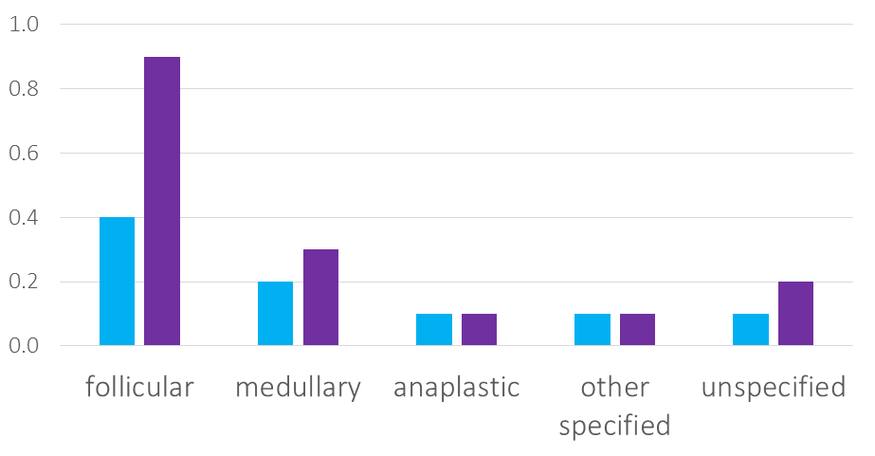
Results
The ASIR of papillary TC was 14 times greater than non-papillary subtypes; while the rate of diagnosis among females was almost three times higher than among males
TC incidence 2012-2016
Histology
non-papillary
Source: Ellison LF, Bushnik T. Changing trends in thyroid cancer incidence in Canada: A histologic examination, 1992-2016 . Health Reports (under review).

Slide 10
Results
Northwest Territories (4.1)
ASIRs per 100,000 were higher in Ontario and Newfoundland and Labrador than anywhere else
Yukon (5.5)
Nunavut (14.5)
TC incidence 2012-2016
Newfoundland and Labrador (21.5)
Province
Ontario (23.1)
Prince Edward Island (7.7)
British Columbia (9.1)
Alberta (13.0)
Nova Scotia (13.0)
Saskatchewan (9.5)
Manitoba (12.2)
New Brunswick (14.4)
Source: Ellison LF, Bushnik T. Changing trends in thyroid cancer incidence in Canada: A histologic examination, 1992-2016 . Health Reports (under review).

Slide 11
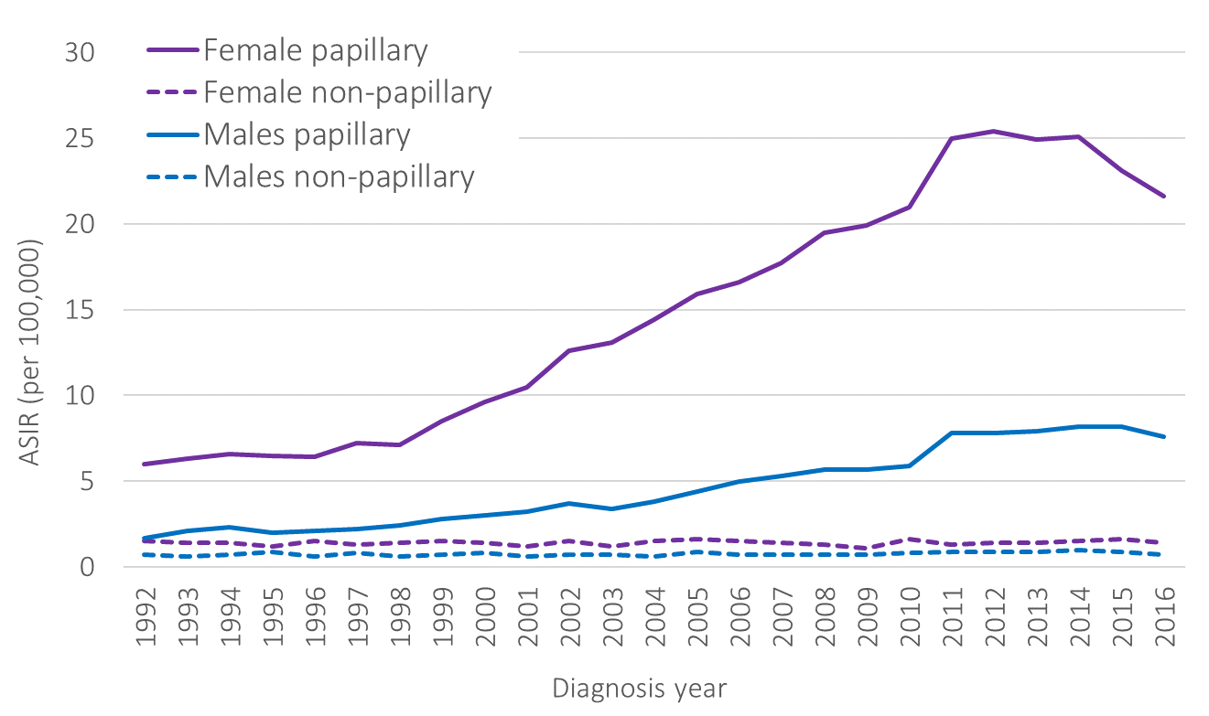
Results
APC -3.7%
APC 7.7%
TC incidence 1992-2016
APC 12.9%
APC stable
Histology
APC 8.1%
Source: Ellison LF, Bushnik T. Changing trends in thyroid cancer incidence in Canada: A histologic examination, 1992-2016 . Health Reports (under review).

Slide 12
Results
TC incidence 1992-2016
Females
Non-papillary: stable
Medullary: APC 1.9%
Anaplastic: APC -1.7%
Other specified: APC 2.3%
Males
Non-papillary: APC 1.1%
Medullary: APC 3.0%
Histology
Source: Ellison LF, Bushnik T. Changing trends in thyroid cancer incidence in Canada: A histologic examination, 1992-2016 . Health Reports (under review).

Slide 13
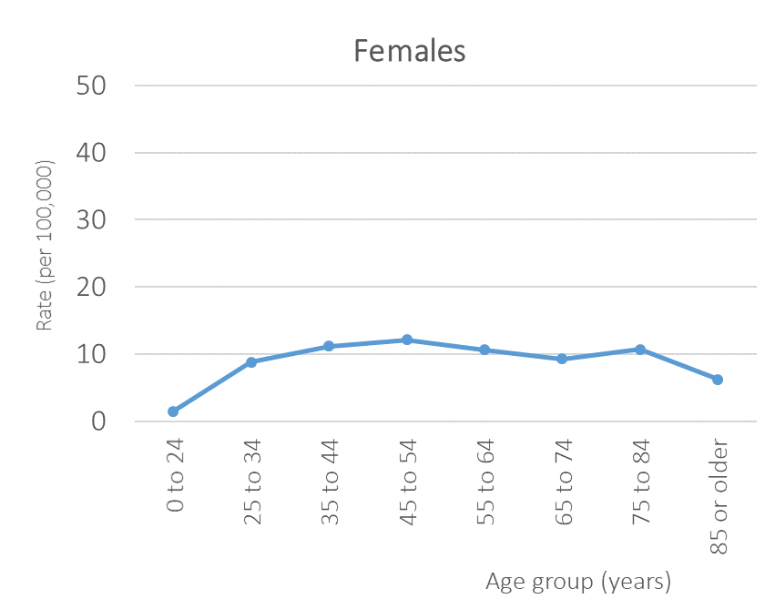
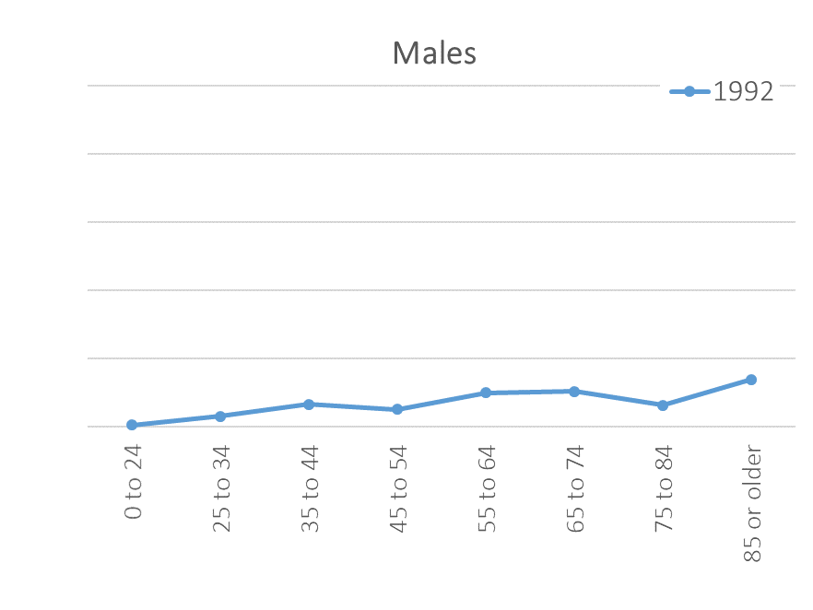
Results
TC incidence 1992-2016
Age
Source: Ellison LF, Bushnik T. Changing trends in thyroid cancer incidence in Canada: A histologic examination, 1992-2016 . Health Reports (under review).

Slide 14
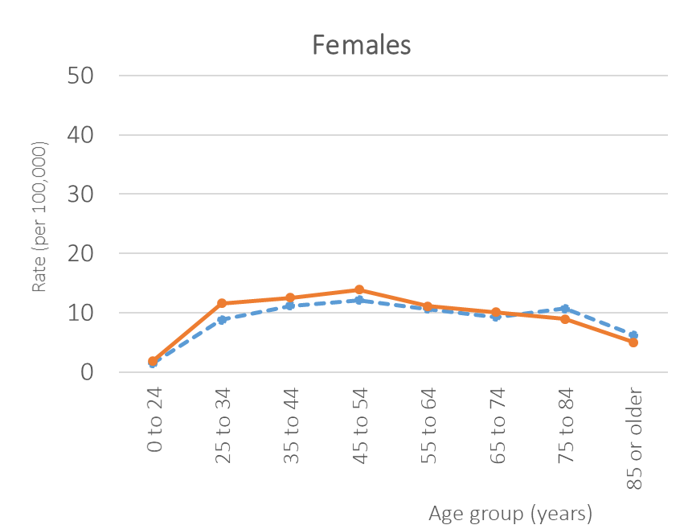
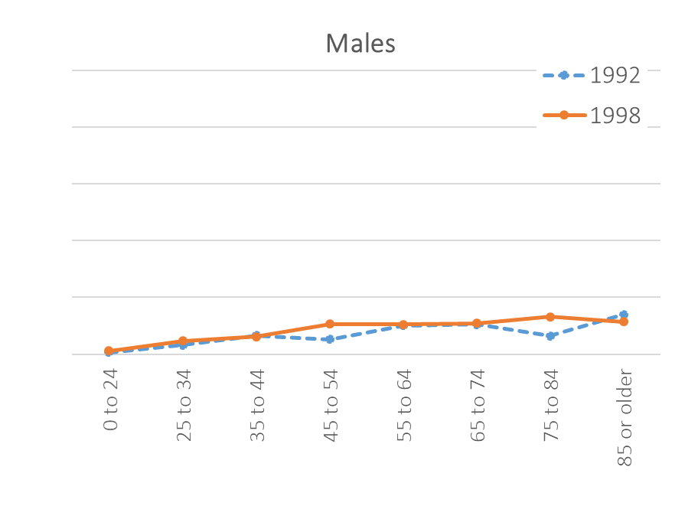
Results
TC incidence 1992-2016
Age
Source: Ellison LF, Bushnik T. Changing trends in thyroid cancer incidence in Canada: A histologic examination, 1992-2016 . Health Reports (under review).

Slide 15
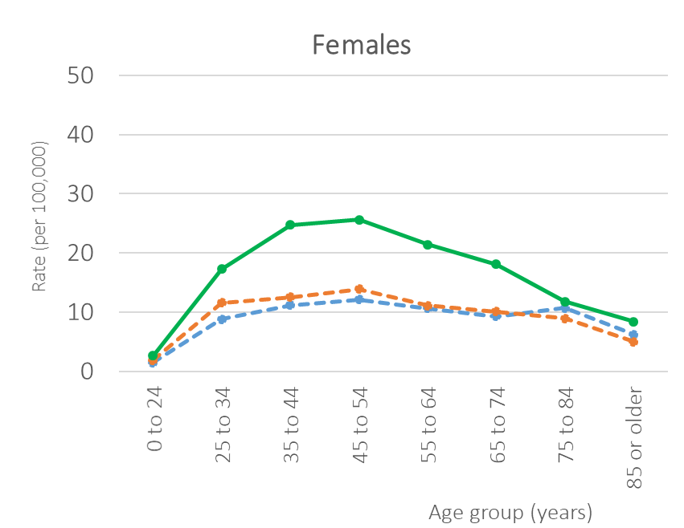
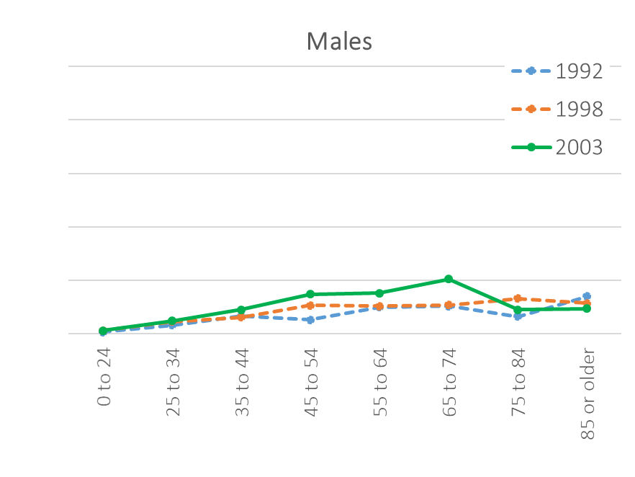
Results
TC incidence 1992-2016
Age
Source: Ellison LF, Bushnik T. Changing trends in thyroid cancer incidence in Canada: A histologic examination, 1992-2016 . Health Reports (under review).

Slide 16
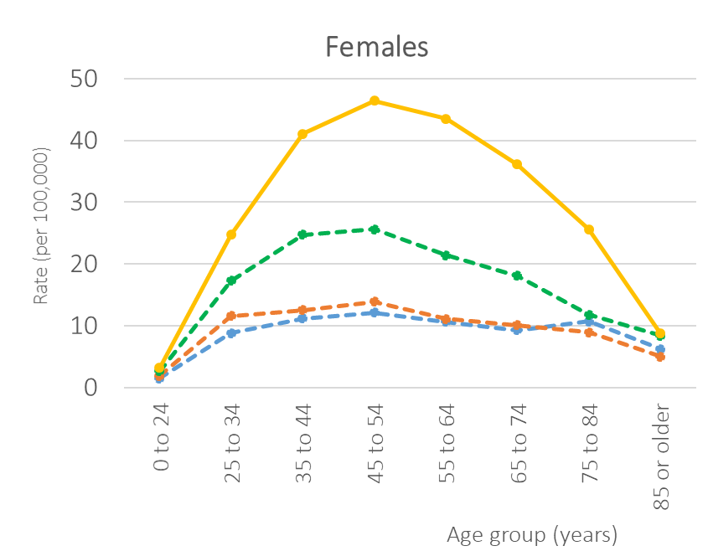
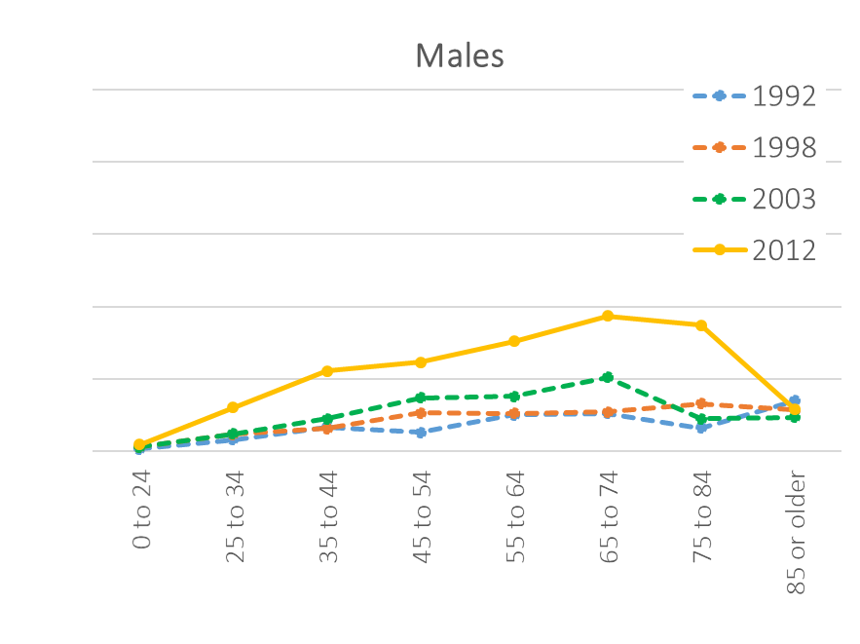
Results
TC incidence 1992-2016
Age
Source: Ellison LF, Bushnik T. Changing trends in thyroid cancer incidence in Canada: A histologic examination, 1992-2016 . Health Reports (under review).

Slide 17
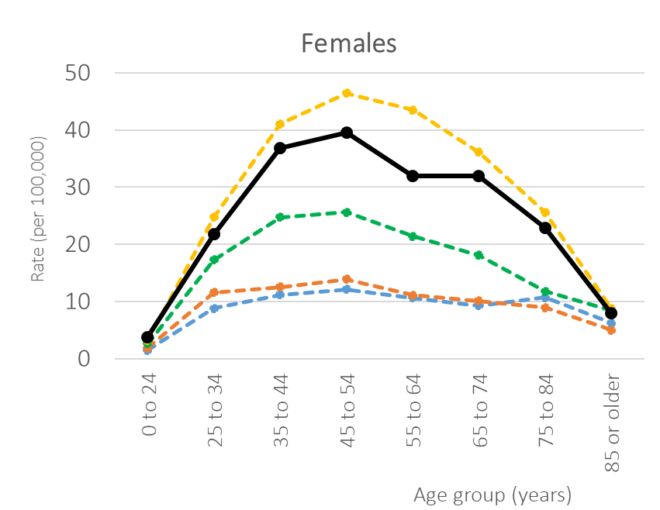
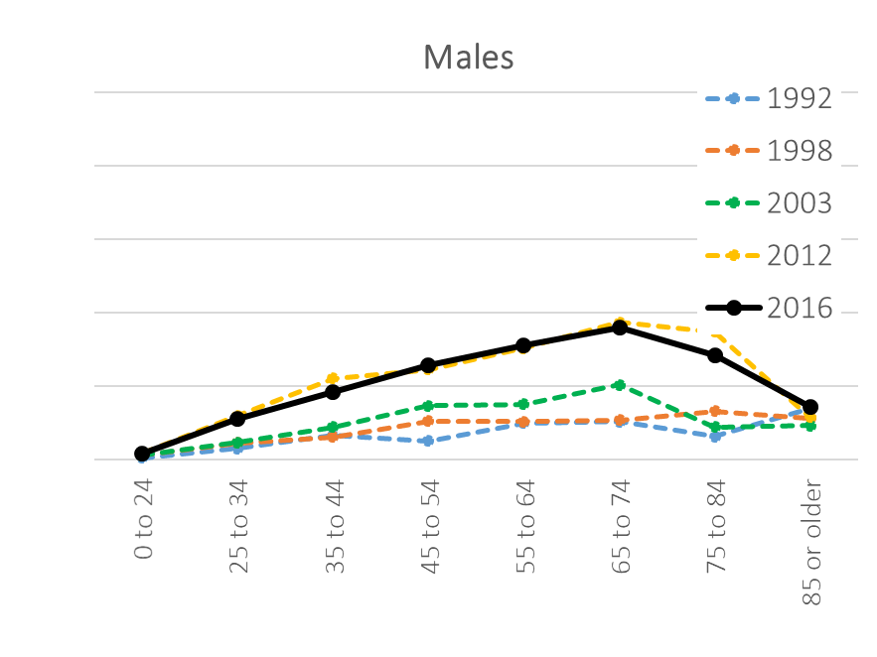
Results
TC incidence 1992-2016
Age
Source: Ellison LF, Bushnik T. Changing trends in thyroid cancer incidence in Canada: A histologic examination, 1992-2016 . Health Reports (under review).

Slide 18
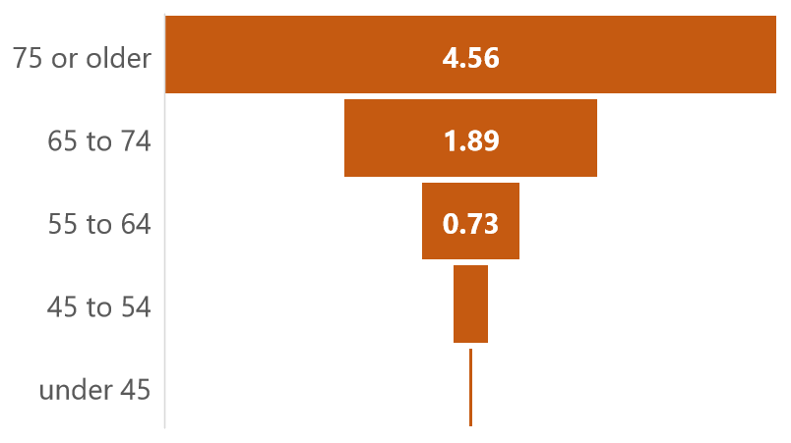
Results
There was a stepwise increase in mortality rates with increasing age
TC mortality
Overall ASMR = 0.60 per 100,000;
similar by sex and by province
Trend between 1992-2016 remained stable for females and increased slightly (APC 1.2%) for males
Overall ASMR = 0.60 per 100,000
0.27
0.03
Mortality rate (per 100,000) in 2012-2016
Source: Ellison LF, Bushnik T. Changing trends in thyroid cancer incidence in Canada: A histologic examination, 1992-2016 . Health Reports (under review).

Slide 19
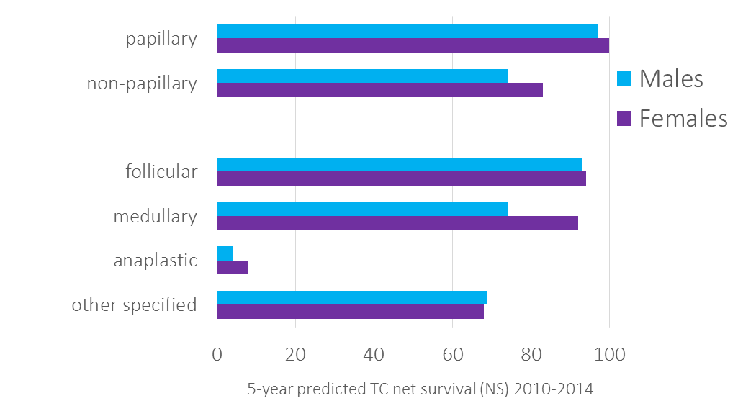
Results
Excellent prognosis for papillary TC; poor outlook for anaplastic
NS higher among females
TC net survival
Histology
non-papillary
Source: Ellison LF, Bushnik T. Changing trends in thyroid cancer incidence in Canada: A histologic examination, 1992-2016 . Health Reports (under review).

Slide 20
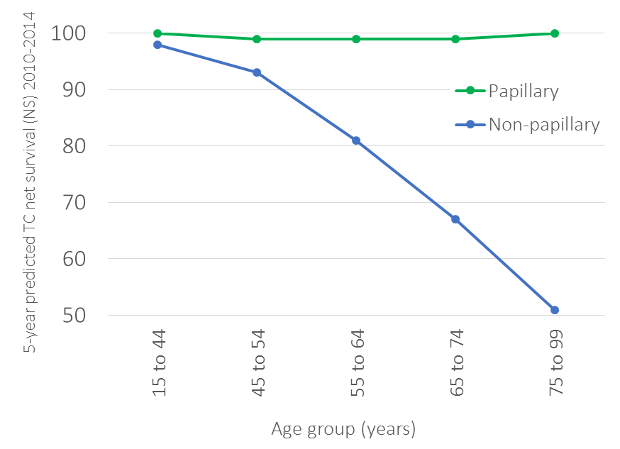
Results
NS for non-papillary decreased with age
TC net survival
Histology
Source: Ellison LF, Bushnik T. Changing trends in thyroid cancer incidence in Canada: A histologic examination, 1992-2016 . Health Reports (under review).

Slide 21
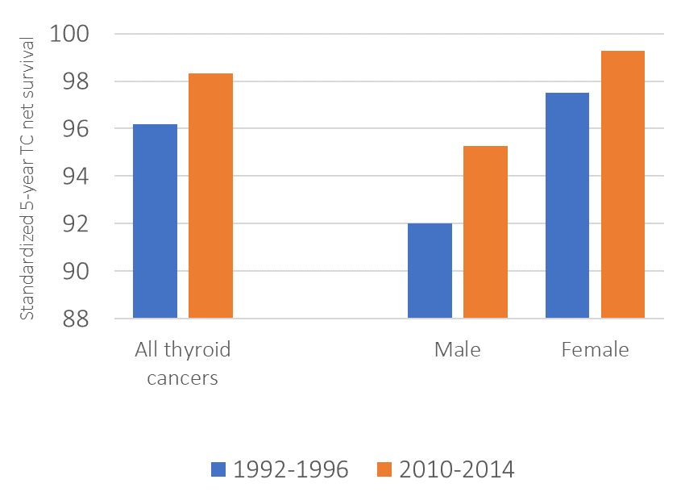
Results
Standardized NS increased slightly over time overall and for both sexes
TC net survival
Histology
Age, sex, case-mix standardized
Age and case-mix standardized
Source: Ellison LF, Bushnik T. Changing trends in thyroid cancer incidence in Canada: A histologic examination, 1992-2016 . Health Reports (under review).

Slide 22
Discussion
Following years of rapid increases, TC incidence declined among females and stabilized among males between 2012 and 2016
primarily due to papillary TC
recent shift in overall trend coincides with revisions to TC management guidelines
medullary TC increased over time for both sexes while overall mortality increased among males and remained stable among females
TC survival in Canada influenced by histology
prognosis for TC increased slightly since early 1990s
recent survival estimates closely aligned with U.S.

Slide 23
Strengths
Limitations
Validated national cancer data
Exclusion of Quebec
Trends in histology-specific incidence and survival
Information on tumour size or stage very limited
Trends in histology-specific incidence and sur

Slide 24
Conclusion
To what extent this recent trend in TC incidence will continue in Canada or what the impact may be on TC survival is not yet clear
A re-examination of projected TC incidence rates past 2016 and continued monitoring of histology-specific TC incidence and survival is recommended

Slide 25
Thank you!
larry.ellison@canada.ca

