Slide 1
Bridging Colorado’s Cancer and Immunization Registries to Improve the Dissemination of a Successful HPV Vaccination Intervention
Amy M. Anderson-Mellies. MPH¹
Jessica R. Cataldi, MD^{2,3}
Marian Håbesland, MPH⁴
Amanda F. Dempsey, MD^{2,3}
Myles G. Cockburn, PhD^{1,4}
¹University of Colorado Cancer Center, Aurora, CO; ²Adult and Child Consortium for Health Outcomes Research and Delivery Science, University of Colorado Anschutz Medical Campus and Children’s Hospital Colorado, Aurora, CO; ³Department of Pediatrics, University of Colorado Anschutz Medical Campus, Aurora, CO; ⁴Colorado School of Public Health, Aurora, CO

Slide 2
Background
Approximately 32,500 cases of HPV-attributable cancers are diagnosed in the US each year and it is estimated that 30,000 of those cases (92%) could be prevented with HPV vaccination.¹
It is recommended that adolescents receive the vaccine by ages 11-12², but only 60.4% of adolescents aged 13-17 had started the vaccination series as of 2016.³
It has been found that whether and how a health care professional recommends the HPV vaccine impacts whether an adolescent gets vaccinated, but studies have so far shown that health care professionals are often ineffective at their communication regarding the vaccination.⁴
Notes:
This means there is an opportunity to influence the utilization of the HPV vaccination on a clinic-level that focuses on communication between medical professionals and patients along with their families.

Slide 3
The Intervention
16 family and pediatric clinics in the Denver Metro
188 medical professionals
43,132 adolescents
1
HPV Vaccination Fact Sheet
Decision Aid
4
Practice-specific fact sheet about the HPV vaccination
Help make the decision of whether to get the HPV vaccination
2
Education Website
5
Communication Training
Parent education website that creates personalized HPV vaccination information
Improve health care professionals’ recommendation practices
3
Disease Images
06
Depicting diseases associated with the HPV virus
Notes:
The intervention The 5 components of the intervention were an HPV fact sheet library to create customized information sheets relevant to each practice’s patient population, a tailored parent education website, a set of HPV-related disease images, an HPV vaccine decision aid, and 2½ hours of communication training on using a presumptive vaccine recommendation, followed by motivational interviewing if parents were resistant to vaccination.

Slide 4
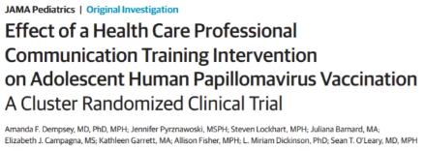
The Intervention

Slide 5
Objective
To identify specific areas within UCCC’s overall catchment area (the state of Colorado) most in need of interventions to increase HPV vaccination as a method of primary prevention of HPV-related cancers.

Slide 6
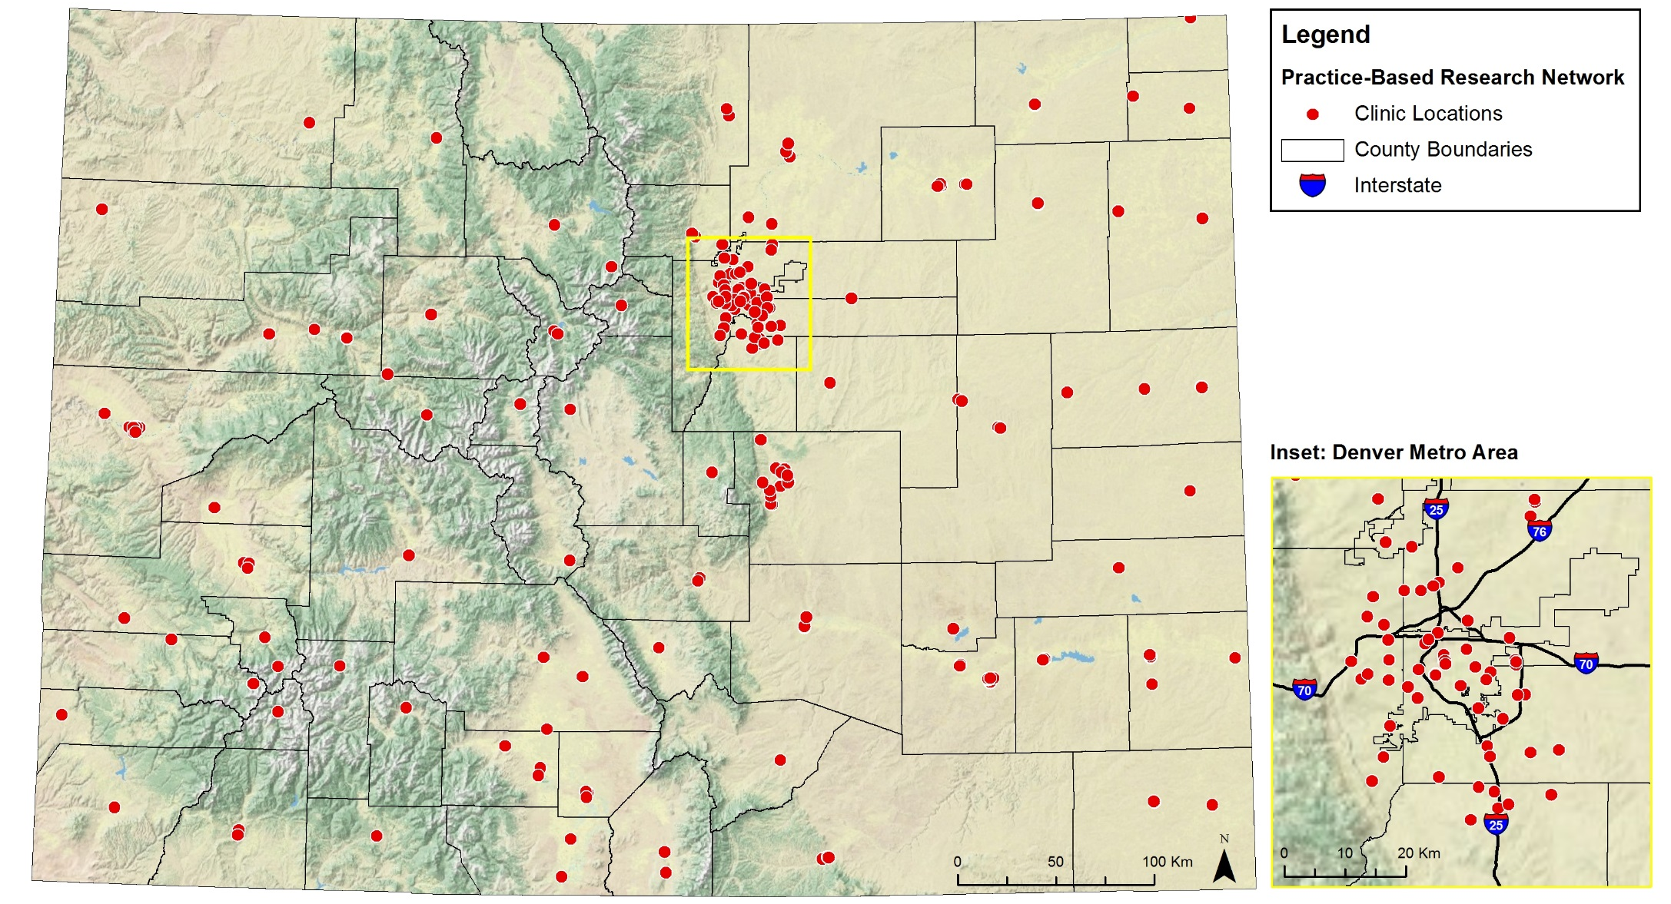
Locations of Colorado Practice-Based Research Network Clinics, 2019
Clinic locations (n=227) provided by the SNOCAP Network Coordinator, Department of Family Medicine, University of Colorado. Sources: County layer, US Census Tiger Shapefiles.
Composed by Amy Mellies and Myles Cockburn
Notes:
PBRN: a group of primary care clinicians and practices working together to answer community-based health care questions and translate research findings into practice.

Slide 7
Data Sources
Colorado Central Cancer Registry (CCCR)
HPV-related cancer diagnosis
Ages <65
Colorado Immunization Information System (CIIS)
Up-to-date with HPV vaccine
Ages 11-17
American Community Survey
(ACS)
Population estimates
2013-2017
2006-2015
Latitude/Longitude
2018
Zip code
Ages 10-17 and ages <65
Block group
Notes:
2,695 HPV-related cancer diagnoses.
Vaccination status for 791,401 adolescents.

Slide 8
Methods
Overlay available data
Population estimates adjusted proportionally to area contained in zip code
Zip code vaccination rate applied to block group population estimate to calculate number not up-to-date
Intersect results with 2km buffer surrounding PBRN clinics
Results adjusted proportionally to area contained in 2km buffer
50%
not up-to-date
Zip Code Vaccination Rate
75%
not up-to-date
100 | 100 | 100
100 | 100 | 100
60 40 | 60 40 | 60 40
100 | 100 | 100
100 | 100 | 100
100 | 100 | 100
50 | 50 | 50
50 | 50 | 50
30 30 | 30 30 | 30 30
75 | 75 | 75
75 | 75 | 75
75 | 75 | 75
50 | 50 | 50
50 | 50 | 50
30 30 | 30 30 | 30 30
75 | 75 | 75
75 | 75 | 75
75 | 75 | 75
x 50% not up-to-date
15
10
25
15
15
5
100 | 100 | 100
100 | 100 | 100
100 | 100 | 100
100 | 100 | 100
100 | 100 | 100
100 | 100 | 100
x 75% not up-to-date
Block Group Population Estimate
There are an estimated 85 adolescents not up-to-date with HPV vaccine within 2km of the clinic

Slide 9
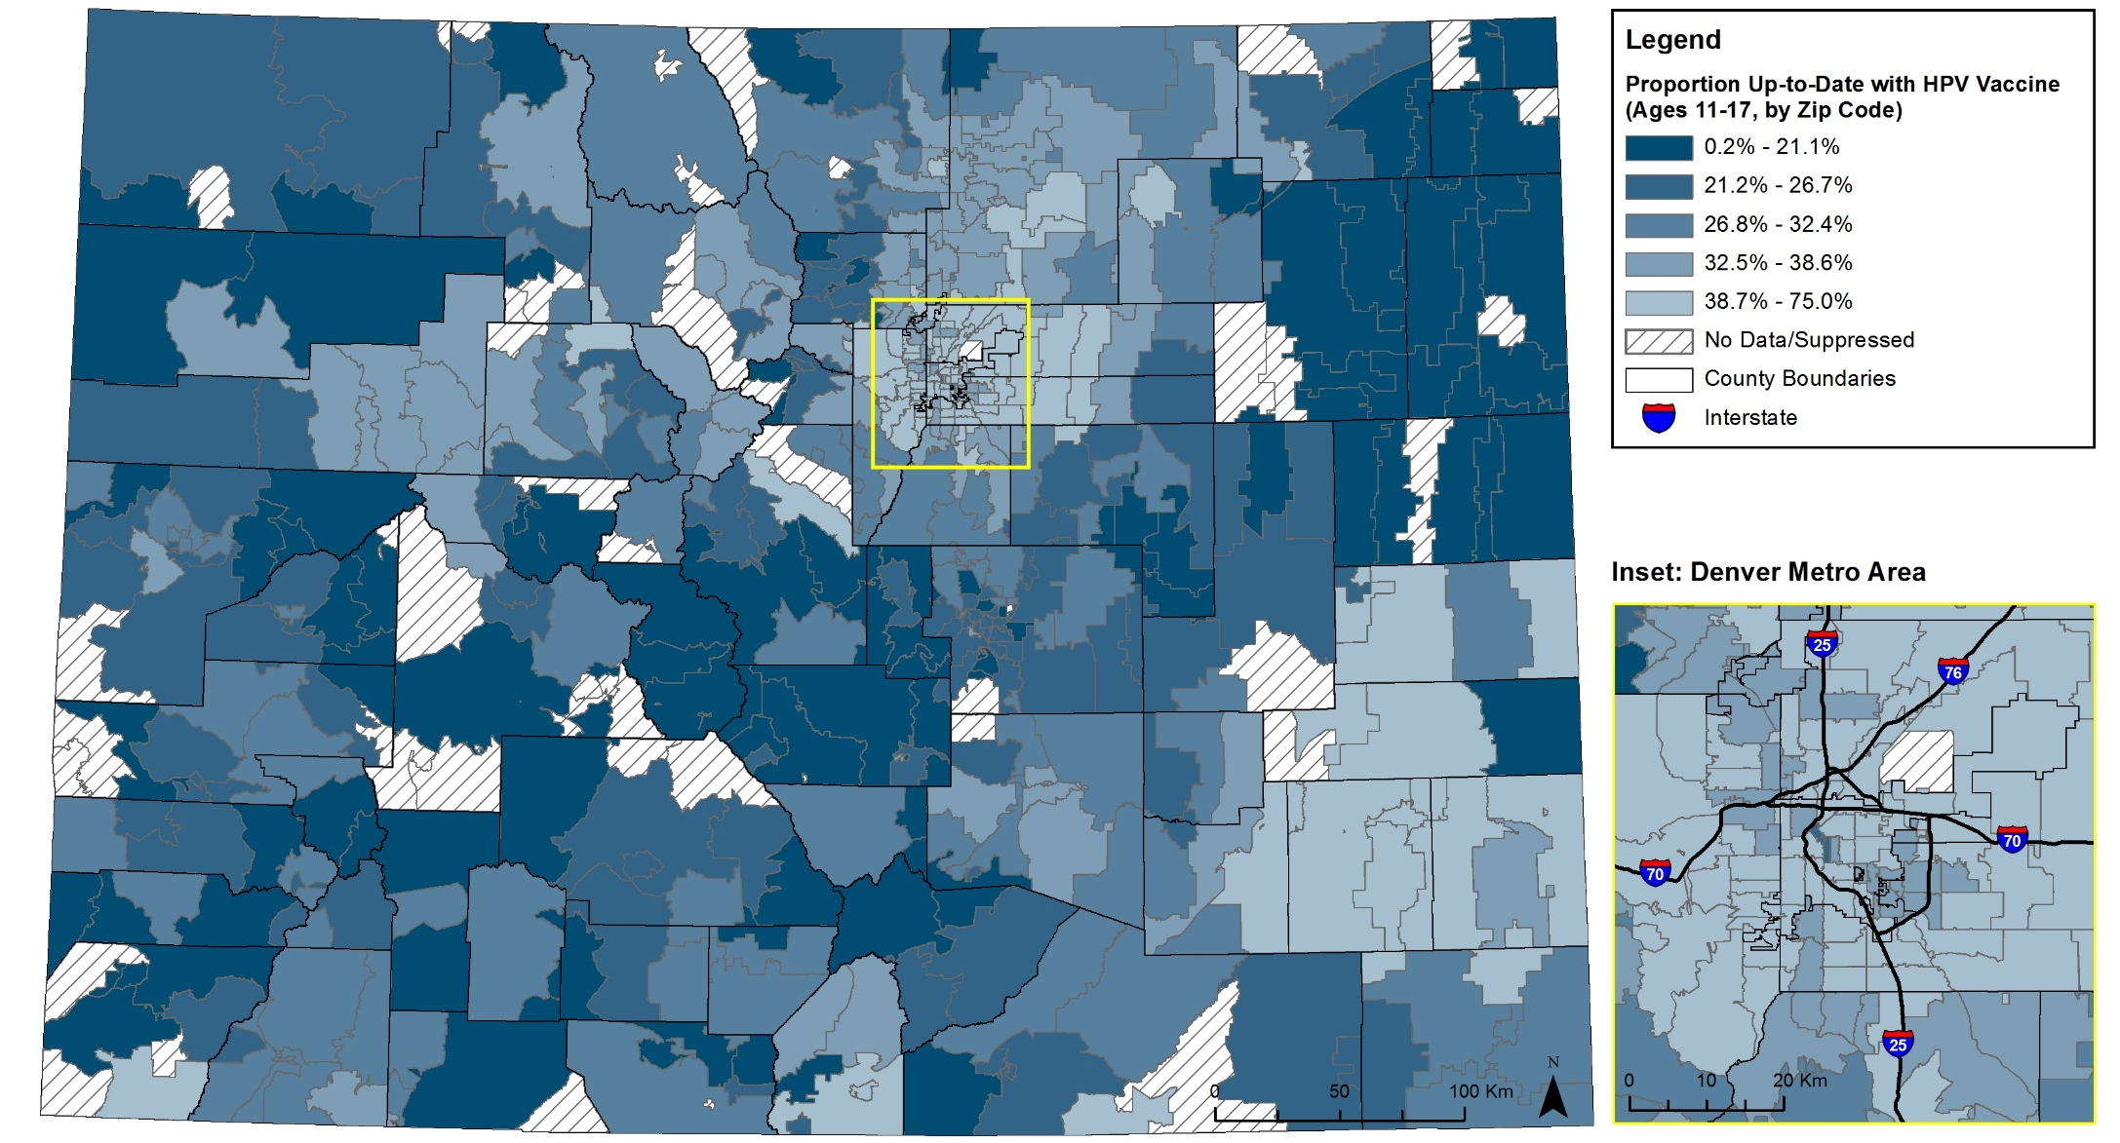
Proportion of adolescents (ages 11-17) not up-to-date with HPV vaccine, by zip code, Colorado, 2018
Data represents adolescents who were aged 11-17 between 1/1/2018 to 6/30/2018 and their vaccination status as of 12/31/2018. Up-to-date was defined as 2 doses given if started before 15 years of age and 3 doses if started after 15 years of age. Areas with a numerator or denominator less than three have been suppressed. These data were supplied in part by the Colorado Immunization Information System of the Colorado Department of Public Health and Environment, which specifically disclaims responsibility for any analyses, interpretations, or conclusions based on the given data. Data were managed, analyzed, and mapped in SAS 9.3 and ArcMap 10.3.1 by the University of Colorado Cancer Center. Sources: Zip Code Tabulation Area layer and County layer, US Census Tiger Shapefiles.
Composed by Amy Mellies and Myles Cockburn

Slide 10
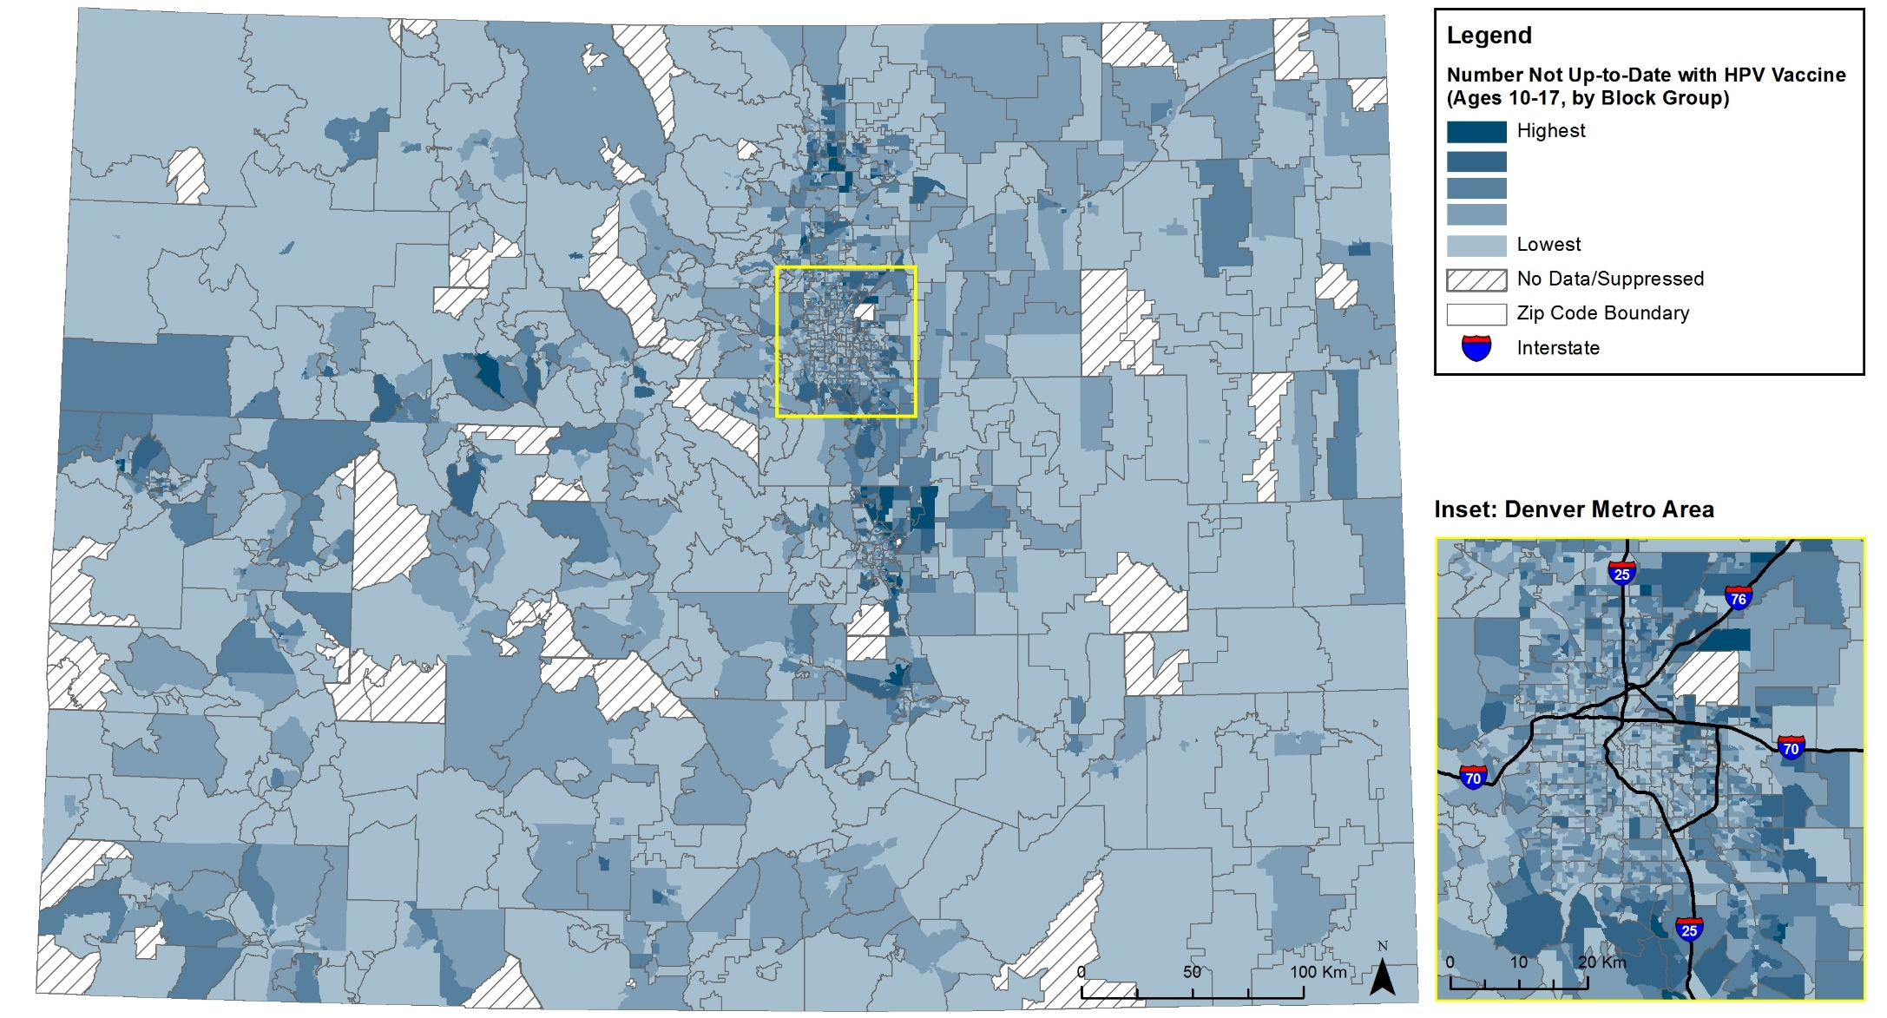
Number of adolescents (ages 10-17) not up-to-date with HPV vaccine, by block group, Colorado, 2018
Data represents zip code level vaccination rates for adolescents (who were aged 11-17 between 1/1/2018 to 6/30/2018 and their vaccination status as of 12/31/2018) applied to the population estimate of adolescents (aged 10-17) in underlying block groups. Up-to-date was defined as 2 doses given if started before 15 years of age and 3 doses if started after 15 years of age. Areas in zip codes with a numerator or denominator less than three have been suppressed. Vaccination data were supplied in part by the Colorado Immunization Information System of the Colorado Department of Public Health and Environment, which specifically disclaims responsibility for any analyses, interpretations, or conclusions based on the given data. Block group population estimates were obtained from the 2017 American Community Survey 5-year estimates. Data were managed, analyzed, and mapped in SAS 9.3 and ArcMap 10.3.1 by the University of Colorado Cancer Center. Sources: Zip Code Tabulation Area layer and Block Group layer, US Census Tiger Shapefiles.
Composed by Amy Mellies and Myles Cockburn

Slide 11
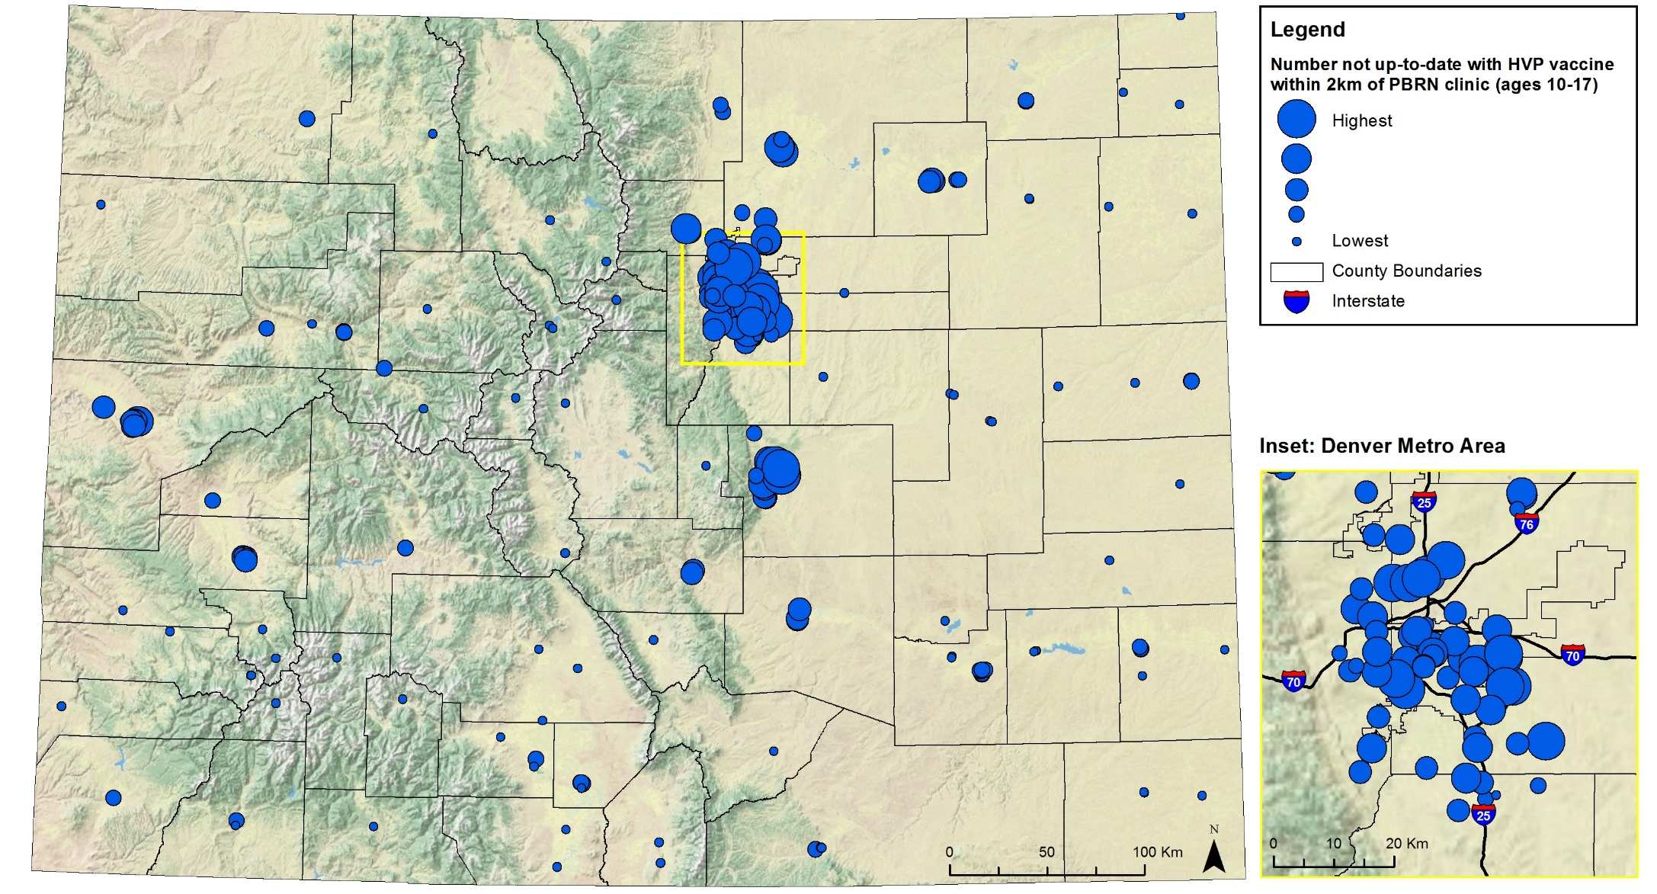
Number of adolescents (ages 10-17) not up-to-date with HPV vaccine within 2km of PBRN clinics, Colorado, 2017-2018
Data represents zip code level vaccination rates for adolescents (who were aged 11-17 between 1/1/2018 to 6/30/2018 and their vaccination status as of 12/31/2018) applied to the population estimate of adolescents (aged 10-17) in underlying block groups. Up-to-date was defined as 2 doses given if started before 15 years of age and 3 doses if started after 15 years of age. Areas in zip codes with a numerator or denominator less than three have been suppressed. Vaccination data were supplied in part by the Colorado Immunization Information System of the Colorado Department of Public Health and Environment, which specifically disclaims responsibility for any analyses, interpretations, or conclusions based on the given data. Block group population estimates were obtained from the 2017 American Community Survey 5-year estimates. Data were managed, analyzed, and mapped in SAS 9.3 and ArcMap 10.3.1 by the University of Colorado Cancer Center. Sources: Zip Code Tabulation Area layer and Block Group layer, US Census Tiger Shapefiles.
Composed by Amy Mellies and Myles Cockburn

Slide 12
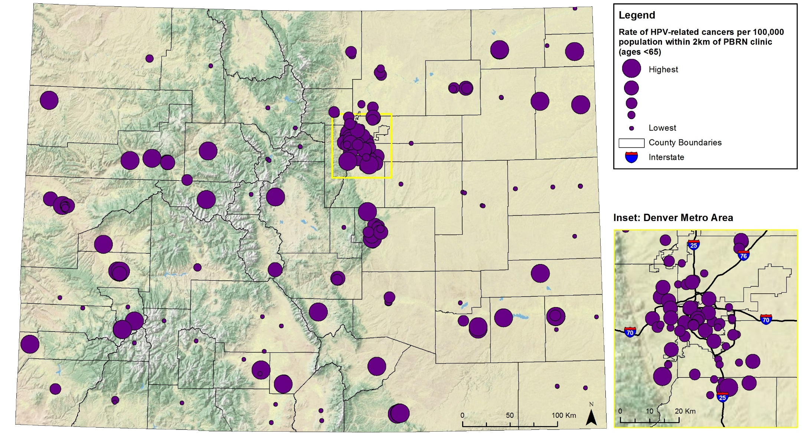
Rate of HPV-related cancers per 100,000 population (ages <65) within 2km of PBRN clinics, Colorado, 2006-2015
Data represents incident cases of HPV-related cancer diagnosed between 1/1/2006 to 12/31/2015. HPV-related cancer was defined as cancer of the cervix, tonsil, and base of tongue. Rates based on latitude/longitude of patient address at diagnosis and underlying block group population estimates. Cancer data was provided by the Colorado Central Cancer Registry, Colorado Department of Public Health and Environment, which specifically disclaims responsibility for any analyses, interpretations, or conclusions based on the given data. Data were managed, analyzed, and mapped in SAS 9.3 and ArcMap 10.3.1 in a partnership between the Colorado Central Cancer Registry and the University of Colorado Cancer Center. Sources: County layer, US Census Tiger Shapefiles.
Composed by Amy Mellies and Myles Cockburn

Slide 13
Ranking of PBRN Clinics
Clinic | # adolescents not up-to-date with HPV vaccine | Rate of HPV-related cancers per 100,000 | Vaccination DECILE | Cancer burden DECILE | DECILE Combined Score
1 | 2,270 | 77.9 | 10 | 8 | 18
2 | 962 | 109.8 | 8 | 9 | 17
3 | 896 | 96.6 | 8 | 9 | 17
4 | 1,253 | 88.7 | 9 | 8 | 17
5 | 1,480 | 87.8 | 9 | 8 | 17
6 | 1,428 | 87.3 | 9 | 8 | 17
7 | 1,180 | 83.2 | 9 | 8 | 17
8 | 1,491 | 80.9 | 9 | 8 | 17
9 | 586 | 182.7 | 6 | 10 | 16
10 | 482 | 152.1 | 6 | 10 | 16

Slide 14
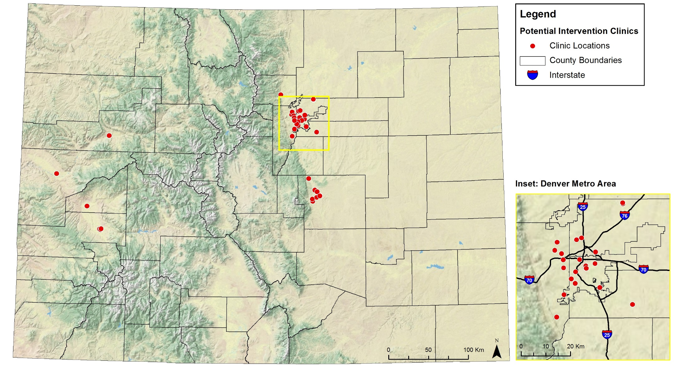
Locations of Colorado Practice-Based Research Network Clinics Considered for HPV Vaccination Intervention, 2019
Clinics selected based on highest combined decile score for number of adolescents not up-to-date with HPV vaccine AND incidence rate of HPV-related cancers. Clinic locations (n=39) provided by the SNOCAP Network Coordinator, Department of Family Medicine, University of Colorado. Sources: County layer, US Census Tiger Shapefiles.
Composed by Amy Mellies and Myles Cockburn

Slide 15
Next Steps
Approach clinics to assess readiness to change and acceptance of the evidence-based intervention shown to improve adolescent HPV vaccination rates.
These data will assist in developing future grant applications to implement this intervention in the highest risk regions of Colorado.

Slide 16
References
Centers for Disease Control and Prevention. Cancers associated with human papillomavirus, United States—2010–2014. USCS data brief, no. 1. (Dec 2017). Accessed 8/9/2018 from: https://www.cdc.gov/cancer/hpv/pdf/USCS-DataBrief-No1-December2017-508.pdf.
Markowitz LE, Dunne EF, Saraiya M, et al. Human papillomavirus vaccination: recommendations of the Advisory Committee on Immunization Practices (ACIP). MMWR Recomm Rep. 2014;63(No. RR-05).
Walker TY, Elam-Evans LD, Singleton JA, et al. National, regional, state, and selected local area vaccination coverage among adolescents aged 13-17 years: United States, 2016. MMWR Morb Mortal Wkly Rep. 2017;66(33):874-882.
Dempsey AF, Pyrznawoski J, Lockhart S, et al. Effect of a Health Care Professional Communication Training Intervention on Adolescent Human Papillomavirus VaccinationA Cluster Randomized Clinical Trial. JAMA Pediatr. 2018;172(5):e180016.

Slide 17
Questions?
amy.mellies@ucdenver.edu
This work was supported in part by the Population Health Shared Resource of the University of Colorado Comprehensive Cancer Center funded by the National Cancer Institute grant P30CA046934.

