Slide 1
Quality Review of Pancreas Cancer
Presenter: Patrick Nicolin, BA, CTR
Metropolitan Detroit Cancer
Surveillance System (MDCSS)
Wayne State University

Slide 2
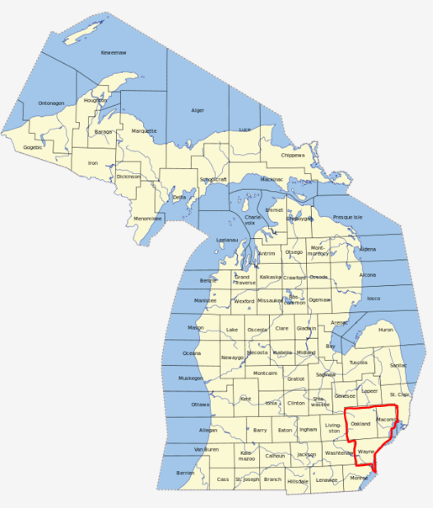
MDCSS
Population-based, central cancer registry
25,000 cases annually
3.8 million population in catchment area
Reports data to:
State of Michigan
NCI SEER Program
50+ facilities
Map compliments of www.bing.com

Slide 3
Pancreas Cancer
Rare cancer (3% of new cancers)
Poor survival (9%)
3rd leading cause of cancer deaths
Source: Surveillance, Epidemiology and End Results (SEER) Program website. New Cases (SEER 13), Cancer Deaths (US), Survival (SEER 18) – https://seer.cancer.gov/statfacts/html/pancreas.html, accessed 04/16/19.

Slide 4
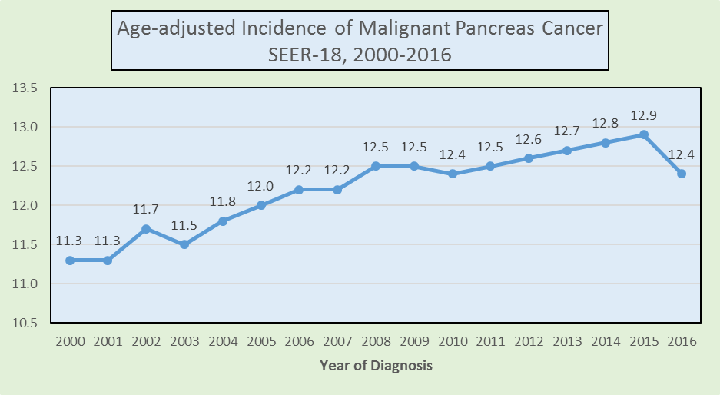
Trend
Pancreas cancer incidence has increased over time.
Source: Surveillance, Epidemiology, and End Results (SEER) Program (www.seer.cancer.gov) SEER*Stat Database: Incidence - SEER 18 Regs Research Data + Hurricane Katrina Impacted Louisiana Cases, Nov 2018 Sub (2000-2016) <Katrina/Rita Population Adjustment> - Linked To County Attributes - Total U.S., 1969-2017 Counties, National Cancer Institute, DCCPS, Surveillance Research Program, released April 2019, based on the November 2018 submission.

Slide 5
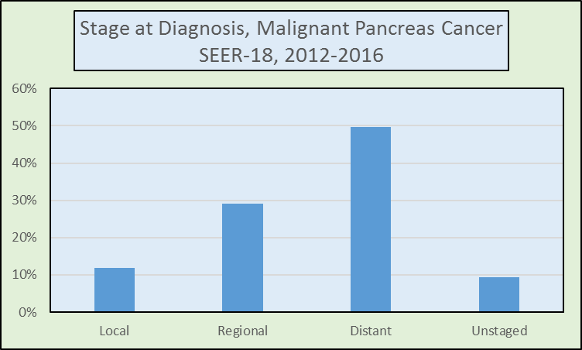
Stage
Only about 12% are diagnosed at local stage.
Source: Surveillance, Epidemiology, and End Results (SEER) Program (www.seer.cancer.gov) SEER*Stat Database: Incidence - SEER 18 Regs Research Data + Hurricane Katrina Impacted Louisiana Cases, Nov 2018 Sub (2000-2016) <Katrina/Rita Population Adjustment> - Linked To County Attributes - Total U.S., 1969-2017 Counties, National Cancer Institute, DCCPS, Surveillance Research Program, released April 2019, based on the November 2018 submission.

Slide 6
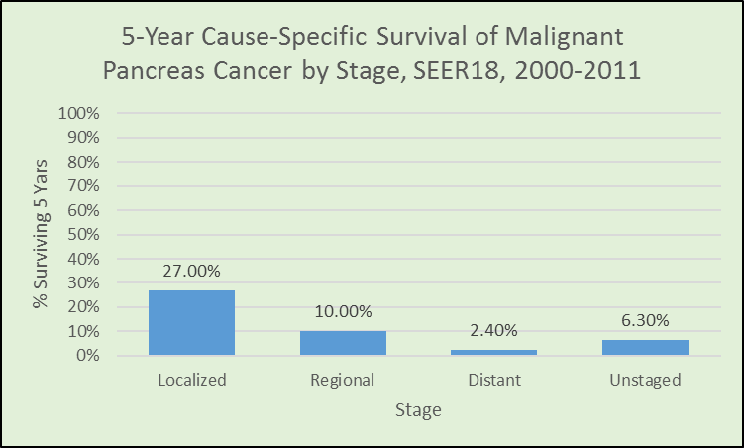
Survival
Survival is poor
<10 % survive 5 years
<1/3 of local stage cases survive 5 years

Slide 7
Surgery
Surgery performed in only about 20% of pancreas cancers.
Only 27% of cases that receive surgery survive for at least 5 years.

Slide 8
Importance
Due to rarity of the disease, poor prognosis and few treatment options, it is vitally important that any treatment provided for pancreas cancer cases be correctly coded, to inform future treatment efforts and survival evaluations.

Slide 9
Background and Issue
Pancreas cancer surgery coding anomalies
Were identified by the Quality Control Coordinator
Hospital abstracts submitted to the central cancer registry

Slide 10
Learning Objectives
Evaluate whether pancreas cancer surgery coding errors were attributable to specific facilities.
Determine whether registrars understand the pancreas cancer surgery codes.
Determine whether specific characteristics predict surgeries likely to be miscoded.

Slide 11
Methods
We randomly assigned:
286 pancreas cancers
That received surgery
To 2 quality reviewers
Diagnosed 2015-2016
A procedure worksheet was designed that both reviewers followed, to standardize evaluation.

Slide 12
Methods
Documentation reviewed (when available):
Abstract text
Operative reports
Pathology reports

Slide 13
Methods
Quality Review:
Reviewers compared the original abstractor surgery code, the surgery code later assigned by the central cancer registry editor and the surgery code assigned by the reviewer.
The reviewer assigned two summary variables to distinguish whether there was a change in coding between the original abstract surgery code and the central registry editor review and whether there was a change between the original abstract code and the study quality reviewer.

Slide 14
Methods
Statistical Review:
Frequencies by outcome codes and graphs were generated in Excel©.
Reviewer data was linked to hospital identity, tumor and patient demographic characteristics using SAS© v.9.4.
Frequencies, overall percent agreement, chi-square and Kappa test statistics were generated using SAS©.
Following removal of non-analytical cases and duplicates, 276 remained for analysis.

Slide 15
Results
Overall percent agreement between the original abstractor and study quality reviewer was 61% (Kappa=0.48, p<0.0001), indicating only moderate agreement.
Agreement occurred more frequently in females (67%, p=0.0454) but there was no statistical difference by quality reviewer, year of diagnosis (2015, 2016), race (White, African Am, Other/Unk), ethnicity (Hispanic, Non-Hispanic), age (0-59, 60-74, 75+), primary site (Head, Body, Tail, Other (included Pancreatic Duct, Islets of Langerhan, Other Pancreas, Pancreas NOS), Overlapping), histology (Adenocarcinoma, Mixed Adenocarcinoma, Carcinoid/Neuroendocrine, Infiltrating Ductal Carcinoma NOS) or stage (in situ & local, regional, distant, n=145).
After initial evaluation, it was determined that due to small sample sizes, differences by individual hospital were not evaluated.
Overall percent agreement between the central registry editor and study quality reviewer was slightly higher at 69% (Kappa=0.55, p<0.001).

Slide 16
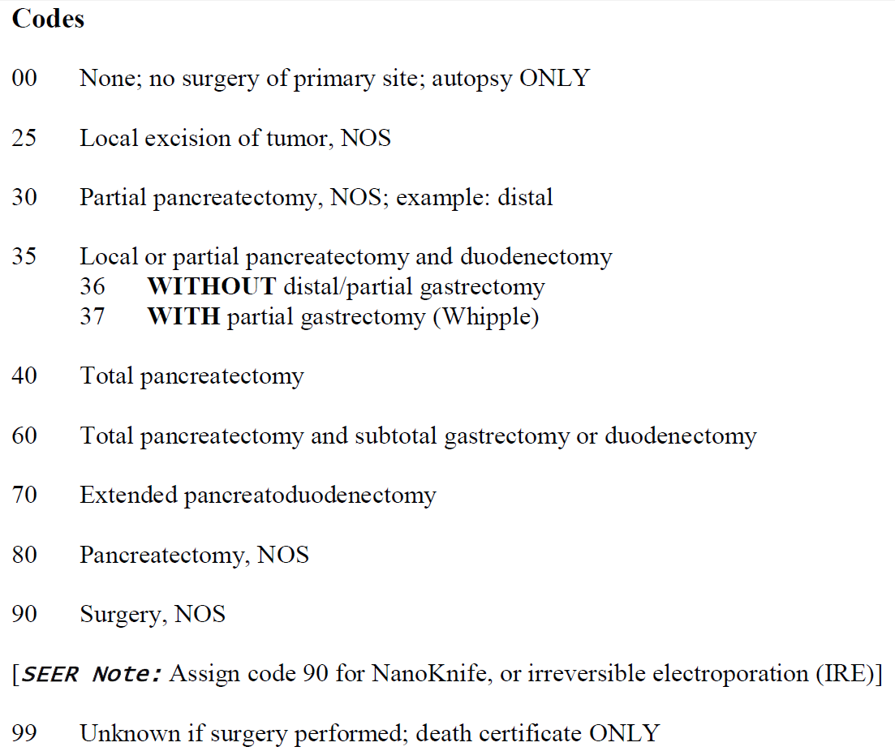
Trouble Codes
Highest errors were with pancreatectomy/duodenectomy codes:
36 - without distal/partial gastrectomy
37 - with partial gastrectomy (Whipple)
followed by:
30 - partial pancreatectomy, nos

Slide 17
Training Suggestions
For the WHIPPLE procedure, key for the abstractor to look for are:
Pylorus preserving on operative report
That means the stomach was not removed.
Another key is to check the gross description of the specimen to make sure the stomach is included.
If so, code = 37
If not, code = 36
You can also anticipate the correct surgery code based upon the cancer sub-site:
Head of pancreas would likely be a Whipple resection (code 36 or 37)
Tail of pancreas would likely be a distal pancreatectomy (code 30)

Slide 18
Results
60% - no change
10% - central registry staff correctly re-coded submitting hospital’s incorrect surgery code
25% - central registry staff missed facility coding errors
4% - the facility and central registry were incorrect
1% - the facility was correct but central registry staff changed a code to be incorrect.

Slide 19
Practical Issues
At the time of this study, the central registry did not collect submission hospital abstractor identities.
Central registry abstractors could be identified.
Errors found in central registry staff did not seem related to level of abstractor experience.

Slide 20
Actions
Hospitals
A new variable was added to the SEER*DMS to track first name and last name initials of Hospital Abstractors, so the central registry could determine if one Hospital staffer had an issue or the entire Hospital Tumor Registry staff.
Central registry
Pancreas Cancer Surgery Codes were reviewed at Abstractor/Editor Team meetings.
Plans are in place to communicate findings and training tips to area hospitals.

Slide 21
Learning Objectives

Slide 22
Conclusions
Our review of pancreas cancer surgery codes revealed misunderstanding of coding pancreatic surgery - amongst both hospital and central registry staff.
Additional training and feedback to hospital and registry staff are in progress.

Slide 23
Questions?
Notes:
In Slide Show mode, select the arrows to visit links.

Slide 24
Acknowledgements

