Slide 2
How to interpret the geographical variations in the incidence of bladder tumours in Europe
Carmen Martos, Francesco Giusti, Emanuele Crocetti, Giorgia Randi, Luciana Neamtiu, Tadeusz Dyba, Nadya Dimitrova, Raquel N. Carvalho, Manuela Flego, Manola Bettio
Joint Research Centre – Ispra (Italy). European Commission
IACR / NAACCR Combined Annual Conference
Vancouver 11-13 June 2019

Slide 3
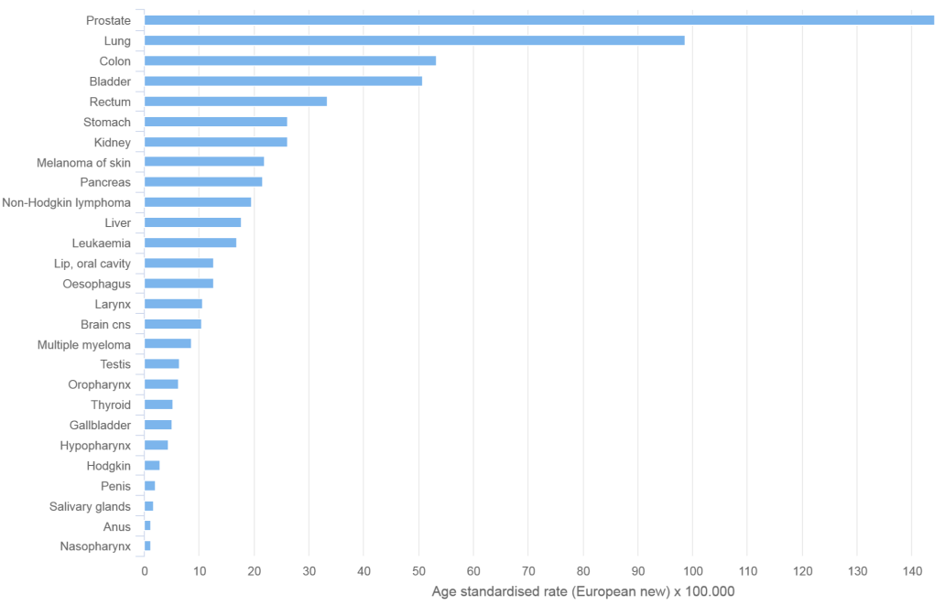
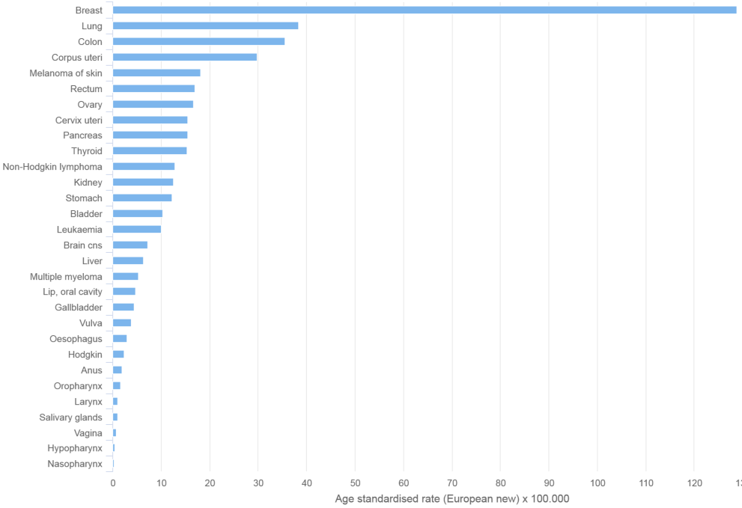
Background (1)
Estimates of cancer incidence in Europe, 2018
51 per 100 000
12 per 100 000
Males
Females
Source: ECIS - European Cancer Information System From https://ecis.jrc.ec.europa.eu. accessed on 09/May/2018 © European Union. 2018

Slide 4
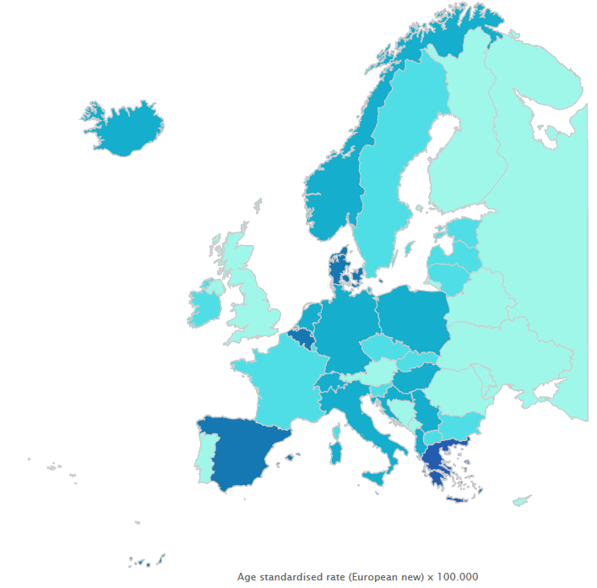
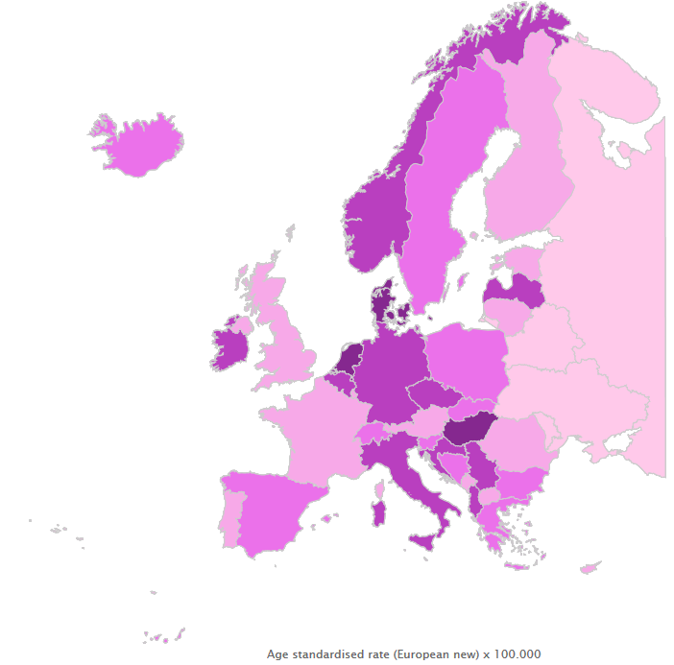
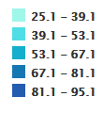
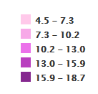
Background (2)
Estimates of bladder cancer incidence in Europe, 2018
Males
Females
Source: ECIS - European Cancer Information System From https://ecis.jrc.ec.europa.eu. accessed on 09/May/2018 © European Union. 2018

Slide 5
Background (3)
Registration practices, such as inclusion of non-invasive bladder tumours and rules for multiple primaries cancers, could affect geographical differences in bladder cancer incidence across Europe.
Since Volume VII "Cancer Incidence in Five Continents", the bladder cancer rubric (ICD-10 C67) has included the in situ (ICD-10 D09.0) and uncertain behaviour (ICD-10 D41.4) categories.

Slide 6
Background (4)
Bladder tumours → Cancer Incidence in Five Continents definition.
https://ecis.jrc.ec.europa.eu/index.php

Slide 7
Objective
To explore the impact of different registration practices and case definitions on the bladder tumour incidence among European cancer registries for the period 2008-2012 by European region and sex.

Slide 8
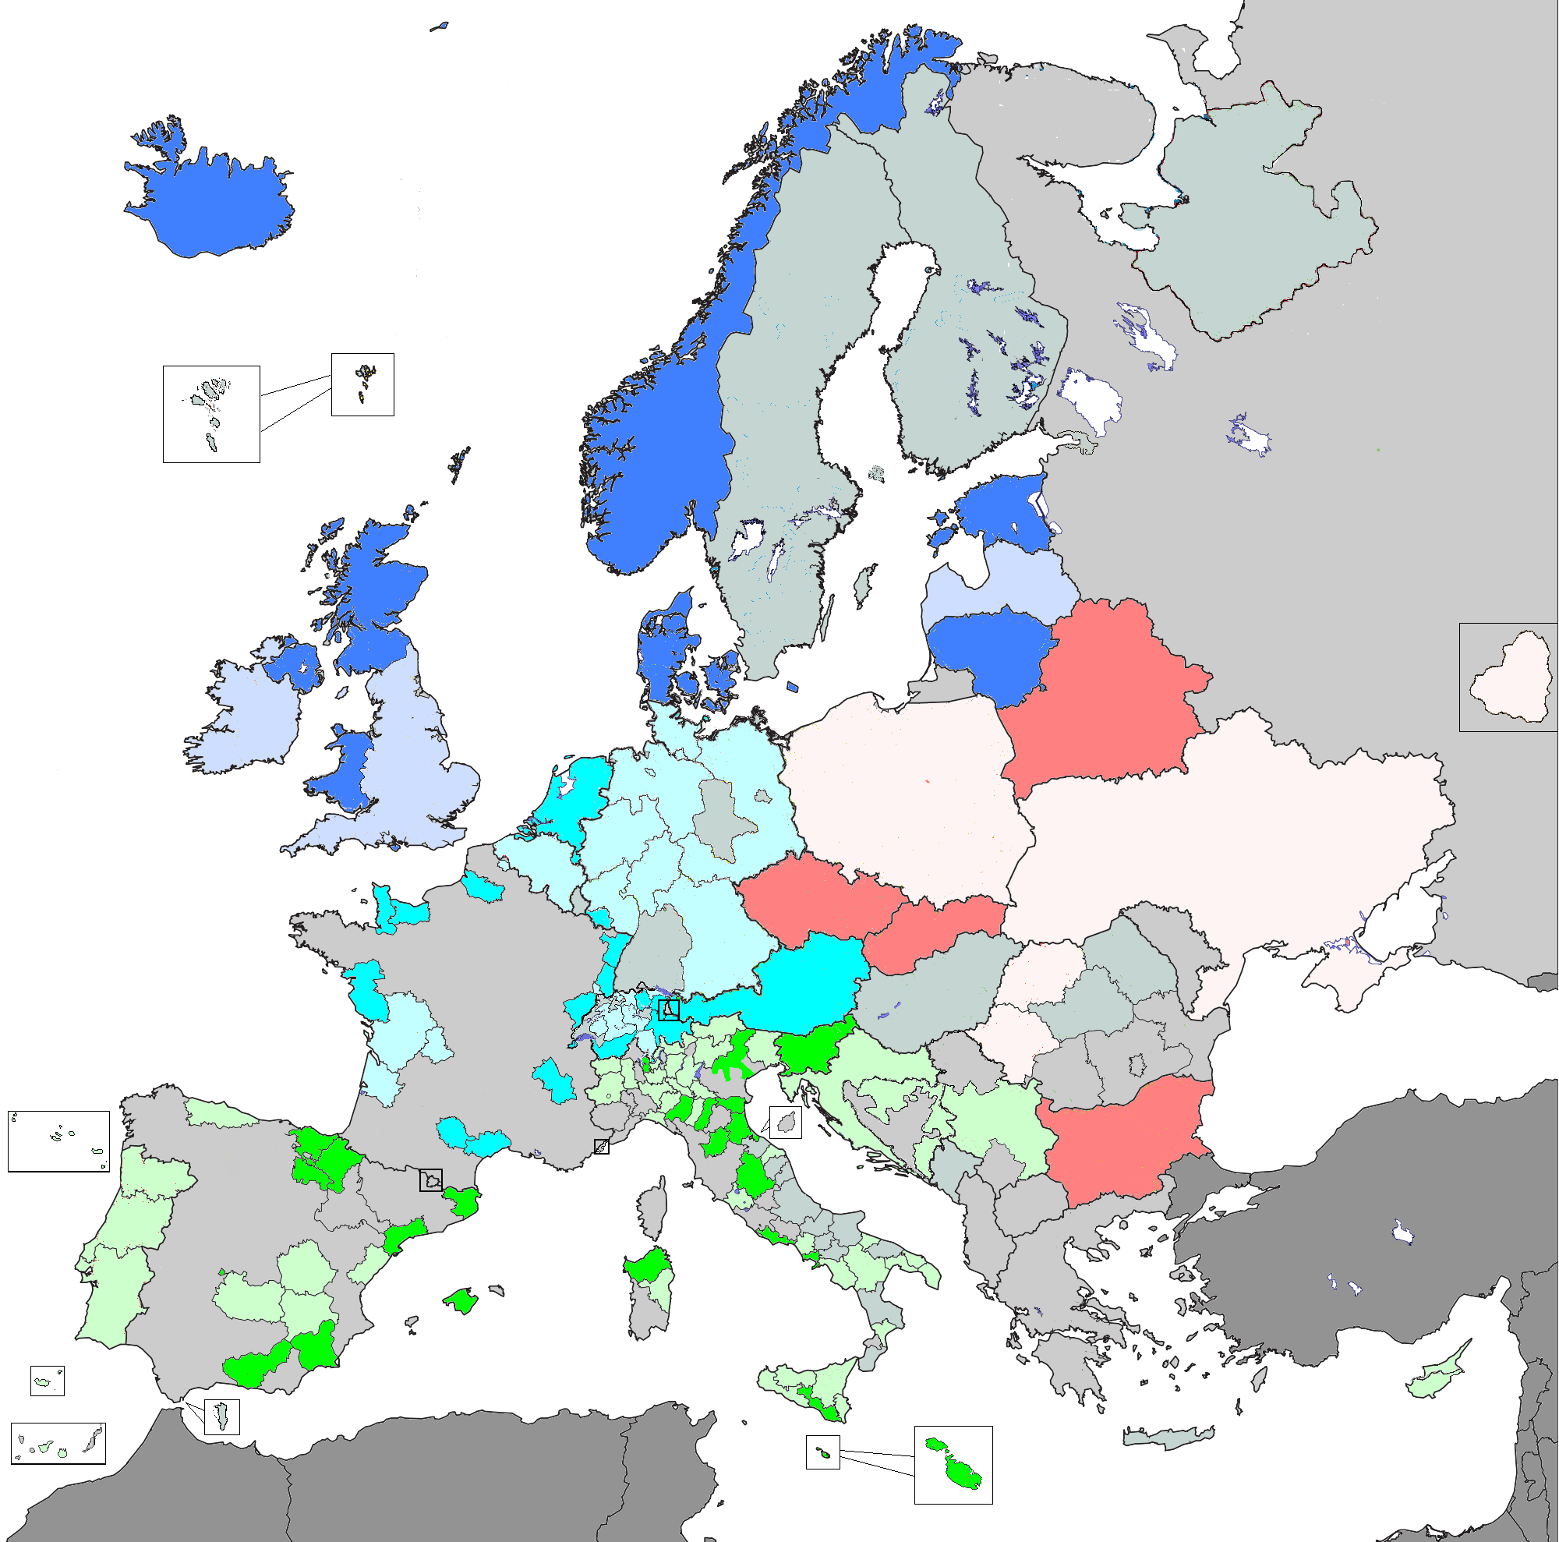
Material and Methods (1)
Data from 52 European population-based cancer registries contributing to the European Cancer Information System (ECIS) and covering a period of at least 20 years were included in the analysis.
A total of 150,618 bladder tumours occurring in the period 2008-2012 were analysed.
The cancer registries were grouped in 4 regions according to the UN European regions.
N Europe
W Europe
E Europe
S Europe
Data N/A

Slide 9
Material and Methods (2)
Three scenarios were compared:
Invasive tumours (behaviour = 3)
Invasive (behaviour = 3) and non-invasive (behaviour 1 and 2) cases sent by the cancer registries.
Invasive (behaviour = 3) and non-invasive (behaviour 1 and 2) cases with the application of the 2004 Multiple Primary Cancer rules and correction of the warnings identified by the JRC-ENCR Quality Check Software.
In which scenario the variability of the bladder tumour incidence is higher among European regions?

Slide 10
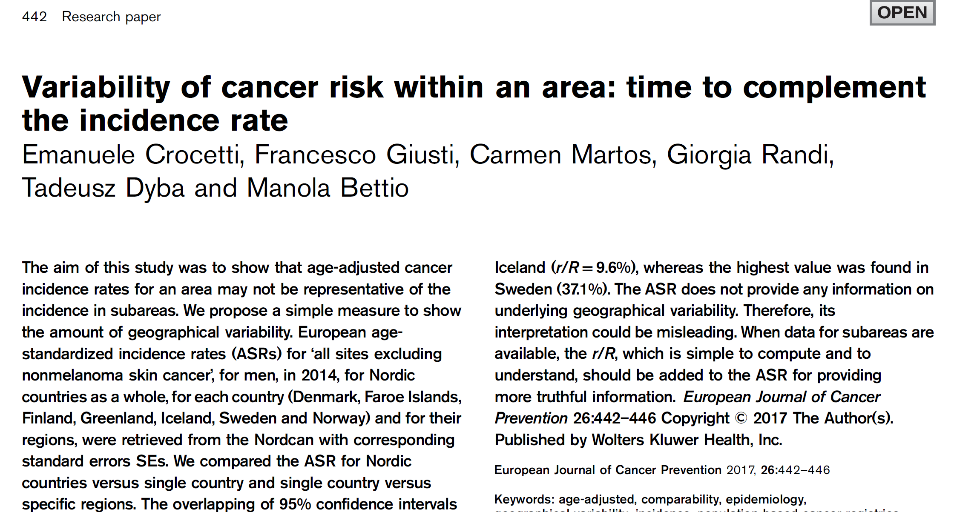
Material and Methods (3)
Computations:
Age standardized rates (ASR) using the 2013 European Standard Population and 95% confidence intervals by region, scenario and sex.
The percent ratio between the highest absolute difference in cancer registry-specific ASRs (range) and the overall ASR of the region (range/ASR*100: r/R%) by region, scenario and sex.

Slide 11
Results (1)
Incidence (ASR) of bladder tumours, males 2008-2012 by European regions

Slide 12
Results (2)
Incidence (ASR) of bladder tumours, females 2008-2012 by European regions

Slide 13
Results (3)
Regions | Scenario 1 ASR (CI) r/R% |  | Scenario 2 ASR (CI) r/R% |  | Scenario 3 ASR (CI) r/R%
Eastern Europe Highest ASR Lowest ASR | 40.8 (40.2-41.4) 47.3 36.4 | 27% | 43.7 (43.1-44.4) 52.4 36.7 | 36% | 42.8 (42.2-43.4) 50.4 36.6 | 32%
Northern Europe Highest ASR Lowest ASR | 38.0 (32.5-33.5) 51.1 25.6 | 77% | 51.8 (51.2-52.5) 62.7 37.8 | 48% | 49.2 (48.6-49.9) 55.6 35.7 | 40%
Southern Europe Highest ASR Lowest ASR | 53.0 (52.2-53.7) 80.1 31.1 | 93% | 77.4 (76.5-78.3) 97.4 48.9 | 63% | 76.1 (75.3-77.0) 97.2 46.1 | 67%
Western Europe Highest ASR Lowest ASR | 37.2 (36.7-37.6) 41.3 24.7 | 45% | 59.3 (58.7-59.9) 79.4 31.2 | 81% | 56.5 (55.9-57.0) 72.9 31.2 | 74%
Incidence (ASR) of bladder tumours, males 2008-2012

Slide 14
Results (4)
Regions | Scenario 1 ASR (CI) r/R% |  | Scenario 2 ASR (CI) r/R% |  | Scenario 3 ASR (CI) r/R%
Eastern Europe Highest ASR Lowest ASR | 8.5 (8.3-8.7) 12.3 4.8 | 87% | 9.2 (9.0-9.4) 13.2 4.9 | 90% | 9.0 (8.8-9.2) 12.6 4.9 | 86%
Northern Europe Highest ASR Lowest ASR | 9.2 (8.9-9.4) 11.9 6.0 | 65% | 14.2 (13.9-14.5) 20.0 7.9 | 85% | 13.6 (13.3-13.8) 18.5 7.9 | 78%
Southern Europe Highest ASR Lowest ASR | 9.1 (8.9-9.4) 14.6 4.7 | 108% | 13.7 (13.3-14.0) 18.3 10.1 | 60% | 13.5 (13.1-13.8) 18.3 9.9 | 62%
Western Europe Highest ASR Lowest ASR | 8.7 (8.5-8.9) 10.0 5.6 | 50% | 13.4 (13.1-13.6) 18.8 5.8 | 97% | 12.8 (12.6-13.1) 18.7 5.8 | 100%
Incidence (ASR) of bladder tumours, females 2008-2012

Slide 15
Conclusions
This study shows a wide incidence variability of bladder tumours within and between European regions.
This variability could be due, at least partially, to the case definition and registration practices of the European cancer registries.
Further harmonisation in registration practices and reporting cases is essential for proper comparability and interpretation of bladder tumour incidence rates in Europe.

Slide 16
Further steps (1)
To review the ENCR recommendations for bladder (1995)
Questions:
Should other urothelial tumours of renal pelvis, ureter and other urinary organs with behaviour 1 and 2 be included as reporting cases or only urothelial tumours of the bladder or only tumours with behaviour 3 ?
Should all morphologies of bladder with behaviour 1 and 2 be included as reporting cases? Only for bladder or also for other urinary organs?...........
ENCR Working Group on urothelial tumours
European Network of Cancer Registries
Joint Research Centre
European Commission

Slide 17
Further steps (2)
To explore the impact of the different reporting case definitions on the incidence time trends of bladder tumours and other urinary organs in the European cancer registries.
To identify the impact of the different multiple primary cancer rules on the incidence of bladder tumours and other urinary organs.

Slide 18
Thank you
Stay in touch!
ec.europa.eu/jrc
@EU_ScienceHub
EU Science Hub - Joint Research Centre
Joint Research Centre
EU Science Hub

Slide 19
Thank you
ENCR-JRC Training on Cancer
Registry Data Coding
JRC Ispra, 5-6 June 2019
JRC-ENCR@ec.europa.eu
https://www.encr.eu/

