Slide 1
ESTIMATING THE NUMBER OF PEOPLE IN ITALY LIVING AFTER A CHILDHOOD CANCER USING THE SOFTWARE COMPREV
ANNA GIGLI – National Research Council, Italy
SILVIA FRANCISCI – National Health Institute, Italy
STEFANO GUZZINATI – Veneto Cancer Registry, Italy
LUIGINO DAL MASO – Aviano Cancer Institute, Italy

Slide 2
RATIONALE
Childhood cancer survival has increased significantly during the last decades
As a consequence an increasing number of adults require appropriate follow-up care due to recurrences and late effects of early treatments
It is important to correctly estimate the prevalence of people diagnosed in their childhood, in order to assess their current healthcare needs
BUT it is difficult, because we have little (or not at all) information on cancer diagnosis in the very past (before the cancer registries began collecting data)

Slide 3
AIMS AND GOALS
We conducted a study in Italy to estimate how many adults alive at time Y have been diagnosed any time in the past with cancer in ages 0-14
Indicator: Complete Prevalence of cases diagnosed in childhood CP_{Y}
Estimates obtained using the software ComPrev

Slide 4
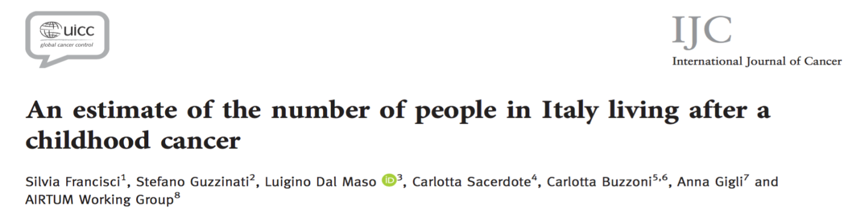
APPLICATION TO ITALIAN DATA
15 Cancer Registries. Incident cases in 1995-2009, diagnosed in age 0-14
Prevalence date Y=1.1.2010 -> Limited–duration prevalence available for 15 years - LDP(15)
All types, Hodgkin’s Disease, Acute Lymphocytic Leukemia, Nervous Central System
Notes:
Più che example la chiamerei application to Italian data e anticiperei già alcuni elementi della parte di applicazione

Slide 5
CHILDPREV METHOD
Pre-CR
extrapolation
CR era
85
No info
Age
29
Partial info
15
14
Complete info
AGE AT DIAGNOSIS
0
1925
1981
1995
2010
Calendar time
Mathematical details in: Simonetti et al (2009) Statistics in Medicine

Slide 6
DATA SOURCES
Population and observed cases in the last 15 years of observation by cancer registry and cancer types
Geographic coverage: 18% of Italy
Notes:
Metterei qui una diapo sui materiali (versione ridotta della table 1 dell’articolo → table 1 del poster)

Slide 7
COMPLETE PREVALENCE OF ALL TYPES
Prevalence fully observed in ages 0-15 (LDP is for 15 years)
Prevalence partially observed in ages 16-29 (29= 14+15)
Prevalence not observed in ages 30+
Notes:
Questa diapo la metterei all’inizio, forse potrebbe proprio sostituire la 12

Slide 8
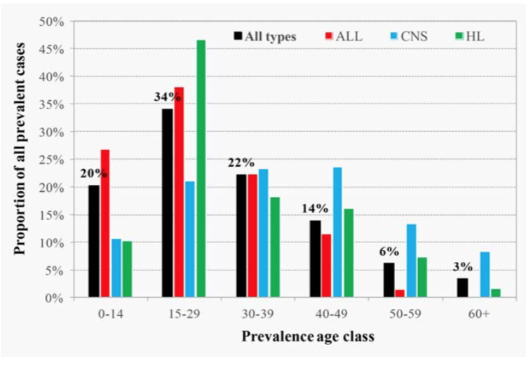
CP BY CANCER TYPE AND AGE
ALL more lethal: no cases survive 60+
CNS better prognosis: more cases survive longer
Distribution of complete prevalence at 1.1.2010 in Italy by cancer type and age at prevalence

Slide 9
CP PROJECTED TO ITALY 01.01.2010 BY AGE
Model constraint: Survival of ALL before 1960 = 0
Unobserved prevalence varies with:
  CR duration
  Lower surv. -> more complete data -> ALL
  Higher surv. -> more cases observed in the past -> CNS
In 0-14: ALL > CNS because incidence ALL > CNS
In 0+: they are equivalent, because ALL =0 before 1960
Notes:
Risultati suddivisi in:
0-14: casi osservati
15-29: casi parzialmente osservati
30+: casi non osservati
Le 3 sedi scelte rappresentano il 50% dei tumori; tassi femmine < maschi sempre (eccetto LLA e SNC 30+); LLA hanno tassi più alti di SNC nelle età infantili perché incidenza LLA > incidenza SNC, ma su tutte le età si equivalgono perché sopravvivenza LLA era 0 prima del 1960

Slide 10
CP OF CHILDHOOD CANCER VS ADULT CANCER
 | Males | Females | Total
ALL TYPES | 23,687 (81) | 20,449 (65) | 44,136 (73)
ACUTE LYMPHOCYTIC LEUKEMIA | 4797 (16) | 5402 (17) | 10,199 (17)
CENTRAL NERVOUS SYSTEM | 5050 (17) | 5627 (18) | 10,677 (18)
HODGKIN’S LYMPHOMA | 1831 (6) | 1250 (4) | 3081 (5)
Proportions per 100,000 in brackets

Slide 11
DISCUSSION
In 2010 in Italy 44,000 persons (about 0.07% of national population) survived from a cancer in their childhood – percentage similar to other studies in US, Nordic countries, and other collaborative studies in childhood cancer survivorship
Most people 'cured' from their disease BUT exposed to late effects of treatments received: recent studies suggest that over 40% of childhood cancer survivors treated from the 1960s to the early 1990s have experienced at least 1 chronic disease, often of severe nature.
This work provides insights in order to tailor follow up of this fragile population, and can be useful for health care planners (when allocating resources) and clinicians (in development of guidelines)
Notes:
Inserirei una slide di discussione sui risultati e sullo strumento COMPREV utilizzato per produrli, vedi un po’ come ti sembra l’ho ripresa dal poster e integrata con l’ultimo punto

Slide 12
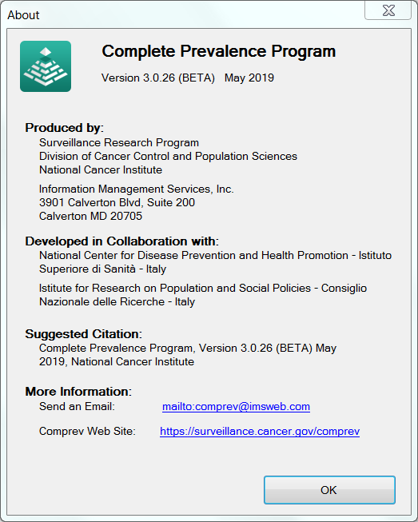
SOFTWARE COMPREV
The software ComPrev, in the new restyled version, provides a very useful and user-friendly tool to estimate childhood cancer survivors
Available freely on web site
THANK YOU
For information on how to use it: anna.gigli@cnr.it

Slide 13
APPLICATION TO ITALIAN DATA
15 Cancer Registries. Incident cases in 1995-2009, diagnosed in age 0-14
Prevalence date 1/1/2010 -> Limited–duration prevalence available for 15 years
All types, Hodgkin’s Disease, Acute Lymphocytic Leukemia, Nervous Central System
Complete info
Partial info
No info
0
15
29
85
Age at prevalence
(2010)
(1995)
(1981)
(1925)
(birth cohort)
Notes:
Più che example la chiamerei application to Italian data e anticiperei già alcuni elementi della parte di applicazione

Slide 14
CHILDPREV METHOD
INPUT:
Limited-duration Prevalence and Population for cases diagnosed at any age
Limited-duration Prevalence and Population for cases diagnosed at age 0-14
Incidence and Survival parameters estimates (Hp: constant incidence and linear survival before the observational time)
COMPUTE:
Correction factor (Completeness Index)
OUTPUT:
Complete Prevalence(diagn. 0-14)
Mathematical details in: Simonetti et al (2009) Statistics in Medicine
Notes:
Il fattore di correzione varia:
Con la durata dell’osservazione (periodo lungo, dati più completi fattore di correzione piccolo)
Con il tipo di tumore (sopravv. bassa, dati più completi fattore di correzione piccolo; incid. crescente rapidamente con l’età, pochi casi osservati nel passato fattore di correzione piccolo)
Tra maschi e femmine (p.es. LH)

Slide 15
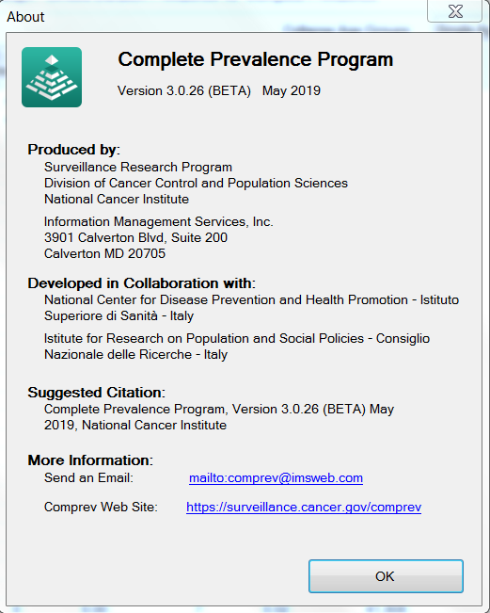
THE SOFTWARE COMPREV
Calculates Complete Prevalence statistics from cancer registry data, using parametric incidence and survival modelling
4 sessions are available, input data requirements vary with the session
RE-STYLED VERSION features:
Better user interface: graphics and exporting of results
Estimation of incidence model parameters
New session: prevalence decomposition by phase of care

Slide 16
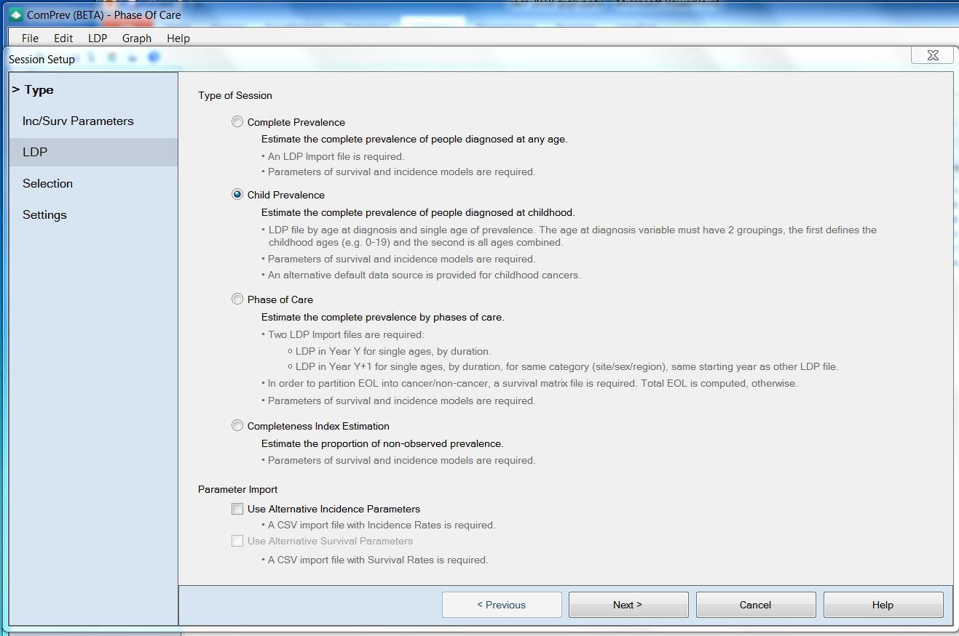
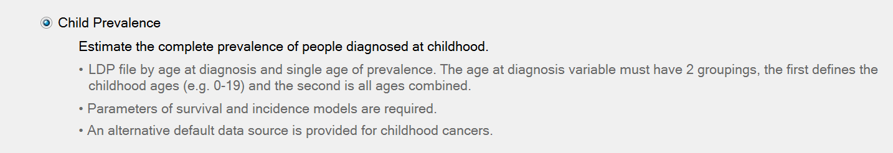
CHILDHOOD PREVALENCE SESSION
Notes:
Questa diapositiva e le successive 4 non servono ad illustrare il metodo, sono una descrizione dell’interfaccia grafica e secondo me non sono centrate rispetto al tema della presentazione, le sostituirei con qualche diapo in più sui risultati e sul commento dei risultati che invece non c’è, si possono prendere le figure dal poster

Slide 17
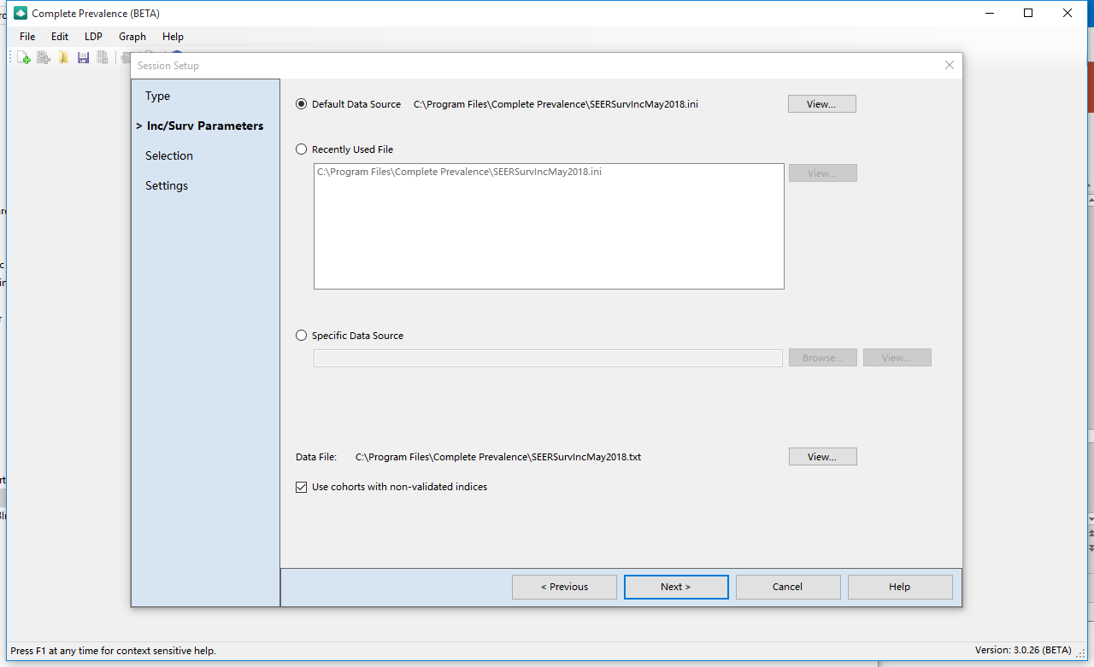
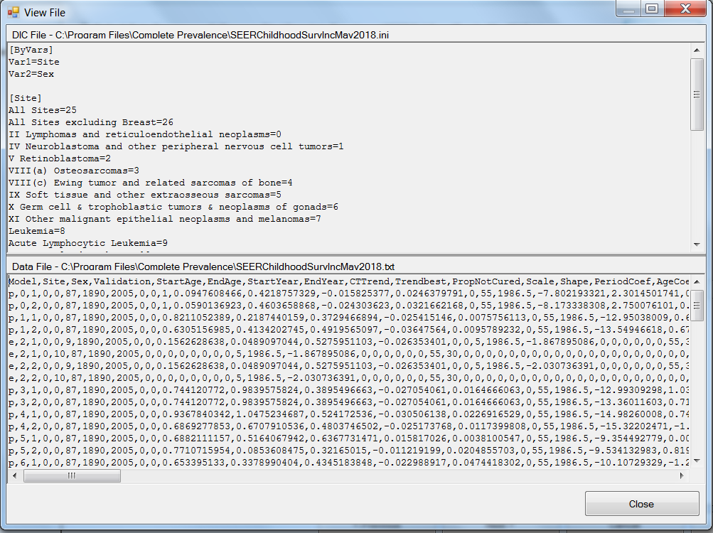
INPUT 1: THE PARAMETERS
Survival and Incidence parameters
(estimates + covariance matrix)
by sex and site
Age interval, Period interval

Slide 18
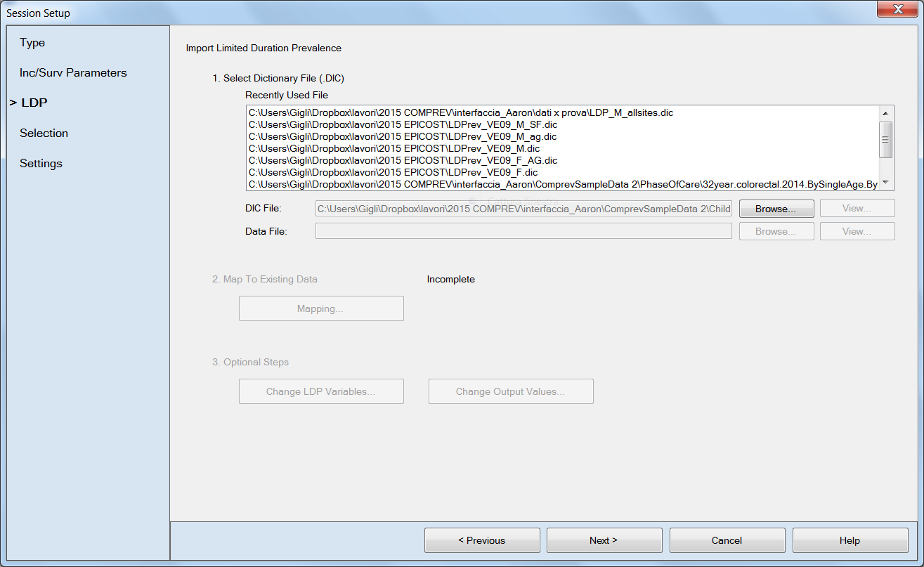
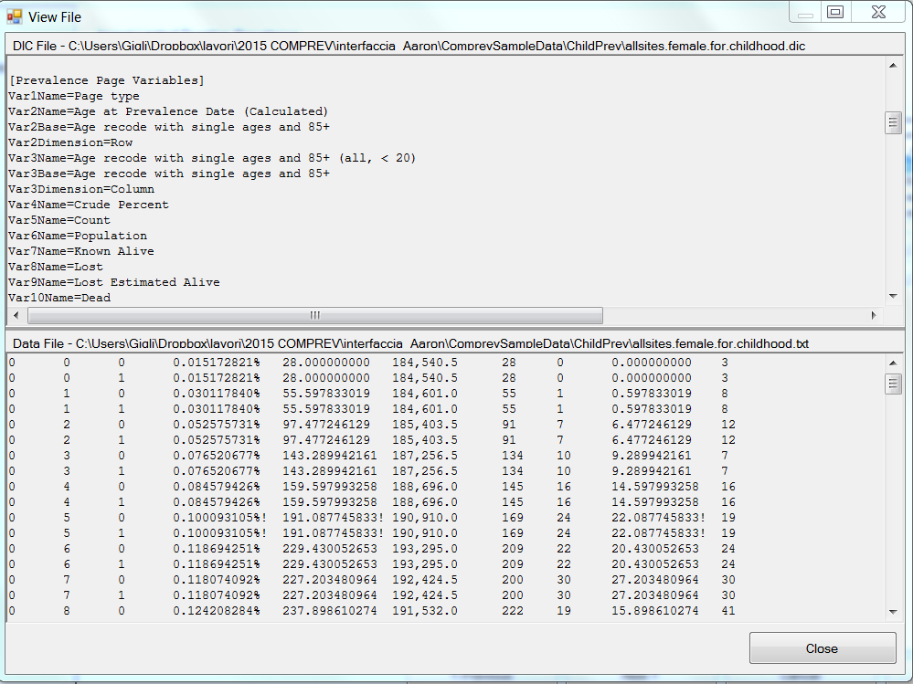
INPUT 2: THE LIMITED-DURATION PREVALENCE
Age at prevalence
Limited-duration prevalence
Population
Lost to follow-up
Dead

Slide 19
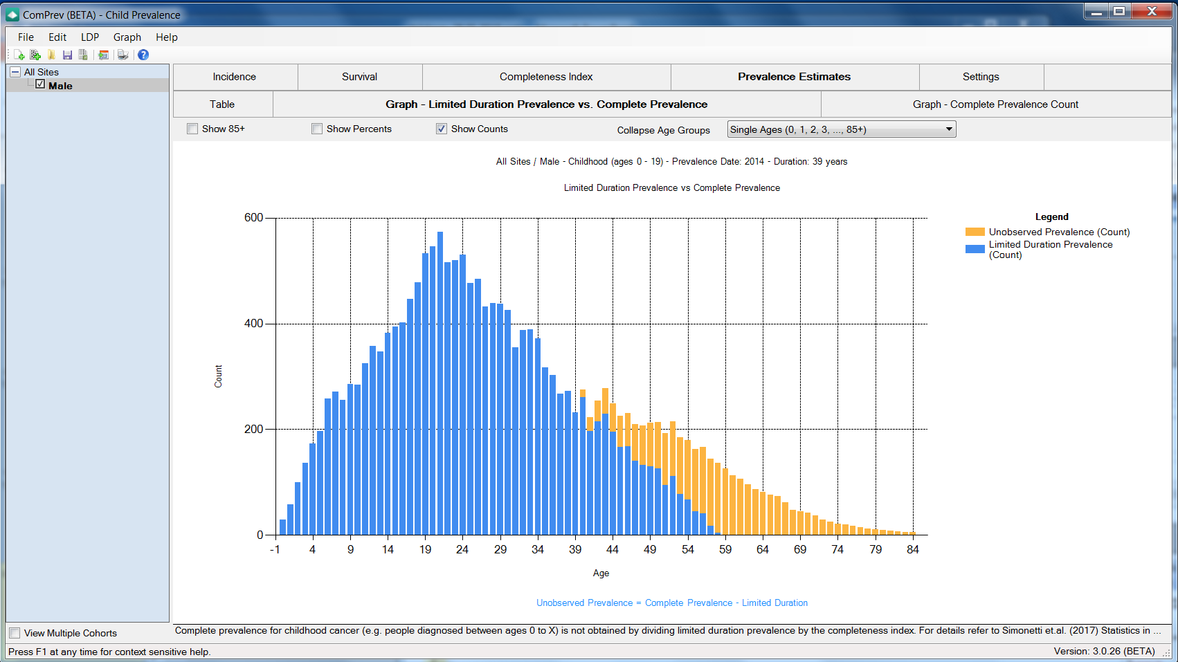
OUTPUT: THE GRAPHICS

Slide 20
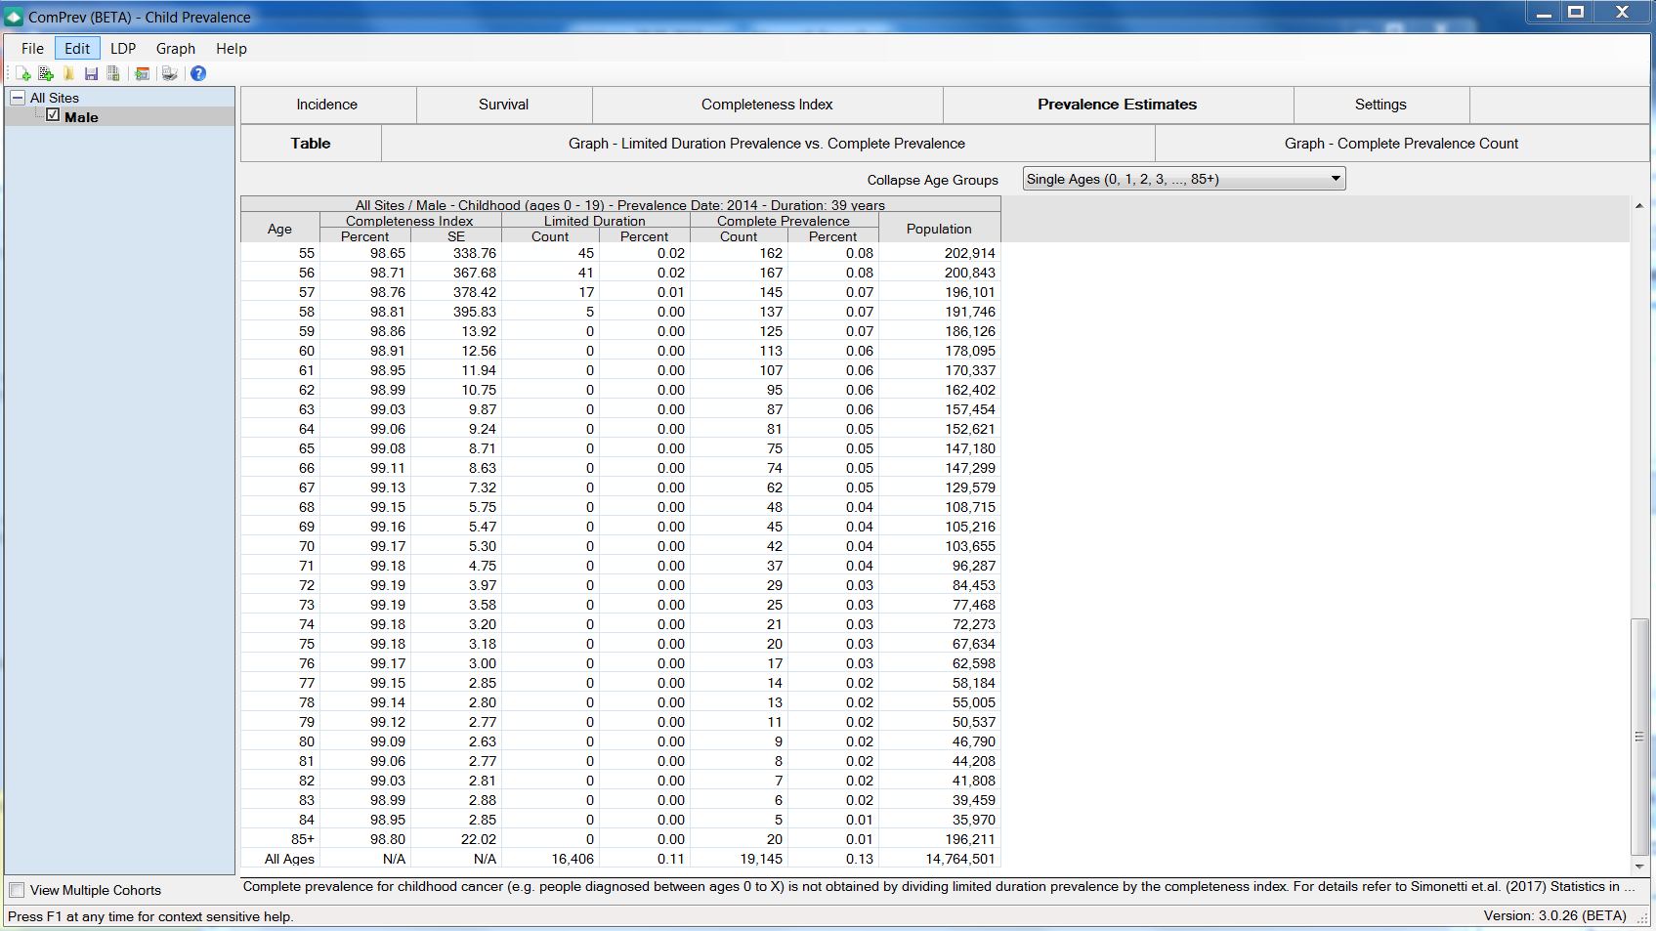
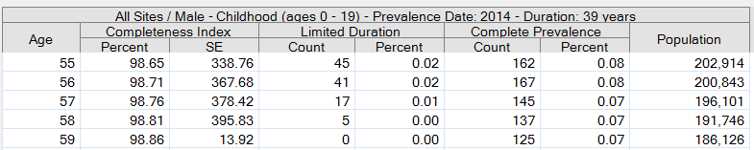
OUTPUT: THE TABLE

Slide 21
CHILDPREV METHOD
Pre-CR
extrapolation
CR era
More complex because LDP = 0 after age 29
-> need a further adjustment taking into account not only prevalence of people diagnosed at age 0-14, but also prevalence of people diagnosed at age 0+
85
No info
Age
29
Partial info
15
14
Complete info
AGE AT DIAGNOSIS
0
1925
1981
1995
2010
Calendar time
Mathematical details in: Simonetti et al (2009) Statistics in Medicine
Notes:
CR era?

Slide 22
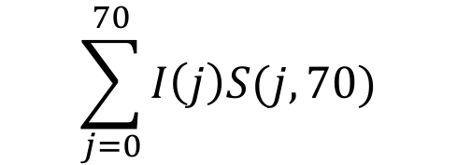

COMPLETE PREVALENCE
One way to estimate CP is via Completeness index method:
Parametric model for I and S
Compute the Completeness Index = proportion of modeled prevalence that is observable:
R(age at prev, CR length)
Combine R and LDP to obtain CP
CP (70,15) =
P (age=70) =
I (j )
probability of developing cancer at age j<70
S (j,70)
probability of surviving age 70, having been diagnosed at age j<70
LDP(70, 1$5$)
R(70,15)
Notes:
Descrivere complete prevalence e completeness index
Togliere riferimenti troppo dettagliati al software
Dare l’idea dell’importanza della stima di questi casi

