Slide 1
Investigating the effects of socioeconomic factors on cancer treatment patterns and outcomes in Canada using individual-level linked national data
Presenters: Shirley Bryan, PhD Statistics Canada
April Smith, MPH Canadian Partnership Against Cancer
Date: June 13th 2019

Slide 2
Background

Slide 3
Equity in Canada’s universal health care system
Primary objective of the Canada Health Act:
“…to protect, promote and restore the physical and mental well-being of residents of Canada and to facilitate reasonable access to health services without financial or other barriers."
-Canada Health Act (1984, c. 6, s. 3.)

Slide 4
Studies suggest Canadians of lower socioeconomic status are at a disadvantage throughout their cancer experience†…
Prevention
Screening & Early Detection
Diagnosis
Treatment
Outcomes
Higher risk factor prevalence
Less likely to be screened
More likely to be diagnosed at a late stage
Less likely to receive evidence-based treatment
Less likely to survive cancer
Worse financial situation
More likely to have unplanned hospitalizations
†Lofters AK, et al. (2015); Webber C, et al. (2017); Gorey KM, et al. (2014); McDonald JT, et al. (2014); Kerner J (2015); Ezeife DA (2018)

Slide 5
…however, existing evidence often has important limitations
Most data is only available at the ecological-level
Lack of pan-Canadian coverage (most studies include only one or two provinces)
This provided the impetus for our collaboration with Statistics Canada in linking the Canadian Cancer Registry (CCR) to tax, immigration, hospital and death data files

Slide 6
CCR-linked datasets:
T1FF
(Tax File)
1992 – 2015
6. 2016 Census Long-Form
2016
2. Discharge Abstract Database
1994/95 – 2015/16
Canadian Cancer Registry
All cancers diagnosed from 1992-2015
5. Longitudinal Immigration Database
1980 – 2015
3. National Ambulatory Care Reporting System
2002/03 – 2015/16
4. Vital Statistics Death Database
1992 – 2014
For the first time ever, researchers can study how socioeconomic factors impact cancer diagnoses, treatment patterns and patient outcomes, using national, person-level data

Slide 7
Methods

Slide 8
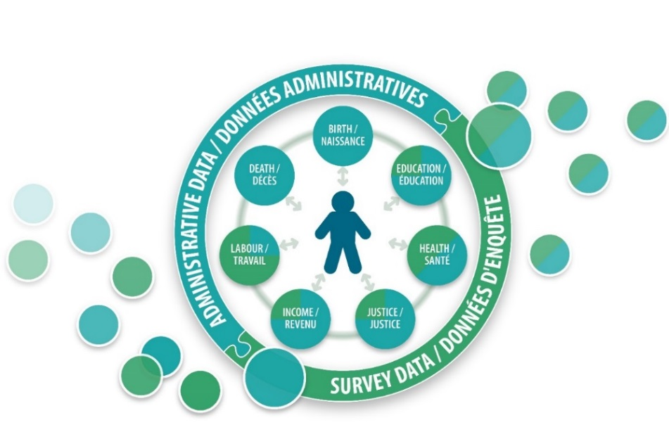
Social Data Linkage Environment
CCR linkage was conducted through Statistics Canada’s Social Data Linkage Environment (SDLE)
SDLE is a secure linkage environment that enables the linkage of datasets using personal identifiers
No analytical information is housed in the SDLE

Slide 9
Overview of the linkage process
Personal identifiers from all datasets are linked into the SDLE
Each person level record is assigned a unique ID
Unique IDs are matched between datasets of interest to create keys that identify a person across multiple data sources
Keys are provided to subject matter team and merged to create output datasets of interest
Cohort file analytical information is merged to outcome file analytical information, no personal identifiers
E.g., Cancer registry data are merged with date, cause and location of death
Notes:
Deterministic record linkage
Matching exactly on a unique key composed of one or more variables
The unique key should be highly discriminatory for any person
Probabilistic record linkage
The likelihood that records being linked refer to the same person is estimated using the generalized record linkage system (G-LINK)
A set of linkage variables selected based on their collective discriminating power and their availability on both the input data file and the DRD
A conservative linkage method is applied so as to attain the highest quality linkage by minimizing false positive links at the expense of generating false negative links
Overview of the linkage process
Source index files are linked to the DRD
Key registry is populated with the paired SDLE IDs and source index file record IDs
Linked keys files are extracted from the Key Registry
Assign randomly generated unique IDs to the records in the linked keys files
Linked datasets are produced by merging linked keys files to the source data files
Validation of linked datasets
Bias assessment of linked and not-linked records (e.g., distributions by key variables such as sex, geography, vital status, etc.)
Linkage rates
Access through the secure the RDC network and having all output vetted prior to release outside of the RDCs:
The Research Data Centres RDCs are part of an initiative by Statistics Canada, the Social Sciences and Humanities Research Council (SSHRC) and university consortia to help strengthen Canada's social research capacity and to support the policy research community. The program would like to acknowledge the generous support of the Canada Foundation for Innovation (CFI) and the Canadian Institutes of Health Research (CIHR).
RDCs provide researchers with access, in a secure university setting, to microdata from population and household surveys, administrative data holdings and linked data. The centres are staffed by Statistics Canada employees. They are operated under the provisions of the Statistics Act in accordance with all the confidentiality rules and are accessible only to researchers with approved projects who have been sworn in under the Statistics Act as 'deemed employees.'
RDCs are located throughout the country, so researchers do not need to travel to Ottawa to access Statistics Canada microdata.

Slide 10
Validation of linked dataset
Validation of the linkage of each dataset into the SDLE
Bias assessment of linked and non-linked records
Linkage rates by various factors
Validation of the linked analytical file
Fitness for use—do the data make sense in the world?
Comparison of like concepts across all linked datasets (e.g., birthdate, sex, date of death)
Validation report with data limitations
Preparation of user documentation
User guide
Vetting rules
Data access through the Research Data Centres network
Notes:
Deterministic record linkage
Matching exactly on a unique key composed of one or more variables
The unique key should be highly discriminatory for any person
Probabilistic record linkage
The likelihood that records being linked refer to the same person is estimated using the generalized record linkage system (G-LINK)
A set of linkage variables selected based on their collective discriminating power and their availability on both the input data file and the DRD
A conservative linkage method is applied so as to attain the highest quality linkage by minimizing false positive links at the expense of generating false negative links
Overview of the linkage process
Source index files are linked to the DRD
Key registry is populated with the paired SDLE IDs and source index file record IDs
Linked keys files are extracted from the Key Registry
Assign randomly generated unique IDs to the records in the linked keys files
Linked datasets are produced by merging linked keys files to the source data files
Validation of linked datasets
Bias assessment of linked and not-linked records (e.g., distributions by key variables such as sex, geography, vital status, etc.)
Linkage rates
Access through the secure the RDC network and having all output vetted prior to release outside of the RDCs:
The Research Data Centres RDCs are part of an initiative by Statistics Canada, the Social Sciences and Humanities Research Council (SSHRC) and university consortia to help strengthen Canada's social research capacity and to support the policy research community. The program would like to acknowledge the generous support of the Canada Foundation for Innovation (CFI) and the Canadian Institutes of Health Research (CIHR).
RDCs provide researchers with access, in a secure university setting, to microdata from population and household surveys, administrative data holdings and linked data. The centres are staffed by Statistics Canada employees. They are operated under the provisions of the Statistics Act in accordance with all the confidentiality rules and are accessible only to researchers with approved projects who have been sworn in under the Statistics Act as 'deemed employees.'
RDCs are located throughout the country, so researchers do not need to travel to Ottawa to access Statistics Canada microdata.

Slide 11
Number of CCR patients (1992 to 2015) linked
Discharge Abstract Database (1994/95 to 2015/16) | 2.2 M
National Ambulatory Care Reporting System (2002/03 to 2015/16) | 1.4 M
T1 Family File (Tax Files) (1992 to 2015) | 3 M
Vital Statistics Death Database (1992 to 2014) | 1.5 M
Longitudinal Immigration Database (1982 to 2015) | 200 K
2016 Census Long-Form | 220 K

Slide 12
Preliminary Results: A spotlight on lung and colorectal cancer disparities by household income

Slide 13
Age standardized incidence rates for lung cancer, by household income
Overall, lower income Canadians have higher rates of lung cancer compared to their wealthier counterparts – particularly for Stage IV diagnosis.
Population:
Patients diagnosed in 2015
30-66 years at time of diagnosis
Income measured in 2013

Slide 14
Age-standardized incidence rates for colorectal cancer, by household income
Trends are different for colorectectal cancer (CRC). Relative to lung cancer, overall CRC incidence appears to be more consistent across income levels.
However, lower income Canadians have higher rates of Stage IV diagnosis and lower rates of Stage I diagnosis.
Population:
Patients diagnosed in 2015
30-66 years at time of diagnosis
Income measured in 2013

Slide 15
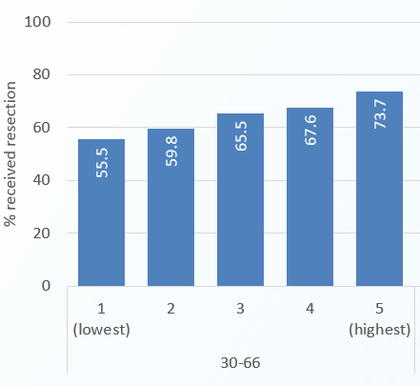
Percent resections within 6 months for Stage I-IIIA lung cancer patients, by household income
Lower income Canadians are less likely than wealthier Canadians to receive surgical resections within 6 months of their diagnosis with lung cancer.
Population:
Patients diagnosed with Stage I-IIIA NSC lung cancer in 2014
30-66 years at time of diagnosis
Income measured in 2013
QC excluded

Slide 16
Plans for further exploration of the datasets…
The Canadian Partnership Against Cancer will be releasing a report in ~Winter 2020 exploring disparities in cancer control using this data linkage
The report will examine the impact and inter-play of multiple socioeconomic factors on cancer diagnosis, treatment patterns and patient outcomes

Slide 17
Next Steps

Slide 18
Next steps for the CCR linked datasets
CCR 1992-2014 linked to deaths 1992 to 2014 was released in June 2018
Cancer linked to death information will be updated by Statistics Canada bi-annually (next update in Spring 2020)
Statistics Canada is undertaking a feasibility project to determine if the old cancer database (1969 to 1991) can be linked to the new cancer database (1992 onwards) and death cleared
Phase 1 of SDLE linked data (CCR to DAD, NACRS, IMDB and Tax) is slated for release in winter 2020

