Slide 1
Cancer in Young People in Canada: Broadening the research and surveillance potential by linking to other administrative databases.
J. Kaur¹, M. Frechette¹, L. Xie ¹, J. Onysko¹
S. Bryan², Y. Decady², R. Barber³, L. Sung⁴
¹ Public Health Agency of Canada; ² Statistics Canada; ³ C17 Council; ⁴ Division of Haematology/Oncology, The Hospital for Sick Children, Toronto

Slide 2
Outline
Overview of the Cancer in Young People in Canada (CYP-C) database
Record linkage at Statistics Canada
Linkage plans: CYP-C to other administrative data
Access to linked data for researchers
Research potential of the linked data

Slide 3
What is CYP-C?
An enhanced cancer registry and research database focused on children aged <15 years AND diagnosed or treated in a Canadian pediatric cancer centre
CYP-C database captures:
Demographics (sex, date of birth, postal code, ethnicity)
Diagnostic details (cancer type and stage, risk category)
Treatment plans / details (chemo, surgery, transplant, trial participation)
Dates (time intervals between events)
Short/medium-term outcomes (5-year follow-up: relapse, complications, and survival)
Longer-term health outcomes through data linkage
Longer follow-up - survival, late effects, causes of death
Canadian Vital Statistics: death database
CIHI hospitalization data

Slide 4
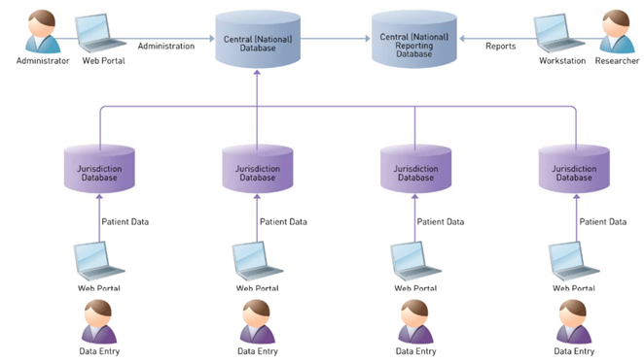
CYP-C – How it works
Data are collected from the 17 pediatric oncology centres across Canada
C17
Ontario data provided by POGONIS are integrated into CYP-C.
Data abstraction is obtained through chart review from each pediatric oncology centre by a Clinical Research Associate (CRA) at each centre.
Detailed information on eligible cases is collected from diagnosis through to five years post diagnosis.
Contains over 16,595 cases (2001 - 2015)

Slide 5
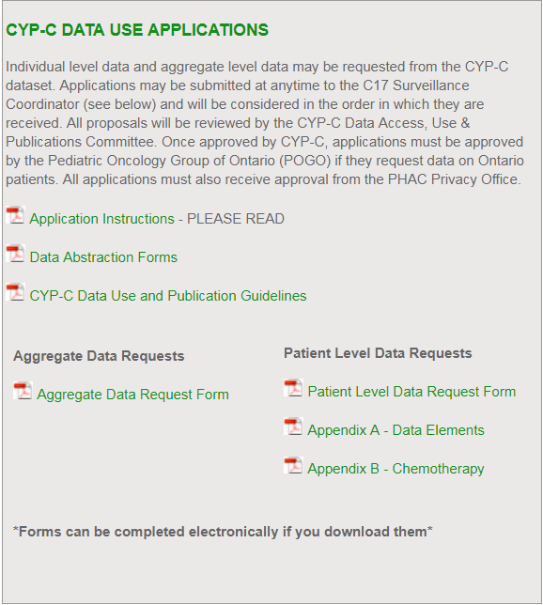
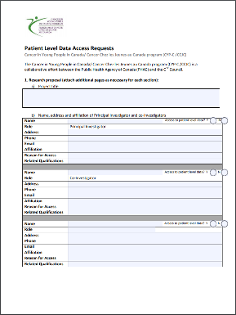
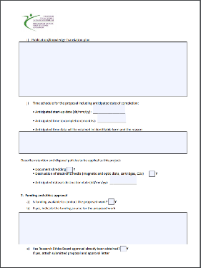
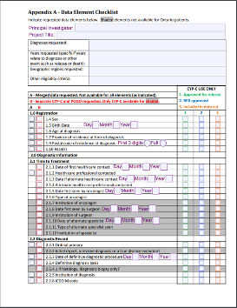
Obtaining CYP-C data
Application process:
Go online: www.c17.ca
Complete a Research Proposal Template
Data Elements Checklist
Chemotherapy Checklist
Data requests can be for aggregate or patient level data
Submit your application
Reviews by CYP-C Management Committee & PHAC Privacy (6-8 weeks)
CYP-C Research Champion Webinars
Notes:
Website lists the data elements and
chemotherapeutic agents used

Slide 6
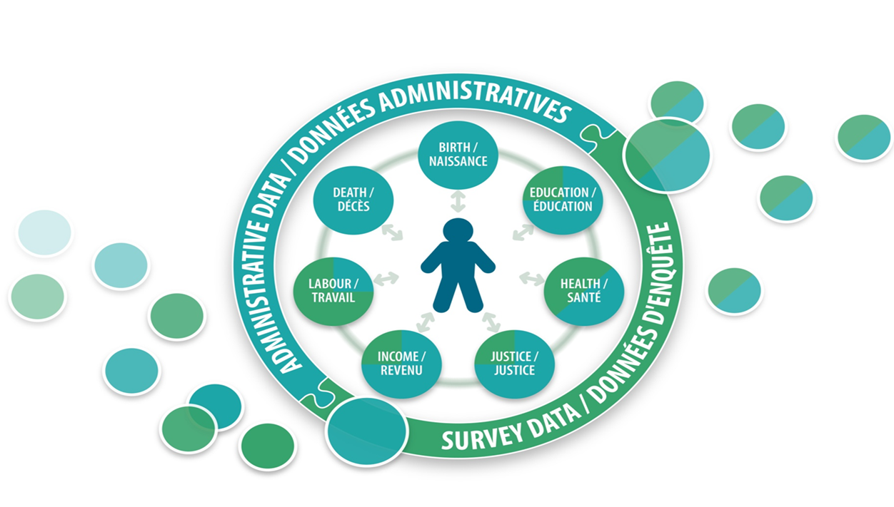
Record Linkage at Statistics Canada
The Social Data Linkage Environment (SDLE) at Statistics Canada facilitates the creation of linked administrative and survey data files for social analysis.
Notes:
The SDLE is designed to bring person-level data together in one virtual linkage environment. These data may come from either administrative sources or surveys (large circle). Inside this large circle are seven interconnected circles which display the range of subjects possible in the SDLE. In addition, the colors show the approximate proportion of administrative (blue) and survey (green) data available at Statistics Canada. These circles point towards the image of a person in the middle, which represents the person-oriented nature of SDLE linkages and the ability to link individuals across multiple sources. Finally, data sources exit the environment on the right side as linked outputs.
Data files are linked together through linkage keys that are stored in the Derived Record Depository (DRD) and the Key Registry. The DRD is essentially a registry of Canadians containing only basic personal identifiers. The DRD is built using core administrative data files (vital statistics, tax and immigration files) and each individual is assigned a unique SDLE identifier. We have done this because we do not have a registry of the population as you might find in provinces through health card files or other administrative files. Every file linked in the SDLE is linked to the DRD.
The Key Registry stores only the SDLE identifiers and associated record identifiers from all survey and administrative data files linked to the DRD.
Once a study requiring data linkage has been approved and the linkage has been conducted, the Key Registry identifiers are used to find the individual records in the source data files (analysis variables without personal identifiers). Selected records and variables from these sources can then be integrated into a linked analysis file.
Identifiers are dropped and an analytical file is created
Access to the deidentified data occurs in a secure centre

Slide 7
Planned linkages
Data files to be linked to CYP-C
Cancer incidence information from the Canadian Cancer Registry (CCR)
Death information (CVSD)
Hospitalization data (DAD, NACRS, OMHRS)
Birth information (CVSB, CVSBD)
Income-personal and family (T1FF)

Slide 8
Overview of the Linkage Process
Personal identifiers from all datasets are linked into the SDLE
Each person level record is assigned a unique ID
Unique IDs are matched between datasets of interest to create keys that identify a person across multiple data sources
Keys are used to create analytical datasets
Cohort file (CYP-C) analytical information is merged to analytical information from other datasets, no personal identifiers
E.g., CYP-C key is merged to CYP-C analytical variables and then merged with other administrative datasets such as the Canadian Cancer Registry and death information
Notes:
Deterministic record linkage
Matching exactly on a unique key composed of one or more variables
The unique key should be highly discriminatory for any person
Probabilistic record linkage
The likelihood that records being linked refer to the same person is estimated using the generalized record linkage system (G-LINK)
A set of linkage variables selected based on their collective discriminating power and their availability on both the input data file and the DRD
A conservative linkage method is applied so as to attain the highest quality linkage by minimizing false positive links at the expense of generating false negative links
Overview of the linkage process
Source index files are linked to the DRD
Key registry is populated with the paired SDLE IDs and source index file record IDs
Linked keys files are extracted from the Key Registry
Assign randomly generated unique IDs to the records in the linked keys files
Linked datasets are produced by merging linked keys files to the source data files
Validation of linked datasets
Bias assessment of linked and not-linked records (e.g., distributions by key variables such as sex, geography, vital status, etc.)
Linkage rates
Access through the secure the RDC network and having all output vetted prior to release outside of the RDCs:
The Research Data Centres RDCs are part of an initiative by Statistics Canada, the Social Sciences and Humanities Research Council (SSHRC) and university consortia to help strengthen Canada's social research capacity and to support the policy research community. The program would like to acknowledge the generous support of the Canada Foundation for Innovation (CFI) and the Canadian Institutes of Health Research (CIHR).
RDCs provide researchers with access, in a secure university setting, to microdata from population and household surveys, administrative data holdings and linked data. The centres are staffed by Statistics Canada employees. They are operated under the provisions of the Statistics Act in accordance with all the confidentiality rules and are accessible only to researchers with approved projects who have been sworn in under the Statistics Act as 'deemed employees.'
RDCs are located throughout the country, so researchers do not need to travel to Ottawa to access Statistics Canada microdata.

Slide 9
Validation of linked dataset
Validation of the linkage of each dataset into the SDLE
Bias assessment of linked and not-linked records
Linkage rates by various factors
Validation of the linked analytical file
Fitness for use—do the data make sense in the world?
Comparison of like concepts across all linked datasets (e.g., birthdate, sex, date of death)
Validation report with data limitations
Preparation of user documentation
User guide
Vetting rules
Data access through the Research Data Centres network.
Notes:
Deterministic record linkage
Matching exactly on a unique key composed of one or more variables
The unique key should be highly discriminatory for any person
Probabilistic record linkage
The likelihood that records being linked refer to the same person is estimated using the generalized record linkage system (G-LINK)
A set of linkage variables selected based on their collective discriminating power and their availability on both the input data file and the DRD
A conservative linkage method is applied so as to attain the highest quality linkage by minimizing false positive links at the expense of generating false negative links
Overview of the linkage process
Source index files are linked to the DRD
Key registry is populated with the paired SDLE IDs and source index file record IDs
Linked keys files are extracted from the Key Registry
Assign randomly generated unique IDs to the records in the linked keys files
Linked datasets are produced by merging linked keys files to the source data files
Validation of linked datasets
Bias assessment of linked and not-linked records (e.g., distributions by key variables such as sex, geography, vital status, etc.)
Linkage rates
Access through the secure the RDC network and having all output vetted prior to release outside of the RDCs:
The Research Data Centres RDCs are part of an initiative by Statistics Canada, the Social Sciences and Humanities Research Council (SSHRC) and university consortia to help strengthen Canada's social research capacity and to support the policy research community. The program would like to acknowledge the generous support of the Canada Foundation for Innovation (CFI) and the Canadian Institutes of Health Research (CIHR).
RDCs provide researchers with access, in a secure university setting, to microdata from population and household surveys, administrative data holdings and linked data. The centres are staffed by Statistics Canada employees. They are operated under the provisions of the Statistics Act in accordance with all the confidentiality rules and are accessible only to researchers with approved projects who have been sworn in under the Statistics Act as 'deemed employees.'
RDCs are located throughout the country, so researchers do not need to travel to Ottawa to access Statistics Canada microdata.

Slide 10
Access to linked data
30 Research Data Centres across Canada
Researchers at different RDCs can collaborate on joint projects
Centre
Branch / Antenne
Yellowknife
Prince George
St. John’s
Edmonton
Burnaby
Saskatoon
Vancouver
Calgary
Moncton
Victoria
Winnipeg
Québec
Lethbridge
North Bay
Montréal
Fredericton
Halifax
Ottawa
Sherbrooke
Guelph
Kingston
Waterloo
Toronto
Hamilton
Windsor
London

Slide 11
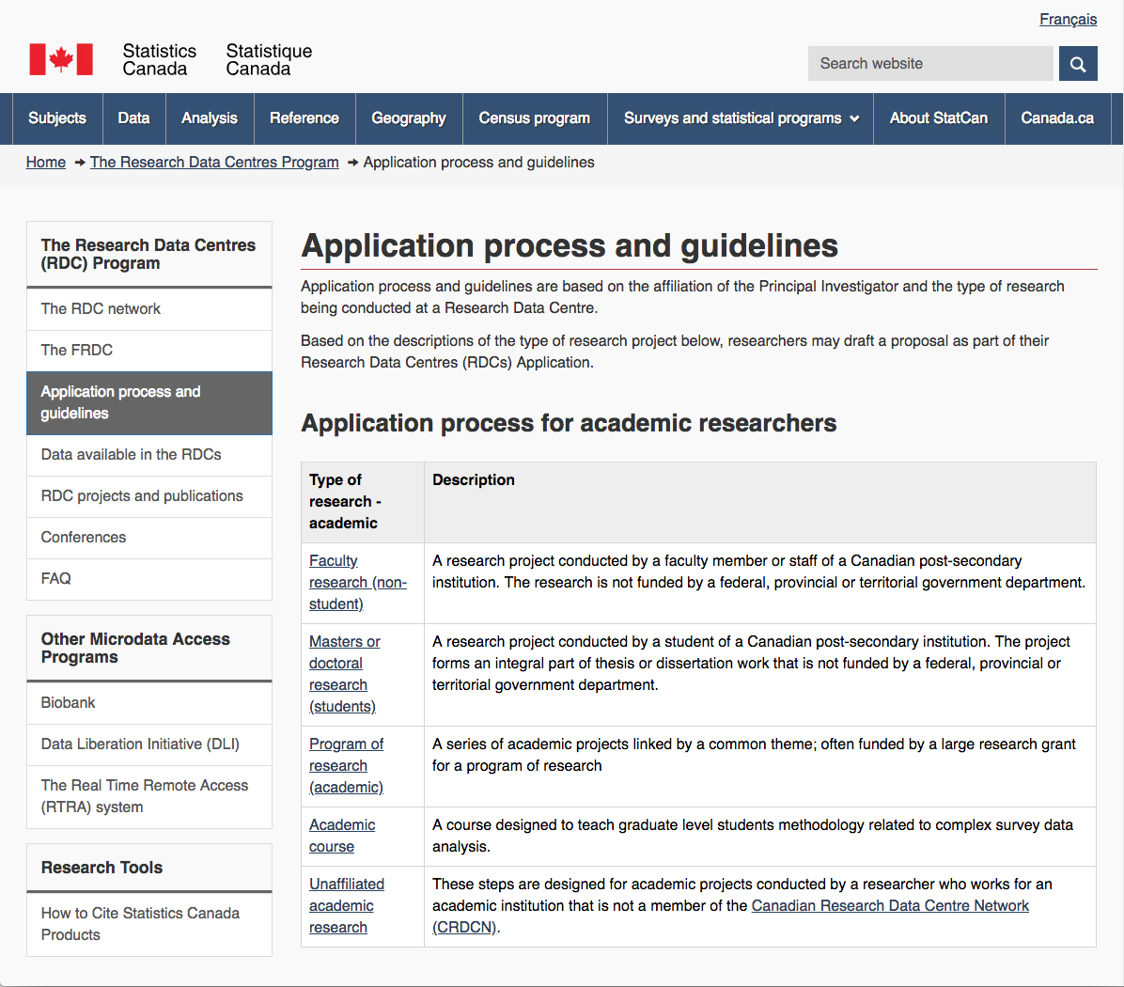
How to access the data
Research Data Centres www.statcan.gc.ca/eng/rdc/process
On average, researchers can be granted access to data already in the RDC within 2 months.
No fees for student research projects.
Generally no fees for academic researchers from participating institutions.

Slide 12
Linked data: analytical plans
Phase 1.
Assessing completeness and death clearance in CYP-C
CYP-C – CCR case completeness and concordance
CYP-C – CVS:D death completeness and concordance
Phase 2.
5,10,15-year survival of childhood cancer patients
5,10,15-year risk of recurrence and subsequent malignancy
5,10,15-year survivor hospitalization rates overall and associated with late effects:
Preventable chronic conditions
Mental disorders
Other Hospitalization for other conditions
Pregnancy/birth
Infection
Emergency visits
Economic impact of childhood cancer diagnoses: on patients and families

Slide 13
Thank you
and thanks to the:
CYP-C Partners Group
CYP-C Management Committee
CYP-C Steering Committee
PHAC & Statcan teams
Contact: jay.Onysko@canada.ca / shirley.bryan@canada.ca

