Slide 1




ESSENTIAL TNM - EVALUATION OF A TRAINING EXERCISE IN SUB SAHARAN AFRICA
PICTURE HERE
Eric Chokunonga
Zimbabwe Cancer Registry
On behalf of:
Dr. Michael Odutola
GICR Regional TNM Trainer
Consultant, African Cancer Registry Network

Slide 2
Background

Slide 3
Background
The stage of a cancer at the time of diagnosis summarizes the size of the tumour and the extent of its spread.
Cancer stage plays a critical component in clinical care, with respect to the choice of cancer treatments and prognosis.
Stage also reflects timing of diagnosis as well as helping to evaluate outcomes of cancer control activities and public health policies such as early detection or patient’s management programmes.

Slide 4
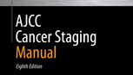
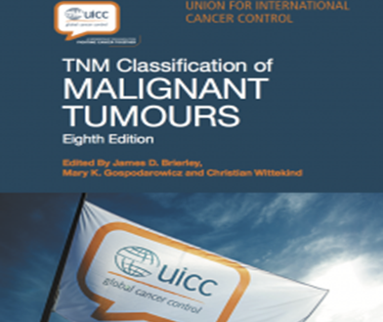
Background
UICC in collaboration with the AJCC developed and published the standard TNM classification of malignant tumours between 1943 and 1952.
Latest TNM edition recently published.
Details of T, N and/or M are not always explicitly recorded in the patient’s record, so consistent capture of the information by cancer registrars is difficult.

Slide 5
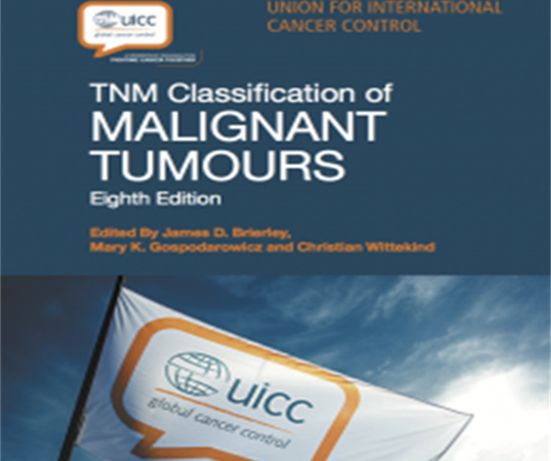
Background
The 8th revision of the TNM manual introduced “Essential TNM”
eTNM is a simplified scheme that can be used to collect stage data when the T, N, and M categories have not been recorded in the clinical records, or if the data to determine the categories are not available.

Slide 6
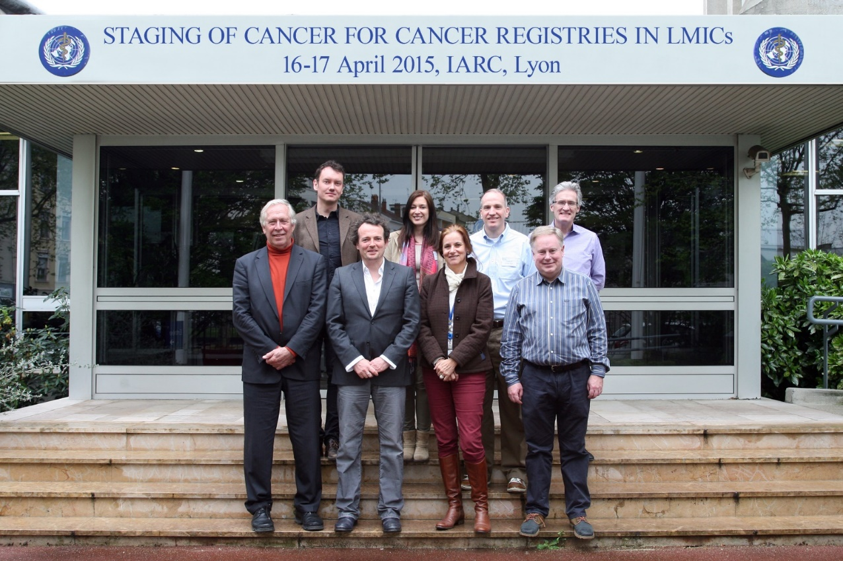
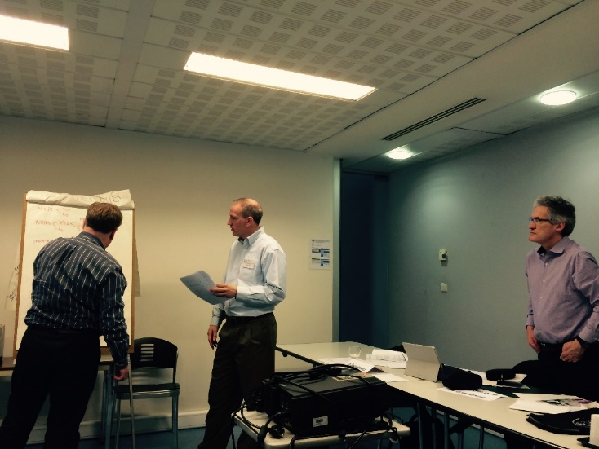



Background
2015
Discussions
Tests
Databases US
Refinements
Discussions
Trainings
Tests
Refinements
2018
Scientific
Publication

Slide 7
Rationale for Essential TNM Training in SSA
Information on cancer stage at diagnosis is largely missing or poorly documented among population-based cancer registries in sub Saharan Africa (SSA).
In an early field trial of eTNM staging, it was observed that some training was needed to enable cancer registrars to abstract the correct TNM from case records.

Slide 8
Essential TNM Training in SSA
IARC through GICR, organized a 3-day training on eTNM in November 2018, in collaboration with Addis Ababa City Cancer Registry (AACCR).
17 cancer registrars from 16 cancer registries in SSA took part.
The course included sessions on the principles of cancer pathology and spread, and how to stage using the “Essential TNM Staging Guide”

Slide 9
Methods

Slide 10
Methods
Participants were required to stage 16 cancer cases, four each of cancer of the prostate, breast, cervix, and colon-rectum.
Cancer cases were anonymized photocopies of case records obtained from GICR repository of cancer cases from SSA.
Pre-training, the participants were asked to assign a UICC/AJCC stage (I-IV) to each case.

Slide 11
Methods
Following training on the use of Essential TNM, they were asked to code T, N and M for each case, based on information from the case record, without access to their previously coded stage for the same cases.
Participants were given 15 minutes, both pre-training and post-training, to review each cancer case and attempt to provide the correct Essential TNM and Stage (I-IV).
The level of discrepancy was scored as the absolute value of the difference between the Stage allocated before (B) and after (A) training, and the correct Stage (C), for all 16 cases.

Slide 12
Results

Slide 13
Results
For each of the 4 cancers, the level of discrepancy between the correct and the allocated stage was lower post training.
The cumulative level of discrepancy for all 16 cases was 122 pre-training, while a lower discrepancy (61) was observed post training.
The mean discrepancy pre-training was 7.18 (SD= 2.94; CI= 3.82 – 10.50), while the mean discrepancy post-training was 3.81 (SD=1.90; CI= 0.65 – 6.05)

Slide 14
Results
The difference between the means (calculated as post-training mean minus pre-training mean) was 3.37 (SE=0.85; CI=2.16-5.49), while the cumulative percentage mean improvement was 53.3%.
The cancer site specific mean score for all participants at pre-test for prostate, breast, cervix and colorectal cancers were 2.53, 2.00, 1.06 and 1.59, while the post-test mean scores were 0.35, 1.18, 0.76 and 1.29 respectively.
Discrepancy post-test was generally better than pre-test for 10 of the 16 cancer cases reviewed. The cancer cases with decline in performance at post-test relative to pre-test were for breast cancer case 1, cervical cancer case 4 and colorectal cancer cases 3 and 4.

Slide 15
Results
Percentage mean improvement of participants by cancer type – the mean improvement of participants was higher for prostate cancer (86.2%) than breast cancer (41.0%), colorectal cancer (33.3%) and cervical cancer (28.3%).

Slide 16
Discussions

Slide 17
Discussions
Overall, there was a substantial improvement in participants’ performance after training on the use of the eTNM staging system.
The highest improvement was observed for prostate cancer and the least overall improvement was reported for cervical cancer, of the cancer cases reviewed.
These exercises also help in understanding where problems arise in abstracting stage, using the eTNM flow-charts and instruction manuals.

Slide 18
Lessons learnt

Slide 19
Lessons learnt
The practical training exercises helped in understanding where problems arise in abstracting stage, using the eTNM flow-charts and instruction manuals.
Use of indigenous/local cases notes for training is important.
Understanding anatomical terminologies and lymphatic drainage of cancers are key components of staging, and we spent added time training the registrars on this, particularly given their background.

Slide 20
Next steps

Slide 21


Next steps
To roll out the eTNM staging system globally:
Need for training: Training of cancer registrars on staging using eTNM, will require developing a cadre of experienced trainers in the regions served by the GICR programme. Training costs might be reduced by the use of pre-developed online modules, although the use of this method of training would need to be validated.
Materials: There would be need to translate the GICR training materials to other languages, use local expressions, and improve availability of TNM books and eTNM materials in these languages.

Slide 22
Conclusion

Slide 23
Conclusion
Application of the eTNM staging system, especially in low resource settings, has the potential to greatly improve comparability of registry data and hence development and evaluation of cancer control and public health policies.

Slide 24
Flowcharts &
Process mapping
Decision
Stop

Slide 25
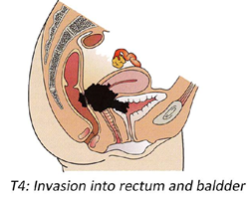
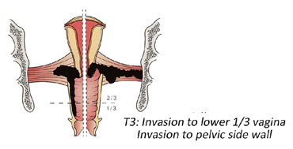
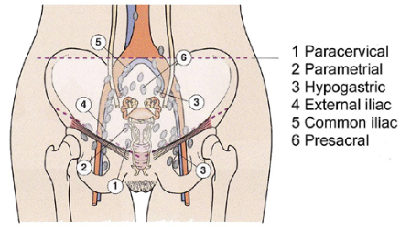
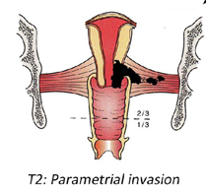

Slide 26
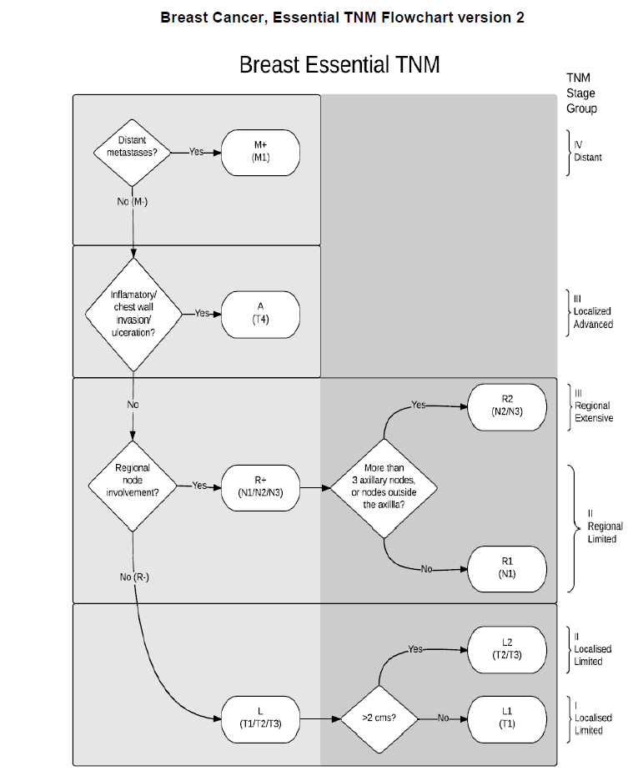
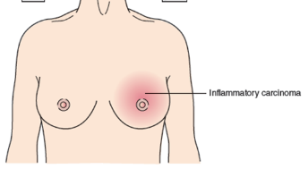
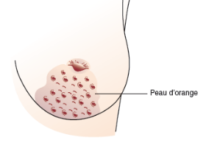
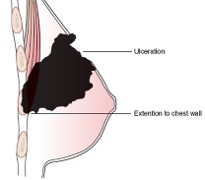
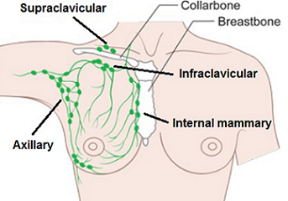
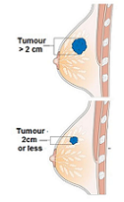

Slide 27
Essential TNM Guide

Slide 28
Thank you for listening….

