Slide 1

Use of Hospital Discharge Data to Increase Accurate Reporting of Non-malignant CNS Tumours
Mary Jane King, Grace Liu, Ontario Cancer Registry
maryjane.king@cancercare.on.ca

Slide 2
NMCNS Tumours in the OCR
Ontario Cancer Registry has been capable of creating non-malignant central nervous system tumour (NMCNS) cases since 2010.
Initially, the proportion of NMCNS to malignant CNS (MCNS) cases was low compared to the U.S., Ontario having fewer non-cancers than cancers.
OCR is automated, creating cases mainly from the following sources:
  Electronic pathology reports
  ALR (Activity Level Reporting) – a CCO funding stream, includes some ICD-10, some ICD-O-3
  DAD (Discharge Abstract Database) – inpatient hospital discharge records
  NACRS (National Ambulatory Care Reporting System) – outpatient hospital discharge records
For reportable cases OCR wants a rich mix of source records in cases in order to ensure correct disease identification.
Cases created with DAD and NACRS (or both) records alone are categorized as “problematic” and not used.
In 2015 this was amended for NMCNS tumors, to allow DAD-only and DAD+NACRS-only cases into the reportable category.
The change was retroactive to 2010, and immediately increased the number of incident NMCNS tumors by about 40%.

Slide 3
Challenges Using Discharge Data
A problem: discharges are coded in ICD-10, converted to ICD-O-3, and the result has been an excess of NOS terms. 30% of the NMCNS histologies are NOS.
ICD-10 NMCNS disease codes do not carry any implicit histology and histology is not required for discharge coding. The codes are generic for sub-site.
NMCNS tumour have a relatively high rate of active surveillance, with diagnostic imaging playing a large role. It is reasonable it assume these cases will not have as rich a source mix
NACRS records can provide Canadian Clinical Classification (CCI) codes for relevant imaging tests, e.g. MRI, CT., which may increase year over year for a , without other procedures, e.g. biopsy.
Finally a summary of a strategy to source the original diagnostics and when to do it.

Slide 4
Source Record Mix, Reportable vs Problematic NMCNS – 2017 Dx Year

Slide 5
Reportable Non-Malignant CNS Cases with Imaging
Diagnosis Year 2017, top 5 types
Problematic Non-Malignant CNS Cases with Imaging Diagnosis Year 2017, top 5 types
13%
Incident Status | Total number of cases | # of cases with NACRS of MRI CT | % of NACRS
N | 2595 | 213 | 8%
P | 988 | 426 | 43%

Slide 6
Reportable Non-Malignant CNS Cases with Imaging - Diagnosis Year 2017

Slide 7
Problematic Non-Malignant CNS Cases with Imaging - Diagnosis Year 2017

Slide 8
Cases with Imaging by Histology, Reportable & Problematic, 2017
14%
Reportable Cases – Most Common Histologies

Slide 9
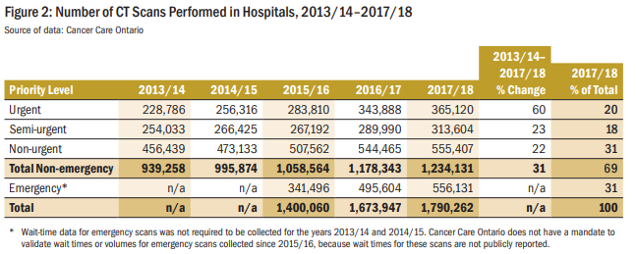
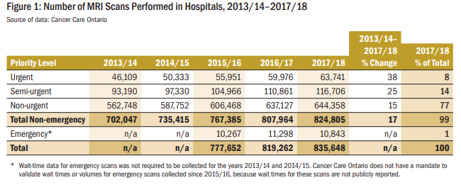
Public Hospitals
“81% of CT scans were performed on the abdomen (30% of the total); brain (28%); and thorax (23%); the remaining 19% of CT scans were performed in areas such as the head and neck, the spine and the pelvis.” [p. 371]
“The majority of MRI scans were performed on the head (31% of the total), the spine (25%) and the extremities—that is, the limbs (24%). The remaining 20% of MRI scans were performed in areas such as the abdomen, pelvis, breast, and the neck area.” [p,370]
Ontario Auditor General 2018 Annual Report, Ch. 3, Section 3.08, MRI and CT Scanning Services
http://www.auditor.on.ca/en/content/annualreports/arbyyear/ar2018.html
http://www.auditor.on.ca/en/content/annualreports/arreports/en18/v1_308en18.pdf

Slide 10
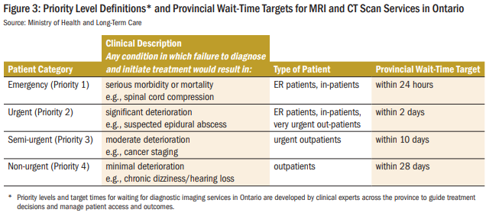
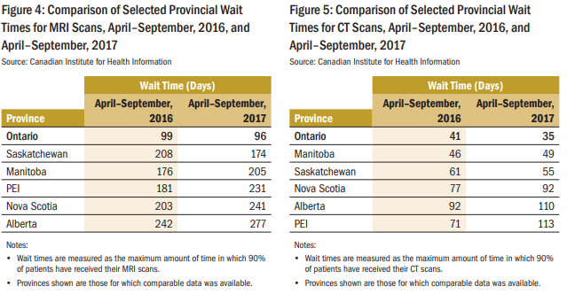
Public Hospitals
“65% of MRI Patients and 33% of CT Patients Had Long Waits for Their Scans, in Excess of the Ministry’s Targets for Semi-urgent and Non-urgent Priority Patients.”
Ontario Auditor General 2018 Annual Report, Ch. 3, Section 3.08, MRI and CT Scanning Services

Slide 11
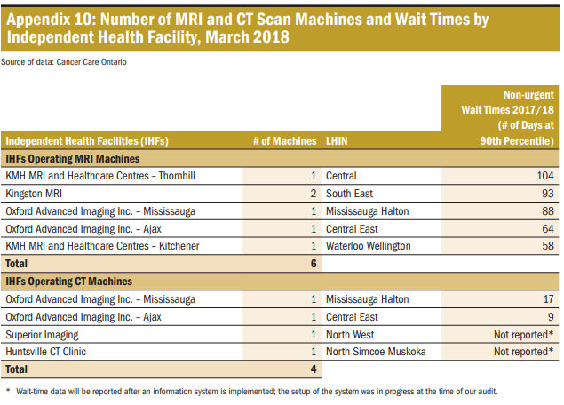
Independent Health Facilities
“Since 2003, the Ministry has contracted with seven
independent health facilities (IHFs) to provide
MRI and/or CT scanning services at no charge to
patients insured under the Ontario Health Insurance Plan—mostly semi-urgent and non-urgent scans. In 2017/18, the IHFs, with a total of six MRI
and two CT machines, performed about 48,000
MRI and 11,320 CT scans outside of hospitals.”
[p. 368]
MRI: “All five IHFs are currently contracted to
provide wait-time information to Cancer Care
Ontario. However, their contracts with the
Ministry do not require them to achieve any
of the provincial wait-time targets that are
expected from Ontario hospitals. In 2017/18,
none of these IHFs met the provincial waittime target of 28 days.” [p. 399]
“Only two of the four IHFs are currently contracted to provide wait-time information to Cancer Care Ontario, although they are not contracted to achieve the wait-time targets. In 2018/19, the Ministry began funding the two other IHFs to establish the capability and start reporting their wait times as well.” [p. 399]
Ontario Auditor General 2018 Annual Report, Ch. 3, Section 3.08, MRI and CT Scanning Services

Slide 12
eHealth Ontario, Diagnostic Imaging Common Services (DI CS)
Four Regional Diagnostic Imaging Repositories (DI-rs).
They allow for storage, retrieval, and sharing of diagnostic reports and images in each region.
All hospitals performing diagnostic imaging are integrated with a regional DI-r.
Many IHFs are also integrated into regional DI-rs.
Contain X-ray, CT, MRI, PET, CT/PET, Ultrasound.
Hospital onboarding of reports 2014-2016. IHF onboarding 2018 and continuing.
There is now a provincial hub, at least for the reports.
Challenge: Currently access is restricted to care givers.
https://www.innovation-lab.ca/diagnostic-imaging-common-services-dics
https://www.ehealthontario.on.ca/en/

Slide 13
Conclusions
This has to be Quality Assurance, not case finding.
Direct examination of HMR impractical in terms of OCR’s capacity.
Engage with eHealth Ontario to allow OCR to compare Diagnostic Imaging Repository with OCR cohort (reportable/problematic).
Best use of capacity is investigation of the subset of NOS histologies and NOS C719.
Given that wait for imaging appointments can be long, evaluate image reports one year post diagnosis date, using NACRS CCI codes and procedure dates to locate image report.
Image reports from IHFs may be harder to locate.

Slide 14
ICD-O-3 Reportable Topgraphies for Non-Malignant CNS Tumours
C70 MENINGES
C70.0 Cerebral meninges
C70.1 Spinal meninges
C70.9 Meninges, NOS
C71 BRAIN
C71.0 Cerebrum
C71.1 Frontal lobe
C71.2 Temporal lobe
C71.3 Parietal lobe
C71.4 Occipital lobe
C71.5 Ventricle, NOS
C71.6 Cerebellum, NOS
C71.7 Brain stem
C71.8 Overlapping lesion of brain
C71.9 Brain, NOS
C72 SPINAL CORD, CRANIAL NERVES, AND OTHER PARTS OF CENTRAL NERVOUS SYSTEM
C72.0 Spinal cord
C72.1 Cauda equina
C72.2 Olfactory nerve
C72.3 Optic nerve
C72.4 Acoustic nerve
C72.5 Cranial nerve, NOS
C72.8 Overlapping lesion of brain and central nervous system
C72.9 Nervous system, NOS
C75 OTHER ENDOCRINE GLANDS AND RELATED STRUCTURES
C75.0 Parathyroid gland
C75.1 Pituitary gland
C75.2 Craniopharyngeal duct

