Slide 1
Breast cancer treatment according to pathogenic variants in cancer susceptibility genes in a population-based cohort
Steven J. Katz MD MPH
Professor of Medicine and Health Management and Policy
University of Michigan
Allison Kurian MD M Sc.
Professor of Medicine and Medical Genetics
Stanford University

Slide 2
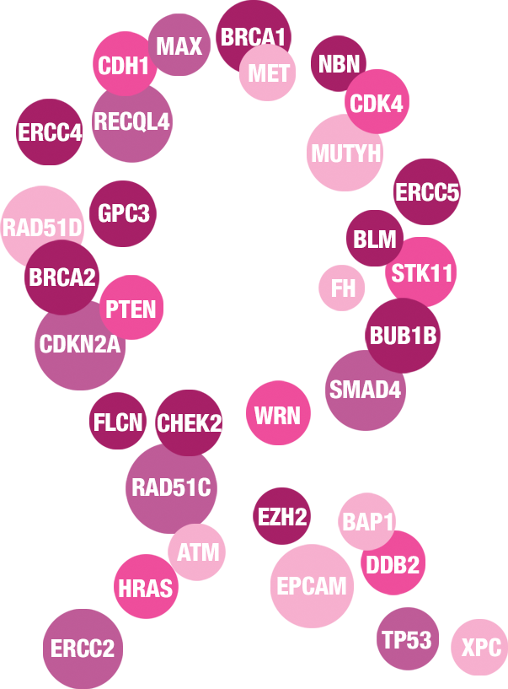
Notes:
Breast cancer is the first common health condition to be subjected to widespread extensive genetic testing
How people react to information about risk: traditional host factors- age, sex, race usurped by genetics

Slide 3
Guidelines 2019
Gene | Breast Relative Risk | Ovarian Relative Risk | Other Cancer Risks | U.S. Clinical Practice Guidelines (NCCN, ASCO, ACS)
ATM | 2 to 3-fold | Potential increase | Ataxia Telangiectasia Syndrome in homozygotes; maybe colon, pancreas, prostate | Screening breast magnetic resonance imaging (MRI), start age 40; insufficient data to recommend risk-reducing salpingo-oophorectomy (RRSO)
BARD1 | Potential increase | Insufficient evidence | Uncertain | Insufficient evidence to guide management
BRCA1 | 10-fold | 20 to 40-fold | Pancreas, prostate; melanoma | Breast MRI at 25, recommend RRSO @40, discuss RR mastectomy (RRM)
BRCA2 | 10-fold | 10 to 20-fold | Pancreas, prostate; melanoma | Breast MRI at 25, recommend RRSO @45, discuss RRM
BRIP1 | Insufficient evidence | 2 to 3-fold | Autosomal recessive (AR) risk | Consider RRSO at 45-50
CDH1 | 5-fold (lobular) | No increased risk | Gastric | Breast MRI at 30, discuss RR gastrectomy
CHEK2 | 2 to 3-fold | No increased risk | Colon; maybe thyroid | Breast MRI at 40, earlier colonoscopy
MLH1, MSH2, MSH6, PMS2, EPCAM | Insufficient evidence | 5 to 10-fold | Colon, uterine, pancreas, others | Consider RRSO and hysterectomy, annual colonoscopy, biannual endoscopy
NBN | 2 to 3-fold | Insufficient evidence | Nijmegen Breakage Syndrome (AR) | Breast MRI at 40
NF1 | 2 to 3-fold | No increased risk | CNS, peripheral nerve sheath, GIST | Breast MRI at 30
PALB2 | 3 to 5-fold | Insufficient evidence | Pancreas | Breast MRI at 30, discuss RRM
PTEN | At least 5-fold | No increased risk | Thyroid, colon, renal, endometrial | Breast MRI at 30, discuss RRM, discuss hysterectomy
RAD51C | Insufficient evidence | 2 to 3-fold | Uncertain | Consider RRSO at 45-50
RAD51D | Insufficient evidence | 2 to 3-fold | Uncertain | Consider RRSO at 45-50
STK11 | At least 5-fold | Non-epithelial: 2 to 3-fold | Pancreas, colon, sex cord-stromal | Breast MRI at 25, discuss RRM
TP53 | At least 10-fold | No increased risk | Sarcoma, leukemia, adrenocortical, brain, etc. | Breast MRI at 20, discuss RRM; whole-body MRI, colonoscopy/endoscopy, complete blood count, etc.

Slide 4
Why the surge in multigene panel testing after diagnosis of breast cancer?
Established clinical utility of BRCA1 and BRCA2 testing
Potential benefit of “trace-back” cascade genetic cancer risk evaluation in relatives in high risk families
Plummeting costs of testing and competitive marketing since 2013
High “optics” of genetic “precision oncology”
Nature of the beast regarding the diffusion of medical testing (vs treatment)
Less concern about direct harm to patients
Less scrutiny of the benefits
Fewer insurance related barriers
Notes:
Think MRI- no harm in more information
Especially when costs of testing plummet
How many know family members friends or colleagues who have had genetic testing for ancestry, health risks etc?

Slide 5
Recommendations for genetic risk evaluation for hereditary breast and ovarian cancer
All women diagnosed with ovarian cancer N=220,000
Many women diagnosed with breast cancer N=3.5 million
Adult women with strong family history of cancer N=15 million
Ashkenazi Jewish women N=2 million
Known pathogenic variant in 1st degree relatives N= unknown
Notes:
Growing common issue in medical care confronting primary care

Slide 6
Test results inform relative risk of future cancer vs absolute benefit of the different treatment options
Patients must juggle two different schemas: prevention of new cancers vs treatment for the one they have
Clinical utility of testing is evolving
Wide variability in cancer relative risk estimates for individual patients with pathogenic variants
The growing problem of addressing variant of unknown significance (VUS)
Test results have implications for relatives
Major challenges of incorporating genetic risk evaluation into treatment decision workflow
Katz SJ, Kurian A, Morrow M JAMA 2015

Slide 7
Georgia-California Genetic Testing Linkage Initiative
Steven J. Katz MD MPH
Allison Kurian MD MS
Kevin Ward Ph.D
Dennis Deapen Ph.D
Ann Hamilton Ph.D
Lynne Penberthy MD MPH
Valentina Petkov MD
Nicola Schussler

Slide 8
GA/CA SEER Genetic Testing Initiative
Testing Laboratory
(Ambry)
Testing Laboratory (Myriad)
Testing Laboratory
(BioRef)
Testing Laboratory (Invitae)
SEER-Genetics Dataset
N=190,000 BC and 15,000 ovarian patients
Patient demographics
Tumor characteristics
Treatment
Survival
Genetic tests done
Detailed test results:
Gene/s tested
Positive, negative, or uncertain
Information Management Services (IMS)
Links and de-identifies data
California Cancer Registry
Breast cancer cases, 2013-17
Ovarian cancer cases, 2013-17
Georgia Cancer Registry
Breast cancer cases, 2013-17
Ovarian cancer cases, 2013-17

Slide 9
% had any genetic test among patients with breast cancer by year (N= 158,480)
%

Slide 10
% had multigene panel testing among testers (breast cancer) by quarter and year (N=39,563)
%

Slide 11
Research questions
What is the association of genetic test results with locoregional and systemic treatment?:
Use of contralateral prophylactic mastectomy (CPM) in candidates for unilateral surgery
Pathogenic variant should be associated with more extensive surgery
Use of irradiation in patients with indications for it
Pathogenic variant should not be associated with use of radiation
Use of systemic chemotherapy in patients with no definitive indication for it
Pathogenic variant should not be associated with use of chemotherapy

Slide 12
No definitive indication for chemotherapy
65,669 Not Linked To Test Result
16,348 Tested Patients
Indication for post-lumpectomy radiation
Candidate for unilateral surgery
82,017 Breast Cancer Patients Diagnosed 2014-15
1,541 Radiation Status Not Available
466 Stage IV
8,520 Non-Lumpectomy
709 Chemotherapy Status Not Available
4,415 Stage 0, III, IV
3,724 Triple Negative, HER2 pos, or RS 30+
3,006 Surgery Type Not Identified
116 Stage IV
1534 Bilateral Tumor
1,201 Incomplete Information
652 Incomplete Information
5,169 Analytical Sample
347 Neoadjuvant Chemotherapy
693 Incomplete Information
6,460 Analytic Sample
10,491 Analytical Sample
Notes:
Surgery type not identified: about half “None, no surgery primary site”; other half “Mastectomy, NOS”
Excluded patients whose test report dates were substantively later than treatment dates- numbers on that paul?

Slide 13
Distribution of test result by clinical cohort
Test Result | Candidates for unilateral surgery | Indication for post-lumpectomy radiation | No definitive indication for chemotherapy
Negative | 7,944 (76%) | 4095 (79%) | 5013 (78%)
VUS Only | 1,729 (16%) | 853 (17%) | 1012 (16%)
BRCA 1 or 2 | 538 (5%) | 101 (2%) | 269 (4%)
Other Path Variant | 280 (3%) | 120 (2%) | 166 (3%)
Total | 10,491 (100%) | 5,169 (100%) | 6,460 (100%)

Slide 14
Treatment rates by genetic test result
Adjusted percentage (95% CI)
Genetic Test Results | Bilateral Mastectomy | Radiation Therapy | Chemotherapy
Negative | 23.6 (22.6 - 24.5) | 76.1 (74.7 - 77.4) | 23.0 (21.6 - 24.4)
VUS only | 24.4 (22.4 - 26.6) | 76.3 (73.3 - 79.1) | 23.0 (20.2 - 26.1)
BRCA1/2 PV | 57.5 (52.9 - 62.0) | 47.6 (37.6 - 57.9) | 36.5 (29.7 - 43.9)
Other PV | 34.0 (28.5 - 34.0) | 69.3 (60.5 - 76.9) | 28.8 (21.5 - 37.3)

Slide 15
Adjusted odds of receipt of CPM

Slide 16
Adjusted odds ratio for receipt of radiation

Slide 17
Adjusted odds of receipt of chemotherapy

Slide 18
Conclusions
Among patients with breast cancer: compared to those with negative test results, women with a cancer susceptibility gene pathogenic variant were:
More likely to receive bilateral mastectomy for a unilateral tumor
Less likely to receive indicated post-lumpectomy radiation
More likely to receive adjuvant chemotherapy without a definitive indication
Women with pathogenic variants may be at greater risk of receiving locoregional and systemic treatment that does not follow practice guidelines

Slide 19
Limitations and next steps
Results limited to patient diagnosed in two large diverse SEER regions
Linkage was high quality but we may have missed some testing
We are updating these results based on a larger cohort diagnosed 2013-17
We will use multiple imputation to address missingness

Slide 20
Acknowledgements
Preliminary data only – not for reproduction or distribution
Funding: NCI R01 CA225697 to Allison Kurian at Stanford University and to Steven Katz at University of Michigan
SEER collaborators Kevin Ward, Ann Hamilton, and Dennis Deapen
We thank Ambry Genetics, Genedx, Invitae, and Myriad for their collaboration on the genetic test linkage to SEER data
Special thanks to Nicki Schussler at IMS.Inc
Acknowledge the support of the NCI Surveillance Program (Valentina Petkov MD and Lynne Penberthy MD)

Slide 21
Notes:
What is going to happen

