Slide 1
Influence of Depression On Treatment and Survival: a Population-based Study for Breast Cancer Patients in Kentucky
Bin Huang
Marky Cancer Center
University of Kentucky
NAACCR Annual Conference
Vancouver June 11, 2019

Slide 2
Background - Depression
Depression has become a growing concern among US population.
In 2009-2012, 7.6% US Population had depression, 3% with major depression. Only 35% depressed reported seeing a mental health professionals.
In a 2018 report, 4.4% of US population affected by major depression
Many factors are associated with the increasing depression rates, i.e. obesity, sedentary life style, sleep-deprivation, social isolation…
People with major depression are nearly 30 percent less healthy which translates to nearly 10 years of healthy life lost for both men and women
Pratt LA, Brody DJ. Depression in the U.S. Household Population, 2009–2012. NCHS Data Brief, No. 172, 2014. https://www.cdc.gov/nchs/data/databriefs/db172.pdf.
Major Depression: The impact on overall health. BlueCross BlueShield Health American Report. May 10, 2018. https://www.bcbs.com/sites/default/files/file-attachments/health-of-america-report/HoA_Major_Depression_Report.pdf
Notes:
Depression is a growing concern and has become an epidemic problem for US population.

Slide 3
Background – Depression in Cancer Patients
Major depression among cancer patients are much higher than general population.
A recent meta-analysis showed that the mean major prevalence of depression was 8-24%.
Depression could decrease acceptance of treatment, reduce quality of life and increase suicide risk.
Effect of depression on survival remained inconsistent.
Effect of depression on receiving guideline treatment has been seldom studied.
Krebber AM, Buffart LM, Kleijn G, et al. Prevalence of depression in cancer patients: a meta-analysis of diagnostic interviews and self-report instruments. Psychooncology. 2014;23(2):121–130.
Massie MJ. Prevalence of depression in patients with cancer. J Natl Cancer Inst Monogr. 2004;32:57–71
Notes:
What is the major trigger for depression? Anxiety.
Having cancer is a major event for cancer patients and cause several anxiety for cancer patient. So it is no surprise that cancer patients have higher depression rates than the general population.

Slide 4
Background – Female Breast Cancer
Female breast cancer is the most commonly diagnosed cancer among women in US; the second leading cause of cancer-related death among women.
Depression is a common mental health outcome among breast cancer survivors with 10%-25% of breast cancer patients experiencing depression.
Past studies have assessed the association between depression and survival by using self-reported questionnaires to examine depression.
Few population-based studies; Studies were often limited to certain population, or lack of key clinic factors and did not differentiate timing of depression.
Notes:
Female breast cancer is the #1 in cancer incidence and #1 in mortality for female. It has been reported that 10-25% of breast cancer patients experiencing depression. So depression is a major concern for female breast cancer patients.

Slide 5
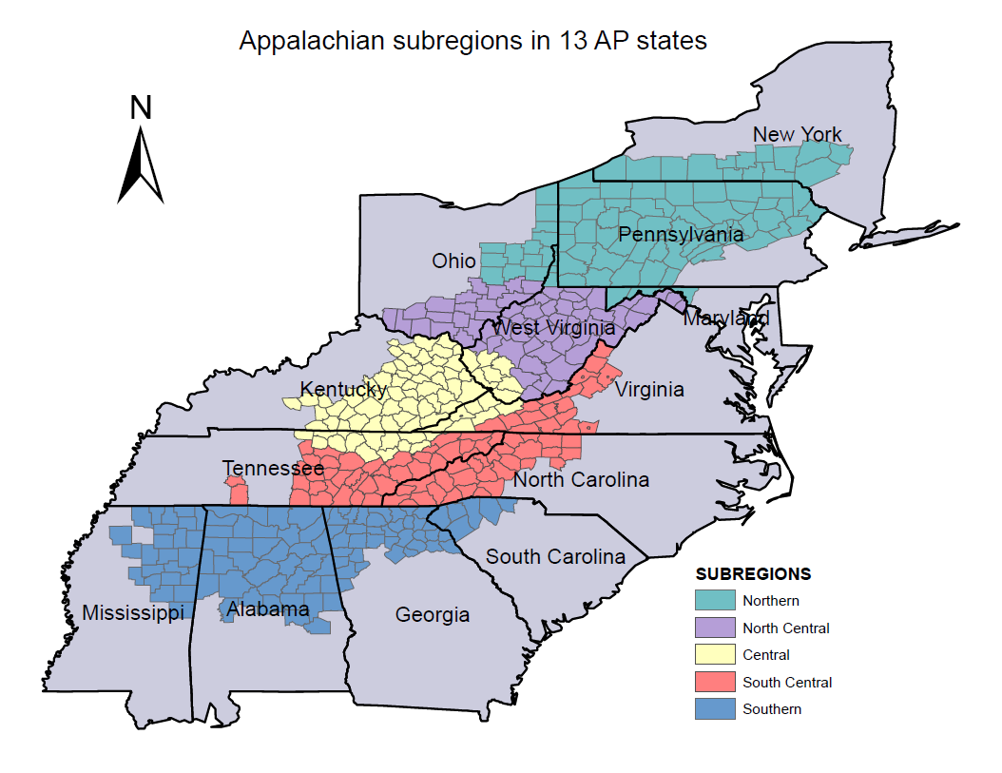
Background - Appalachia
Notes:
Appalachian population is a special population in Kentucky. Appalachia population is predominated by white population. It encompase 13 states and it is divided into five subregions. Central Appalachia has the highest cancer burden in incidence and moraltiy, low education, poor health access. Appalachian KY is part of the Central Appalachian population hence it has been our focus for research and prevention effort.

Slide 6
Objectives
Primary objectives
To identify whether depression is associated with receiving nonguideline cancer treatment among female breast cancer patients
To exam whether depression and timing of depression are associated with worse survival.
Secondary objective
To explore whether Appalachian patients have higher risk of experiencing depression and receiving nonguideline cancer treatment.
Notes:
The primary objectives of the study is to

Slide 7
Methods
Data Sources
KCR data linked with Health Administrative Claims, including Medicare, Medicaid, and private insurance claims data.
Selection criteria
Invasive First primary breast cancer patients aged 20 or older at cancer diagnosis from 2007 to 2011.
Continuous insurance enrollment in combined claims data 12 months before and after cancer diagnosis was required.

Slide 8
Methods
Depression Status
ICD-9-CM codes in inpatient or outpatient claims data.
296.20, 296.21,296.22,296.23,296.24, 296.25,296.26, 296.30, 296.31, 296.32,296.33,296.34, 296.35, 296.36, 298.0, 300.4, 309.0, 309.1, 311.0
Based on claims within 12 months prior cancer diagnosis and 13 months at/after cancer diagnosis.
Four groups
No depression(n=5212)
Pre-diagnostic depression only(n=221): 12 month prior cancer diagnosis
Post-diagnostics depression only(n=375): 13 month at/after cancer diagnosis
Persistent depression(both periods) (n=246): Having depression before and after cancer diagnosis

Slide 9
Methods
Standard Care
The definition of standard care was based on the NCCN guidelines 2018 and summarized by stage
ER/PR/HER2+: Hormone therapy/trastuzumab (all stage)
Stage I/II: Mastectomy or lumpectomy with adjuvant radiation. If not hormone receptor-positive, chemotherapy was defined as standard care.
For Stage III: Neoadjuvant therapy or/mastecotomy, following with adjuvant chemo or hormone/trastuzumab.
For stage IV:, Chemo or hormone therapies are the primary treatment.

Slide 10
Results

Slide 11
Results – Age and Depression

Slide 12
Results – Insurance and Depression

Slide 13
Results – Smoker and Depression

Slide 14
Results – Comorbidity and Depression

Slide 15
Results – Stage and Depression

Slide 16
Results – Standard Care and Depression

Slide 17
Results – Association between Receiving standard care and Depression in Logistic Model
Variables | OR | 95% CI |  | P-value
Depression Status |  |  |  | 0.2778
Pre-diagnostic depression only | 0.724 | 0.521 | 1.007
Post-diagnostic depression only | 1.037 | 0.792 | 1.359
Persistent depression | 0.956 | 0.690 | 1.324
No Depression | Reference
Appalachian Status |  |  |  | 0.0232
Appalachian | 1.238 | 1.030 | 1.489
Non-Appalachian | Reference
Other significant factors: Marriage status, age, stage, insurance, education, comorbidity

Slide 18
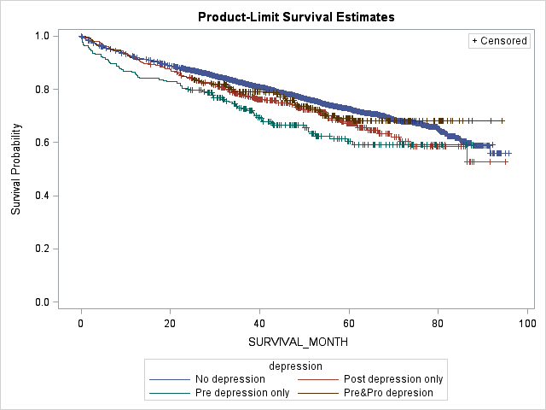
Results - KM plots by Depression

Slide 19
Results – Association with Survival
 | Model I |  |  |  | Model II
Factors | HR | 95% CI |  | P-value | HR | 95% CI |  | P-value
Depression Status |  |  |  | 0.0002 |  |  |  | <.0001
Pre-diagnostic depression | 1.24 | 0.98 | 1.57 |  | 1.38 | 1.09 | 1.74
Post-diagnostic depression | 1.51 | 1.24 | 1.84 |  | 1.48 | 1.22 | 1.80
Persistent depression | 1.16 | 0.90 | 1.49 |  | 1.16 | 0.90 | 1.49
No Depression | Reference
Standard Care |  |  |  | <.0001 | - | - | - | -
No | 2.20 | 1.95 | 2.48 |  | - | - | - | -
Unknown | 1.06 | 0.78 | 1.45 |  | - | - | - | -
Yes | Reference |  |  |  | - | - | - | -
Other significant factors: Marriage status, age, stage, insurance, education, smoking status, comorbidity, ER/PR, grade

Slide 20
Summary
Age, smoking status, comorbidity, stage are associated with depression status, particularly for Medicaid patients. Appalachian patients did not have elevated risk of depression.
Depression status was not significantly associated with receiving standard care, although the patients with pre-diagnosis depression showed lower chance to receive it.
Patients with persistent depression having better survival suggests the importance of managing the disease. Earlier control and well-management of depression may have a positive effect on survival.

Slide 21
Acknowledgements
University of Kentucky
Feitong Lei, MPH
Thomas Tucker, PhD
Eric Durbin, DrPH
Robin Vanderpool, DrPH
Edward Romond, MD
Centers for Diseases Control and Prevention
Eric Tai, PhD

Slide 22
Thanks!
Bin Huang, Kentucky Cancer Registry
bhuang@kcr.uky.edu

