Slide 1
Methods, Results, and Lessons Learned From Two Postmarketing Drug Safety Surveillance Studies Linking State Cancer Registry Data to Large Pharmacy Databases
June 11, 2019
David Harris, MPH
RTI Health Solutions: Kirk Midkiff, Alicia Gilsenan, Elizabeth Andrews IQVIA: Deborah Casso, Amanda Anderson, Susan Oliveria
Eli Lilly and Company: Nicole Kellier-Steele
Presented at the NAACCR / IACR 2019 Combined Annual Conference
Vancouver, British Columbia, Canada

Slide 2
Objectives of Presentation
To describe the methods for two parallel but separate studies that implemented linkages between state cancer registry data and data from two large prescription databases in the United States
Medicare Part D prescription claims data
IQVIA longitudinal commercial prescription dispensing database (LRx)

Slide 3
BACKGROUND

Slide 4
Background – Teriparatide
Teriparatide (Forteo) is a medication indicated for:
Treatment of postmenopausal women with osteoporosis at high risk for fracture
Increase of bone mass in men with primary or hypogonadal osteoporosis at high risk for fracture
Treatment of men and women with osteoporosis associated with sustained systemic glucocorticoid therapy at high risk for fracture
Multidose prefilled delivery device (pen) for subcutaneous injection containing 28 daily doses of 20 mcg
FDA approved teriparatide in 2002; expanded indication approved in 2009

Slide 5
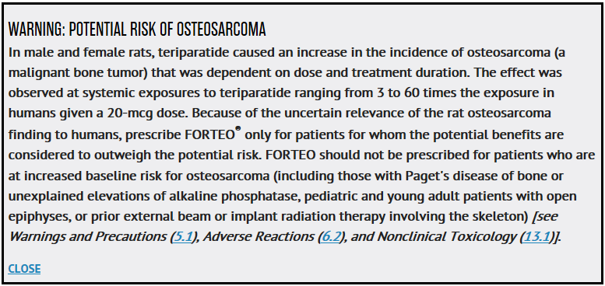
Background – Research Question
Is there an increased incidence of osteosarcoma in patients taking teriparatide compared with those patients who do not use teriparatide?
NIH, US National Library of Medicine, DailyMed: https://dailymed.nlm.nih.gov/dailymed/drugInfo, accessed on May 22, 2018

Slide 6
Background – Osteosarcoma
Primary malignant bone tumor
Incidence rate that varies in adults from 1.7 per million per year in those aged 25 to 59 years to 4.2 per million per year for those aged 60 years or older
Approximately 250-350 cases diagnosed each year in persons aged 40 years and older in the US

Slide 7
Background – Program History for the Forteo Postmarketing Safety Studies
Study Name | Study Period | Diagnosis Years Included | Number of Participating Registries
Forteo Post-Approval Surveillance Study: Case Series (US) | 2003 – 2018 | 2003 – 2016 | 30
Forsteo Post-Approval Surveillance Study (Europe) | 2004 – 2014 | 2004 – 2011 | 5 Nordic countries
Forteo Patient Registry | 2009 – 2024 | 2009 – 2022 | 42
Forteo – Medicare Linkage Studyª | 2015 – 2017 | 2007 – 2014 | 26
Forteo – IQVIA Linkage Studyª | 2016 – 2018 | 2005 – 2014 | 29
ª Focus of today’s presentation

Slide 8
Study Objective and Rationale for Database Linkage Studies
The primary objective was to estimate the incidence rate ratio and 95% confidence interval of osteosarcoma for patients aged 18 years or older (IQVIA) or aged 65 years or older (Medicare) with a prescription claim for teriparatide versus a cohort of matched comparators
Secondary objectives included characterizing the teriparatide and comparator cohorts using the following information:
Demographic characteristics
Selected prescription drugs dispensed during the baseline period
Duration of teriparatide use (for teriparatide-treated cohort)
Rationale: Using prescription data allowed the capture of information on duration of teriparatide use and a comparator cohort of nonusers

Slide 9
METHODS

Slide 10
Study Design Overview
 | Forteo – IQVIA Linkage Study | Forteo – Medicare Linkage Study
Data source | Commercial Pharmacy | Medicare Part D
Diagnosis years | 2005-2014 | 2007-2014
Population | 18 years and older | 65 years and older
Exposure | Teriparatide prescription filled | Teriparatide prescription filled
Options for linkage | (1) Send identifiable data to TTP (2) Install de-identification software to create token | Send identifiable data to TTP using 1 of 2 options for required variables
Variables needed for linkage | Name, DOB, sex, address, and 5-digit zip code used by TTP or registry to create de-identified token | Full 9-digit SSN; or At least 3 of: last 4 digits of SSN, last name, DOB, and sex (plus zip code and state)
Outcome | Osteosarcoma identified through linkage to cancer registries | Osteosarcoma identified through linkage to cancer registries
Note: Light blue indicates key differences;
TTP = trusted third party; SSN = Social Security Number.

Slide 11
Forteo – Medicare Linkage Study, Linkage Method
GDIT (Trusted Third Party)
1. RTI-HS creates cohort and sends encrypted ID list from Medicare data file to GDIT
2. Registry creates study file of osteosarcoma cases and sends file (including only patient identifiers and ID) to GDIT
3. GDIT conducts linkage and sends Bene ID + study ID to RTI-HS for matches only
RTI-HS
Cancer Registry
4. RTI-HS sends study ID to registries for matches
5. Registries send study ID and cancer diagnosis information to RTI-HS for matches
Bene ID = Medicare Beneficiary ID; GDIT = General Dynamics IT; ID = identification; RTI-HS = RTI Health Solutions.

Slide 12
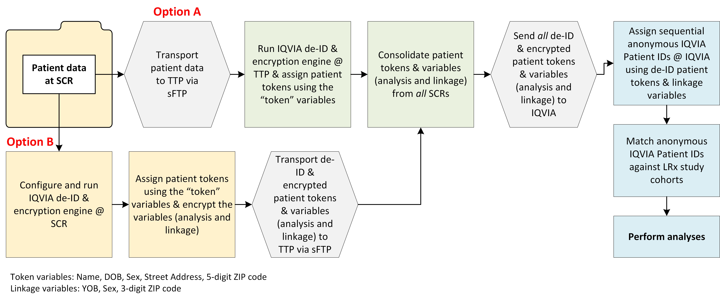
Forteo – IQVIA Linkage, Data Flow and Linkage Method
de-ID = de-identification software or deidentified; DOB = date of birth; LRx = large US commercial prescription dispensing database; SCR = state cancer registry; sFTP = secure file transfer protocol; TTP = trusted third party; YOB = year of birth.

Slide 13
RESULTS

Slide 14
Registry Linkage Results
IQVIA Linkage
A total of 29 registries participated and sent 4,242 osteosarcoma cases aged 18 years and older for linkage
16 registries submitted data to IQVIA’s trusted third party
13 registries elected to install the de-identification software and submitted a hashed token to IQVIA’s trusted third party
Medicare Linkage
A total of 26 registries participated and sent 811 osteosarcoma cases aged 65 years and older for linkage
19 registries submitted the full 9-digit SSN
7 registries submitted at least 3 of the 4 required variables (last 4 of SSN, last name, DOB, and sex) plus zip code and state

Slide 15
Cancer Registries That Participated in Both the Forteo Medicare and IQVIA Linkage Studiesª
ª A total of 22 registries participated in both studies

Slide 16
Cancer Registries That Participated in Only the Forteo Medicare Linkage Studiesª
ª A total of 4 registries participated in only the Medicare study.

Slide 17
Cancer Registries That Participated in Only the Forteo IQVIA Linkage Studyª
ª A total of 7 registries participated in only the IQVIA study.

Slide 18
Cancer Registry Participation in the Forteo Medicareª and IQVIA^{b} Linkage Studies
Participation by State
ª A total of 26 registries participated in the Medicare study; representing 68% of all osteosarcoma cases aged 65 years and older occurring during the study period.
^{b} A total of 29 registries participated in the IQVIA study; representing 70% of all osteosarcoma cases aged 18 years and older occurring during study period.

Slide 19
Challenges to Participation
Reasons why registries could not participate in one or both studies:
Inability to send identifiable data externally and/or install IQVIA de-identification software on registry computers
CMS and its trusted third party were unable to sign required registry data use and/or confidentiality agreements
Lack of resources
Challenges among participating registries:
Working through local registry/state restrictions for sharing identifiable data
Changes in CMS data release policies during the course of the study
Gaining internal acceptance for a new type of data linkage (e.g., sending data to trusted third party, linkage using only de-identified hashed tokens)
Gaining permission to install external software
Completing contractual agreements that aligned with requirements of all participating parties
CMS = Centers for Medicare and Medicaid Services.

Slide 20
CONCLUSIONS AND NEXT STEPS

Slide 21
Conclusions
Varying requirements and the logistics of working with state entities, the federal government, and a commercial database made the studies complex and resource-intensive
However, linking state cancer registry data to prescription databases can be an effective way to conduct safety studies investigating rare drug exposures that also require validated outcomes for a rare cancer

Slide 22
Next Steps
Final reports have been submitted to the study sponsor and are under review by regulatory agencies
A manuscript of final study results is in development

Slide 23
Thank You Questions?
David Harris, MPH
+1.919.541.7493
dharris@rti.org

