Slide 1
Implementation of ePath Reporting in California: Setting Data Quality Standards
Andrea Sipin-Baliwas
NAACCR/IACR Meeting
Vancouver, Canada
June 11, 2019

Slide 2
AB2325: Revolutionizing Cancer Research
Requires pathologists who diagnose cancer to provide their cancer pathology reports to the California Cancer Registry (CCR) electronically effective January 1, 2019
A pathology lab will be able to comply by adhering to the reporting requirements regarding the specific data items and standardized format regardless of the technical platform used to capture, store, and submit data
However, it appears that many laboratories currently lack the capacity to submit the reports in the required HL-7 2.5.1 format

Slide 3
milestones
An Inforgraphic Timeline is in this worksheet starting in cell B1. 5 teardrop shapes with milestone titles above them and milestone dates within them are mapped along a curved line that charts the year from start to end. Next to each teardrop is a description or list of activities for each milestone or informational marker. To modify the content in this worksheet, update the Chart Data table in the Chart Data worksheet. There are no further instructions in this worksheet.
Define Data Standards
Legislation Signed
15 Jan
5/28/2018
Release Implementation Guide
14 Sep
1 Jul
2016
2017
Implementation Start
Release of Direct Data Entry Web Portal
8 Jun
1 Jan
Data Quality Assessment
2018
2019

Slide 4
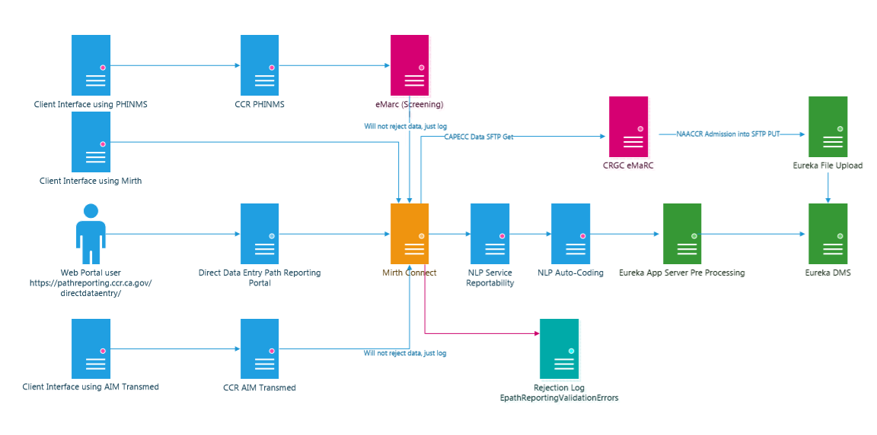
Ccr data flow diagram

Slide 5
Current state of implementation
 | AIM ePath | HL7251 MLLP | HL7251 SFTP | HL7251 WebService SOAP | NPCR-AERRO PHINMS | PORTAL | Grand Total
Counts Statewide | 83 | 10 | 34 | 24 | 20 | 164 | 335
Updated 5/9/19

Slide 6
Importance of assessing data quality
Challenge: Pathology labs lack required CTR expertise to conduct accurate and complete casefinding of cancer positive reports
Ability of labs to transmit complete path reports
Preliminary assessment of new feeds raises concerns:
Labs transmitting partial reports (sending Final Diagnosis text only)
Volume drop compared to Regions’ historical path report volume when conducting on-site casefinding → Missing reportable paths
Los Angeles Cancer Surveillance Program conducting 2 regional pilot projects to determine scalable solutions for adoption
Centralized NLP implementation will determine reportable vs. non-reportable and assist in ensuring only reportable cases are processed and allow for analytics for feedback

Slide 7
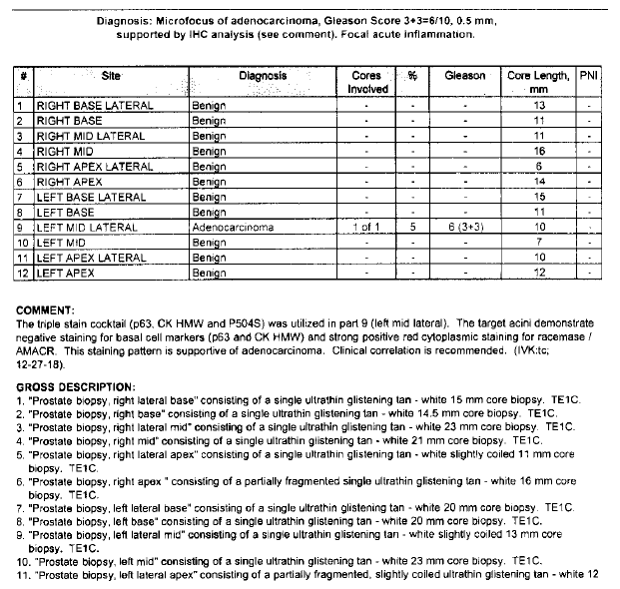
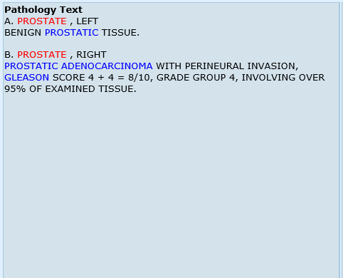
???

Slide 8
Development of epath data quality plan
Data Quality Plan components:
Completeness
Adherence to HL-7 format requirement
Monitoring of completeness
Addressing non-compliance
Accuracy
Monitoring of reportable vs non-reportable
Monitoring of accuracy and quality of reporting
Addressing non-compliance
Timeliness
Adherence to 2-week timeline from final diagnosis/sign-out to date transmitted
Monitoring of timeliness
Addressing non-compliance

Slide 9
Development of epath data quality plan
Statewide centralized approach
Consideration for developing edit checks run against transmitted ePath
Establishing annual audits and improvement processes
Determine method of communicating data quality issues to transmitting lab
Determine who is responsible (State/Regions) for compliance with the three metrics described and how often assessment will take place
Develop a strategy for ensuring compliance in accordance with AB2325 requirements
The California Department of Public Health directs the statewide cancer registry as per California Health and Safety Code 103875-103885 and has issued four grants to support registry implementation. The current grants include UC Davis as the central registry and 3 regional registries: The Cancer Registry of Greater California, the Greater Bay Area Cancer Registry, and the Los Angeles Cancer Surveillance Program. These three regional registries also function as CA NCI SEER registries.

Slide 10
completeness
two definitions:
1. Are the individual path reports completely populated with the necessary variables (message validation)? 2. Are all of the reportable path reports being reported?

Slide 11
Message validation
Adherence of HL-7 message to constraints document
Mirth engine generates monthly reports on success/failure
Checks for HL7 structure against the Implementation Guide
Checks for required items against the Implementation Guide
Checks code sets against the Implementation Guide
Invalid responses contain reason for rejection
Define threshold/failure
Currently only assessing presence of elements of the message, not the validity of the content

Slide 12
Message failure notification
MLLP
MSH|^~\&|Eureka|CCR|CPSI|San Gabriel Valley M|20190308081304||ACK^R01^ACK|20190308081304|P|2.5.1
MSA|AE|20190201114215443|An Error Occurred Processing Message: Missing PID.10.1 in repetition # 1 RaceCode, other components are present, Missing PID.10.2 in repetition # 1 RaceText, other components are present, Missing NK1.2.2 LastName, while NK1.2.1 is present, OBR.4.1 value of 34574-4 does not match cooresponding table of: /^(11529-5|60570-9|35265-8|60571-7|60569-1|60567-5|60568-3|33716-2|33717-0|48807-2|18743-5|55228-1|55229-9|26435-8|33719-6|55230-7)$/,
SOAP
<soap:Envelope xmlns:soap="http://www.w3.org/2003/05/soap-envelope" xmlns:ws="http://ws.connectors.connect.mirth.com/">
<soap:Header/>
<soap:Body>
<ws:acceptMessageResponse>
<response>
<messageControlID>20190318083219</messageControlID>
<status>invalid</status>
<errors>
<error>Missing ORC.22.5 Ordering Facility-ZipCode other components are present</error>
</errors>
</response>
</ws:acceptMessageResponse>
</soap:Body>
</soap:Envelope>
“AE” in MLLP and “Invalid” in SOAP being the important parts which note a failed message.

Slide 13
Ccr data flow diagram

Slide 14
Are all the reportable paths being reported?
If lab has previously reported, can compare counts with historical counts
Counts will be established over time
Conduct one-time on-site audits (only possible with remote access)
Look at Eureka abstracts with histologic confirmation – should have path report
Who will be responsible?
CCR for messages received
Regions will have some ability to know or estimate denominator
Non-compliance
Total non-response
Don’t provide necessary information
Remedy for non-compliance
Fee-for-service
Financial penalties for when access is not provided
Different levels of non-compliance

Slide 15
Plans for monitoring
Will monitor sites via the report below for number of ePath received monthly
Currently developing a daily load report to immediately identify potential transmission issues as they arise
CCR ePath Disposition
Year Cases Loaded 2019 from all facilities
 | Jan | Feb | Mar | Apr | May | Jun | Jul | Aug | Sep | Oct | Nov | Dec | Total
2019 | 68,776 | 42,146 | 52,843 | 48,597 | 48,807 | 4,244 | 0 | 0 | 0 | 0 | 0 | 0 | 265,413
FACILITY A
 | Jan | Feb | Mar | Apr | May | Jun | Jul | Aug | Sep | Oct | Nov | Dec | Total
2019 | 15 | 49 | 79 | 21 | 28 | 6 | 0 | 0 | 0 | 0 | 0 | 0 | 198
FACILITY B
 | Jan | Feb | Mar | Apr | May | Jun | Jul | Aug | Sep | Oct | Nov | Dec | Total
2019 | 10 | 21 | 12 | 24 | 17 | 6 | 0 | 0 | 0 | 0 | 0 | 0 | 90
FACILITY C
 | Jan | Feb | Mar | Apr | May | Jun | Jul | Aug | Sep | Oct | Nov | Dec | Total
2019 | 799 | 600 | 606 | 675 | 671 | 25 | 0 | 0 | 0 | 0 | 0 | 0 | 3,376
FACILITY D
 | Jan | Feb | Mar | Apr | May | Jun | Jul | Aug | Sep | Oct | Nov | Dec | Total
2019 | 187 | 126 | 130 | 131 | 117 | 3 | 0 | 0 | 0 | 0 | 0 | 0 | 694

Slide 16
accuracy
Monitoring of Reportable vs. Non-Reportable
Review of Eureka report
Determine ways to decrease number of non-reportable ePath
Address balance between sensitivity and specificity

Slide 17
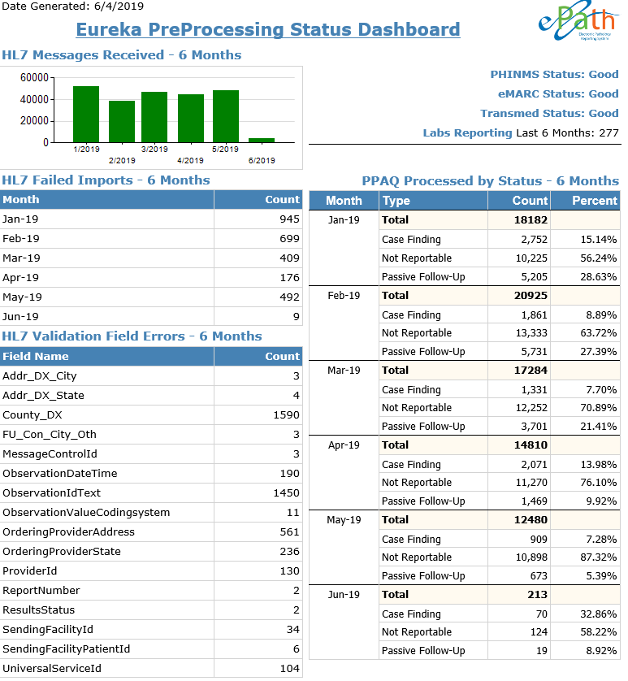
Note:
“Not Reportable” category is inaccurately high due to current workaround in processing cases.

Slide 18
timeliness
Adherence to 2-week timeline from final diagnosis/sign-out to date transmitted
Monitoring of timeliness:
Calculate interval between specimen date and date received → “Finalization” of report
Prepare reports by lab
Addressing non-compliance
To be determined
Number of Reports Received (227 facilities total) | Average Number of Days
41179 | 15

Slide 19
Topics for further consideration
Determine method of communicating data quality issues to transmitting lab
Automated responses to lab
Determine who is responsible for monitoring and assuring compliance with the three metrics described
Working to establish frequency of assessment
Establishing annual audits and improvement processes
Remote access to assess and assist failing facilities
Ongoing identification of new labs – Who and how?

Slide 20
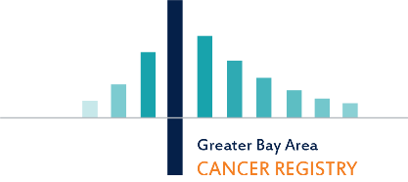
THANK YOU
Co-Authors:
Dennis Deapen
Cheryl Moody
Jenna Mazreku
Jeremy Pine
Kathleen Davidson-Allen
Kyle Ziegler
Mignon Dryden
Acknowledgements:
George Curtis
Ghenadie Ciornii
Nhu La
Timothy Davison
The collection of cancer incidence data used in this study was supported by the California Department of Public Health pursuant to California Health and Safety Code Section 103885; Centers for Disease Control and Prevention’s (CDC) National Program of Cancer Registries, under cooperative agreement 5NU58DP006344; the National Cancer Institute’s Surveillance, Epidemiology and End Results Program under contract HHSN261201800032I awarded to the University of California, San Francisco, contract HHSN261201800015I awarded to the University of Southern California, and contract HHSN261201800009I awarded to the Public Health Institute. The ideas and opinions expressed herein are those of the author(s) and do not necessarily reflect the opinions of the State of California, Department of Public Health, the National Cancer Institute, and the Centers for Disease Control and Prevention or their Contractors and Subcontractors.

