Slide 1
Cancer Registry Collaboration with Cancer Control Program on a Population-Based Survey of Utah Cancer Survivors
Kimberly Herget, MStat
Utah Cancer Registry
NAACCR/IACR Annual Conference, June 2019
Acknowledgement:
Supported by the Centers for Disease Control and Prevention National Program of Cancer Registries under cooperative agreement NU58DP006320.

Slide 2
Background

Slide 3
Cancer Patient Health Status
Cancer registry data does a good job of collecting information at time of diagnosis
Beyond survival time, cancer registries do not collect information on patients long term after diagnosis

Slide 4
Identifying Cancer Survivor Needs
State cancer control programs have a need for a comprehensive understanding of cancer survivors’ experiences
Data are needed to evaluate those programs

Slide 5
Identifying Cancer Survivor Needs
Previous assessments in 2010 and 2017 via the Behavioral Risk Factor Surveillance System (BRFSS) cancer survivor module
Limitations of BRFSS
Self-reported cancer status
Many responders are non-melanoma skin cancer survivors
Anonymous so it cannot be linked to diagnostic information
Infrequent assessment
Collaboration between Utah Cancer Registry and the Utah Department of Health’s Comprehensive Cancer Program

Slide 6
Utah State Cancer Plan Goals for Cancer Survivors

Slide 7
Purpose

Slide 8
Assess trends of Utah cancer survivors’ long term health status and needs
Provide evidence to evaluate cancer control programs

Slide 9
Methods

Slide 10
Questionnaire Design
Input from relevant partners
Utah Department of Health
Utah Cancer Action Network
Huntsman Cancer Institute (National Cancer Institute designated Cancer Center)
Used many questions from BRFSS
Other questions were taken from validated survey instruments
Include questions relevant to the state cancer plan goals
Notes:
Over half of questions from BRFSS. Others were requests from the UDOH or researchers
55 questions total

Slide 11
Questionnaire Topic Areas
General health status
Health behaviors
Smoking status
Physical activity
Life satisfaction
Limitations due to physical, emotional, or mental health problems
Pain management
Treatment
Insurance payment for all/part of treatment
Survivorship care plan distribution
Enrollment in clinical trials
Caregivers
Health screenings

Slide 12
Survey Methods
Eligibility
Aged 18 or older at diagnosis
Diagnosed as a resident of Utah between 2012 and 2016
SEER-reportable invasive or benign brain/CNS tumor
Living in Utah in 2018
Sampling strategy
Sampled randomly from the Utah Cancer Registry
Identified 807 potential participants
Oversampled in areas with low health insurance coverage
Recruitment and data collection
$2 incentive for all participants sent with introductory letter
Participants aged 18 to 79 years sent a letter with link to an online survey
Participants aged ≥80 years sent a paper questionnaire
Non respondents were followed up by both phone and mail
Notes:
Small health areas based on BRFSS study
In words – the participants were offered to send a paper questionnaire if they did not want to take an online survey. Online survey done via Qualtrics program.

Slide 13
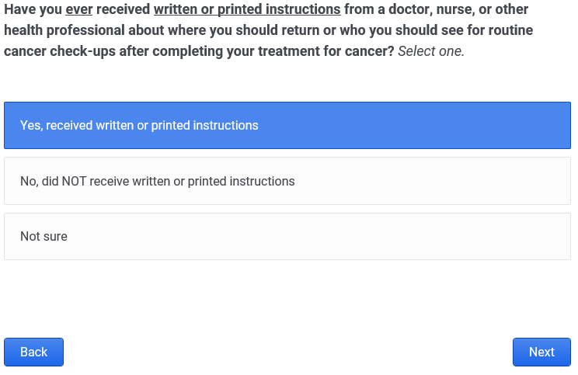

Slide 14
Results

Slide 15
Table 1. Survey response and participant characteristics, 2018
 | Eligible Sample | Respondent | Response Rate¹
 | n | n | %
Total | 807 | 485 | 60.7
Sex
Female | 448 | 276 | 61.7
Male | 359 | 209 | 59.4
Age at diagnosis
18 to 39 years | 97 | 43 | 47.2
40 to 64 years | 399 | 243 | 62.5
65 to 95 years | 310 | 199 | 66.9
Insurance Area
High Insurance Coverage | 292 | 196 | 66.2
Low Insurance Coverage | 515 | 290 | 53.1
1 Weighted to account for stratified sample and age standardized
Notes:
Add race/ethnicity
High and low insurance areas

Slide 16
Table 1 continued. Participant characteristics, 2018
 | Eligible Sample | Respondent | Response Rate²
 | n | n | %
Cancer Site¹
Breast | 145 | 103 | 72.1
Melanoma | 107 | 72 | 65.7
Prostate | 138 | 86 | 64.3
Colorectal | 70 | 36 | 45.5
Brain And Central Nervous System | 62 | 22 | 37.9
Other Sites | 138 | 86 | 64.3
Race and Ethnicity
Non Hispanic White | 734 | 460 | 63.2
Hispanic | 55 | 20 | 40.5
All other races | 18 | 6 | 26.5
1Five most sampled cancer sites shown 2 Weighted to account for stratified sample and age standardized
Notes:
8 of the sampled benign brain and CNS patients refused because ‘they did not have cancer’. This was 14.5% of the benign cases sampled

Slide 17
Figure 1. Overall general health reported¹
1 – Weighted to account for stratified sample and age standardized

Slide 18
Figure 2. Pain caused by cancer or treatment¹
1 – Weighted to account for stratified sample and age adjusted

Slide 19
Figure 3. Limitations due to physical, mental, or emotional health
1 – Weighted to account for stratified sample and age standardized
Notes:
Clinical trial, care plans, and health insurance paying for cancer care

Slide 20
Conclusion

Slide 21
Discussion
Year one of this project has given us baseline data for understanding Utah cancer survivors’ health status
Reported pain varies by cancer site
Almost half of respondents have some limitations because of their physical or mental health

Slide 22
Next steps
Plan to collect data annually to assess trends
2019 data collection in progress
Oversample of Hispanic cases
Online and paper questionnaires now available in Spanish
Real time electronic death certificates will be used to avoid sending letters to deceased patients

Slide 23
Lessons Learned
High response rates can be achieved using a mixed mode protocol
online questionnaire first
mail and phone in subsequent follow-ups
prepaid incentive sent with study invitation
Pre-paid incentive requires extra administrative planning and quality control when mailing study invitations
Pre-notice letters identify bad/more current addresses before the study invitations containing the prepaid cash incentive are sent
Low response rate with benign cases as many respondents stated they ‘never had cancer’

Slide 24
Acknowledgements
Utah Cancer Registry staff who contributed to this project:
Judy Ou, PhD, Sandra Edwards, MS, Marjorie Carter, MS-MPH, Anne Kirchhoff, PhD, Morgan Millar PhD, Brad Belnap, BS, Carol Sweeney, PhD
Thanks to the study staff: Kate Hak and Lori Burke
This work was supported by the Centers for Disease Control and Prevention National Program of Cancer Registries under cooperative agreement NU58DP006320-02-00.
The Utah Cancer Registry is also supported in part by:
NCI Surveillance, Epidemiology, and End Results Program Contract No. HHSN261201800016I
University of Utah Health
Huntsman Cancer Institute

