Slide 1
NAACCR Geocoder Alias Tables: Improving geocoding quality through the inclusion of placename aliases
Daniel W. Goldberg, Payton Baldridge
Department of Geography
Texas A&M University
Recinda Sherman
NAACCR
Pam Agovino, Gerry Harris New Jersey Department of Health

Slide 2
Aliases
Commonly Encountered / Alternative Names for a Location
USPS ZIP/City Confusion
Green Brook, NJ ~= Dunellen, NJ (Both 08812)
Vanity City
Beverly Hills ~= Los Angeles (Some people prefer “Beverly Hills”)
Colloquial
Harlem ~= New York City ~= New York (Many people use it)
Misspellings/Abbreviations
Buena Vista Town ~= Buena Vista Twp ~= Buena Vista Township

Slide 3
Issues
Some Registries (e.g. NY) only accept 100% matches
Non-standard placenames = <100% match
134 W 122nd St, New York, NY 10027 = 100%
134 W 122nd St, Harlem, NY 10027 = 96%
Results in
Many “Review” cases which should be labeled “Match”
Unnecessarily high “Review” workloads
Much unhappiness: “Reviewing” is the worst

Slide 4
Resolution
Generate a list of acceptable aliases
Replace alias with official name
Re-score
Aliases must be:
Frequent
Same ZIP Code
Approved
Harlem, NY 10027 New York, NY 10027

Slide 5
Alias List Sources
Historical User Queries
10 years of data
Data “in the wild”
What do people ask for?
VS
What does the data return?
Reference Data Sets
13 years (historical + current)
20 data sets
Crosswalk between:
Address
City
Zip

Slide 6
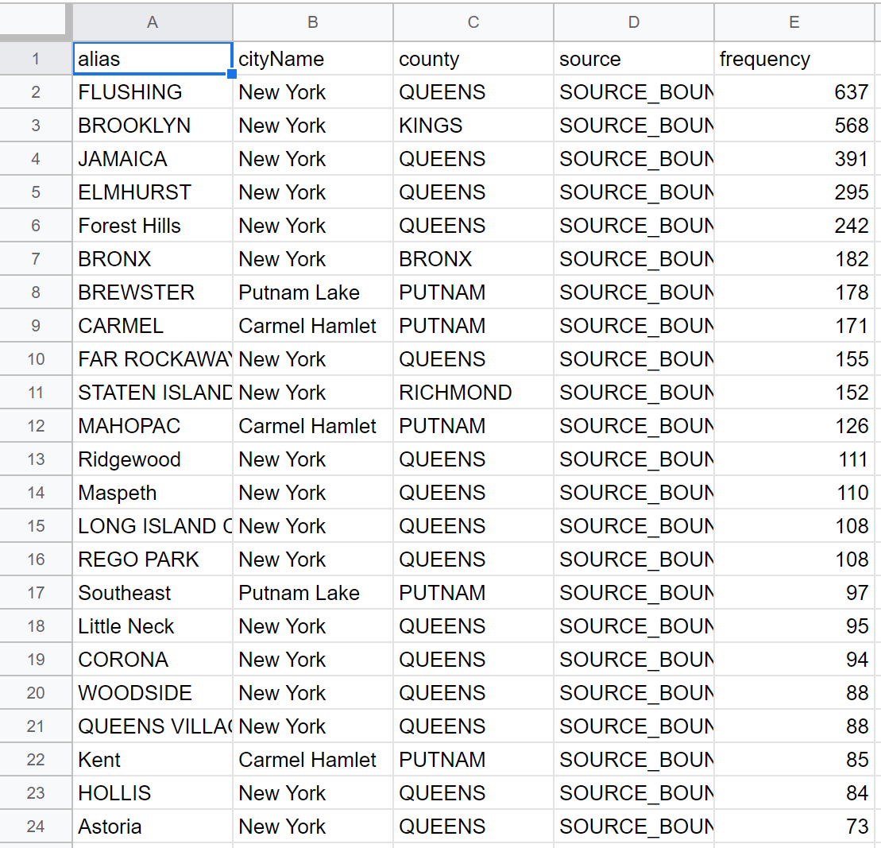
Example Aliases

Slide 7
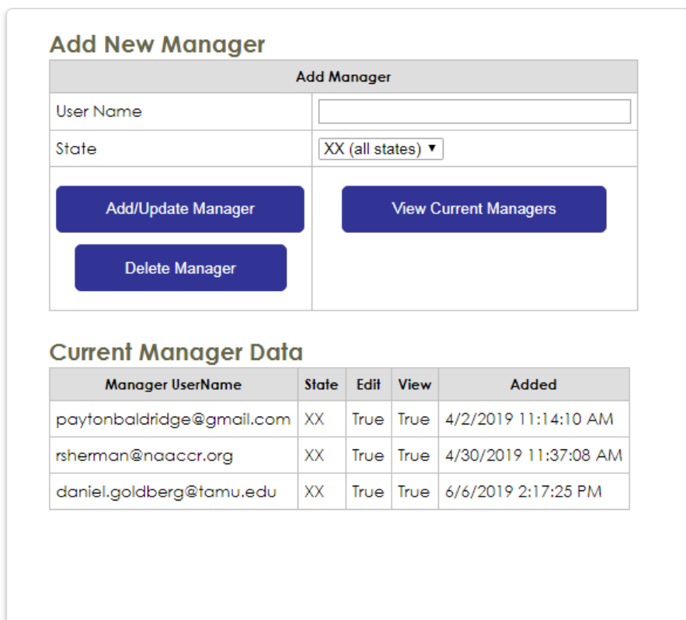
Alias Administration Management

Slide 8
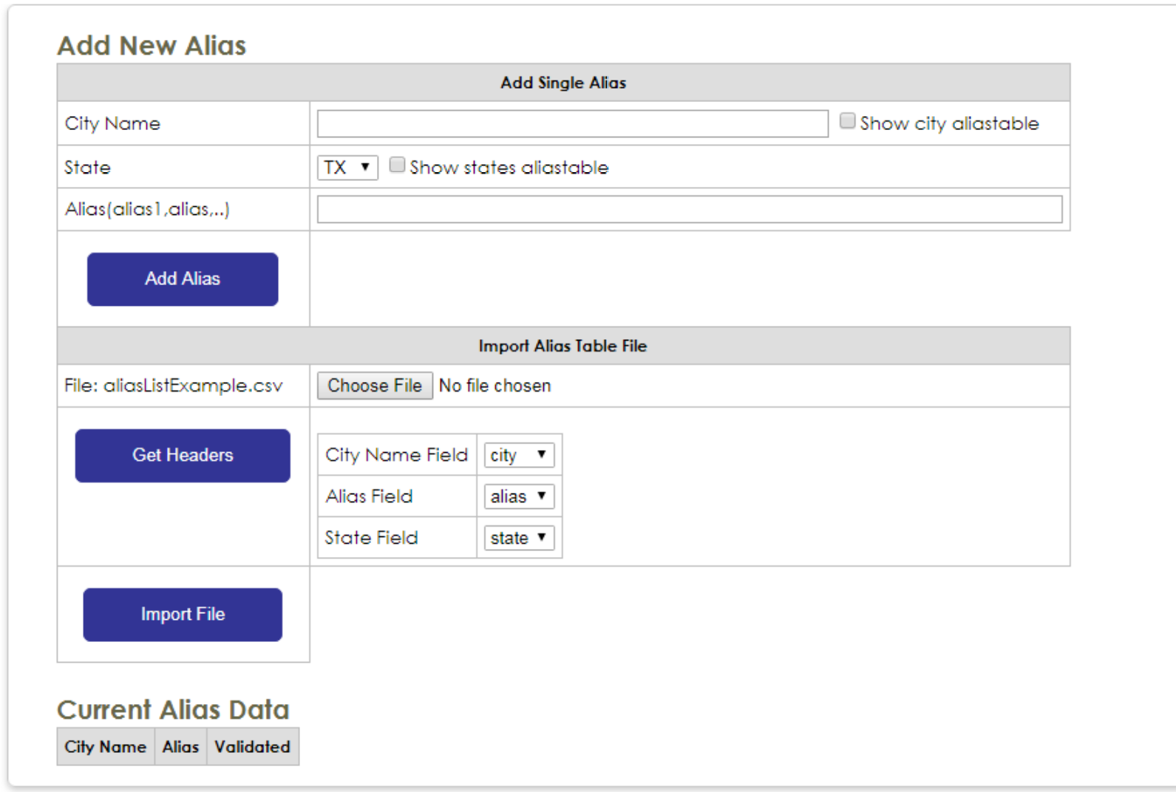
Alias List Management

Slide 9
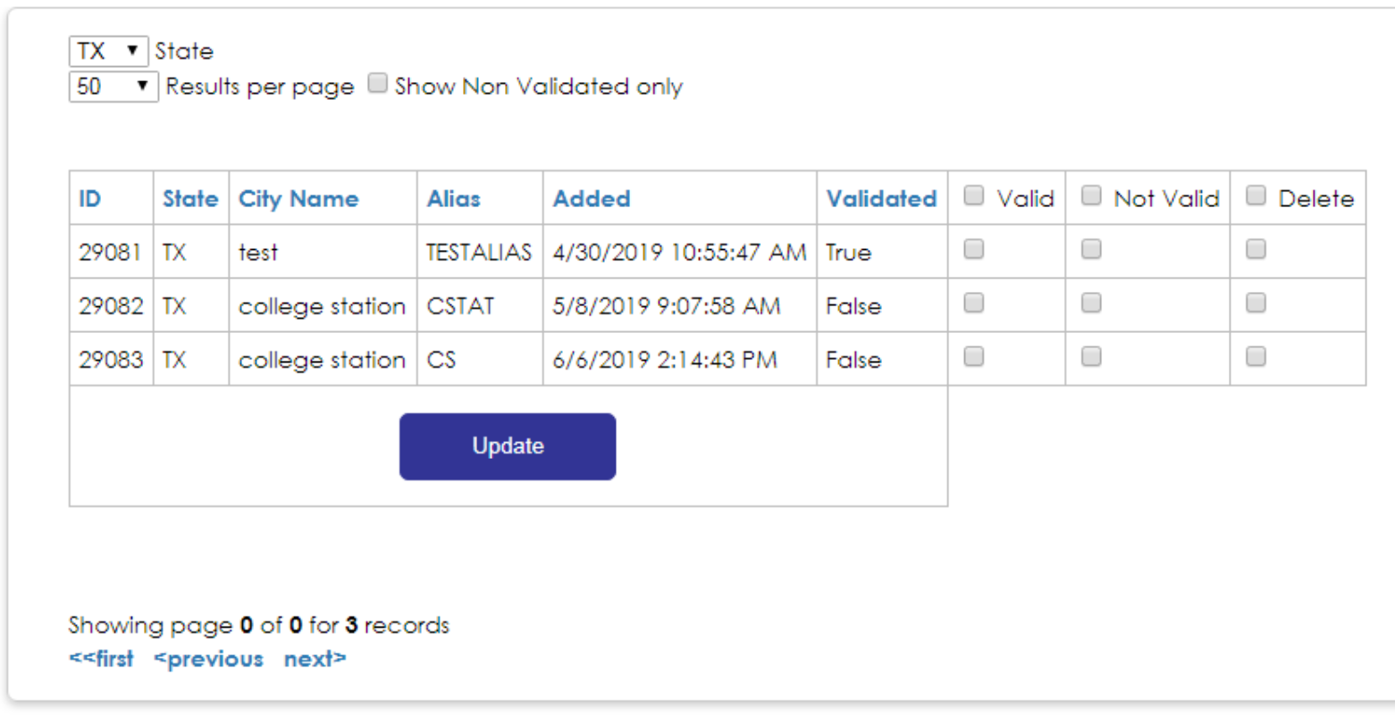
Alias List Management

Slide 10
Status & Process
Aliases have been loaded for all states
Aliases are sorted by frequency/occurrence
Sorted most frequent to least frequent
Registries should select an Admin (and alert TAMU)
Admin should log into https://geo.naaccr.org
Admin should start at the top of the list
Validate aliases they want to include for their state
Remove (or leave invalidated) aliases which should not be used
Geocoding will now use the validated aliases
Available in SEER*DMS
Available in NAACCR Web Geocoder

Slide 11
Test Case
New Jersey State Cancer Registry
Geocoded with and without aliases
Potential Changes
Categories of output: Match, Review, Fail)
Match to Review – aliases resulted in a worse geocode
Match to Fail – aliases resulted in the worst geocode
Review to Match – aliases resulted in a better geocode
Review to Fail – aliases resulted in the worst geocode
Fail to Match – aliases resulted in a better geocode
Fail to Review – aliases resulted in a better geocode

Slide 12
Results
N = 955,839 Dx Address
Years = 2000 – 2017
Type | Without Aliases | With Aliases | Difference | Diff%
Match | 757,285 | 776,654 | +19,369 | +2.6%
Review | 137,705 | 118,902 | -18,803 | -13.7%
Fail | 60,849 | 60,283 | -566 | -0.1%
Total | 955,839 | 955,839 | 0
1 minute per review X 18,803 reviews = 313 hours = ~8 weeks of work saved (minimum)

Slide 13
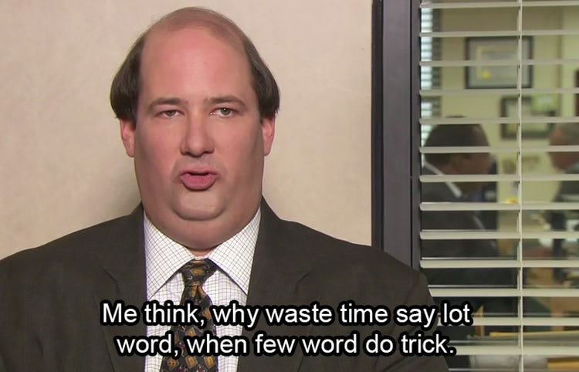
TODO: Everyone
Send us your “approver”
Start using aliases
Increase match rates
Do less reviews (be like Kevin [from the Office, not Henry])
review lot
geocode
review

Slide 14
Thanks & Questions?
Daniel W. Goldberg – daniel.Goldberg@tamu.edu Payton Baldridge – pbaldridge@tamu.edu
Department of Geography
Texas A&M University
Recinda Sherman – rsherman@naaccr.org
NAACCR
Pamela Agovino – pamela.agovino@doh.nj.gov
Gerrald Harris – gaharris@cinj.rutgers.edu New Jersey Department of Health/Cancer Institute of New Jersey

