Slide 1
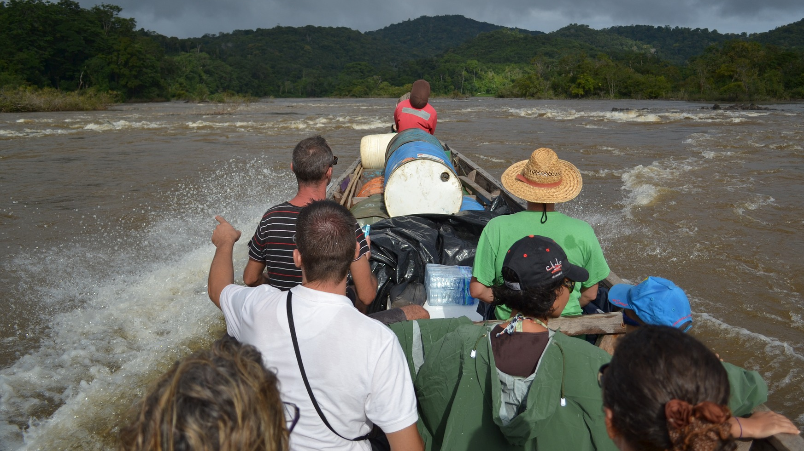
Overcoming challenges related to cancer case identification in rural West Guyana
Sarah Crooks
IARC Caribbean Cancer Registry Hub
Caribbean Public Health Agency (CARPHA)
Trinidad and Tobago
NAACCR /IACR Combined Annual Conference
June 11 – 13, 2019
Vancouver, BC, Canada

Slide 2
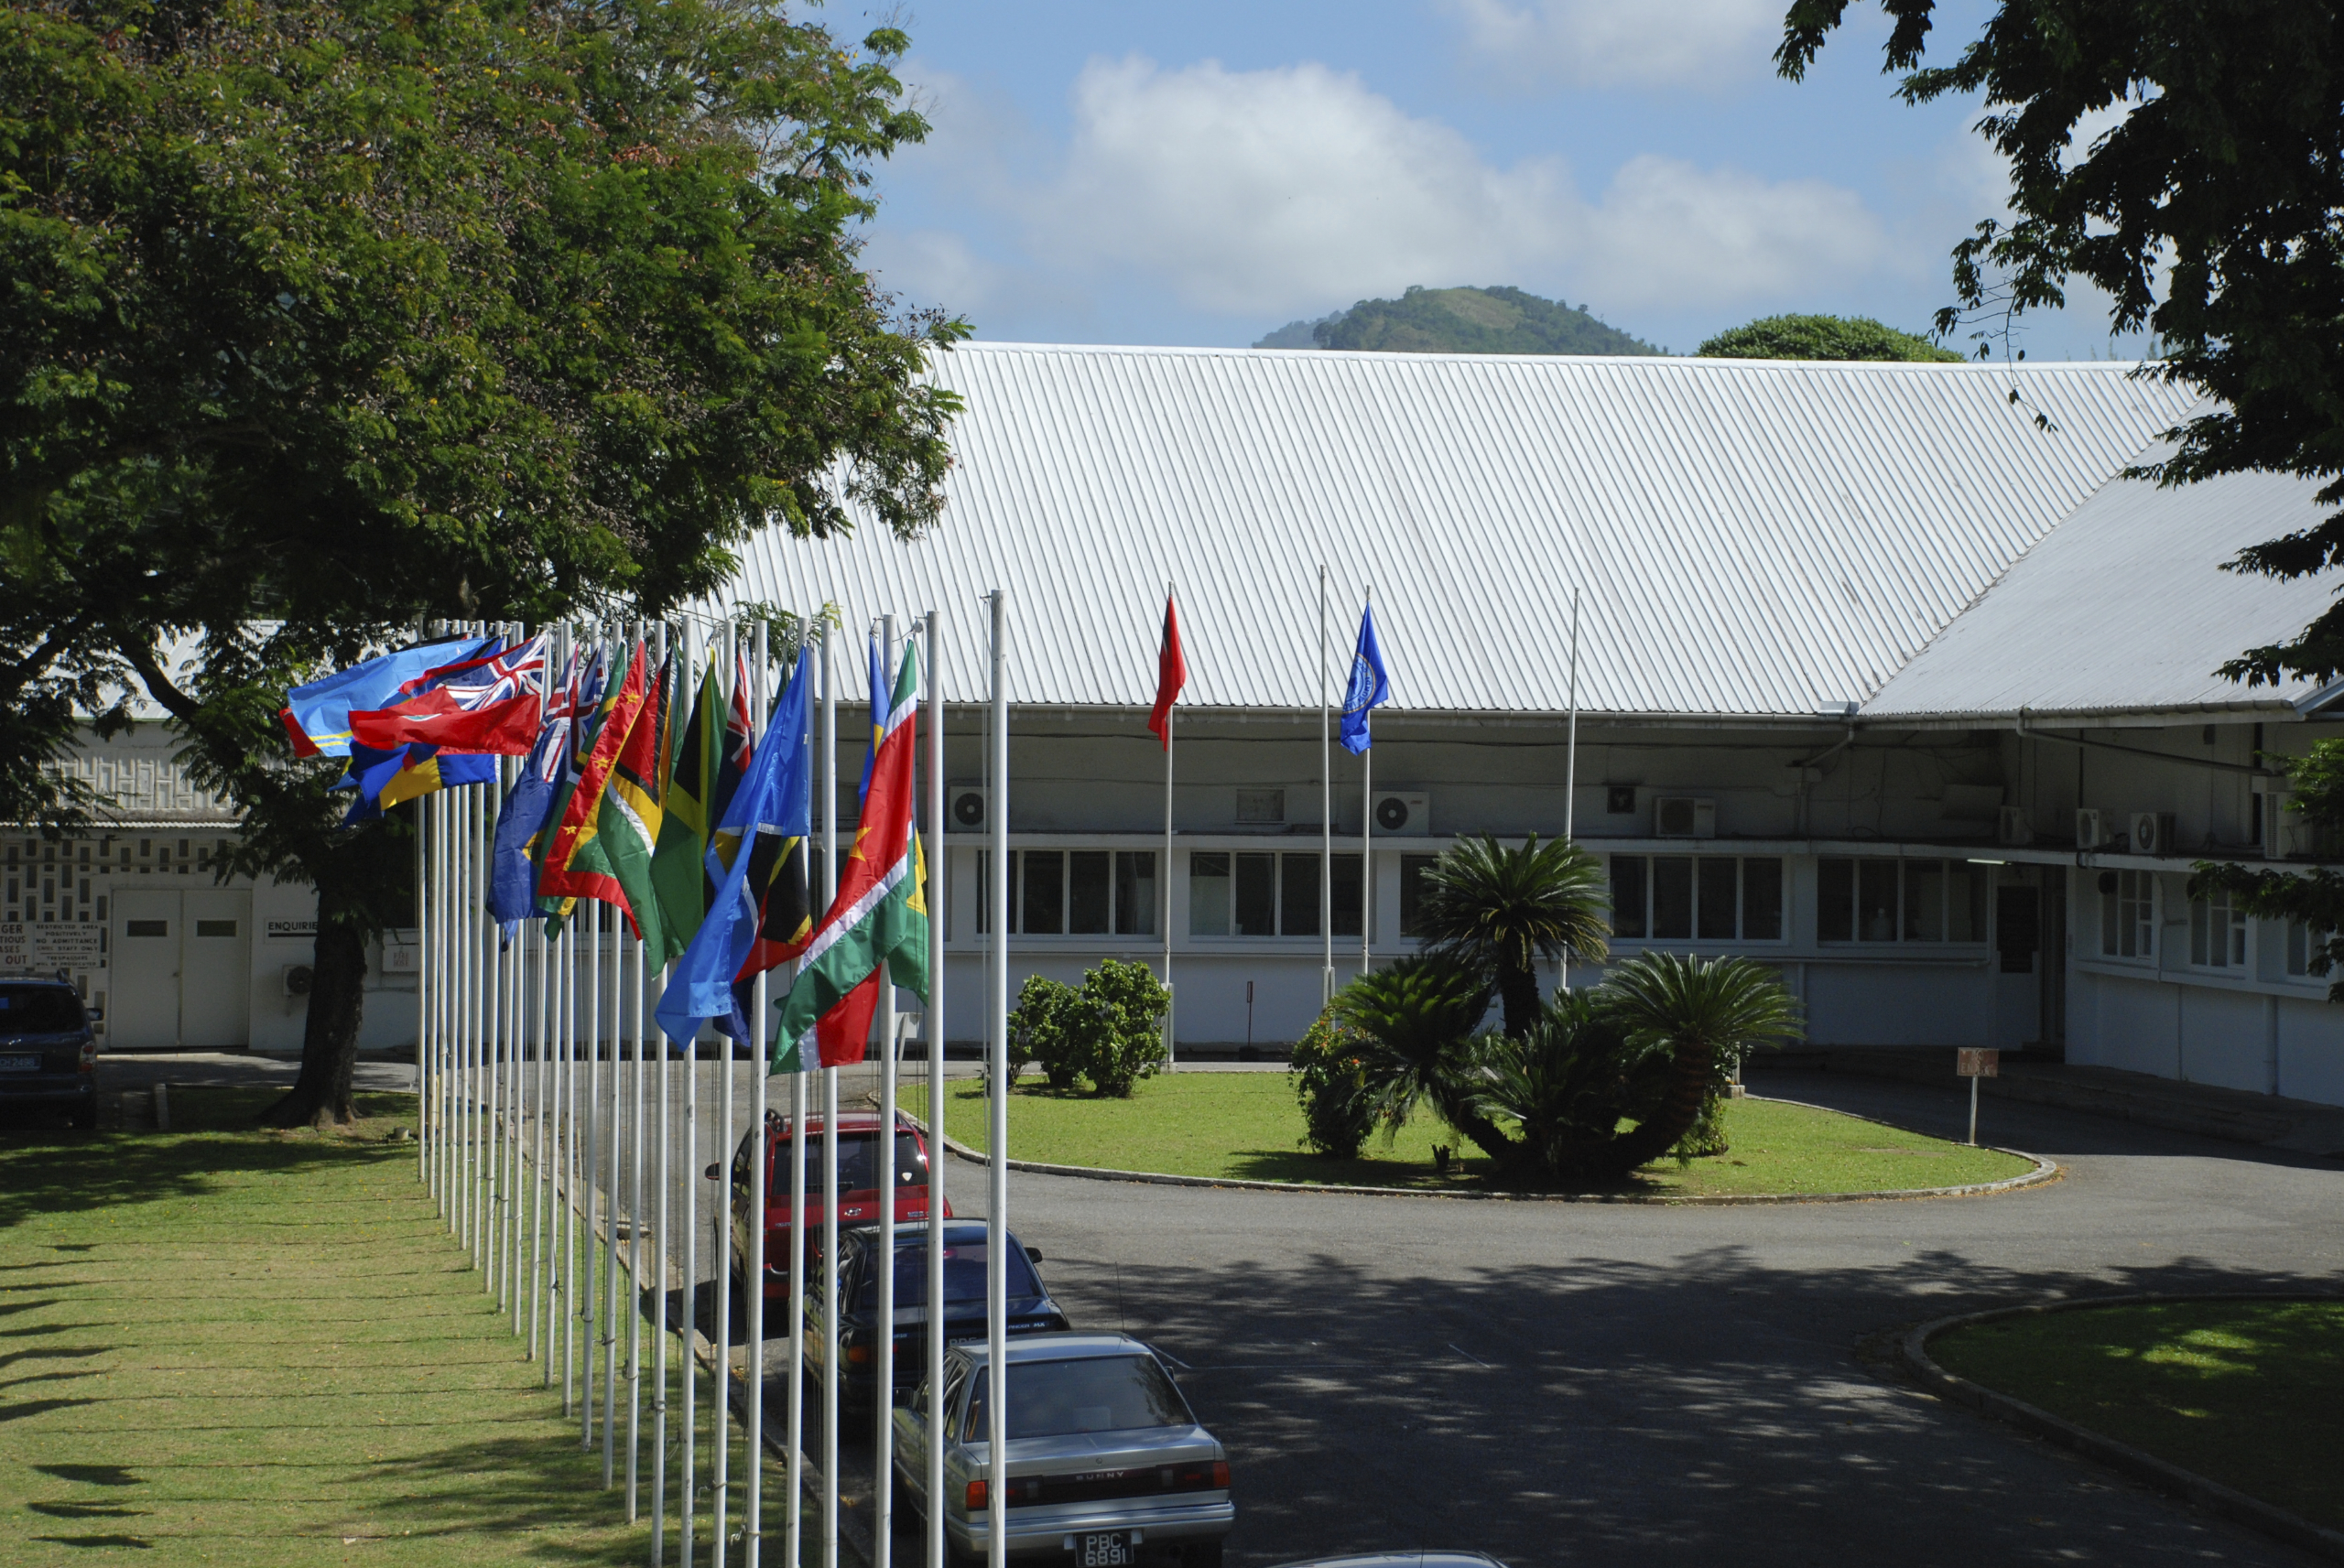
The IARC Caribbean Cancer Registry Hub
One of six regional IARC Hubs worldwide
Became operational in 2015
Based at the Caribbean Public Health Agency (CARPHA), in Port of Spain, Trinidad & Tobago
Operations managed by 3 CARPHA staff members with technical and financial support provided by multiple partners (NCI, NAACCR, IARC, CDC, PAHO)
MISSION: To improve the availability, use and dissemination of high-quality cancer data to inform cancer control in the Caribbean region
Recent site visit to Guyana completed (May 2019)

Slide 3
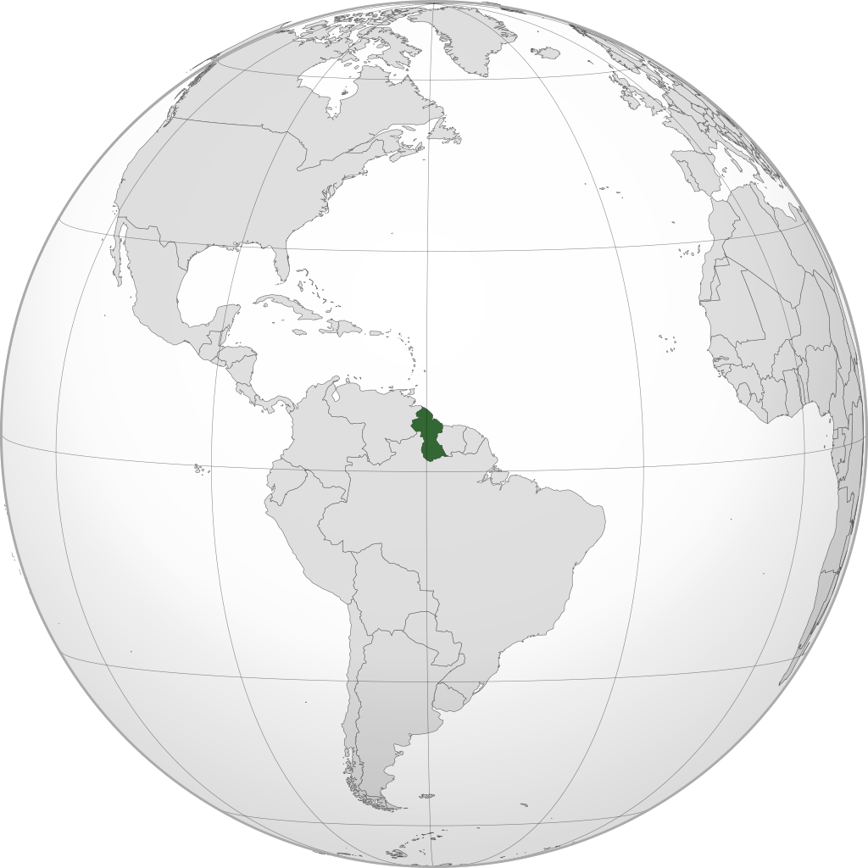
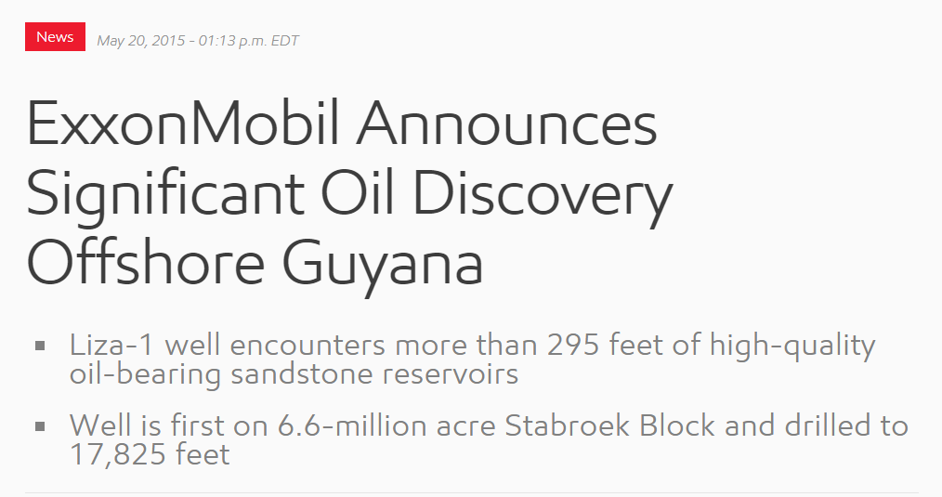
Co-operative Republic of Guyana
Notes:
Guyana is located on the NE coast of South America and is the only English-speaking country in SA. Guyana has a population of ~ 750,000 and was reclassified by the World Bank in July 2016 from a lower-middle income country to an upper-middle income country, with the discovery of substantial oil reserves in 2015. This has important long term implications for health budgets and spending that have not yet been realized; the change in income classification however, immediately makes Guyana not eligible for ‘low-income opportunities’.

Slide 4
THE GUYANA CANCER REGISTRY
Established by the Ministry of Health in May 2000
Located in the capital, Georgetown
Population-based cancer registry
Cancer is not a reportable disease, but there is willingness from both public and private institutions to report cases to the Registry
Combination of active and passive data collection
Penelope Layne-Lewis
Cancer Registrar
National Cancer Registry, Guyana
(May 2000 – Present)
Challenge: Accessing case registry information for cancer patients in rural West Guyana

Slide 5
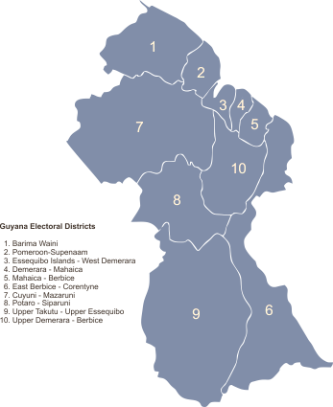
Rural West Guyana/ The Hinterland
Georgetown
Guyana is divided into 10 administrative regions
The Hinterland regions of Guyana comprise about two-thirds of the land area of Guyana
They include:
Barima-Waini (Region 1)
Cuyuni-Mazaruni (Region 7)
Potaro-Siparuni (Region 8) and
Upper Takatu-Upper Essequibo (Region 9)
Rural West Guyana

Slide 6
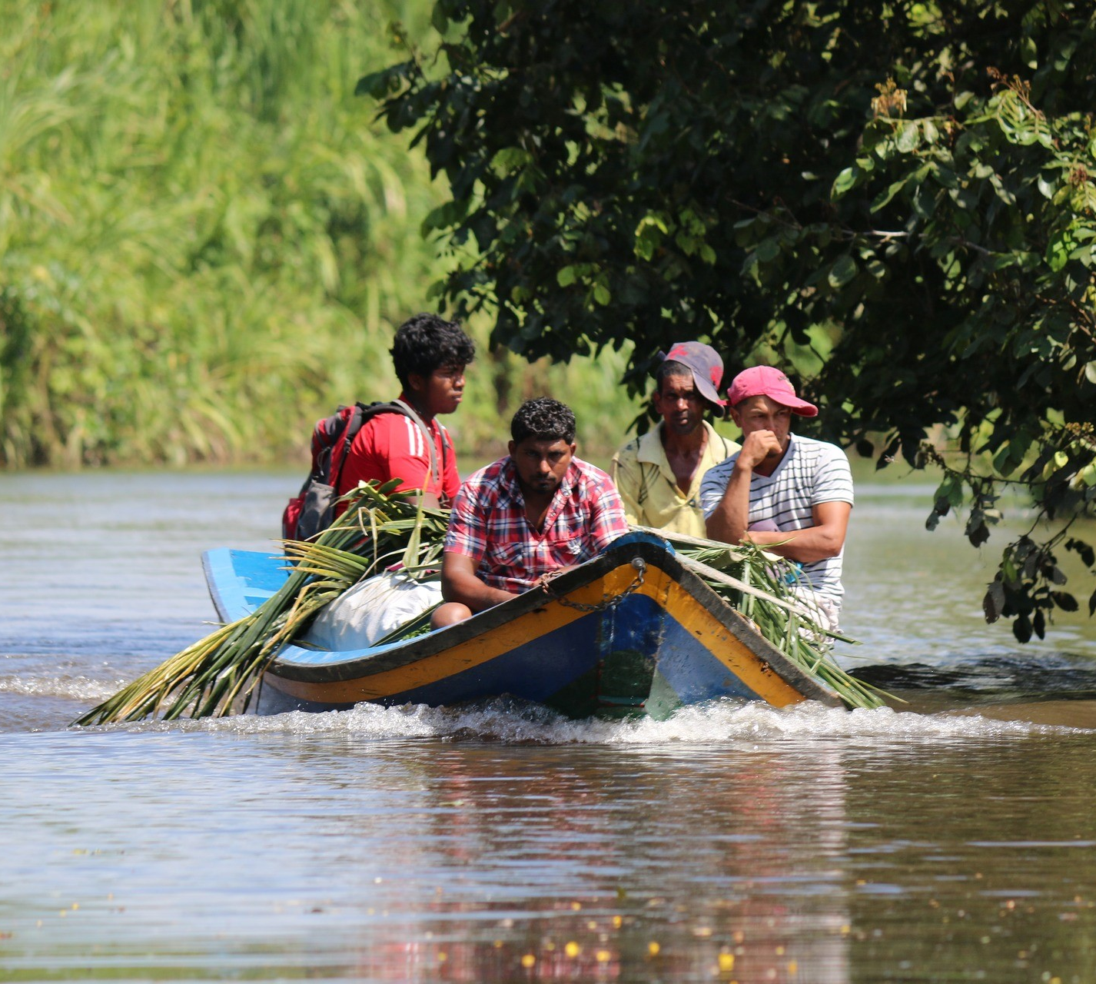
Rural West Guyana is characterized by dense forests, rivers, and mountain ranges.
It is sparsely populated - 10.9% of the total population resides here.
Access is limited and requires transport by plane, boat or on foot.
Notes:
These highland areas are covered by dense forest lands and mountain ranges and marked also by series of hills and rivers. Despite the large landmass of the Hinterland regions as compared to the Coastland, they are sparely populated due to the barriers set by the geographical terrains. The population in these regions is ~ 82,000, which represent 10.9 percent of the total population. The name Guyana means “land of many waters” in a native Amerindian language referring to the many rivers running through the country

Slide 7
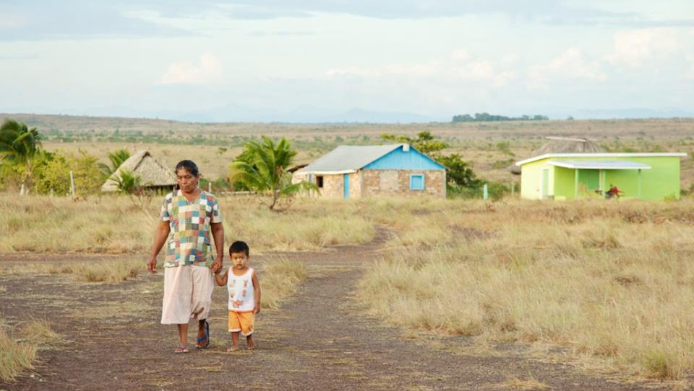
Populations here are largely indigenous Amerindians and are disproportionally affected by poverty and poor health outcomes, including cancers.
2009 study found high rates of cervical cancer and high-grade dysplasia in Indigenous Guyanese women (Kightlinger et al.)
Life expectancy for Guyana
Males: 64 years
Females: 69 years
Notes:
Life expectancy by region is not available but overall, life expectancy for Guyana is low - total life expectancy is 66.2 which gives Guyana a World Life Expectancy ranking of 135 (out of 195 countries).

Slide 8
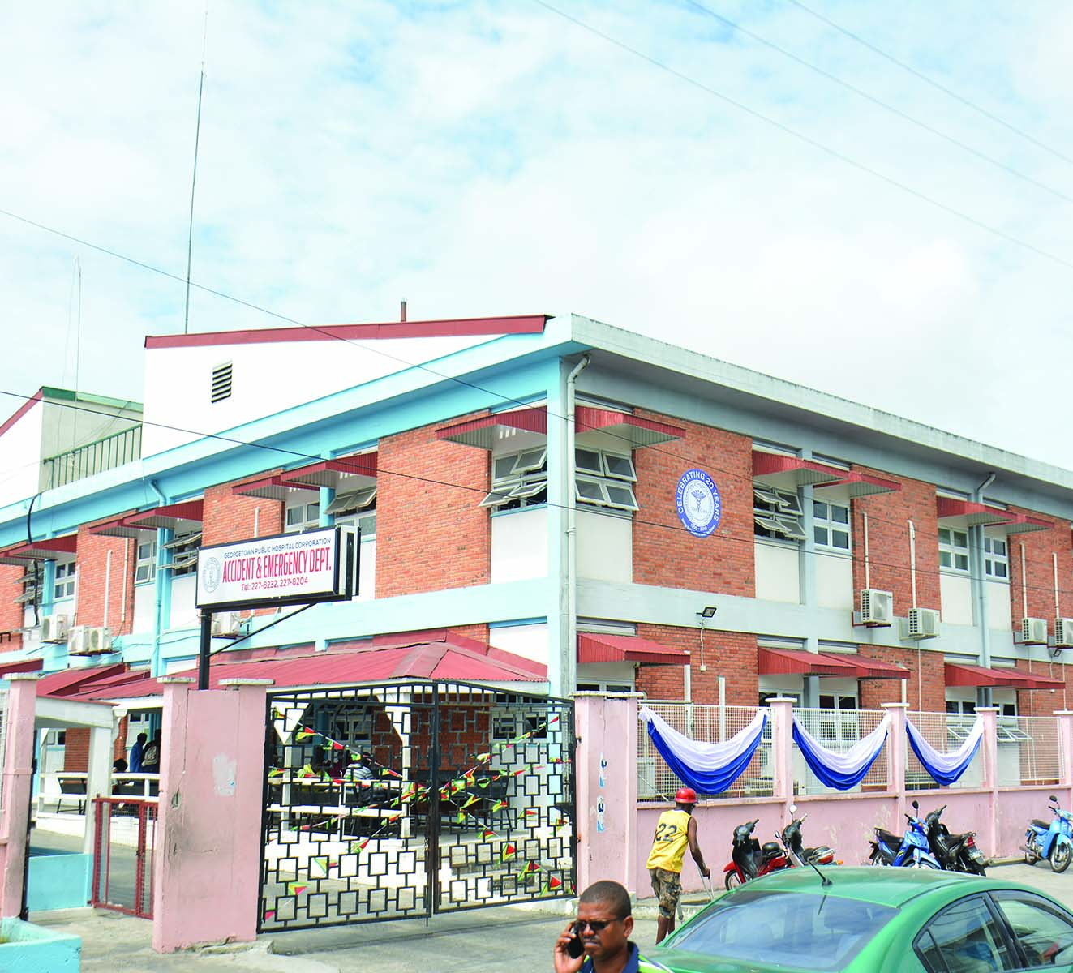
Obtaining case information from rural West Guyana
Cases from rural West Guyana are referred by regional health care providers or Regional Hospitals to the Georgetown Public Hospital Cooperation (GPHC), the largest hospital in Guyana.
At GPHC, medical records and pathology reports for these patients are made available to the Cancer Registry
These include little information other than the cancer diagnosis itself.

Slide 9
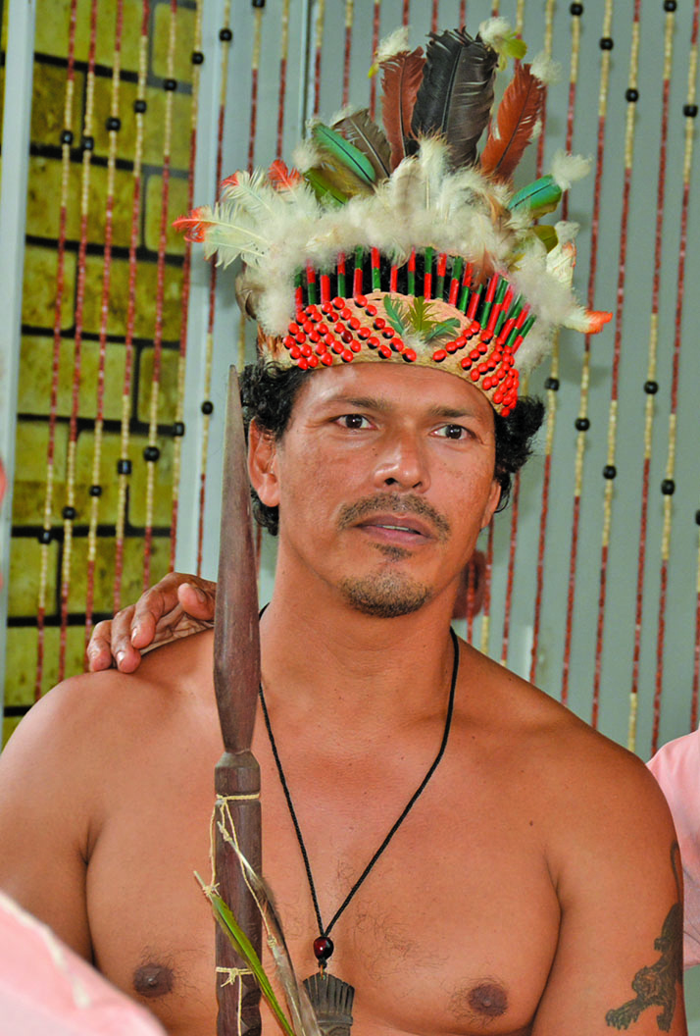
Information retrieval system
This was piloted in 2008 with assistance from Remote Area Medical (RAM), a non-profit organization that works to deliver health care to under-served, isolated communities in the United States and globally
The system established attempts to collect key demographic information missing for cases from remote areas.
The Registry first contacts the appropriate Regional Hospital, which in turn contacts the “Toschao” or the Head of each community to request the missing information.
The corresponding records are then updated accordingly.

Slide 10
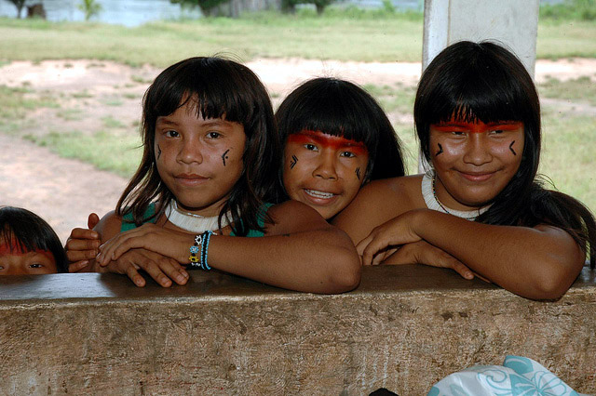
2012-2013 Results

Slide 11
Notes:
For 2012-2013, 5.2% of the cases in the Registry were registered from rural West Guyana using this approach (n=46).
For 2012-2013, the incident cancer cases per 100,000 population in rural west Guyana were roughly half of that observed nationally.

Slide 12
Cancer Site Breakdown, 2012-2013
Notes:
These pie charts illustrate the site breakdown of registered cancer cases.
In Rural West Guyana, almost half of all incident cases were cancer of the female genital organs; compared to quarter of incident cases at the National level; while the proportion of total incident cases which were breast cancer cases at the National level was double that observed in rural west Guyana.

Slide 13
Conclusions, Recommendations and Next Steps
It is likely that not all cancer cases in the Rural West Guyanese population have been registered using this approach
Further efforts are required to capture missing cases, including:
Approaches which are appropriate and specific to the Region
More active and timely follow-up by the Cancer Registry
Improvements to the financial and logistical support provided by the Ministry of Health
Further investigation and clinical/epidemiological research is needed to understand the different patterns observed in cancer burden of the national population vs. the hinterland population

Slide 14
Authors
Sarah Crooks
Programme Coordinator, IARC Caribbean Cancer Registry Hub
CARPHA, Trinidad & Tobago
Rachel Hanisch
Division of Cancer Control and Population Sciences NCI
Damali Martin
Global Health Coordinator, Epidemiology & Genomics Research Program, Division of Cancer Control and Population Sciences, NCI
Penelope Layne-Lewis
Cancer Registrar
National Cancer Registry, Guyana
Glennis Andall-Brereton
Principal Investigator, IARC Caribbean Cancer Registry Hub
CARPHA, Trinidad & Tobago
Les Mery
Global Programme Manager, Cancer Surveillance Unit, IARC
Brenda Edwards
Senior Advisor, Office of the Director, Division of Cancer Control and Population Sciences, NCI

Slide 15
Thank you. Any Questions?
Notes:
Kaieteur Falls is the world's largest single drop waterfall by the volume of water flowing over it. The waterfall has a drop of 741 feet compared to Niagara Fallls which has a drop of only 167 feet. Located in rural west Guyana ☺

