Slide 1

IACR Regional Hub for Cancer Registration: South, South-East and Eastern Asia – Mumbai
`
Les Mery
NAACCR / IACR Combined Annual Scientific Conference 2019
Vancouver, Canada

Slide 2
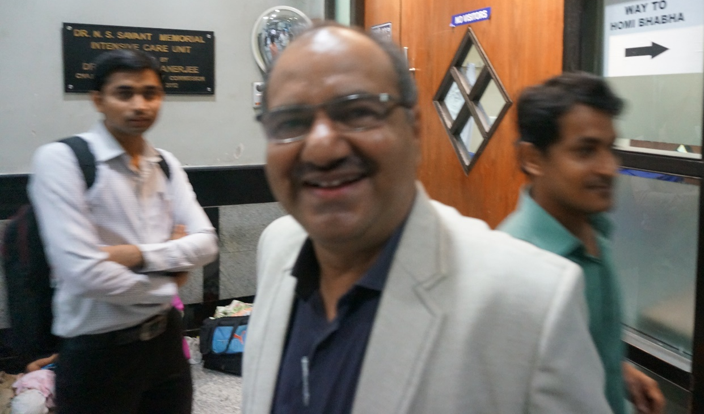
Acknowledgements
Tata Memorial Centre Mumbai, India
  Dr Atul Budukh
  Suchita Yadav
  Sonali Bagal
  Shraddha Shinde
  Dr Rajesh Dikshit
IARC
Lyon, France
  Morten Ervik
  Dr Freddie Bray

Slide 3
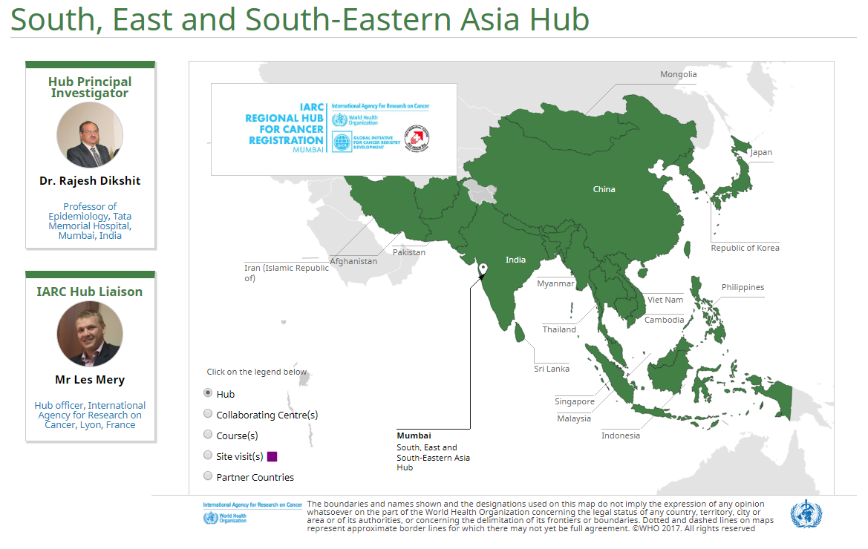

Slide 4
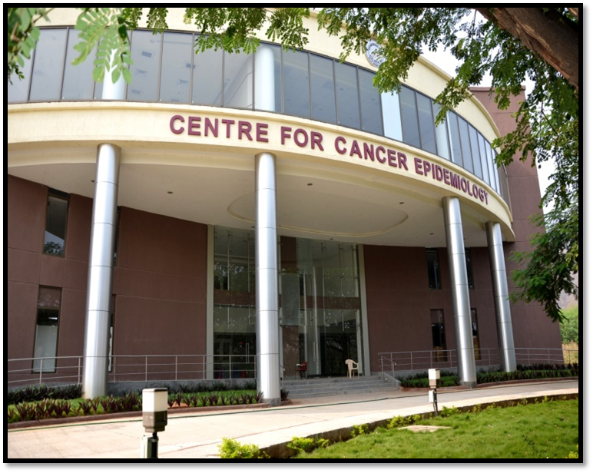

Background
Based at the Tata Memorial Centre in Mumbai, India and launched in 2012
Provides support to 25 countries in South, South-East and Eastern Asia, representing nearly 50% of the world population (2012): global 7.0 billion; 3.8 billion in Mumbai Hub

Slide 5
IARC Regional Hubs: Functions
Delivery of basic / advanced courses
Development of accompanying resources
Site visits to review practices
Consultancy and mentorship to resolve specific issues
Foster relationships between disciplines
Provide information on upcoming activities
Support cancer control interventions
Stimulate research

Slide 6
Building Support Structures – IARC GICR Collaborating Centres
Implemented as of 2017
Concept is to assist with the delivery of support to countries
Each centre contributes resources and is focused on specific areas
National Cancer Centre – China
National Cancer Institute – Thailand
National Cancer Centre – Japan
National Cancer Centre – Korea
Cancer Institute of Iran

Slide 7
Principal Investigator | Institution
Dr Tomohiro Matsuda Director, National Cancer Registry Section | National Cancer Center Japan
Dr Suleeporn Sangrajrang Deputy Director, Health System Development | National Cancer Centre Thailand
Dr Wenqiang Wei Professor and Chief of Clinical Trials Section, Department of Cancer Epidemiology Director of National Cancer Registry Office | National Cancer Center China
Dr Young-Joo Won Head, Division of Cancer Registration and Surveillance | National Cancer Center Republic of Korea
Dr Kazem Zendehdel Deputy of Research, Cancer Research Center | Cancer Institute of Iran, Tehran University of Medical Sciences IR Iran

Slide 8
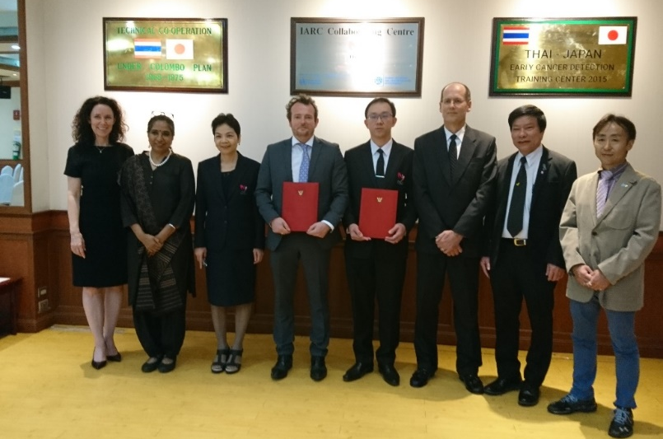

National Cancer Institute, Thailand to provide basic and tailored registry training in ASEAN countries
National Cancer Centre, Japan to supporting the development of analytic capacity and research using registry data

Slide 10
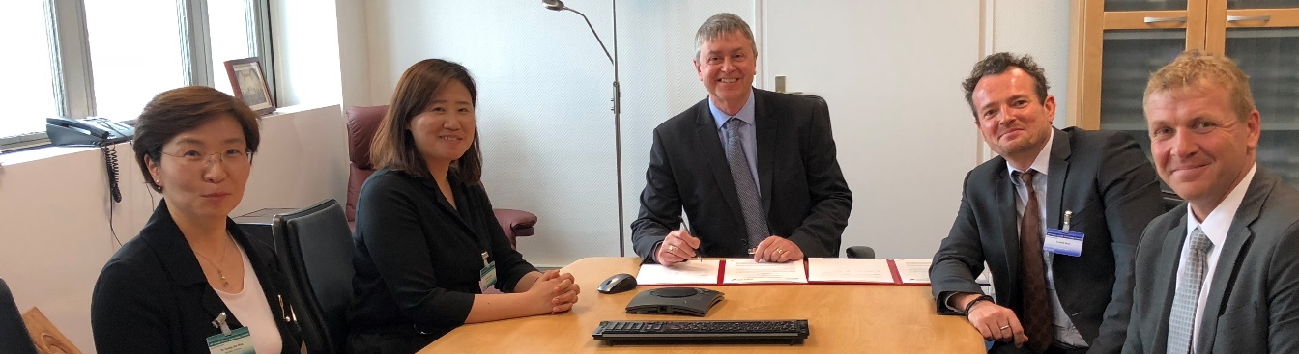


IARC GICR Collaborating Centre
Associate Professor Young-Joo Won
National Cancer Centre Korea
Funding support for the establishment of first IARC GICR Regional Summer School
Development of curriculum for Master’s degree in Cancer Registration and Global Certification
Collaboration with the Korean Graduate School of Cancer Control

Slide 11
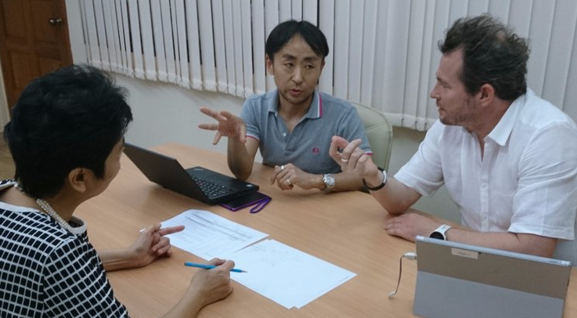
IARC GICR Collaborating Centre
Dr Tomohiro Matsuda
National Cancer Centre
Japan
Technical consultancies and training support to registries in the region
In-kind funding for the development of E-learning material and education certification programme
Led for collaborative research project with Cambodia, Philippines and Vietnam to help build capacity
Development of first Asian Cancer Registry Network

Slide 12
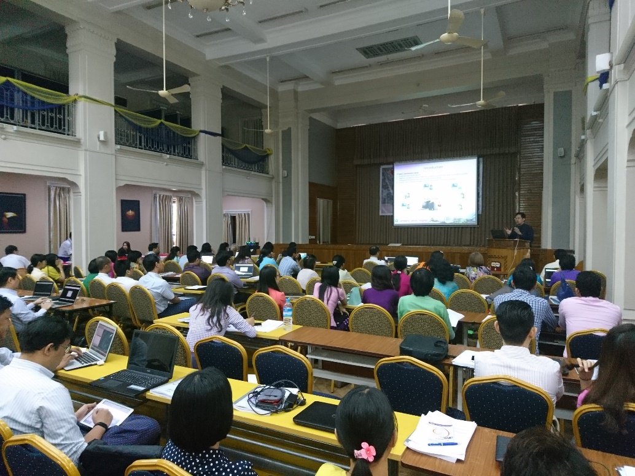
Basic cancer registration course
Yangon, June 2017
Led by the National Cancer Institute of Thailand, together with the Myanmar Government, the National Cancer Centre in Japan and IARC, a Basic Cancer Registration course was held in Yangon
Approximately 100 participants from across the country attended

Slide 13


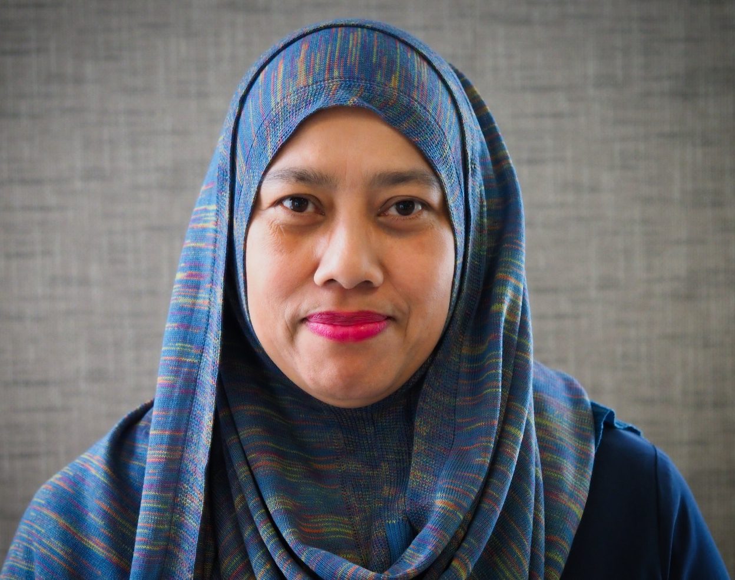
GICR Partner Country Profile:
Malaysia – Dr Azizah Ab Manan
Quality control and publication plan for National Cancer Registry
Study site to examine lung cancer outcomes
GICRNet trainer in Data Quality

Slide 14
Case study of capacity building through the GICR – Myanmar
GICR Phases | Key Activities | IARC Partners*
COUNTRY ASSESSMENT
  Review cancer and vital registries to determine opportunities
  Identify local leaders
SITE VISIT
  Establish the basis for an implementation plan
  Meet with stakeholders to provide recommendations
DIRECTED SUPPORT
  Establish the IARC Hub as the first point of contact
  Coordinate opportunities with other partners for efficiency
  Promote accountability via a signed agreement and the use of a monitoring framework
GENERATE EVIDENCE
  Implement quality improvement methods
  Publish data from the cancer registry
  Communicate results for cancer control action
2014
Discussions with local contacts on needs – leading to a course on basic cancer registration in Yangon
Installation and customization of IARC CanReg5 software
Agreement with the Ministry of Health and Sports (MoH) to launch pilot cancer registry, Naypyidaw General Hospital
2015
ImPACT Mission to review cancer control services in Mandalay, Naypyidaw and Yangon
Debriefing with senior MoH staff to refine recommendations
2016
Engagement with surveillance leaders to establish a plan for PBCR**, Myanmar Cancer Control Leadership Forum
Elaboration of cancer registry plan, including costing and milestones at the National Cancer Control Programme Meeting
Naypyidaw PBCR staff selected as IARC ‘50 for 50’ Programme
2017
IARC – MoH Collaborative Research Agreement finalized to become a GICR Partner Country
Delivery of a national training course
Revisions to CanReg5 to include new fields and local language
Naypyidaw PBCR staff training at IARC Summer School
2018 – 2020 (PLANNED)
Mentorship exchange with IARC - GICR Collaborating Centres
Initial data quality review of Naypyidaw PBCR
Networked version of CanReg5 system to other centres – Mandalay, Yangon and Taunhhyi
Assessment of feasibility for the implementation of PBCRs in other regions of the country
IARC Mumbai Hub
National Cancer Institute (Thailand)
Myanmar MoH
International Association of Cancer Registries
International Atomic Energy Agency
World Health Organization
National Cancer Institute (US)
National Cancer Centre (Japan) / IARC GICR Collaborating Centre
National Cancer Institute (Thailand) / IARC GICR Collaborating Centre
International Union for Cancer Control
Bloomberg Philanthropies
Vital Strategies
* Listed in chronological order by involvement; ** Population-Based Cancer Registry

Slide 15
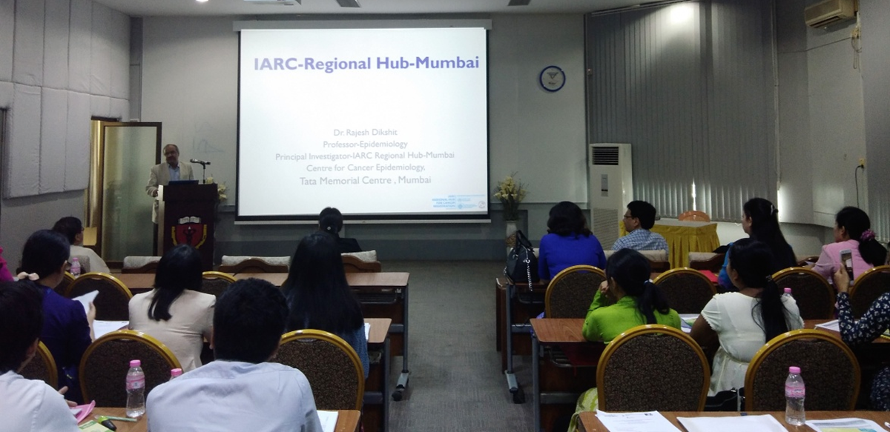
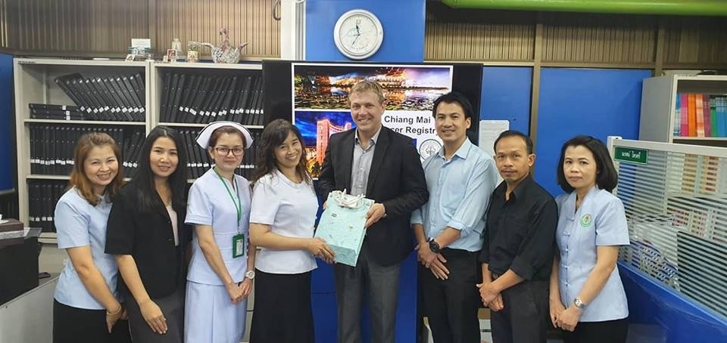
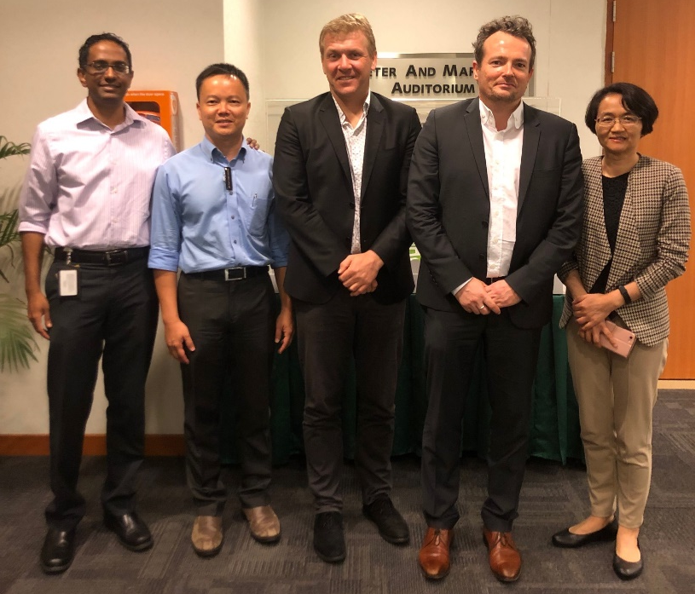
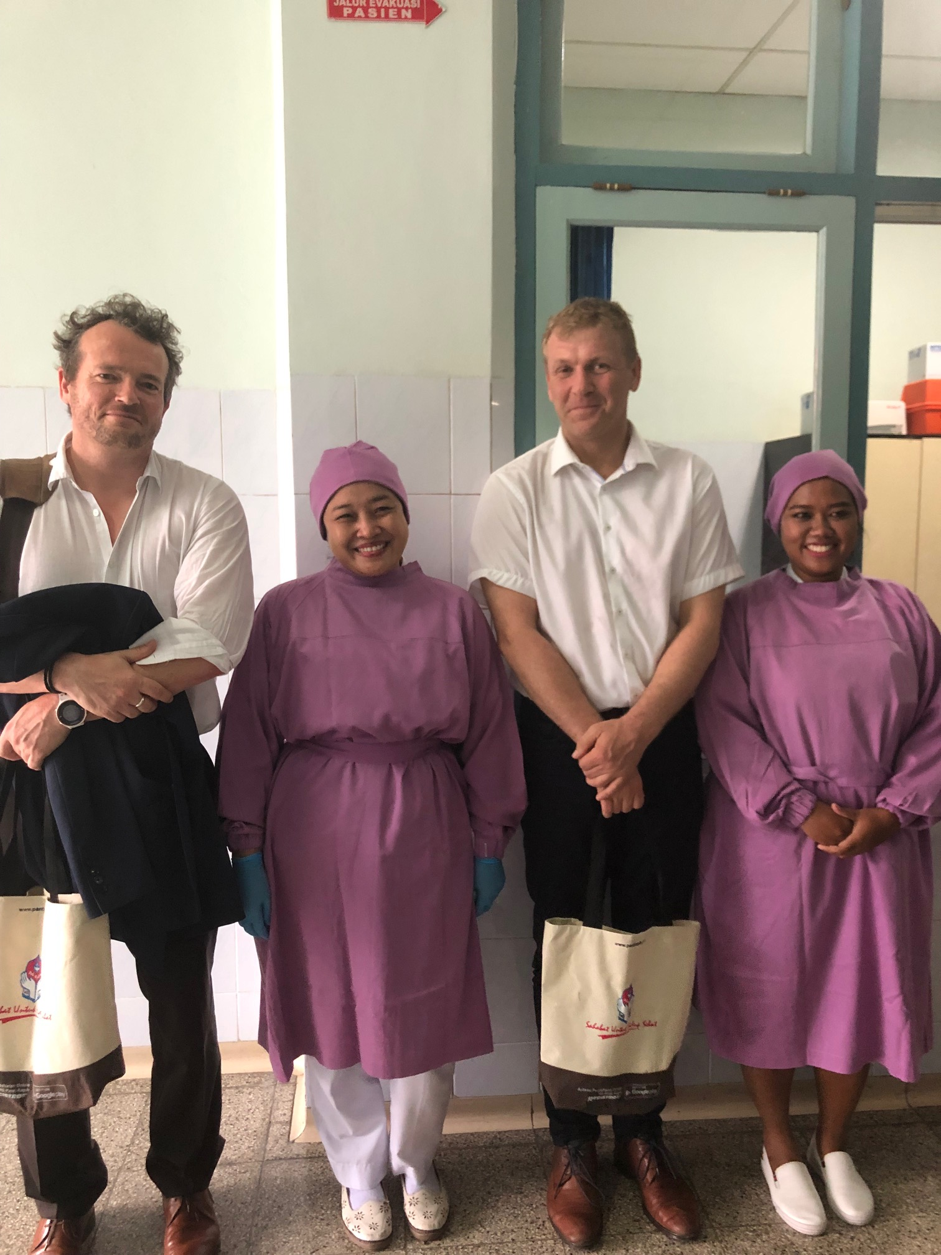
  Mumbai Hub site visit to Myanmar,
  August 2018
  Chiang Mai Cancer Registry, Thailand March 2017
  Site visit to Singapore,
  February 2019
  Penang Cancer Registry, Malaysia
  March 2017

Slide 16
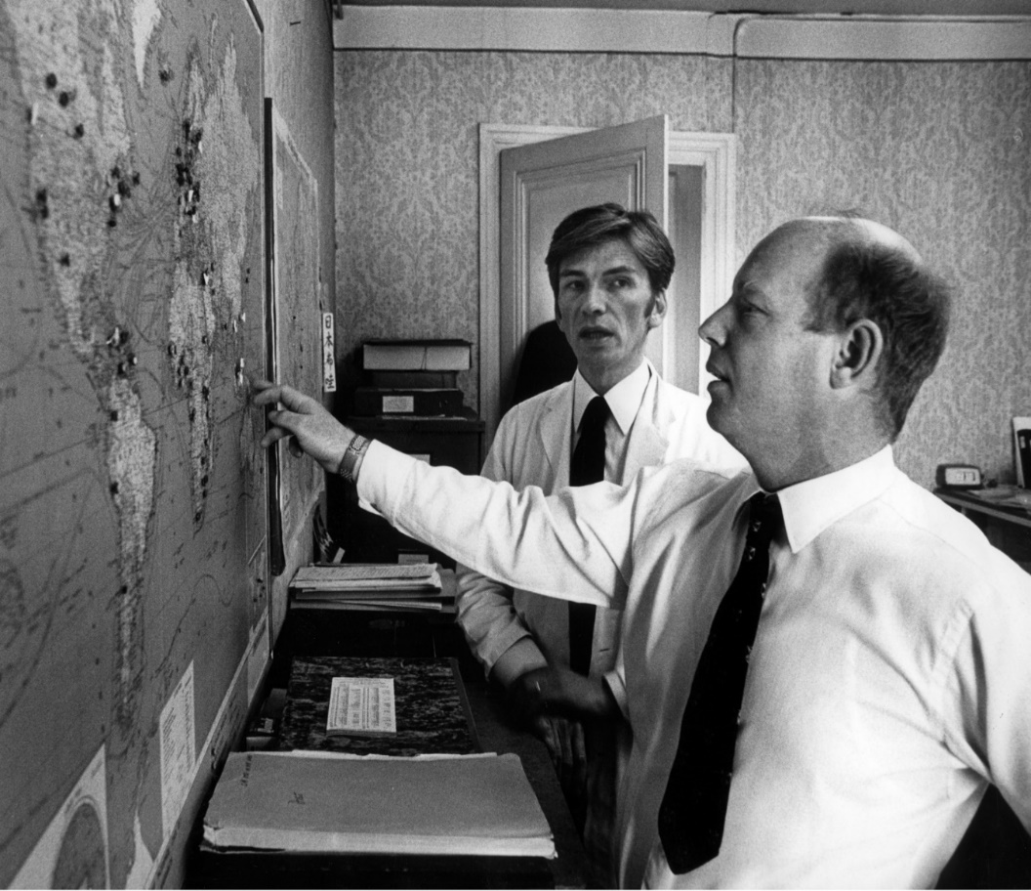
Evolving while staying the same...
Dr Calum Muir
(1930–1995)
Dr Hrafn Tulinius
(1931–2015)

Slide 17


Slide 18









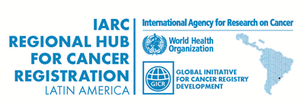












Thank you!
Email: meryl@iarc.fr
Website: http://gicr.iarc.fr

