Slide 1
Urban-Rural Variations in Quality of Care and Survival Among Cancer Patients in California
Arti Parikh-Patel, PhD MPH
Cyllene Morris, DVM MPVM
Kenneth W. Kizer, MD MPH
California Cancer Reporting and Epidemiologic Surveillance (CalCARES) Program
Institute for Population Health Improvement
University of California, Davis

Slide 2
Background
Although more urbanized than the nation as a whole, CA has a significant rural land mass, with rural communities spread throughout multiple counties
Rural Californians are older, more economically disadvantaged, and in poorer health than urban residents.
Access to care, socioeconomic status (SES), race/ethnicity, and other factors may mediate the relationship between rurality and quality of cancer treatment and outcomes.
Previous research on the impact of rural place of residence on cancer treatment and outcomes has yielded inconsistent results, due in part to variation in the definition of rurality.

Slide 4
MSSA: Medical Service Study Area
Defined geographic analysis unit for CA Office of Statewide Health Planning and Development
Grouping of census tracts
Used to determine which areas of the state are deficient in medical services
US Health Resources and Services Administration (HRSA) recognizes MSSAs as “Rational Services Areas”

Slide 5
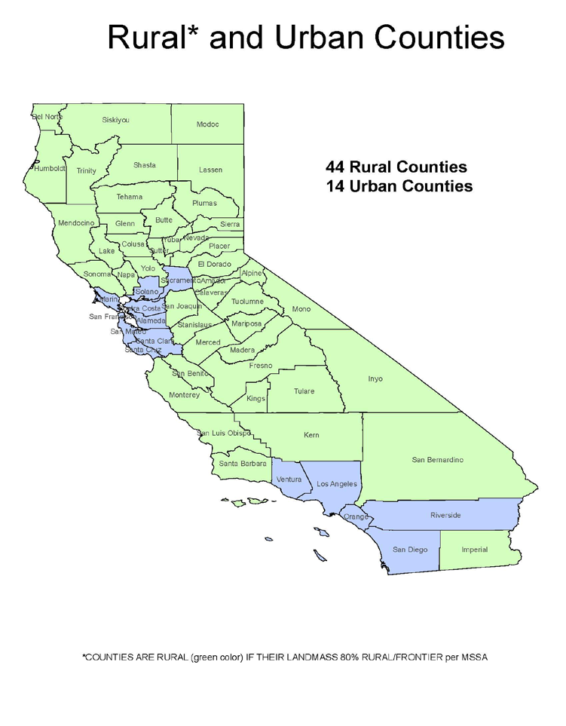
State definition: 80% of total landmass of 156,000 mi² is rural
Medical Service Study Areas (MSSAs) are sub-county designations
All population centers within the MSSA are within 30 minutes travel time to the largest population center as defined by the California Health Manpower Policy Commission.
There are 541 MSSAs in California.
Rural MSSAs: ≤250,000 persons per mi² (n=186)
Frontier MSSAs: ≤11 persons per mi² (n=56)

Slide 6
Objectives
Describe differences in demographic and clinical characteristics of urban and rural cancer patients in California
Investigate the independent effects of rural area of residence on quality of cancer care and survival after adjustment for known demographic and clinical risk factors.

Slide 7
Methods
Breast, ovarian, endometrial, cervix, colon, lung, or gastric cancer patients dx 2004-2016 were identified in the California Cancer Registry (CCR).
Multivariate logistic regression and Cox proportional hazards models generated to assess the independent effect of rural area of residence on quality of care and survival
Models adjusted for: health insurance type, age, sex, race/ethnicity, comorbidity, and socioeconomic status (SES).

Slide 8
Methods (con’t)
Quality of Care: Commission on Cancer quality measures.
Urban/Rural: Metropolitan Standard Statistical Areas (MSSA)
SES: established aggregate score based on patients’ block group of residence at dx; tertiles
Comorbidity: previously validated index; linkage of CCR with statewide hospital discharge, ambulatory care and emergency encounters data

Slide 9
Cancer Type by Urban-Rural Area of Residence, California, 2004-2016 (n=912,853)
Cancer Type | Urban n (col %) | Rural n (col %) | Total n (col %)
Breast | 340,019 (43.2) | 49,607 (39.7) | 389,626 (42.7)
Ovarian | 32,809 (4.2) | 4,933 (3.9) | 37,742 (4.1)
Endometrial | 56,286 (7.1) | 8,241 (6.6) | 64,527 (7.1)
Cervix | 16,679 (2.1) | 2,438 (2.0) | 19,117 (2.1)
Colon | 121,230 (15.4) | 18,889 (15.1) | 140,119 (15.3)
Lung | 187,844 (23.8) | 36,434 (29.2) | 224,278 (24.6)
Gastric | 33,076 (4.2) | 4,368 (3.5) | 37,444 (4.1)
TOTAL | 787,943 (86.3) | 124,910 (13.7) | 912,853 (100.0)

Slide 10
Cancer Type by Urban/Rural Residence, California, 2004-2016 (n=912,853)
% of total

Slide 11
Age Group and Sex by Urban/Rural Residence, California, 2004-2016 (n=912,853)
AGE
SEX
% of categorical total

Slide 12
Race/Ethnicity and SES by Urban/Rural Residence, California, 2004-2016 (n=912,853)
SES
RACE
% of categorical total

Slide 13
Health Insurance Type by Urban/Rural Residence, California, 2004-2016 (n=912,853)
Insurance Type
% of total

Slide 14
Comorbidity and Stage at Diagnosis by Urban/Rural Residence, California, 2004-2016 (n=912,853)
COMORBIDITY
STAGE
% of categorical total

Slide 15
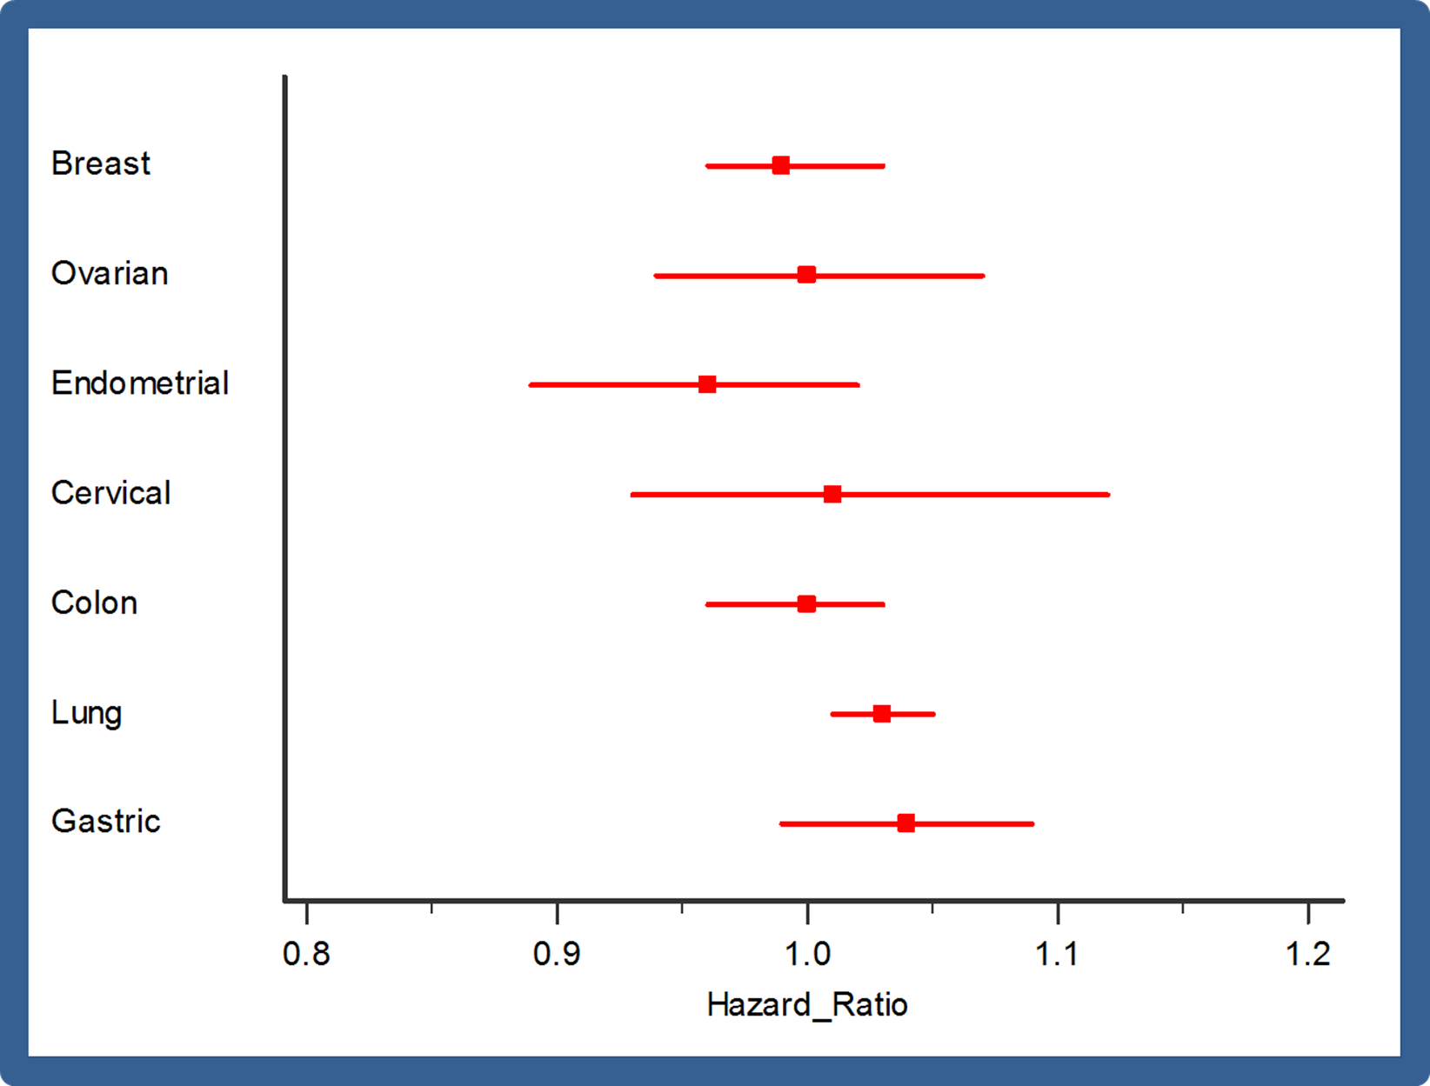
Association Between Rural Area of Residence and Risk of Death, 2004-2016 (n=912,853)

Slide 16
Association Between Urban/Rural Area of Residence and Concordance with Quality Measures by Cancer Type, California, 2004-2016 (n=912,853)^{1,2}
Cancer Type/ Quality Measure | Odds Ratio | 95% C.I.
Breast Radiation considered or administered after breast conserving surgery for women <70 Radiation considered or administered after mastectomy for women with ≥4 positive lymph nodes | 1.02 1.22 | 0.98, 1.07 1.11, 1.34
Ovarian Salpingo-oophorectomy with omentectomy, debulking, cytoreductive surgery or pelvic extenteration performed in stages I-III | 1.08 | 0.94, 1.24
Gastric ≥15 regional lymph nodes removed and pathologically examined for AJCC stage I-III cancer | 0.86 | 0.75, 0.97
¹Adjusted for age, sex, race, SES, insurance type, comorbidity and stage (when appropriate)
²Referent group is urban area of residence at time of diagnosis

Slide 17
Association Between Urban/Rural Area of Residence and Concordance with Quality Measures by Cancer Type, California, 2004-2016 (n=912,853)^{1,2}
Cancer Type/ Quality Measure | Odds Ratio | 95% C.I.
Cervical Use of brachytherapy in patients treated with primary radiation with curative intent Chemotherapy administered to patients receiving radiation for stages IB2-IV, or to patients with + pelvic nodes, surgical margins, and/or + parametrium | 1.05 1.01 | 0.88, 1.27 0.86, 1.20
Lung ≥10 regional lymph nodes removed and pathologically examined for AJCC stage IA, IB, IIA or IIB resected non-small cell lung cancer | 0.96 | 0.89, 1.04
¹Adjusted for age, sex, race, SES, insurance type, comorbidity and stage (when appropriate)
²Referent group is urban area of residence at time of diagnosis

Slide 18
Association Between Urban/Rural Area of Residence and Concordance with Quality Measures by Cancer Type, California, 2004-2016 (n=912,853)^{1,2}
Cancer Type/ Quality Measure | Odds Ratio | 95% C.I.
Colon ≥12 regional lymph nodes removed and pathologically examined for resected cancer Adjuvant chemotherapy administered to patients under 80 with stage III cancer | 0.83 1.20 | 0.76, 0.91 0.87, 1.64
Endometrial Chemotherapy and/or radiation administered to patients with stage IIIC or IV endometrial cancer Endoscopic, laparoscopic, or robotic surgery performed for stages I-III, (excluding sarcoma and lymphoma), | 1.10 0.95 | 0.94, 1.30 0.80, 1.13
¹Adjusted for age, sex, race, SES, insurance type, comorbidity and stage (when appropriate)
²Referent group is urban area of residence at time of diagnosis

Slide 19
Summary
Rural cancer patients were significantly older, non-Hispanic white, and of lower SES compared to urban residents.
Rurality is an independent predictor of receipt of recommended radiation therapy and surgery for select cancer types.
This relationship is attenuated after controlling for demographic factors and health insurance type.

Slide 20
Summary (con’t)
Despite observed differences in quality of care, survival was not different in urban and rural populations in California after adjustment for other demographic factors.
Further research into the individual and structural factors underlying the association between rurality and receipt of recommended treatment is warranted.

Slide 21
Strengths and Challenges
Population-based study in a large and diverse population
Missing tx information; chemotherapy and radiation known to be underreported
Varying definitions of rurality; Classification of urban/rural: MSSA vs. RUCA

Slide 22
Future Directions
Incorporate structural factors into model:
-physician characteristics (physician speciality, training, experience, caseload)
-hospital characteristics (total surgical volume, hospital type (community, teaching, etc.), certification (ACOS, COC)

Slide 23
Questions?

Slide 24
Demographic Characteristics of Cancer Patients by MSSA Urban/Rural Area of Residence, California, 2004-2016 (n=912,853)
Variable | Urban N (Col %) | Rural N (Col %) | Total N (Col %)
Sex Female Male Other | 612,538 (77.7) 175,347 (22.3) 58 (0.0) | 93,112 (74.5) 31,793 (25.5) 5 (0.0) | 705,650 (77.3) 207,140 (22.7) 63 (0.0)
Age Group <40 40-64 65-74 75+ | 32,507 (4.1) 347,181 (44.1) 192,621 (24.4) 215,634 (27.4) | 3,856 (3.1) 52,555 (42.1) 33,885 (27.1) 34,614 (27.7) | 36,363 (4.0) 399,736 (43.8) 226,506 (24.8) 250,248 (27.4)
Race/Ethnicity NH White NH Black Hispanic Asian/PI Other/Unknown | 468,125 (59.4) 60,362 (7.7) 139,014 (17.6) 112,196 (14.2) 8,246 (1.1) | 96,511 (77.3) 3,031 (2.4) 18,852 (15.1) 4,176 (3.3) 2,340 (1.9) | 564,636 (61.9) 63,393 (6.9) 157,866 (17.3) 116,372 (12.7) 10,586 (1.2)

Slide 25
Demographic Characteristics of Cancer Patients by MSSA Urban/Rural Area of Residence, California, 2004-2016 (n=912,853)
Variable | Urban N (Col %) | Rural N (Col %) | Total N (Col %)
SES 1 (Low) 2 3 (High) | 195,074 (24.8) 270,316 (34.3) 322,553 (40.9) | 48,020 (38.4) 54,190 (43.4) 22,700 (18.2) | 243,094 (26.6) 324,506 (35.6) 345,253 (37.8)
AJCC Stage I II III IV Unknown | 322,724 (41.0) 139,233 (17.7) 116,807 (14.8) 147,467 (18.7) 61,712 (7.8) | 47,962 (38.4) 20,809 (16.7) 19,017 (15.2) 25,632 (20.5) 11,490 (9.2) | 370,686 (40.6) 160,042 (17.5) 135,824 (14.9) 173,099 (19.0) 73,202 (8.0)
Cormorbidity 0 1 2 3+ Unknown | 407,846 (51.8) 137,134 (17.4) 53,636 (6.8) 62,134 (7.9) 127,193 (16.1) | 62,497 (50.0) 25,238 (20.2) 9,609 (7.7) 9,822 (7.9) 17,744 (14.2) | 470,343 (51.5) 162,372 (17.8) 63,245 (6.9) 71,956 (7.9) 144,937 (15.9)

Slide 26
Demographic Characteristics of Cancer Patients by MSSA Urban/Rural Area of Residence, California, 2004-2016 (n=912,853)
Variable | Urban N (Col %) | Rural N (Col %) | Total N (Col %)
Insurance Type Private Medicare Medicaid Dual Eligible County Uninsured Unknown | 487,693 (61.9) 116,895 (14.8) 80,076 (10.2) 42,139 (5.3) 7,125 (0.9) 11,464 (1.5) 42,551 (5.4) | 1,480 (55.6) 24,584 (19.7) 12,195 (9.8) 7,567 (6.0) 1,071 (0.9) 1,480 (1.2) 8,506 (6.8) | 557,200 (61.0) 141,479 (15.5) 92,271 (10.1) 49,706 (5.5) 8,196 (0.9) 12,944 (1.4) 51,057 (5.6)
Cancer Type Breast Ovarian Endometrial Cervical Colon Lung Gastric | 340,019 (43.2) 32,809 (4.2) 56,286 (7.1) 16,679 (2.1) 121,230 (15.4) 187,844 (23.8) 33,076 (4.2) | 49,607 (39.7) 4,933 (3.9) 8,241 (6.6) 2,438 (2.0) 18,889 (15.1) 36,434 (29.2) 4,368 (3.5) | 389,626 (42.7) 37,742 (4.1) 64,527 (7.1) 19,117 (2.1) 140,119 (15.3) 224,278 (24.6) 37,444 (4.1)

