Slide 1
Developing a REDCap Inquiry System to Facilitate Case Specific Communication Between Hospital Registrars and Central Registry Editing Staff
Carrie Bateman, BS
Registry Manager, Utah Cancer Registry

Slide 2
Overview of presentation
Background
Purpose
Methods
Results
Summary

Slide 3
Background
Utah Cancer Registry (UCR) had no system in place to track numbers, types, or time spent on questions being asked by hospital abstractors
Anecdotally, it appeared that the majority of inquiries were being directed to only a few editors, creating an undue burden on those staff
Notes:
These questions came by phone or email any time of day. The phone calls often took much longer than needed which took editors away from their other tasks.

Slide 4
Purpose
Develop a systematic tracking method using a standard system for hospital registrars to submit inquiries electronically
Evenly distribute the workload of responding to inquiries
Collect data to identify training needs for hospital registrars
Notes:
To address the unequal distribution of the questions and to allow for tracking of the questions we decided to develop an online request form for hospital registrars to complete. This online form allows us to more evenly distribute the workload and collect data about what kind of questions are being asked so we can provide training as needed.

Slide 5
Methods
Created a form using REDCap clinical research tool
Web-based
User-friendly
Secure
Data are stored on University of Utah servers that are HIPAA compliant and approved for storage of protected health information (PHI).
Notes:
University of Utah subsidizes the use of REDCap so we do not have to pay for it. It is secure and easy to use.

Slide 6
Workflow
UCR editors have rotating 1-week assignments for inquiry monitoring
Notes:
Take them through the workflow

Slide 7
Hospital Registrars’ form
Notes:
We ask for the name and contact information from the requestor along with the items below

Slide 8
Asks which of two categories their inquiry is about
Notes:
We wanted to collect different information about each type of inquiry so we ask the hospital registrar to categorize their inquiry. Then when UCR staff are documenting about the inquiry they collect the specific items for each type.
We track several things on both types that we will go over below.

Slide 9
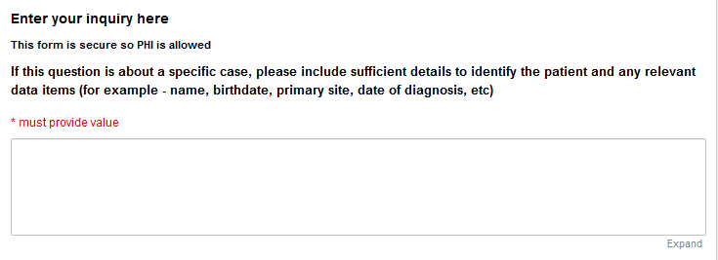
Provides space to enter detailed information
Notes:
This free text box allow for up to 65000 characters.

Slide 10
Provides a reference number and “save and return later” functionality
Notes:
The reference number is a combination the requestors last name and an incremental number assigned by the system. So the blank space you see before the number is where the last name will appear when the requestor types it in above.

Slide 11
Utah cancer registry staff form
Notes:
UCR staff document information about each inquiry.
individual inquiries we track the primary site and diagnosis year
coding guidelines questions we track if the response will be beneficial to other hospital registrars and the de-identified question and answer

Slide 12
Inquiries are grouped into one or more categories
Notes:
These categories help us understand what information hospital abstractors are missing so we can target training.

Slide 13
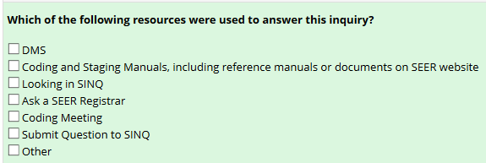
Asks for documentation of sources used
Notes:
We document the resources used and send the resources to the hospital abstractors.

Slide 14
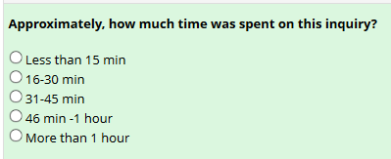
Collects UCR staff name, their answer to the inquiry, and how long it took them to answer the inquiry
Notes:
We track the time so that we know what impact this is having on editors workload.

Slide 15
Reports and analysis
Able to create simple reports within REDCap
Missing data items
Frequencies
Look for specific inquiries by
User
Type
Facility
Diagnosis year
Primary site
Etc.
Allows for exporting created reports or the entire dataset for more extensive analysis
Notes:
The internal reporting is mainly used to find missing or incomplete data and allows for grouping reports into categories.
We are able to export from REDCap in csv, SAS, or other statistical software file types. This makes doing the analysis much easier.

Slide 16
Results: Overall
From April 24, 2018 to April 30, 2019, we received a total of 860 inquiries through the REDCap survey
Most inquiries (827) were regarding missing information on individual cases, while only 33 were coding guideline inquiries

Slide 17
Results: Inquiries about individual patients
The three most common categories were
Treatment (81%)
Diagnostic Information (56%)
Staging (35%)
Most inquiries (85%) required <15 minutes of editor time
13% of inquiries required 16-30 minutes of editor time.
The average time for editor response was 1.4 days with 72% of inquiries answered within one day

Slide 18
Results: Inquiries about coding guidelines
3 days on average for editors to respond
61% answered within one day
Editors spend more time answering these inquiries (Table 1)
Table 1: Editor time spent answering coding guideline inquiries
 | n | %
Total | 33
Less than 15 min | 12 | 36
16-30 min | 15 | 46
31-45 min | 2 | 6
46 min -1 hour | 3 | 9
More than 1 hour | 1 | 3
Notes:
Editors take time to thoroughly research these questions so they give an accurate response

Slide 19
Results: Hospital registrar training
Almost half of our general coding questions are about the new solid tumor rules including
Determining multiple primaries
Coding histologies
We address training needs by
Sending the question and answer to all hospital registrars via our listserv
Posting the questions and answers to our website
Providing educational webinars on common topics

Slide 20
Results: Overall user comments
Pros
Inquiries documented in writing
Cons
No personal interactions

Slide 21
Results: UCR user comments
Pros
Can choose when to respond
Fewer interruptions to their work
Cons
System does not automatically copy their response into an email

Slide 22
Results: Hospital registrar user comments
Pros
Easy to use
Quick responses
Cons
Can be difficult to convey the question in writing

Slide 23
Summary
More even distribution of workload among editing staff
Able to assess hospital registrar training needs and provide targeted training
Editors are better able to manage their time when responding to inquiries

Slide 24
Utah Cancer Registry is supported by:
Surveillance, Epidemiology and End Results program (SEER) contract number HHSN261201800016I
National Program of Cancer Registries (NPCR) under cooperative agreement NU58DP006320
Huntsman Cancer Institute Foundation
University of Utah Health

Slide 25
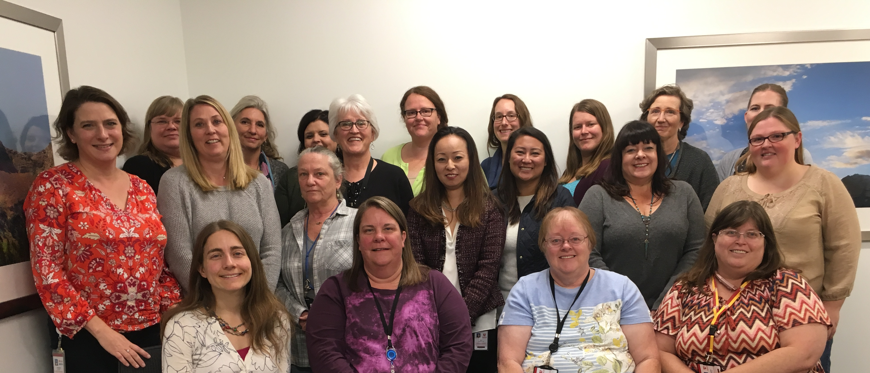
Thanks!
Utah Cancer Registry
Mandy Giles
Kacey Wigren
Loretta Huston
Bethany Fotumale
Debbi Romney
Sandra Reay
Jacque Clarken
Heather Cheney
SuAnn McFadden
Jen Doherty
Huntsman Cancer Registry
Kim Svoboda
Belinda Taylor
AnDe Buchi
Julie Varner
Claudia Campbell
Caroline Allred

