Slide 1
Colorectal cancer survival disparities in California 1997-2014
Debby Oh, MSc, PhD
Greater Bay Area Cancer Registry

Slide 2
Source: Division of Cancer Prevention and Control, Centers for Disease Control and Prevention
Notes:
Colorectal cancer (CRC) is the third most common cancer in men and women and the second leading cause of cancer death in the United States.
Both incidence and mortality rates have declined in recent decades with increased screening and scientific advances in treatment.
However, improvement in cancer outcomes have not been equal for all groups.

Slide 3
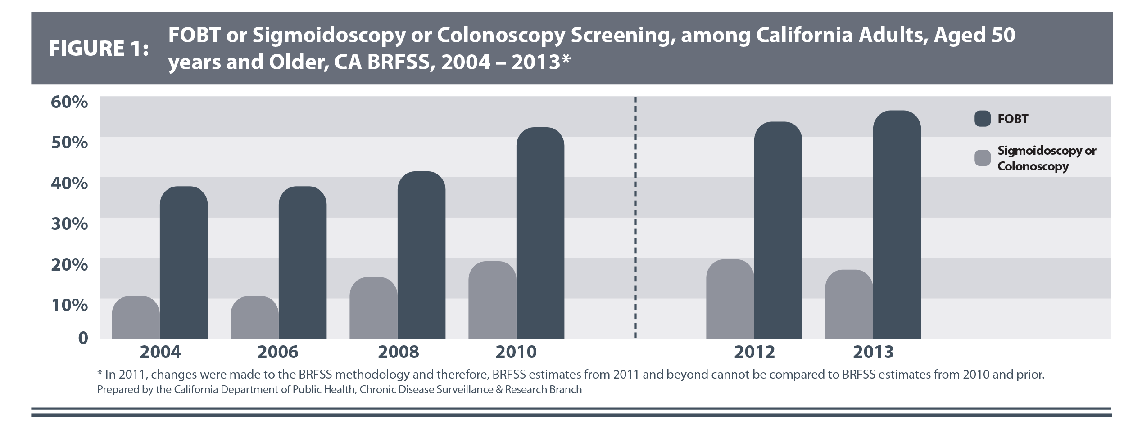
CRC screening has improved over time
Source: California Department of Public Health, February 2016
Notes:
Some of the largest disparities are in patients with cancers that can be identified early through screening, such as colorectal cancer.
Colorectal cancer screening has indeed improved over time in California. This data was taken from the Behavioral Risk Factor Surveillance System (BRFSS).
Though due to changes in the BRFSS methodology you can’t compare the two time periods, it is still clear that there is a positive trend in screening. In particular, you can see that fecal occult blood test (FOBT) has increased over time.

Slide 4
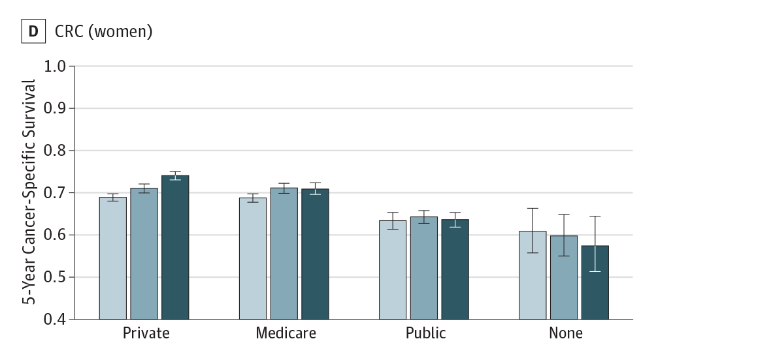
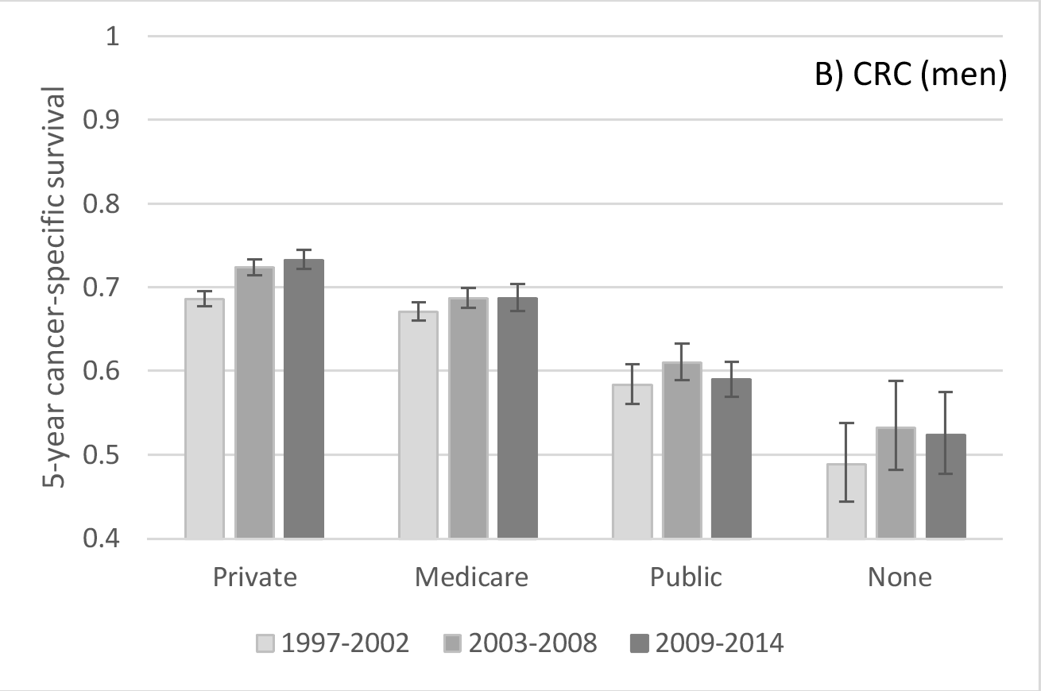
Improvements in survival limited to patients with insurance
CRC-Specific survival by insurance (California)
Source: Ellis, et al. JAMA Oncology 2017
Notes:
In previous work done out of our cancer registry led by Libby Ellis, we looked at over a million patients diagnosed with breast, prostate, colorectal, lung cancer, or melanoma (n=1,149,891) from 1997-2014.
We found improvements in survival between 1997 and 2014 were limited to patients with private or Medicare insurance
This analysis looked at five different cancer sites. Here I am showing CRC-specific survival by insurance type. You can see that for both men and women, improvements in survival is limited to those with private or medicare insurance.

Slide 5
RESEARCH QUESTION: To what extent are improvements in colorectal cancer survival experienced across sociodemographic groups?
Notes:
Stemming from the previous work, we asked the research question: “To what extent are improvements in colorectal cancer survival experienced across sociodemographic groups?”

Slide 6
Methods
Data from the California Cancer Registry were used to estimate trends in 5-year colorectal cancer-specific mortality
Analyses included all patients in California diagnosed between January 1997 and December 2014 with colorectal cancer as a first, primary malignancy
Follow-up through 2016
Notes:
We took data from the California Cancer Registry to estimate trends in 5-year colorectal cancer-specific mortality
Analyses included all patients in California diagnosed between January 1997 and December 2014 with colorectal cancer as a first, primary malignancy
Previous work only had follow-up through 2014, we were able to add two more years of follow up data (which was especially helpful for the cases in the most recent period).

Slide 7
Study population
First primary CRC cases in California 1997-2014
 | 1997-2002 | 2003-2008 | 2009-2014
All | n=65,752 | n=66,186 | n=65,122
Mean follow-up | 3.4 | 3.5 | 3.0
Notes:
We looked at approximately 200,000 cases (n=197,060) of first primary CRC cases in California 1997-2014
Mean follow up for the first two periods was around the same (3.4 and 3.5). Mean follow up for the last time period was a little lower since we were only able to follow-up to 2016.

Slide 8
Study population
Notes:
Over time, the proportion of those in the older category decreased (and the proportion in the youngest category increased). This is likely due to improvements in screening.
The proportion of non-Hispanic white decreased, proportion of Hispanics and Asian/Pacific Islander increased.

Slide 9
Study population
Notes:
nSES uses detailed demographic, social, economic, and housing data collected through the American Community Survey (ACS).
Education Index
Percent persons above 200% poverty line
Percent persons with a blue collar job
Percent persons employed
Median rental
Median value of owner-occupied housing unit
Median household income
For CRC cases, distribution of nSES didn’t change much over time
Insurance status was defined based on primary and secondary payer
Overtime, there was in increasing proportion of any public/Medicaid/Military insurance; decreasing proportion of Medicare only or Medicare + Private insurance
Medicare is a federal program that provides health coverage if you are 65+ or under 65 and have a disability, no matter your income.
Medicaid is a state and federal program that provides health coverage if you have a very low income.

Slide 10
5-year CRC-specific mortality
 | 1997-2002 | 2003-2008 | 2009-2014
 | HR (95% CI) | HR (95% CI) | HR (95% CI)
Age at diagnosis
<50 | Reference | Reference | Reference
50-75 | 1.19 (1.13-1.26) | 1.13 (1.07-1.19) | 1.17 (1.11-1.24)
76+ | 1.74 (1.63-1.85) | 1.84 (1.73-1.96) | 2.00 (1.87-2.13)
Adjusted for patient and clinical characteristics: sex, marital status, AJCC stage, subsite, lymph nodes positive, tumor size, tumor grade, surgery, radiation, chemotherapy, urbanization level, treated at an NCI designated hospital
Notes:
Multivariable Cox proportional hazard regression models were used to assess the effect of sociodemographic variables on CRC-specific mortality in each time period.
Analyses were adjusted for demographic, treatment and tumor characteristics, and neighborhood factors.
5-year CRC-specific mortality for those in the oldest category increased over time. (P-value for interaction with time period: <.0001)
Could be related to improvements in screening and treatment in younger cases

Slide 11
5-year CRC-specific mortality
 | 1997-2002 | 2003-2008 | 2009-2014
 | HR (95% CI) | HR (95% CI) | HR (95% CI)
Race/Ethnicity
Non-Hispanic White | Reference | Reference | Reference
Non-Hispanic Black | 1.13 (1.06-1.20) | 1.11 (1.05-1.18) | 1.06 (0.99-1.13)
Hispanic | 0.93 (0.88-0.98) | 0.96 (0.91-1.00) | 0.97 (0.92-1.01)
Asian/Pacific Islander | 0.93 (0.88-0.98) | 0.87 (0.83-0.92) | 0.95 (0.90-1.00)
Adjusted for patient and clinical characteristics: sex, marital status, AJCC stage, subsite, lymph nodes positive, tumor size, tumor grade, surgery, radiation, chemotherapy, urbanization level, treated at an NCI designated hospital
Notes:
While in the first time period, NH Black had a higher mortality than whites, there was no statistical difference between Black and Whites in last time period.
No significant change for Hispanic and Asian/PI over time
P-value for interaction with time period = 0.3664

Slide 12
5-year CRC-specific mortality
 | 1997-2002 | 2003-2008 | 2009-2014
 | HR (95% CI) | HR (95% CI) | HR (95% CI)
Neighborhood SES quintile
1st (lowest) | 1.27 (1.20-1.34) | 1.20 (1.13-1.27) | 1.24 (1.16-1.31)
2nd | 1.18 (1.12-1.24) | 1.18 (1.12-1.25) | 1.20 (1.13-1.27)
3rd | 1.11 (1.05-1.16) | 1.14 (1.08-1.20) | 1.12 (1.06-1.19)
4th | 1.05 (1.00-1.11) | 1.08 (1.02-1.13) | 1.05 (0.99-1.11)
5th (highest) | Reference | Reference | Reference
Adjusted for patient and clinical characteristics: sex, marital status, AJCC stage, subsite, lymph nodes positive, tumor size, tumor grade, surgery, radiation, chemotherapy, urbanization level, treated at an NCI designated hospital
Notes:
No significant change for nSES over time, but those with lower nSES had consistently worse outcomes.
P-value for interaction with time period = 0.6600

Slide 13
5-year CRC-specific mortality
 | 1997-2002 | 2003-2008 | 2009-2014
 | HR (95% CI) | HR (95% CI) | HR (95% CI)
Insurance status
Private only | Reference | Reference | Reference
No insurance | 1.13 (1.01-1.26) | 1.21 (1.08-1.35) | 1.22 (1.08-1.38)
Medicare only or Medicare + Private | 1.05 (1.01-1.09) | 1.08 (1.04-1.12) | 1.15 (1.10-1.20)
Any Public/Medicaid/Military | 1.08 (1.02-1.14) | 1.17 (1.12-1.23) | 1.23 (1.17-1.29)
Adjusted for patient and clinical characteristics: sex, marital status, AJCC stage, subsite, lymph nodes positive, tumor size, tumor grade, surgery, radiation, chemotherapy, urbanization level, treated at an NCI designated hospital
Notes:
Similar to work by Ellis et al, increase in disparities for all other insurance categories compared to private insurance
P-value for interaction with time period = 0.0008

Slide 14
Conclusions
Increase in mortality disparities for 76+
Decrease in racial disparities over time for Blacks
No statistical difference between Black and NH Whites in most current time period
No change for nSES, but consistent disparities
Lower nSES groups had consistently higher mortality
Increase in disparities by insurance status
Notes:
Increase in mortality disparities for those in the oldest age category
Decrease in racial disparities over time for Blacks, with no statistical difference between Black and NH Whites in most current time period
No change in mortality over time by nSES, but consistent disparities with lower nSES groups having consistently higher mortality
Increase in disparities by insurance status over time

Slide 15
Future directions
Investigate underlying drivers behind decrease in CRC cancer disparities for NH Blacks
Investigate impact of ACA and Medicaid expansion on cancer disparities over time
Notes:
Investigate impact of Affordable Care Act and Medicaid expansion on cancer disparities over time
California started early expansion of Medicaid in July 2011
Low Income Health Program offered health care coverage to low income uninsured adults up to 200% of the federal poverty level.
Approximately 1.4 million California gained coverage under Medi-Cal program by the end of 2014 (UCLA 2017).
Enrollment for Mediaid in California increased from 7.9 million to 9.9 million in 2014 following the full implementation of the ACA.

