Slide 1

Comparative net survival of cancer in the elderly:
Data from the cancer registry of Guadeloupe
J. Deloumeaux¹. B. Bhakkan¹, M. Tabue-Teguo²
¹ Guadeloupe Cancer Registry, ² Geriatrics Department, University Hospital of Guadeloupe

Slide 2

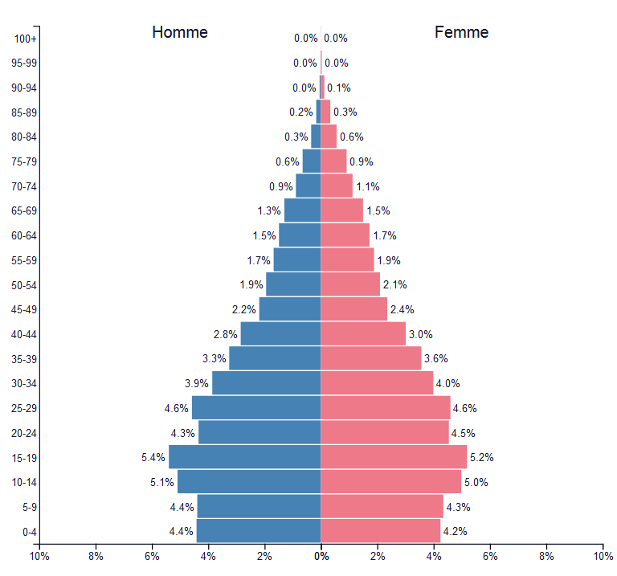
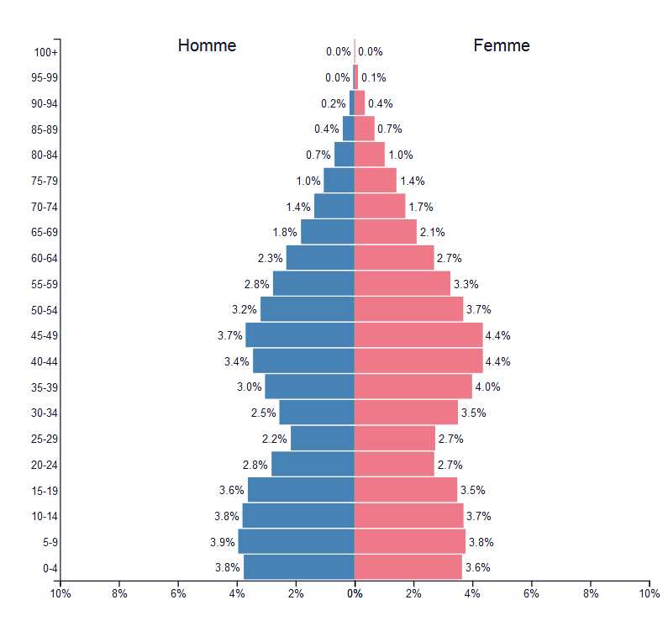
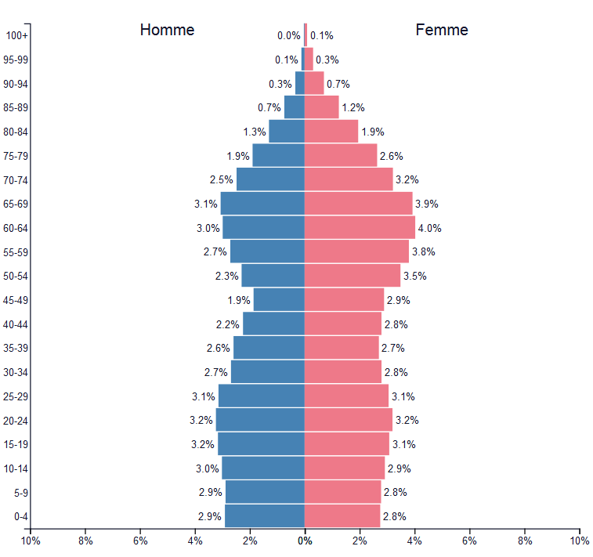
Context-1
Guadeloupe is a French speaking Caribbean archipelago of about 395,000 inhabitants, mainly of African descent.
Between 1990 and 2011, the population growth gradually slowed down and the territory has been losing inhabitants since (-0.5% per year)
Consequences : by 2030, people over 65 years are expected to represent 28% of the population.
PopulationPyramid.net, Guadeloupe – 1990- 2011 and 2030

Slide 3
Context-2
Social inequalities and environmental pollution with pesticides
A population-based cancer registry set up in 2008
  ~1500 new invasive cancer cases recorded each year
  Lower overall incidence of cancer compared to metropolitan France
    Men: 308.8 [301.1 ; 316.8] vs 355.3 [351.2 ; 359.4]
    Women: 166.7 [161.2 ; 172.4] vs 261.1 [257.7 ; 264.5]
  But higher incidence for some cancer sites:
    Prostate
    Stomach
    Cervix
    Multiple myeloma
Changes in cancer distribution are to be expected in the next decades.
Cancer burden and cancer care in the elderly are a growing concern for health planning

Slide 4
Objectives
To estimate net survival (survival that would be observed if cancer was the only cause of death) in patients over 65 compared to those under 65
To identify potential differences in cancer care in the elderly

Slide 5
Methods
We analyzed data from the cancer registry for the period 2008–2015 for 4 major cancer sites.
Net-survival was estimated with the unbiased Pohar-Perme estimator method:
  Expected mortality rates derived from the observed mortality rates available by sex, annual age, year of death, and department of residence.
The endpoint was set at September 30th 2018 (vital status provided par the French national system).
The analyses were computed with R software

Slide 6
Results-1
Over the period, 13220 incident cancer cases were recorded
  7071 (53.5%) of the patients were over 65.
  67.7% of the patients over 65 were men
Main cancer sites in the elderly were
  In men
    Prostate: 2797 (58.5%)
    Colon: 318 (6.6%)
    Stomach: 298 ( 6.2%)
  In women
    Breast : 513 ( 22.4%)
    Colon: 273 (11.9%)
    Stomach: 200 (8.7%)

Slide 7
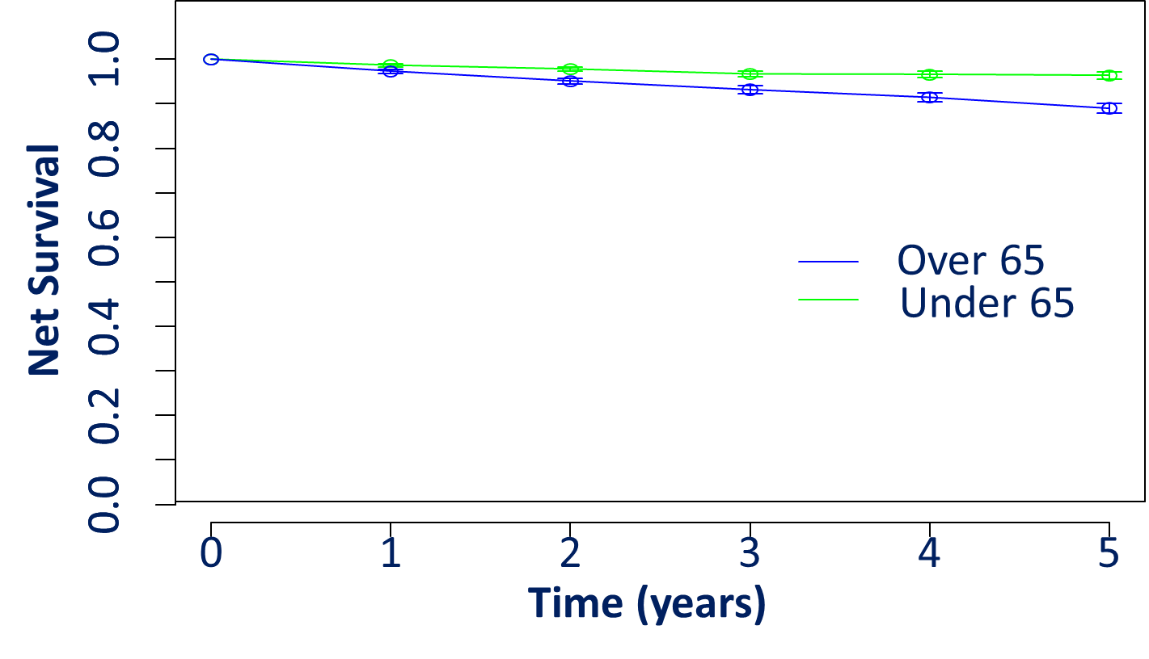
RESULTS-Prostate cancer
Mean age was 58 years in men under 65 and 74 years in the elderly
36.6% of patients with Pca were under 65 years old at diagnosis.
75% of patients under 65 had surgery as first treatment compared to 61% in the elderly.
 | <65 |  |  | >65
 | 1 year | 3 years | 5 years | 1 year | 3 years | 5 years
Nb at risk | 1444 | 1323 | 985 | 2457 | 2095 | 1403
nb events | 33 | 29 | 13 | 155 | 123 | 98
survival | 0.987 | 0.967 | 0.964 | 0.973 | 0.932 | 0.89
lower | 0.979 | 0.954 | 0.949 | 0.964 | 0.916 | 0.868
upper | 0.994 | 0.979 | 0.979 | 0.983 | 0.948 | 0.913
1 and 3 years net survival were comparable between groups, but 5 years net survival was lower in the elderly (89% vs. 96.4%)
5 years net survival in France 2005-2010 , all patients: 94%

Slide 8
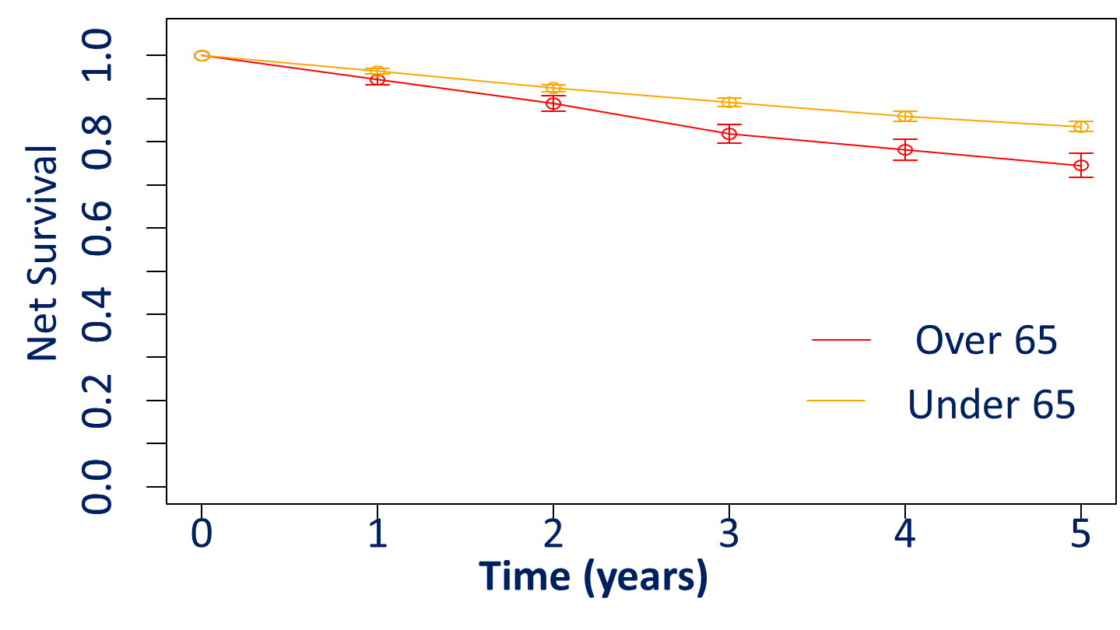
RESULTS-Breast cancer
Mean age was 50 years old for women under 65 and 75 in the elderly
70.6% of patients with breast cancer were under 65 at diagnosis.
86.3% of patients under 65 had surgery compared to 88.5% in the elderly.
 | <65 |  |  | >65
 | 1 year | 3 years | 5 years | 1 year | 3 years | 5 years
Nb at risk | 1045 | 949 | 629 | 430 | 340 | 193
nb events | 45 | 39 | 22 | 37 | 40 | 16
survival | 0.964 | 0.892 | 0.835 | 0.944 | 0.819 | 0.745
lower | 0.952 | 0.873 | 0.812 | 0.920 | 0.777 | 0.692
upper | 0.975 | 0.911 | 0.859 | 0.969 | 0.862 | 0.802
3 and 5 years net survival were lower in the elderly compared to women under 65 (81% vs. 89% and 74.5% vs 83.5% respectively)
5 years net survival in France 2005-2010, all patients : 88%

Slide 9
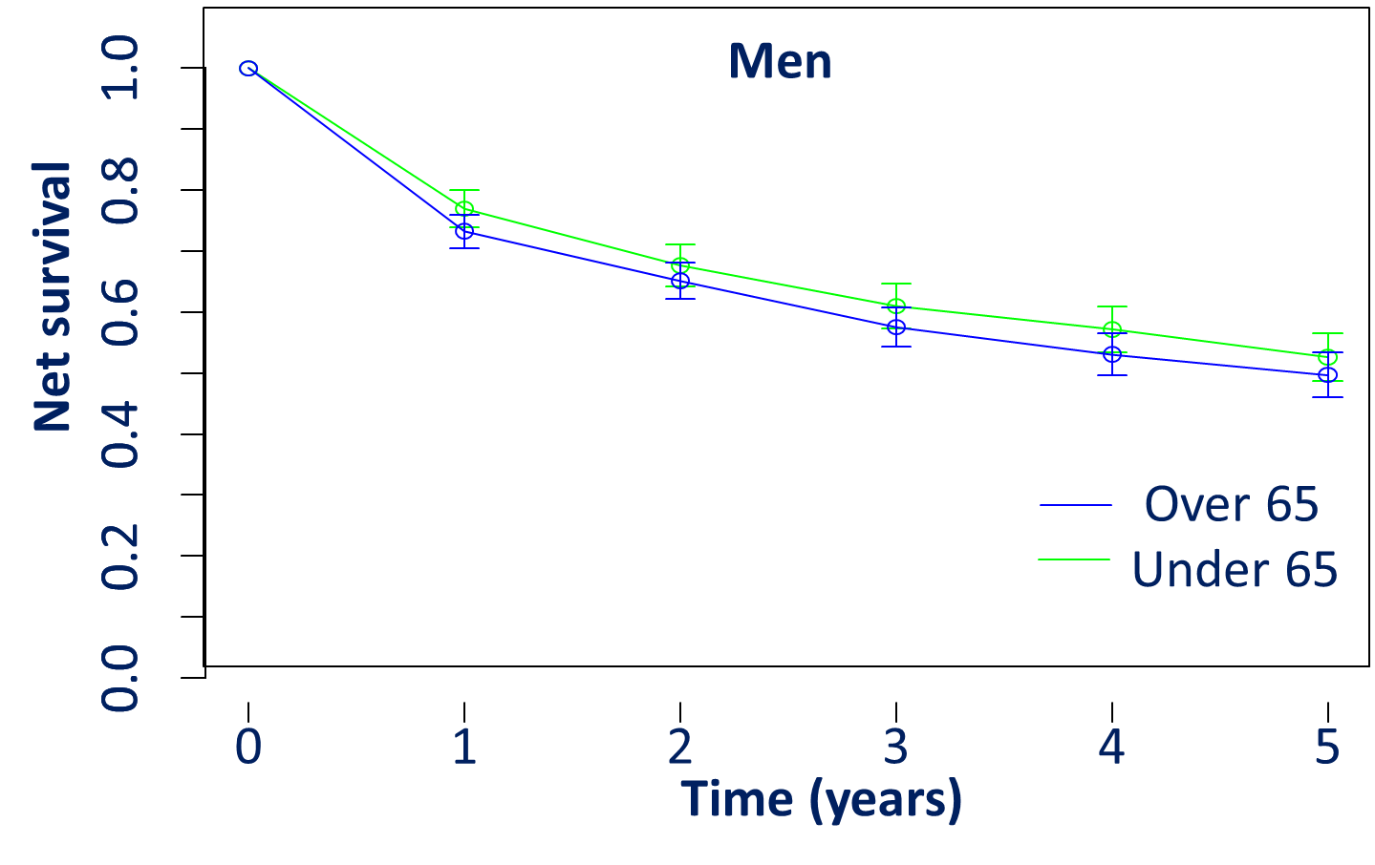
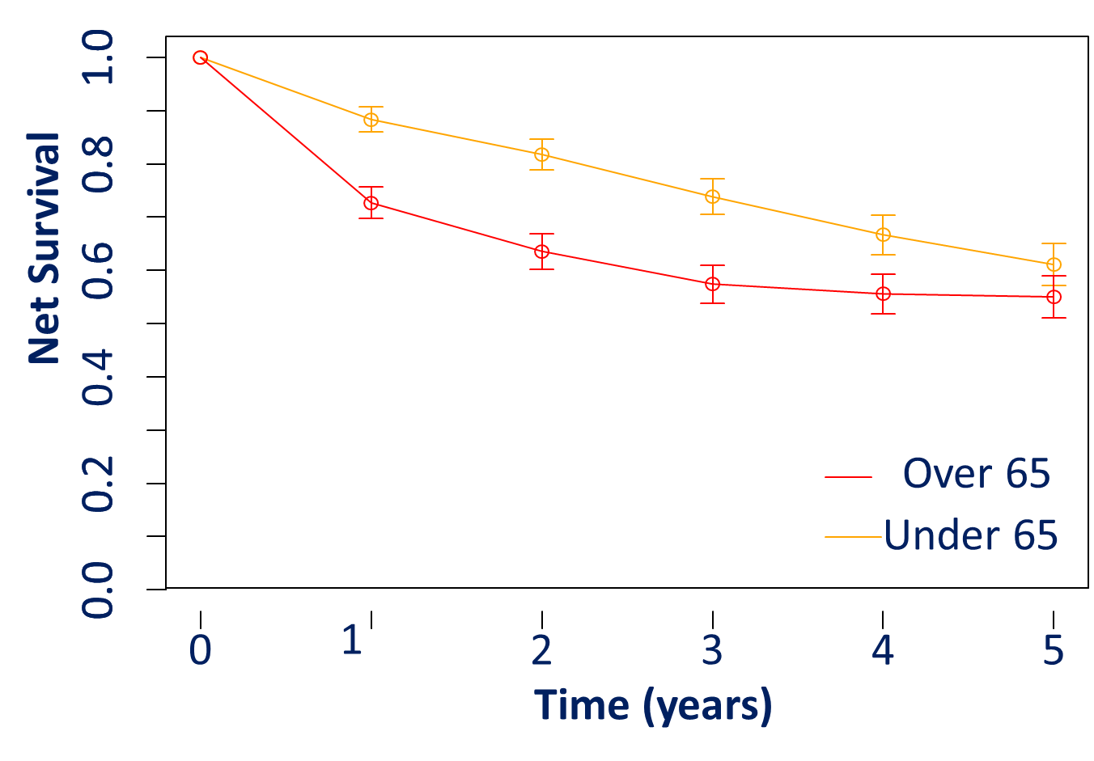

RESULTS-Colon cancer
Mean age was similar in men and women under 65 (56 years old). It was 74 years in men and 76 in women over 65.
91% of patients under 65 had surgery vs. 94% in the elderly without difference between gender
In men, net survival was comparable for both groups. At 5 years, it was 49.7% in the elderly and 52.6% in patients under 65.
In women, net survival was lower in the elderly at 1 and 3 years (88% vs. 72.7% et 57.4% vs 73.8%). A 5 years, it was 55% vs 61% respectively.
5 years net survival in France 2005-2010, all patients : men (61%), women (59%)

Slide 10
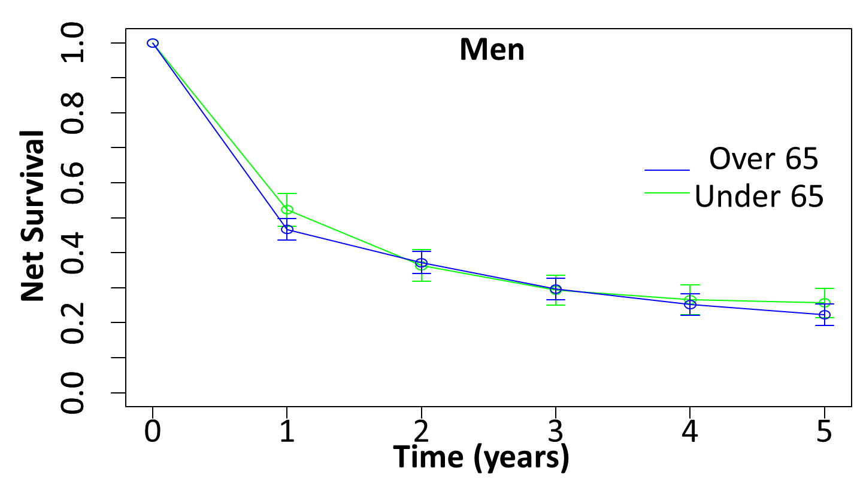
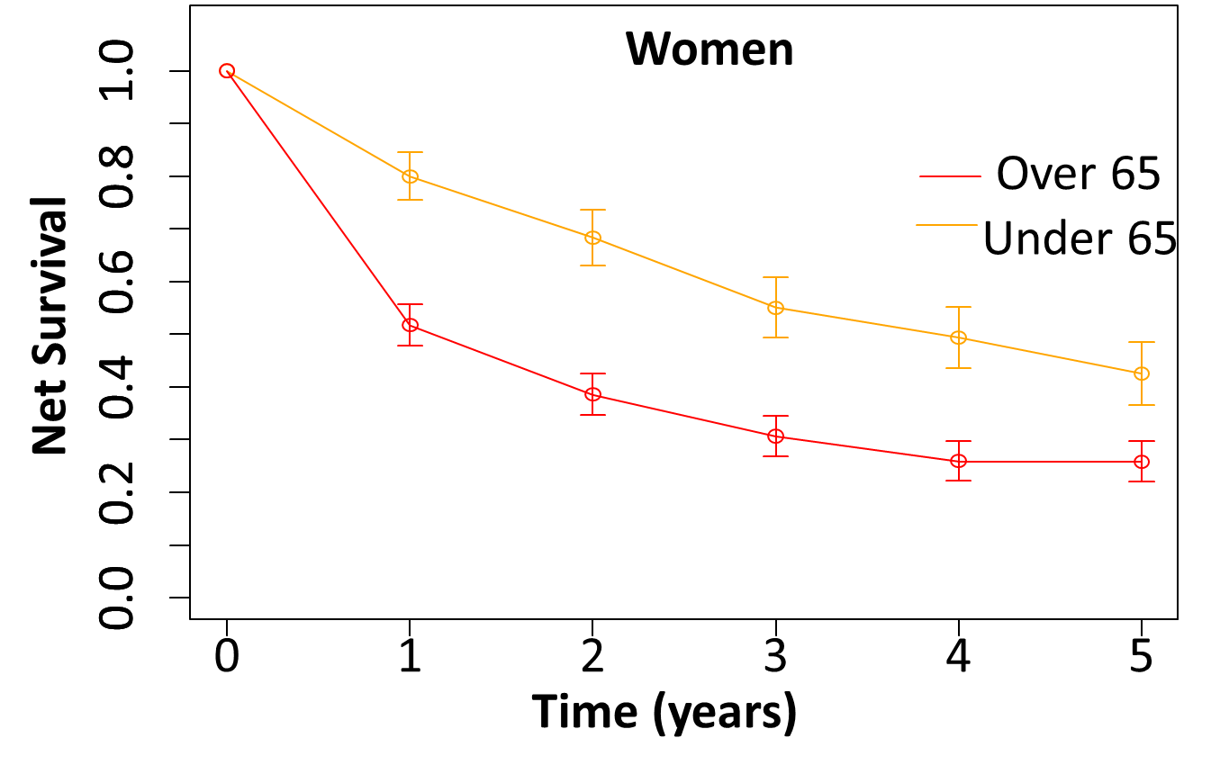
Results-Stomach cancer
Mean age was 53 in women under 65 vs. 56 years in men. It was 77 years for men and women over 65 .
66% of patients under 65 had surgery vs. 74% in the elderly without difference between gender.
In men, net survival was comparable for both groups. At 5 years, it was 22.3% in the elderly and 25.6% in patients under 65.
In women, net survival was lower in the elderly: 52% vs 80% at 1 year and 26% vs 42% at 5 years.
5 years net survival in France 2005-2010, all patients : men (23%), women (28%)

Slide 11
Discussion
We observed little differences in survival rates between the elderly and patients under 65 for prostate and breast cancer.
In addition, these survival rates differed slightly to those reported in metropolitan France, indicating comparable care.
Net survival was similar in men in both groups for colon and stomach cancer but in women, we observed lower survival in the elderly at 1 and 3 years for colon and at all time period for stomach cancer.

Slide 12
Conclusion
Lower survival is observed for digestive cancer in elderly women compared to women under 65.
With an increasing incidence of these cancer sites particularly in women, additional studies are needed, and careful monitoring should be implemented.
Analytic studies should be also considered in the environmental pollution context particularly for stomach cancer
  See poster #271 (P-82)

Slide 13







Slide 14

Thank you for your attention!

