Slide 1
THE NEW WORLD OF STANDARDIZED ELECTRONIC PATHOLOGY (E-PATH) REPORTING
Eric B. Durbin, MS
Jovanka N. Harrison, PhD
NAACCR Pathology Data Work Group
NAACCR Annual Conference
June 16, 2009
San Diego, California

Slide 2
Overview
Importance of data standards
History of NAACCR E-Path standards
NAACCR HL7 E-Path messages
Synoptic reporting
Conformance testing
Diffusion of NAACCR E-Path Standards

Slide 3
Who Needs Standards for Electronic Pathology Reports?
95% of all cancer cases are microscopically confirmed in a pathology report
Data standards facilitate transmission of critical pathology data from pathology labs to cancer registries
Improves registry accuracy and efficiency
One interface fits all
Reduces costs
One interface fits all

Slide 4
History of E-Path Data Standards
NAACCR Pathology Data Work Group
Data Standards for Cancer Registries
Pathology Laboratory Electronic Reporting
September 2000 (Volume II, Chapter 6)
November 2005 (Volume V, Version 2.0)
May 2008 (Volume V, Version 2.1)
February 2009 (Volume V, Version 2.2)
June 2009 (Volume V, Version 3.0)
URL
http://www.naaccr.org/index.asp?Col_SectionKey=7&Col_ContentID=122

Slide 6
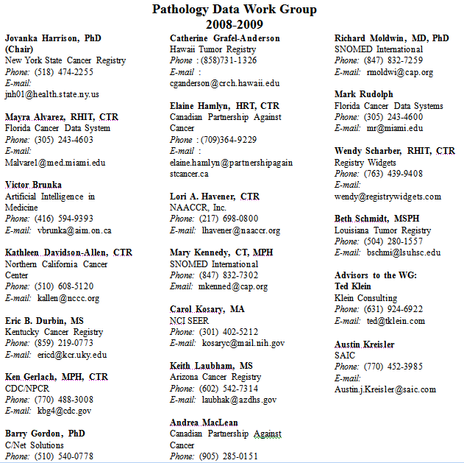
Acknowledgements

Slide 7
NAACCR Volume V
Chapter 2: Implementation Guide for Transmission of Laboratory-Based Reports to Cancer Registries Using Version 2.X of the HL7 Standard Protocol
Volume V Version 2.1 (May 2008)
HL7 Version 2.3.1
Volume V Version 3.0 (June 2009)
HL7 Version 2.5.1

Slide 8
Why Health Level Seven (HL7)?
Flexible and robust protocol
Widely utilized for electronic data transmissions
Electronic Medical Record (EMR) systems
Pathology Laboratory Information Systems (LIS)
Widely utilized in
US
Canada
Europe
Federal mandates likely on the horizon

Slide 9
NAACCR Pipe-Delimited Format
Not widely utilized
Limited cancer registries
Limited pathology LIS systems
Less sophisticated (less technically challenging)
Retained for legacy e-path reporting systems
May be used alone or in conjunction with HL7

Slide 10
NAACCR Volume V: Chapter 2 HL7 Implementation Guide
Defines HL7 messages for transmitting pathology reports to cancer registries
Specifies how to encode path report data elements
Defines requirement status for each HL7 field
(R) Required
(RE) Required but may be empty
(C) Conditional
(CE) Conditional but may be empty
(X) No supported

Slide 11
HL7 Basics: Delimited, Positionally Defined Data Fields
HL7 messages are ASCII text
All data fields are delimited by a specified separators
Delimiters defined at beginning of message
Fields usually delimited by ‘|’ (pipe) character
Sub-fields usually delimited by ‘^’ (hat) character
Standard for each field position specifically defined

Slide 12
HL7 Basics: Segments
Various HL7 segments carry categories of information
Each segment type identified by three character id at the beginning of the segment
MSH, PID, ORC, OBR, OBX, SPM
Some segments types are optional
Some can be repeated
Repeats are sequentially numbered
OBX|1|TX|22637-3^FINAL DIAGNOSIS^LN^^DIAGNOSIS^L|1|LEFT INGUINAL LYMPH NODE - GRANULOMATOUS LYMPHADENITIS||||||F<CR>
OBX|2|TX|22637-3^FINAL DIAGNOSIS^LN^^DIAGNOSIS^L|1|/ljm <CR>
OBX|3|TX|^^^^Clinical History^L|2|? lymphoma Quick Section||||||F<CR>

Slide 13
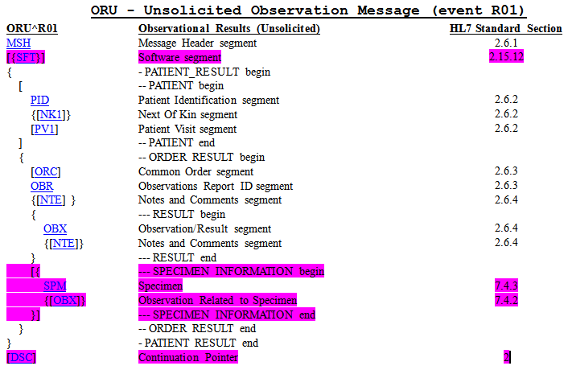
NAACCR HL7 E-Path Message Structure

Slide 14
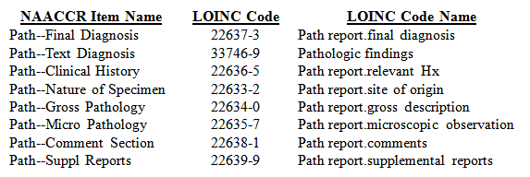
HL7 E-Path OBX Segment
Observation/Result (OBX) Segment
Specific observation identifier or “question” (OBX-3)
Identified by LOINC or SNOMED Codes
Specific observation or “answer” (OBX-5)
Primarily narrative text

Slide 15
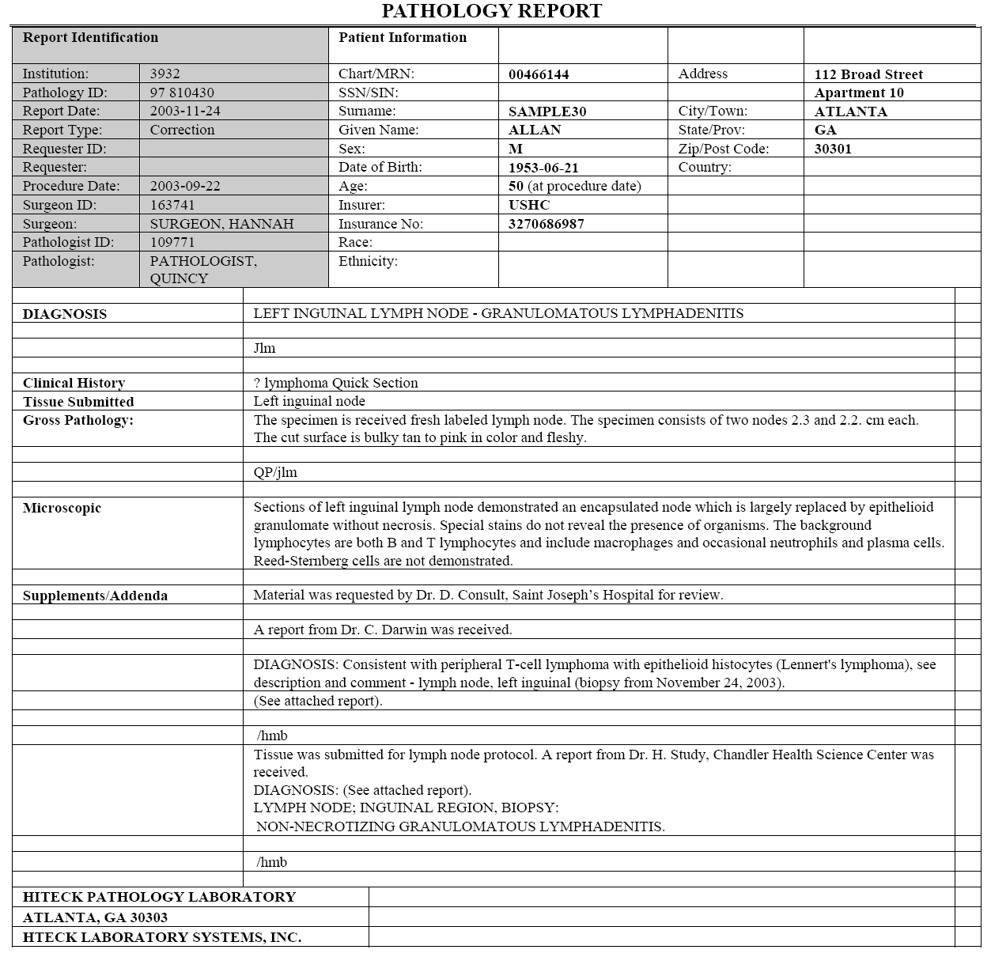

Slide 16
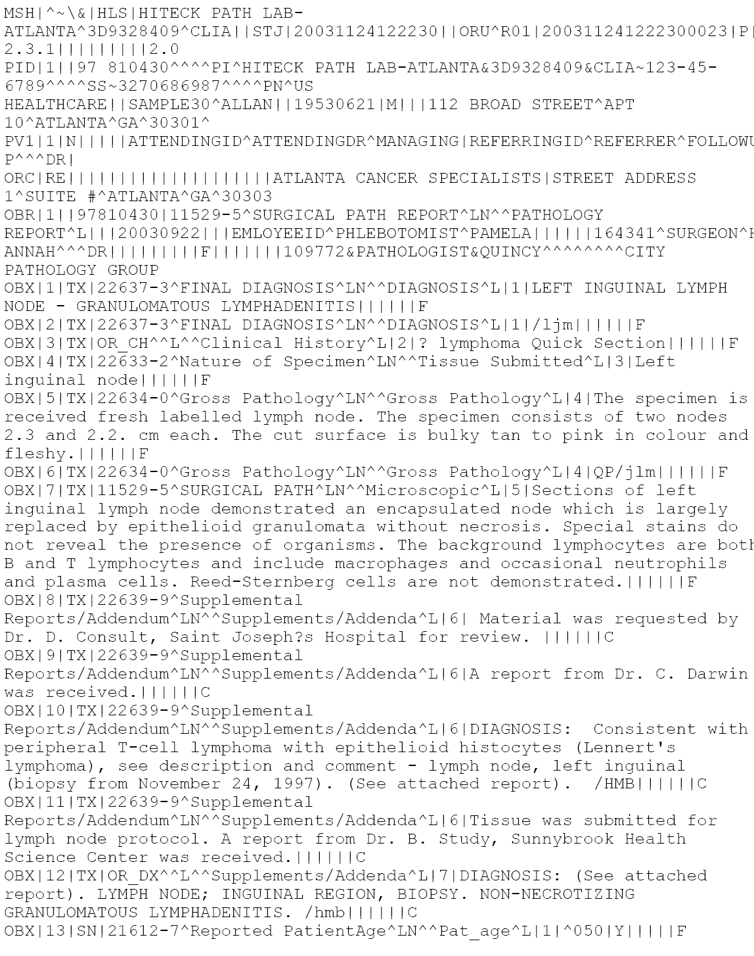

Slide 17
Next Steps: Encoded Synoptic E-Path Reports
College of American Pathologists (CAP) define standard Cancer Protocols and Checklists for all pathology reports
http://www.cap.org/
Protocols and checklists specified by site and procedure
Breast, Colon and Rectum, Lung, Prostate, etc.
Biopsy, resection, etc.
Pathologists follow CAP Protocols when evaluating specimens
Computerized, “synoptic” reports contain discrete encoded data elements
NAACCR HL7 standard can accommodate encoded synoptic pathology reports

Slide 18
NAACCR HL7 Conformance Testing and Validation
HL7 Messaging Workbench (MWB)
Standalone software application for validating the conformance of HL7 messages
Can be used by vendors and registries to validate E-Path HL7 messages
Profile for NAACCR HL7 standard available on NAACCR web site

Slide 19
Real World Implementations of NAACCR HL7 Standard
CAP survey of 25 LIS vendors
Published in February 2009
Use of NAACCR standards to report to tumor registries or public health agencies
http://www.cap.org/apps/docs/cap_today/0209/0209_CAPTODAY_AnatPathol_ProdGuide.pdf
Electronic Interface Description (N=25) | Number (%)
NAACCR Volume V Version 2.1 Available | 11/17 (65%)
NAACCR Volume V Version 2.1 Installed | 4/17 (24%)
Older NAACCR Standard Installed | 8/17 (47%)
Non-Standard Interface Installed | 10/17 (59%)
No Answer | 8 /25 (32%)

Slide 20
Fruits of Our Labors
New PHINMS E-Path transmissions to Kentucky Cancer Registry:
“I consulted Volume V and found everything I needed.”
Dr. Sally Bushhouse
Minnesota Cancer Surveillance System
June 16, 2009

Slide 21
Contact Information
Eric B. Durbin, MS
Director of Cancer Informatics
Markey Cancer Control Program/Kentucky Cancer Registry
Markey Cancer Center
University of Kentucky
2365 Harrodsburg Rd, Ste A230
Lexington, KY 40504-3381
ericd@kcr.uky.edu
(859)219-0773 x223

